Slide 1


Slide 2
Agenda
01
Who are the project members?
02
What is IDunion and blockchain?
03
What is our mission?
04
Our IDunion blockchain dashboard
05
What have been our ups and downs?
06
Q&A

Slide 3
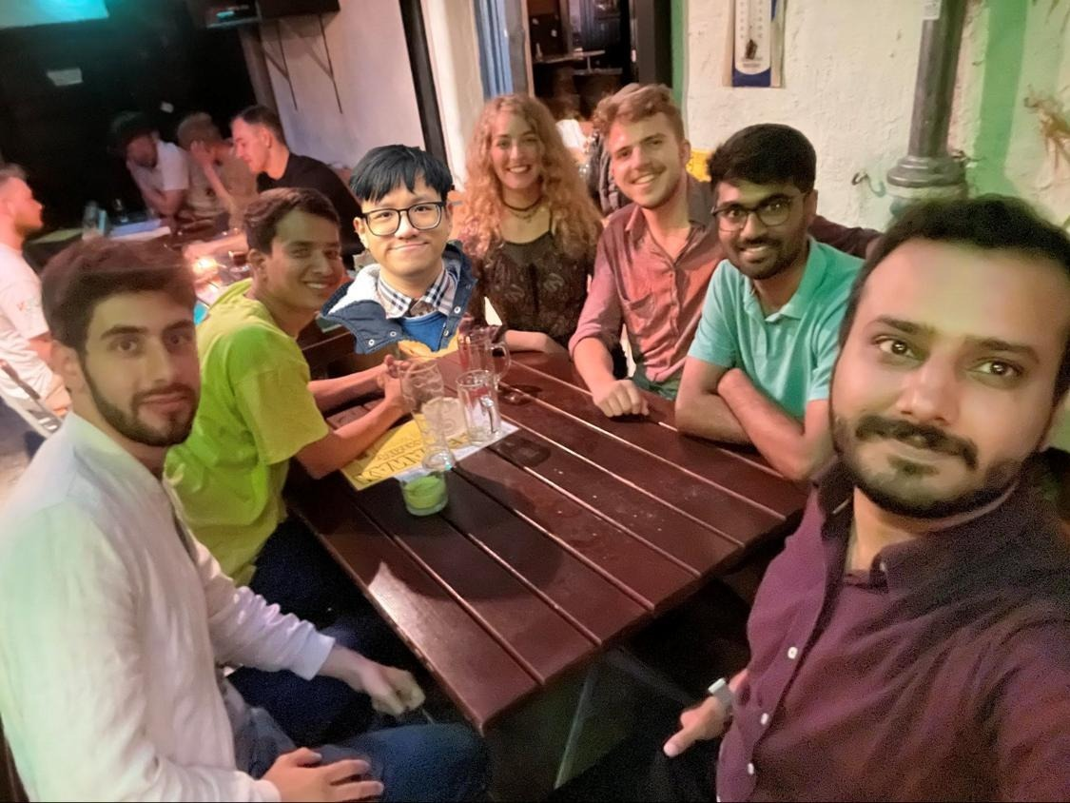
Who are the project members?
The team
Industry partner: Siemens AG, Technology
Team:
Product Owner (PO): Anna-Maria, David
Software Developer (SD): Murali, Julian, Khai, Muhammad
Scrum Master (SM): Gaurav
Project language: English
Core technologies: Python, Javascript, Grafana, Hyperledger, Indy, IDunion blockchain

Slide 4
What is IDunion and blockchain?
A really short introduction to IDunion and blockchain
Blockchain, or Distributed Ledger Technology:
First steps ~50 years ago with Hash-Trees (Meerkle 1979, D. Chaum 1982, Haber and Stornetta 1991)
Basically a data-base (of the kind of ledger)
Decentralized and every node has a copy
Consensus mechanism applied for changes (e.g. proof-of-work, proof-of-sake)
IDunion: [read more about the project: https://idunion.org/?lang=en ]
Eco-System for identity (self-)management: with ledger, wallet, consensus-protocol
Roles: Credential issuer, verifier and owner
Example: IndyWorld Demo by IBM: https://youtu.be/cz-6BldajiA

Slide 5
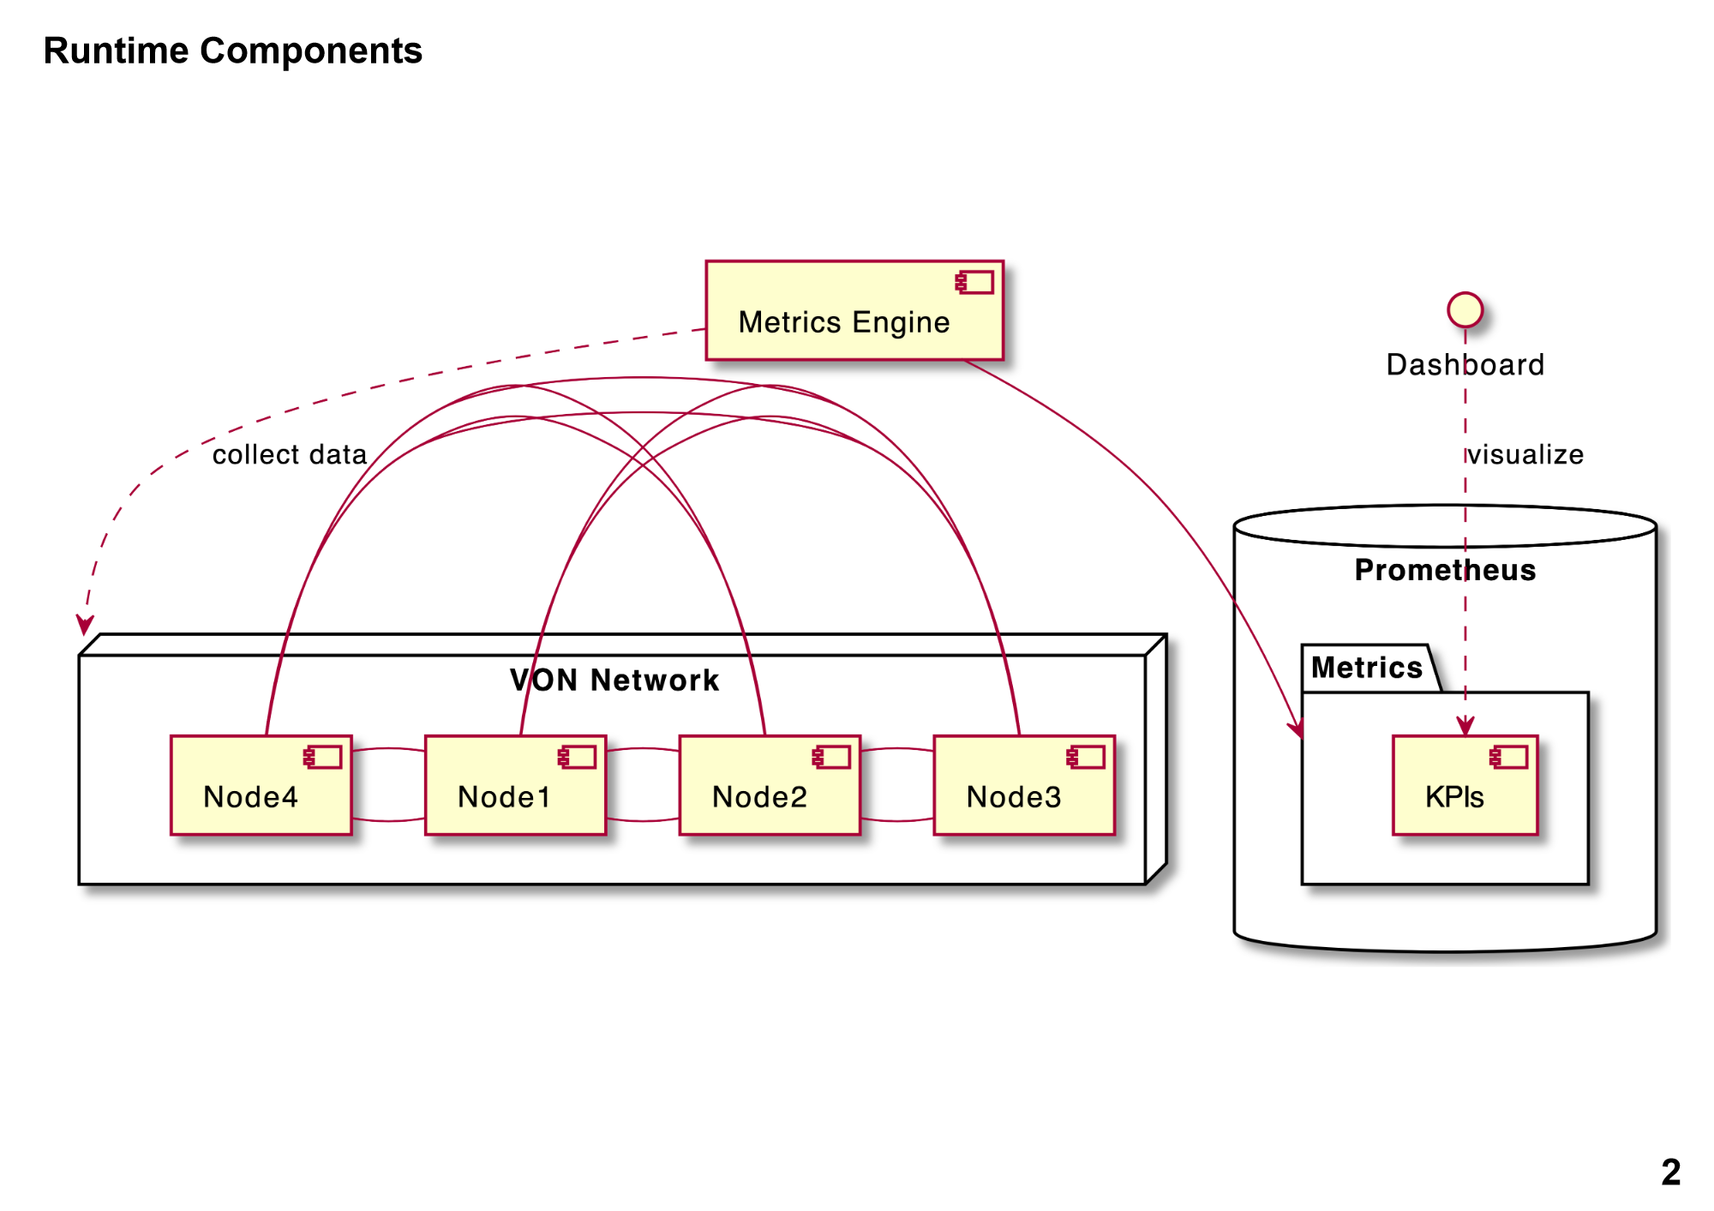




What is our mission?
The overall software architecture and implemeted tools
The overall goal: Implement a metrics engine and a dashboard for the IDunion blockchain

Slide 6
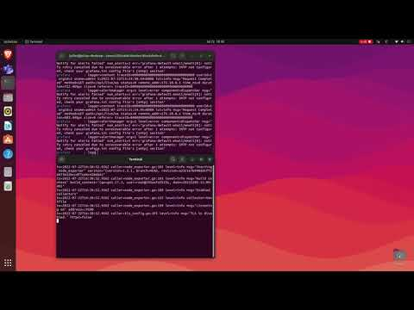
Our IDunion blockchain dashboard
Let´s see our demo
IDunion blockchain dashboard demo - YouTube

Slide 7
What have been our up and downs?
A short reflection
Ups
Great team spirit
On-site, real-life team meeting
New and thrilling topic
Challenges
Tough on-boarding phase due to toolchain setup, the technology stack (Hyperledger, Prometeus, Grafana, VON-network, industry partner data)
One developer joined ~3 weeks after project start
First developer left the team at the beginning, one more developer quit the project 2-3 weeks later
Uncertain capacity estimations, especially if unexpected impediments showed up

Slide 8
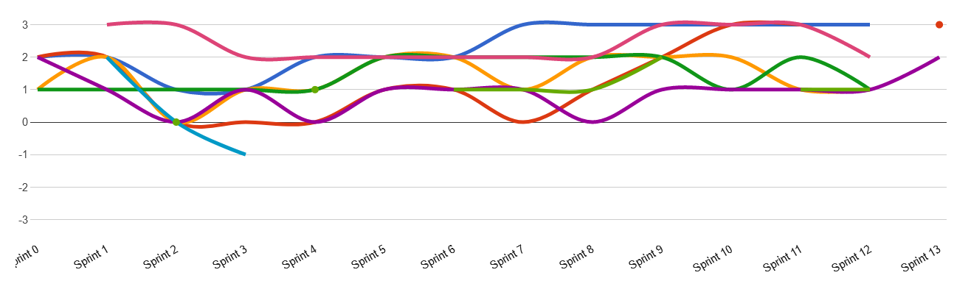
What have been our up and downs?
Our happiness index
Unknown technology
KPI decisions & node redundancies

Slide 9

Q&A
Any questions, remarks?

