Slide 1
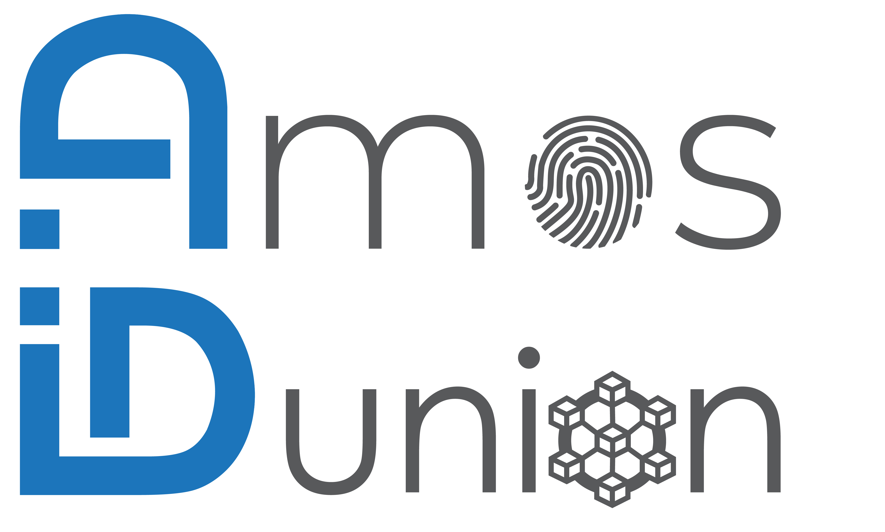
What worked and what did not?
Our project retrospective
Dear reader,
The AMOS project has been a great experience and we are really glad to had the chance to participate. During our time we experienced ups and faced some challenges:
Worked out well (ups)
Get to know the modern way of working (Scrum team): We have followed quite well the Scrum practices.
We have put hands on a new, thrilling topic and delivered software in a real-life setup.
Great team spirit: The atmosphere in the team was great.
On-site team meeting
Get to know the industry partner
Challenges
Tough on-boarding phase due to toolchain setup, the technology stack (Hyperledger, Prometeus, Grafana, VON-network, industry partner data)
First developer left the team at the beginning, one more developer quit the project 2-3 weeks later
One developer joined ~3 weeks after project start
Uncertain capacity estimations, especially if unexpected impediments showed up - it is tough to keep the pace in every week of the semester
Overall we can recommend the project and the experience is valuable in many aspects for our future.
Best regards,
The IDunion Blockchain dashboard project team

