Slide 1




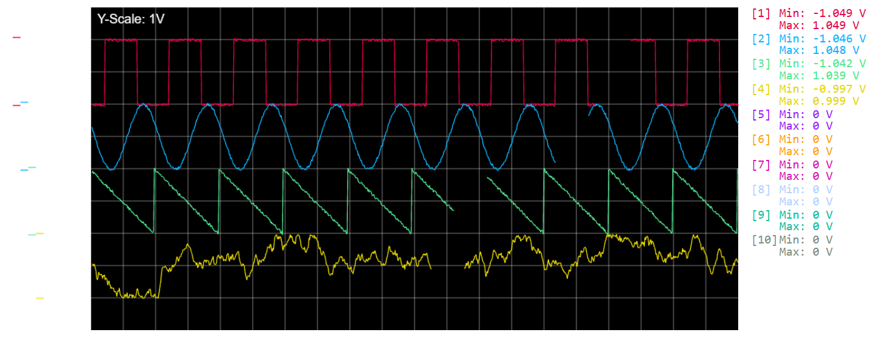

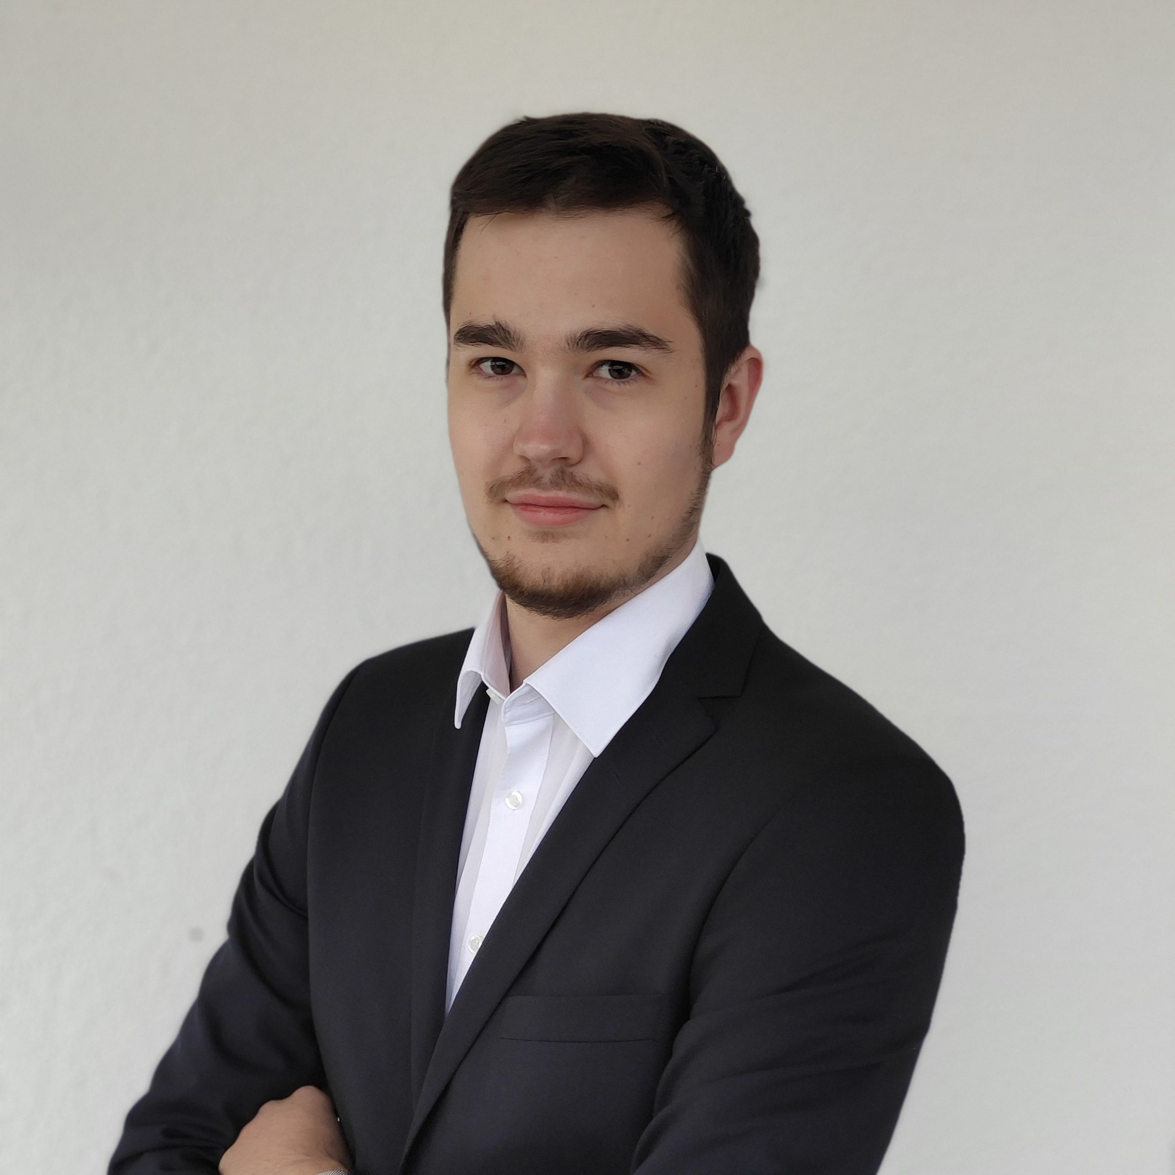
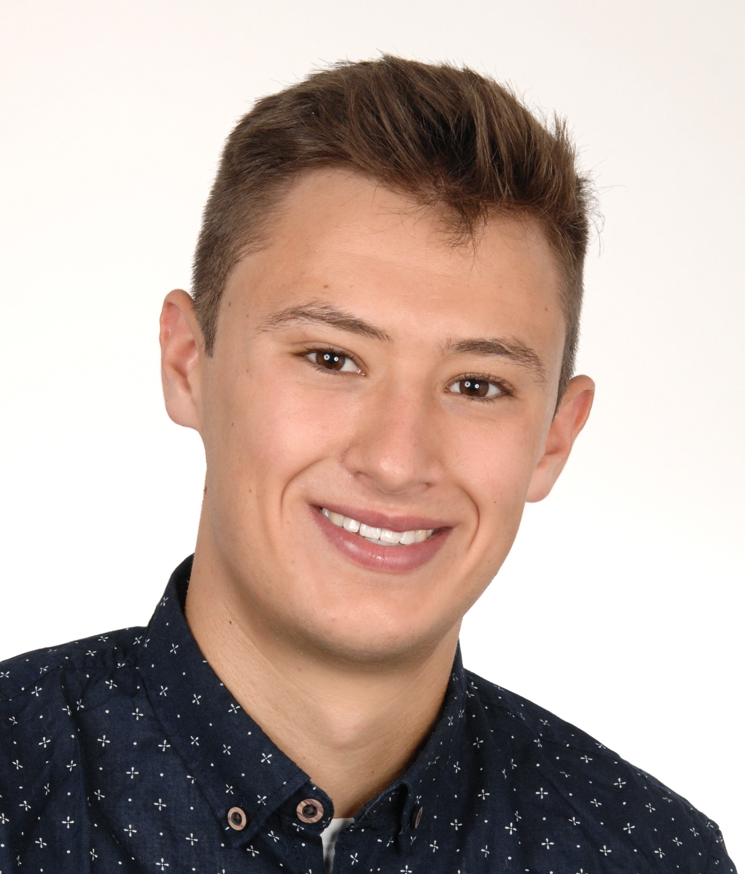






The objective of SOSCI is to enable users of oscilloscope a way to gain access to all the features and possibilities through a software that can be done through a hardware oscilloscope and beyond. Our vision is to create a method that would better everyday life of engineers.
Software
Oscilloscope
Display numerical data streams in real time over the network. No need for additional hardware.
Have a detailed look into your signals by adapting sweep speeds, amplitude and offset in real time.
Not dev Dev
Lightsaber
Mirobert
Refactorer
CICDegen
Tooltip
Nico
Cookie
Fairy
Critical
Eye
WebGL
Expert
Bouncing Leander
Review
Master
Dev
Darshan
Saber
Jelodari
Robert
Balink
Marcel
Schöckel
Jan
Degen
Nicolas Kolbenschlag
Ingrid
Mönch
Jens
Wächter
Leon Jünemann
Leander Tolksdorf
Philipp
Kramer

Slide 2
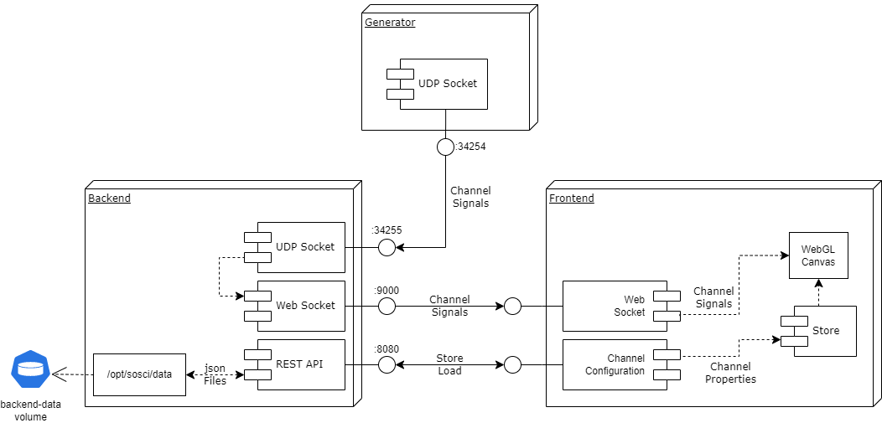
Software Architecture
Overview
The application contains 3 components which run as Docker containers. Those containers exchange data via a shared network to finally display it to the user via the frontend.
Channel Signal Simulator
The generator acts as a simulator for signals. He sends continuously signals for 10 channels to the connected backend via an UDP data stream. Sample rate and frequency is changeable.
Oscilloscope Backend
The backend accepts the incoming channel data from the generator and prepares it for transmission to the frontend.
It also provides a REST API for loading & storing channel configurations like enabled channels, offset and amplitude settings.
Oscilloscope User Interface
The frontend provides a graphical user interface including the plotted channels and detailed information about min & max values.
Via the control panel it's also possible to adapt the sweep speed, amplitude and offset for each individual channel.
The settings page provides access to pre-configured channel properties and gives also the ability to create new presets.

