Slide 1
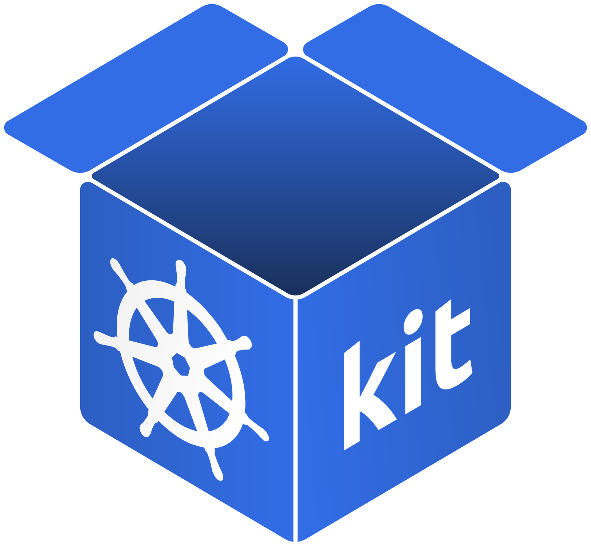
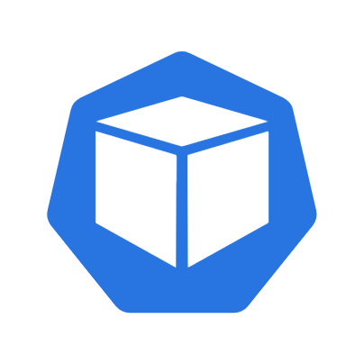
















Quickly see real-time health states of your infrastructure
Deep dive into current configurations
Identify capacity bottlenecks on CPU & RAM
Pods
Kubernetes Inventory Taker
kit shall be a lightweight tool that empowers DevOps teams to monitor their Kubernetes clusters with ease,
providing them with a single platform for inventory visibility, deep insights, real-time analytics, and intelligent monitoring and alerting.
Containers
Jan Degen
Philipp Kramer
Anna Kwiatek
Ali Aziri
Stefan Zabka
Nikolas
Jochens
Muhammad Fahad Ali
Lucas
Gehrlein
Simon
Wiesend

Slide 2
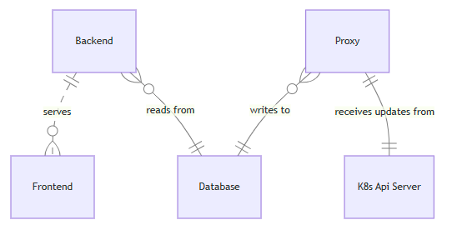
Software Architecture
Proxy
The Proxy is responsible for reflecting the state of the K8s cluster into the relational DB. It uses the K8s client libraries to interact with the API server and the Bun ORM framework in connection with the Golang Postgres Driver to insert data into the DB.
Explorer
The user facing web service consists of a next.js frontend application and a next.js router, which is responsible for loading the current state from the DB and sending updates to the existing clients.
The frontend is then responsible for displaying the data in a variety of views, allowing the user to explore the current state of a cluster.

