Slide 1

Notes:
Hello and welcome to the presentation of our project - PIT Mutation Mate!

Slide 2
Team
Software Developers
Product Owners
Scrum Master
Liam
Tim
Brianne
Emmanuel
Olivia
Lennart
Nikolaos
Luca
Felix
Notes:
Introduce our team (very brief)

Slide 3
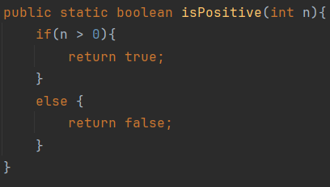

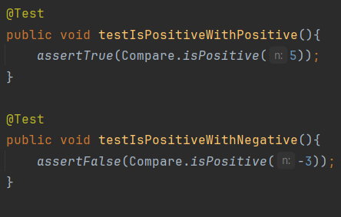
What’s mutation testing?
“Testing your test to test that they test what you think they test.”
→ assess the efficacy of your test suite
→ identify how you can improve your tests
Notes:
Our project is concerned with simplifying the use of mutation testing
But what is mutation testing?
It’s a tool to “test your test to test that they test what you think they test”.
This means it helps you assess the efficacy of your test suite and identify how you can improve your results
Here is an example case: we have on the left a function which returns whether an integer is Positive. On the right are two tests to test this function. One tests whether the function return true with n=5 and the second one tests whether the function returns false with n= -3.

Slide 4
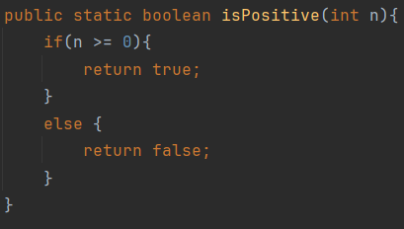
What’s mutation testing?
“Testing your test to test that they test what you think they test.”
→ assess the efficacy of your test suite
→ identify how you can improve your tests
Notes:
Now, mutation testing will “mutate” parts of your code.
The condition n greater than 0 is changed or ”mutated” to n greater-equal 0. The condition of the test is now different! But, our tests still pass. Clearly, our test suite is not covering all edge cases, like testing the positivity of 0.

Slide 5
What’s mutation testing?
Mutation testing is less about testing the quality of your code. It’s for checking the quality of your tests.
Notes:
So, why mutate? If your tests still pass after changing your code, then the quality of your tests need improvement.
To summarise: mutation testing checks the quality of your tests.

Slide 6
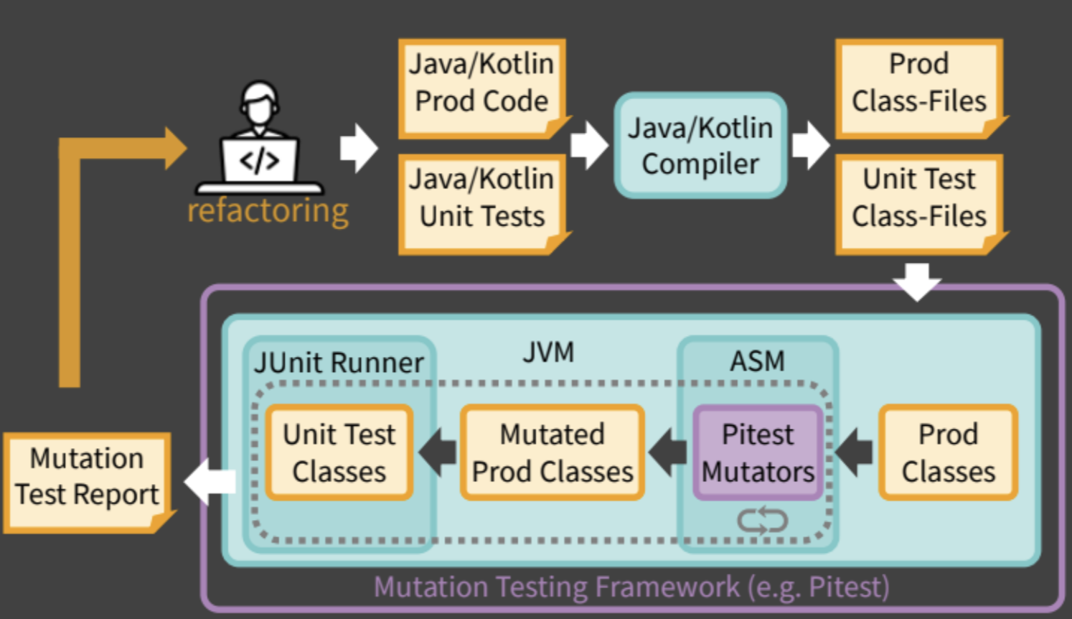
Pitest
A popular mutation testing system for Java/JVM languages
Source: esolutions
Notes:
Pitest is the gold standard for mutation testing in Java-based projects
Provides a workflow for running mutation analysis on your codebase, with a final report summary as an output of this process
Go through diagram cycle (starting from Java/Kotlin Prod Code):
We have our code and tests
Compile
Class files are fed to Pitest
Mutators “mutate” the classes
These mutated classes are run through your (same!) test suite
Pitest generates the report
Based on the report, refactor!

Slide 7
Workflow without our plugin
Run Pitest from command line
Locate generated report file
Open and view HTML report
Problem: developer is forced to switch contexts
Notes:
So, what is this workflow?
Switching contexts is inefficient and leads to loss of focus. How can we solve this problem?

Slide 8



What’s our use case?
→ Enabling easier mutation testing when using Pitest
Our plugin
IntelliJ IDE
Notes:
Our solution is to provide a plugin which integrates:
the execution of mutation analyses
the scope configuration of mutation analyses
the viewing and visualisation of report results
all within the IDE (IntelliJ)!
No more need to switch contexts for doing mutation testing: the developer now have more time to focus on real

Slide 9
Live presentation of plugin
Notes:
run pitest through gutter button -> say that this will run pitest on this specific class
show the results in the pitest tab
show the results in the editor
hover over the highlighted code to show the mutation information
show the disabling/enabling functionality (mention that this is important for the developer not to be distracted while coding)
then show that pitest can run be run through context menu (inside the editor, inside the tree structure, for file as well as packages)
run for a package and show the package breakdown visualisations

Slide 10
Thank you for your attention!

