Slide 1





AMOS Project: TaskOrbit
Team 4 Product Owners: Carl Mosler, Christoph Huy
Scrum-Master: Rene Jokiel
Developers: Qiblatain Fatima, Asad Raza, Vineesh Koppay, Abdul Moeez, Shikhar Thakur, Dhruvin Vekariya, Endri Shameti

Slide 2
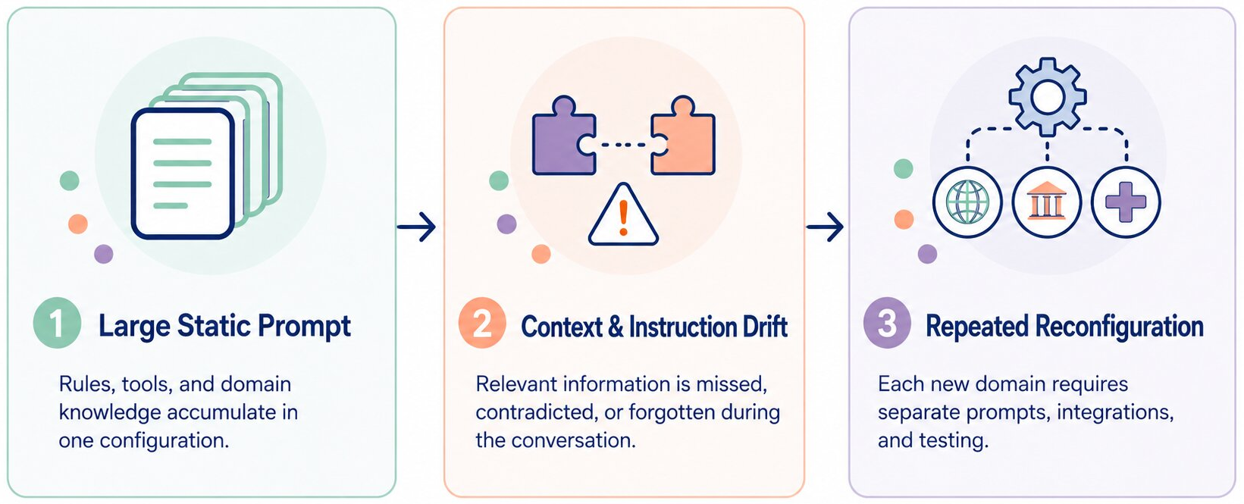
TaskOrbit
Problem Definition
Figure: Key limitations of traditional conversational agent configurations

Slide 3
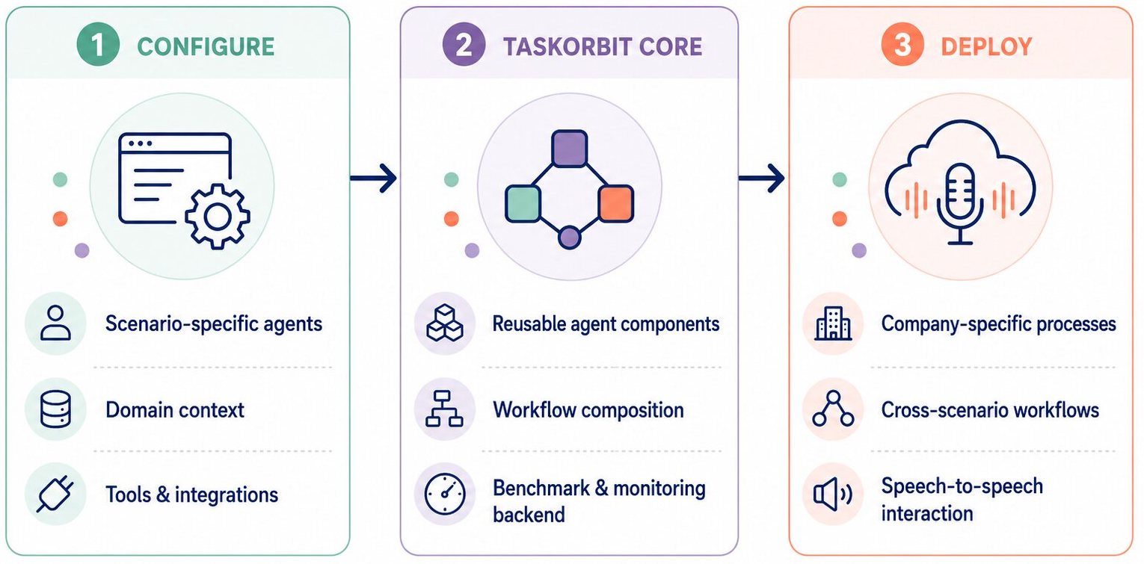
TaskOrbit
Project Vision
Figure: TaskOrbit’s configurable workflow from scenario-specific agent setup to company-specific deployment

Slide 4
TaskOrbit
CORE PIPELINE
Techstack & System Architecture
User Voice Input
Modular Architecture
Provider-based STT, LLM and TTS components
Config-driven parsing and routing
Extensible Integrations
Interchangeable third-party services
Support for custom providers and workflows
Self-hosted open-source model inference
Cloud-Native Backend
Web-based configuration interface
Scalable deployment on GCP
Benchmarking and monitoring support
Technology Stack
React, TypeScript, Vite
Python, FastAPI
LiveKit, Deepgram, ElevenLabs, OpenRouter
Gemma 4, Qwen 3.6, ChatGPT 4o, Gemini 2.5
STT-Provider
Config Parsing & Routing
LLM Backend Provider
TTS-Provider
Agent Voice Output
TypeScript
React
Vite
Python
FastAPI
ElevenLabs
Deepgram
LiveKit
GCP
OpenRouter

Slide 5
TaskOrbit
CORE PIPELINE
VOICE WORKFLOW ORCHESTRATION
User Voice Input
TaskOrbit turns individual scenario agents into deployable, end-to-end voice multi-agent workflows
STT-Provider
VALUE PROPOSITION
A technology foundation for company-specific processes — not a one-size-fits-all solution.
• Build and deploy reusable scenario agents
• Compose agents into cross-scenario workflows
• Automate interactions from speech input to spoken response
Config Parsing & Routing
LLM Backend Provider
PROJECT SCOPE
TTS-Provider
• Agent runtime and workflow execution
• Benchmarking for custom workflows
• Basic tools: end calls, forwarding and external data references
• Flexible inference: External, self-hosted open-source models or OpenRouter
Agent Voice Output
TypeScript
React
Vite
Python
Node.js
ElevenLabs
Deepgram
LiveKit
GCP
OpenRouter
Notes:
1 Min Demo Pitch

