Slide 1
Datazine Social Media Strategy Evaluation
Notes:
Datazine is an French online magazine
Based on Datazine’s social media strategy: to better understand the readers and to acquire new subscribers via content,
I’m going to evaluate the effectiveness of the magazines’s Facebook strategy and give recommendations through the data provided.

Slide 2
Introduction
Overview
1
Data
Preparation
2
Data
Extraction
3
Recommendation
Tool: SQLite Studio (3.2.1)
Notes:
Firstly I’m going to show how did I prepare the data for the analysis.
Then I will present you the analysis result and their SQL code.
Finally I will give my recommendation on the Datazine’s social media strategy.

Slide 3
Data Preparation
Create the Tables
7 tables are created in database:
FanPerCity, FanPerCountry, FanPerGenderAge, FansPerLanguage,
GlobalPage, PopStats, PostsInsights
CREATE TABLE FanPerCity (
ID INTEGER PRIMARY KEY AUTOINCREMENT
Date VARCHAR (255),
City VARCHAR (255),
CountryCode VARCHAR (255),
NumberOfFans INT (255));
CREATE TABLE GlobalPage (
ID INTEGER PRIMARY KEY AUTOINCREMENT
Date VARCHAR (255),
CountryCode VARCHAR (255),
NewLikes INT (255),
DailyPostsReach INT (255),
DailyPostShares INT (255),
DailyPageActions INT (255),
DailyPostImpressions INT (255) );
📖
Create table.txt
Notes:
According to the data provided by Datazine, I have created 7 tables in the database.
For example in first table FanPerCity, we have Date, City, CountryCode and NumberofFans,
Each line of data is unique for each combination of Date and City. There are two candidate keys.
So I created an artificial primary key ‘ID’, to represent each line of the data.

Slide 4
Data Preparation
Create the Tables
7 tables are created in database:
FanPerCity, FanPerCountry, FanPerGenderAge, FansPerLanguage,
GlobalPage, PopStats, PostsInsights
CREATE TABLE FansPerGenderAge (
ID INTEGER PRIMARY KEY AUTOINCREMENT
Date VARCHAR (255),
Gender VARCHAR (255),
AgeGroup VARCHAR (255),
NumberOfFans INT (255) );
CREATE TABLE FansPerLanguage (
ID INTEGER PRIMARY KEY AUTOINCREMENT
Date VARCHAR (255),
Language VARCHAR (255),
CountryCode VARCHAR (255),
NumberOfFans INT (255) );
📖
Create table.txt

Slide 5
Data Preparation
Create the Tables
7 tables are created in database:
FanPerCity, FanPerCountry, FanPerGenderAge, FansPerLanguage,
GlobalPage, PopStats, PostsInsights
CREATE TABLE FanPerCountry (
ID INTEGER PRIMARY KEY AUTOINCREMENT
Date VARCHAR (255),
CountryCode VARCHAR (255) REFERENCES PopStats (CountryCode),
NumberOfFans INT (255) );
CREATE TABLE PopStats (
CountryCode VARCHAR (255) PRIMARY KEY
REFERENCES FanPerCountry (CountryCode),
CountryName VARCHAR (255),
Population INT (255),
AverageIncome DOUBLE (255) );
📖
Create table.txt

Slide 6
Data Preparation
Create the Tables
7 tables are created in database:
FanPerCity, FanPerCountry, FanPerGenderAge, FansPerLanguage,
GlobalPage, PopStats, PostsInsights
CREATE TABLE PostsInsights (
CreatedTime VARCHAR (255) PRIMARY KEY,
EngagedFans INT (255), Impressions INT (255),
NegativeFeedback INT (255), NonViralimpressions INT (255),
NonViralReach INT (255), PostActivity INT (255),
PostActivityUnique INT (255), PostClicks INT (255),
UniquePostClicks INT (255), PostReactionsAnger INT (255),
PostReactionsHaHa INT (255), PostReactionsLike INT (255),
PostReactionsLove INT (255), PostReactionsSorry INT (255),
PostReactionsWow INT (255), Reach INT (255)
);
📖
Create table.txt

Slide 7

Data Preparation
Update the table
For calculation later on, I added Week and Time column in table PostsInsights.
ALTER TABLE PostsInsights ADD Week VARCHAR (255)
UPDATE PostsInsights
SET Week =
CASE
WHEN strftime('%w',CreatedTime) = '0' THEN 'Sunday'
WHEN strftime('%w',CreatedTime) = '1' THEN 'Monday'
WHEN strftime('%w',CreatedTime) = '2' THEN 'Tuesday'
WHEN strftime('%w',CreatedTime) = '3' THEN 'Wednesday'
WHEN strftime('%w',CreatedTime) = '4' THEN 'Thursday'
WHEN strftime('%w',CreatedTime) = '5' THEN 'Friday'
WHEN strftime('%w',CreatedTime) = '6' THEN 'Saturday’
END
📖
Create table.txt
Notes:
For the week.
I have extracted the name of week to be a new column according to the created time.
%w means extract the week day of the date time value.

Slide 8
Data Preparation
Update the table
For calculation later on, I added Week and Time column in table PostsInsights
ALTER TABLE PostsInsights ADD Time VARCHAR (255)
UPDATE PostsInsights
SET Time =
CASE
WHEN strftime('%H',CreatedTime)*1 >= 5 AND strftime('%H',CreatedTime)*1 <= 8 THEN '05:00 - 08:59 '
WHEN strftime('%H',CreatedTime)*1 >= 9 AND strftime('%H',CreatedTime)*1 <= 11 THEN '09:00 - 11:59 '
WHEN strftime('%H',CreatedTime)*1 >= 12 AND strftime('%H',CreatedTime)*1 <= 14 THEN '12:00 - 14:59 '
WHEN strftime('%H',CreatedTime)*1 >= 15 AND strftime('%H',CreatedTime)*1 <= 18 THEN '15:00 - 18:59 '
WHEN strftime('%H',CreatedTime)*1 >= 19 AND strftime('%H',CreatedTime)*1 <= 21 THEN '19:00 - 21:59 '
ELSE '22:00 or later '
END;
📖
Create table.txt
Notes:
%H means extract the hour of the date time value.

Slide 9

Data Preparation
Data Set Problem
There are 14 countries in ‘FansPerCountry’ table not existing in ‘PopStats’ table.
So we can’t relate these 14 countries with the population. This will influence the result of calculation later.
I suggest update the latest data of ‘PopStats’
SELECT count(*) 'Null in Population' FROM
(SELECT DISTINCT CountryCode FROM FanPerCountry) f
LEFT JOIN (PopStats) p
ON f.CountryCode = p.CountryCode
WHERE Population IS NULL
Result:
📖
Create table.txt
Notes:
For the clue of the problem, I have written a query with sql.
In the code i use LEFT JOIN with the FanPerCountry and PopStats.
Left Join function means I made a new table with all information in FanPerCounty and the matched information in PopStats.
And I count the null value of population in this new table.
The result shows there are 14 null values, means there are 14 country codes in FanPerCountry that can’t be matched with the country information in PopStats.

Slide 10
Data Extraction
Global Statistics
Time scale is from 2018-9-19 to 2018-10-16.
There are 41,571 new subscribers for the page over the period.
Daily average reach of the posts on the page over the period is 83,826,721.
Daily average NewLikes rate on the page over the period is 402,415.
Number of new subscribers SELECT endfan - startfan FROM (SELECT SUM(NumberOfFans) startfan FROM FanPerCountry GROUP BY Date HAVING Date = '2018-09-19') LEFT JOIN (SELECT SUM(NumberOfFans) endfan FROM FanPerCountry GROUP BY Date HAVING Date = '2018-10-16')
Daily Average Reaches SELECT ROUND(AVG(reaches)) FROM (SELECT SUM(DailyPostsReach) reaches FROM GlobalPage GROUP BY Date);
Daily Average Newlikes SELECT ROUND(AVG(likes)) FROM (SELECT SUM(NewLikes) likes FROM GlobalPage GROUP BY Date);
📖
Query.doc
Notes:
For the number of new subscirbers
Fisrstly I calculated the total number of fans on 9-19 and 10-16
Then I join the two value together and calculate the difference.
For Daily average reach
I used Group By to aggregate the total reaches on each date, and then calculate the average number.
It’s the same for the newlikes.

Slide 11
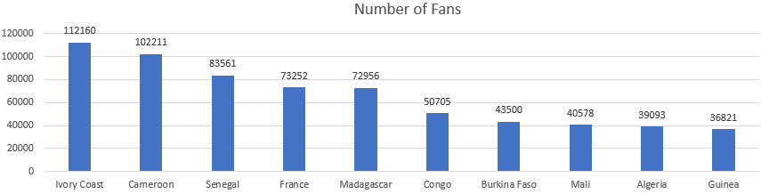
Data Extraction
Top 10 countries (Number of Fans)
📖
Query.doc
SELECT CountryCode, NumberOfFans
FROM FanPerCountry
WHERE Date = (SELECT MAX(Date) FROM FanPerCountry)
ORDER BY (NumberOfFans+0) DESC
LIMIT 10;
Notes:
The country has the most number of fans is Ivory Coast, Cameroon and Senegal.
In the code I used where to restrict the data into latest date.
Then I order the result by number of fans in descending order.
Finally I limit the number of presented results to 10.

Slide 12
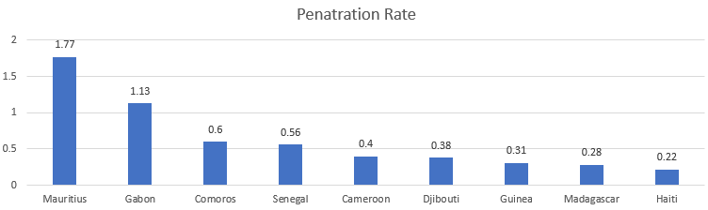
Data Extraction
Top 10 countries (Penetration Rate)
%
📖
Query.doc
SELECT CountryName,
ROUND((NumberOfFans*1.00 / Population* 1.00)*100,2) PenetrationRate
FROM PopStats p
LEFT JOIN FanPerCountry f
ON p.CountryCode = f.CountryCode
WHERE Date = (SELECT MAX(Date) FROM FanPerCountry)
ORDER BY PenetrationRate DESC
LIMIT 10;
Notes:
This graph show the top 10 countries having highest penetration rate.
Here the penetration rate means the percentage of the country population that are fans
So the countries having the highest penetration rate is Mauritius and Gabon
In the code I join the table of FanPerCountry and the population in PopStats and calculated the number of fans over population
Due to the dataset problem I presented before, the rank only takes into account the countries that have population information in PopStats table.

Slide 13
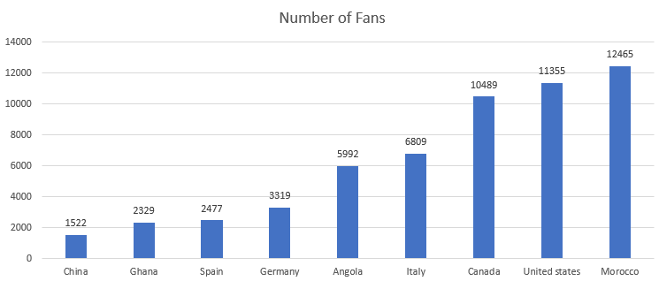
Data Extraction
Bottom 10 Cities (Number of Fans)
with Large Population
📖
Query.doc
SELECT CountryName, NumberOfFans
FROM PopStats p
LEFT JOIN FanPerCountry f
ON p.CountryCode = f.CountryCode
WHERE Date = (SELECT MAX(Date) FROM FanPerCountry)
AND Population+0 > 20000000
ORDER BY NumberOfFans+0
LIMIT 10;
Notes:
The problem is the same for this analysis.
In this graph I have selected all countries with a population of over 20 million. And then their number of fans are presented in the graph.
The countries that have most growth potential is China, Ghana, Spain and Germany.
So we can do more customized marketing events in these countries and we will get higher return on investment.
In the code, similarly I joined the 2 tables and restrict the date and population interval.
And then present the data in ascending order according to number of fans.

Slide 14
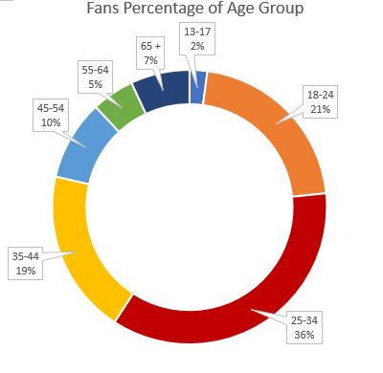
Data Extraction
Analysis by Age Group (Split of Fans)
WITH FPGA AS (
SELECT * FROM FansPerGenderAge
WHERE Date = (SELECT MAX(Date) FROM
FansPerGenderAge ))
SELECT AgeGroup,
ROUND(SUM(NumberOfFans)*1.0/
(SELECT SUM(NumberOfFans) FROM FPGA)*100.0,2)||'%'Percentage
FROM FPGA
GROUP BY AgeGroup;
📖
Query.doc
Notes:
This is the split of the age group of our fans.
The age group having the most number of fans is 25 to 34. They account for 36 percent.
Then come the age group of 18 to 24 and 35 to 44, each of them accounts for around 20 percent.
In the code I have used the common table expressions. Because there is a table I have cited twice in the code.
I saved FPGA as the table with the latest data.
Then based on the data in FPGA, I aggregate the number of fans in each age group OVER the total number of fans.

Slide 15
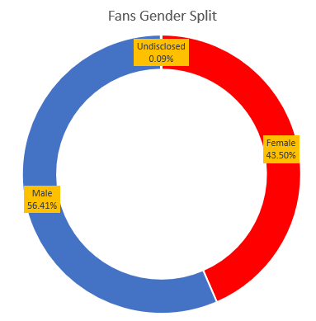
Data Extraction
Analysis by Gender (Split of Fans)
WITH FPGA AS (
SELECT * FROM FansPerGenderAge
WHERE Date = (SELECT MAX(Date) FROM FansPerGenderAge ))
SELECT Gender,
ROUND(SUM(NumberOfFans)*1.0/
(SELECT SUM(NumberOfFans) FROM FPGA)*100.0,2) ||'%' Percentage
FROM FPGA
GROUP BY Gender;
📖
Query.doc
Notes:
This is the split of gender of our fans.
56 percent of the fans are male and 43 percent of them are female. That means both the Males and Females are equally important to our social media content.
The code of this data is similar to the previous one, just changing the age to gender.

Slide 16
Data Extraction
Analysis by Language
There are 49,418 English speaking fans.
They account for 5.09% of total fans
Potential market in US is 200,322.75 dollars.
SELECT Language, SUM(NumberOfFans FROM FansPerLanguage WHERE Date = (SELECT MAX(Date) FROM FansPerLanguage) AND Language = 'en' GROUP BY Language
SELECT Language, ROUND(SUM(NumberOfFans)*1.0/ (SELECT SUM(NumberOfFans) FROM FansPerLanguage WHERE Date = (SELECT MAX(Date) FROM FansPerLanguage))*100.0,2) FROM FansPerLanguage WHERE Date = (SELECT MAX(Date) FROM FansPerLanguage) AND Language = 'en' GROUP BY Language
SELECT Language, CountryCode, Round(NumberOfFans*0.0001*(SELECT AverageIncome FROM PopStats WHERE CountryCode = 'US'),2) FROM FansPerLanguage WHERE Date = (SELECT MAX(Date) FROM FansPerLanguage) AND Language = 'en' AND CountryCode = 'US'
📖
Query.doc
Notes:
The potential market is calculated by 0.01% of average income of the fans in US.
We can see there is large market potential to launch an English version of the magazine. This will increase the fans number in US and UK and increase our revenue a lot.
The detail of the codes are quite similar to the previous ones

Slide 17
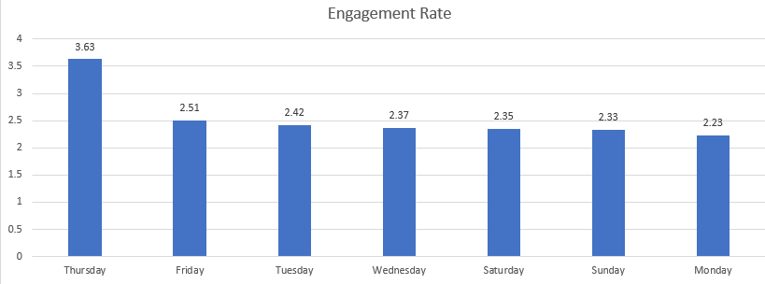
Data Extraction
Engagement per Day of the Week
%
📖
Query.doc
SELECT Week,
ROUND(AVG(EngagedFans*1.0 / Reach*1.0)*100,2)||'%' EngageRate
FROM PostsInsights
GROUP BY Week
Notes:
The engagement is calculated as engaged fans over all reaches.
We can see the posts on Thursday have the highest engagement rate in average.

Slide 18
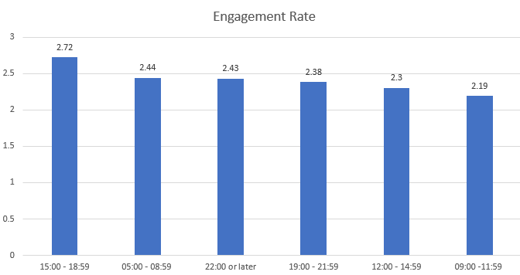
Data Extraction
Engagement per Time of Day
%
📖
Query.doc
SELECT Time,
ROUND(AVG(EngagedFans*1.0 / Reach*1.0)*100,2)||'%' EngageRate
FROM PostsInsights
GROUP BY Time
Notes:
And the posts in time period of 15:00 to 19:00 have the highest engagement rate in average.

Slide 19
Recommendation
Strategy Recommendation
Launch more customized marketing events in China, Ghana, Spain and Germany because they have highest potential market.
Make our content more customized to the fans around 25-34 years old, because they account for the largest percentage in our fans.
Launch an English version magazine because we have high potential market in English speaking countries.
Post more content on Thursday at 15:00 to 19:00 because the fans tend to engage more in this time period.

Slide 20

THANKS!

