Slide 1
F.I.N.
OffShore Resource
Drill
Team Temple
Alexander Mot
Manraj Singh Rai
Christopher Tesar
Pardeep Singh Bhattal

Slide 2
Offshore drilling harms the environment
But, we still need resources. So how can we balance resource extraction while minimizing environmental harm?

Slide 3
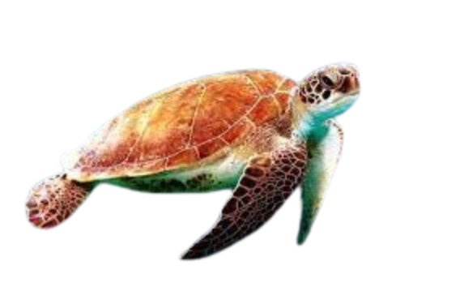
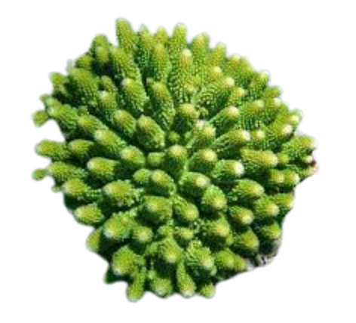
Preservation Path
Mapping the Way to Sustainable Seas!

Slide 4
What is Preservation Path?
Maps out preservation sites, including Coral Reefs, Habitats of Endangered Species, and Historical Shipwrecks.
Plans and optimizes offshore resource drilling activities.
  Factors in location of preservation sites, calculates most efficient paths for resource extraction while avoiding or minimizing disturbance to these sites.
The UI presents data in a visually appealing and comprehensible manner, utilizing interactive map and dashboards.

Slide 5
Design Process

Slide 6
Define Project Objectives
Clearly articulate the objectives and scope of the preservation path
Identify types of algorithms we could use for this system
Define the problem it aims to address and the desired outcomes it intends to achieve, such as optimizing offshore resource drilling while minimizing environmental impact.

Slide 7
Development Process
We broke the process down step by step!
We developed a UI to visualize our data.
  This was to help our algorithm as we could see how everything works step by step
We got to work on the algorithm.
Finally we built upon our earlier data visualizations to visually display the algorithm for route finding
Research and presentation progression was concurrently done.

Slide 8
Data Selection
World Map
Obtain:
  Oil
  Precious Metals
  Helium
  Shipwreck
Preserve:
  Coral Reef
  Endangered Species
  Shipwrecks
Informational
  Algal

Slide 9

Use of Data
The data was quite messy
How does the user sees the data:
We had to normalize and interpret the data. With the Numpy library
With our normalized data, we assigned scaled hex values with the specific data points for each coordinate. This allowed for us to have a gradient heatmap for each specific parameter.
We assigned a score to every tile
This allowed for us to prioritize visiting certain spaces over others. Higher the score, higher the priority.
(s1) ⋅ Obtain - (s2) ⋅ Preserve + (s3) ⋅ Information
= Total Score
More of a
Resource
Less of a
Resource
*Where s1,s2,s3 are scalar values

Slide 10
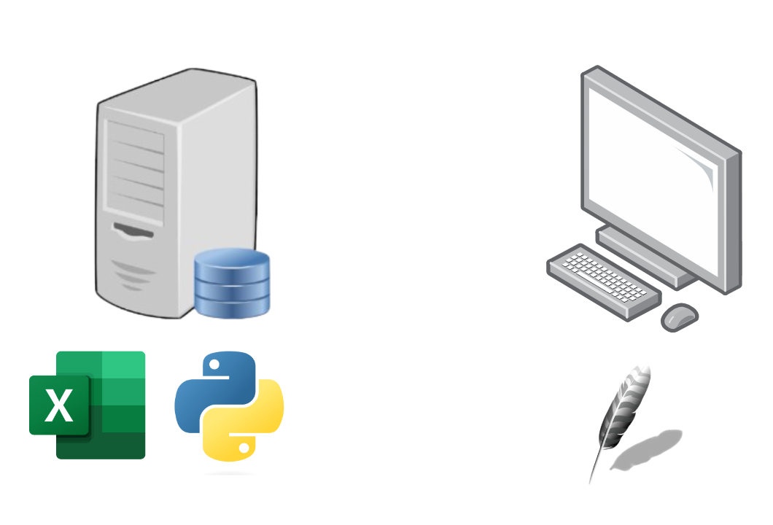
Software Implementation

Slide 11
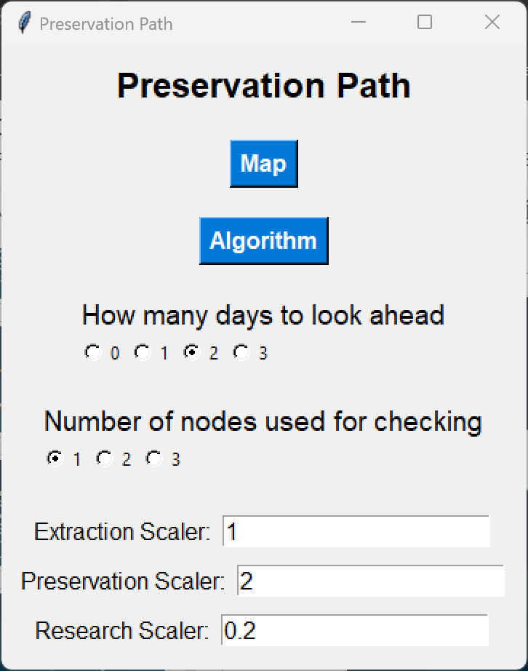
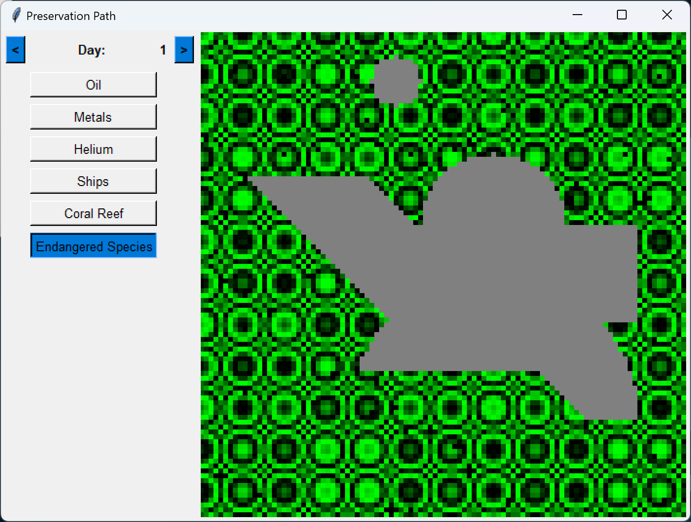

UI Design

Slide 12
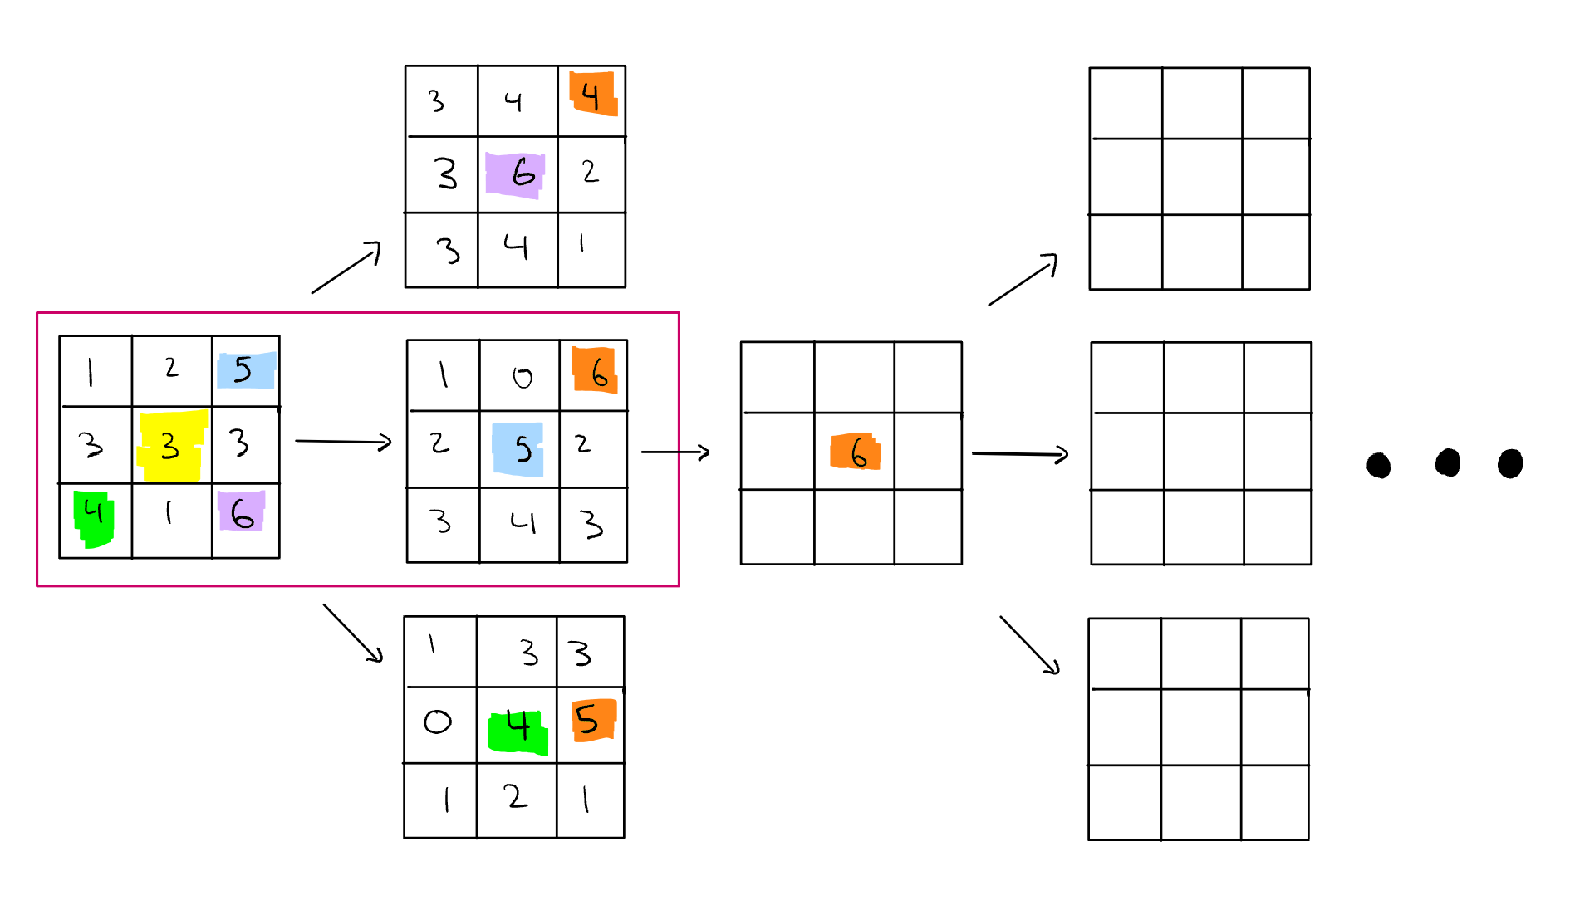
Algorithm Development

Slide 13
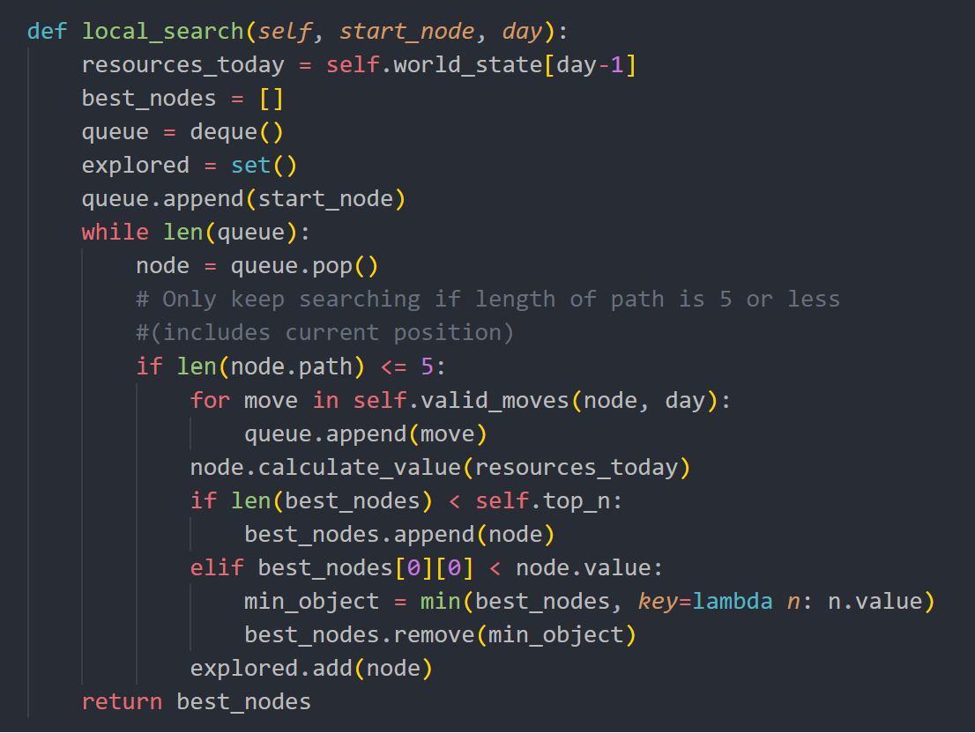

Slide 14
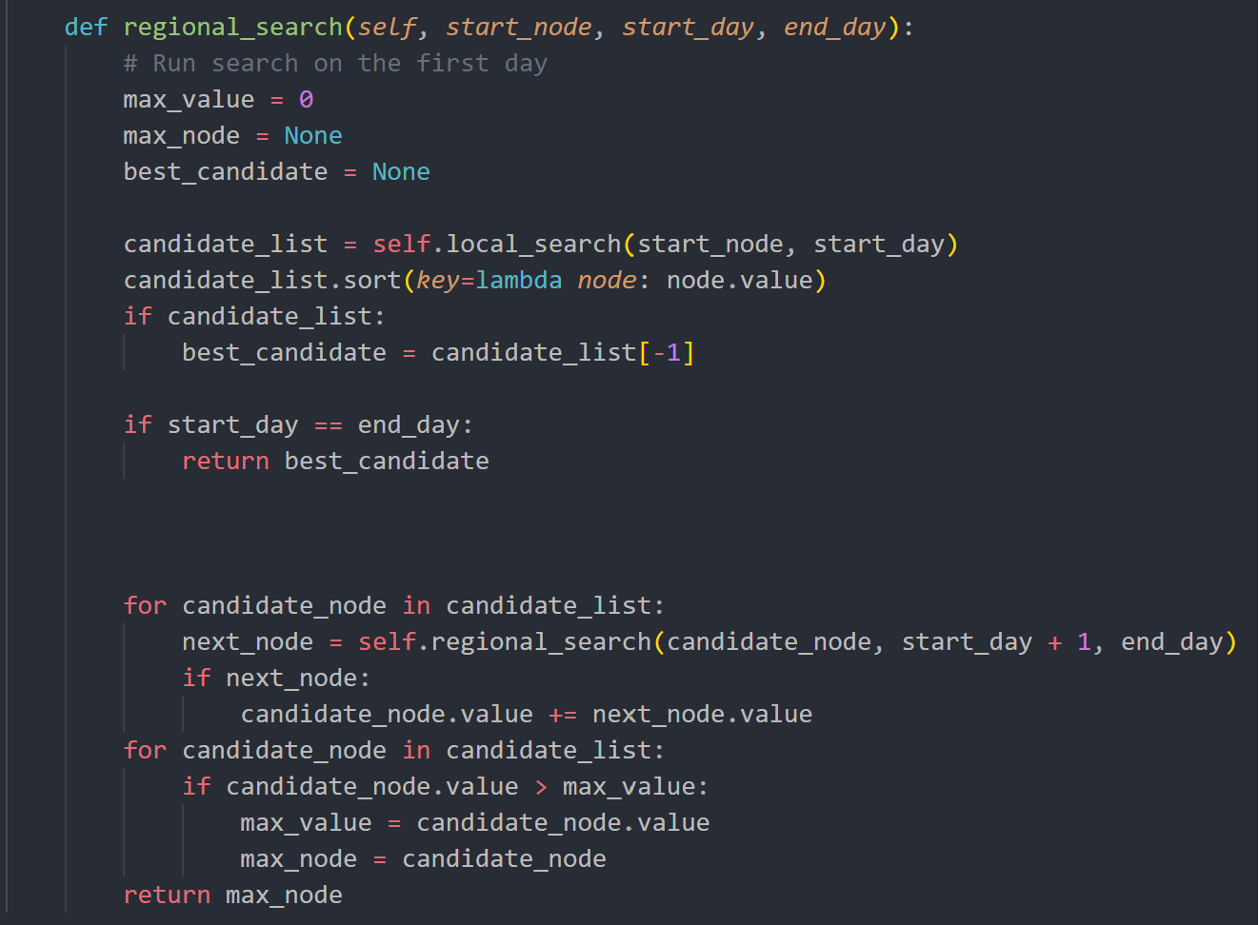

Slide 15
Future Implementations
Further frontend development to make it even more appealing for users
More robust data visualization
  Displaying heatmaps of all resources selected simultaneously
Implement more advanced algorithms
  Machine Learning Algorithms:
    SVM, Random Forest, Clustering, etc.
Accommodate both professionals in their everyday tasks and researchers exploring new avenues of inquiry.

Slide 16
DEMO

Slide 17
Thank You
Do you have any questions?

