Slide 1
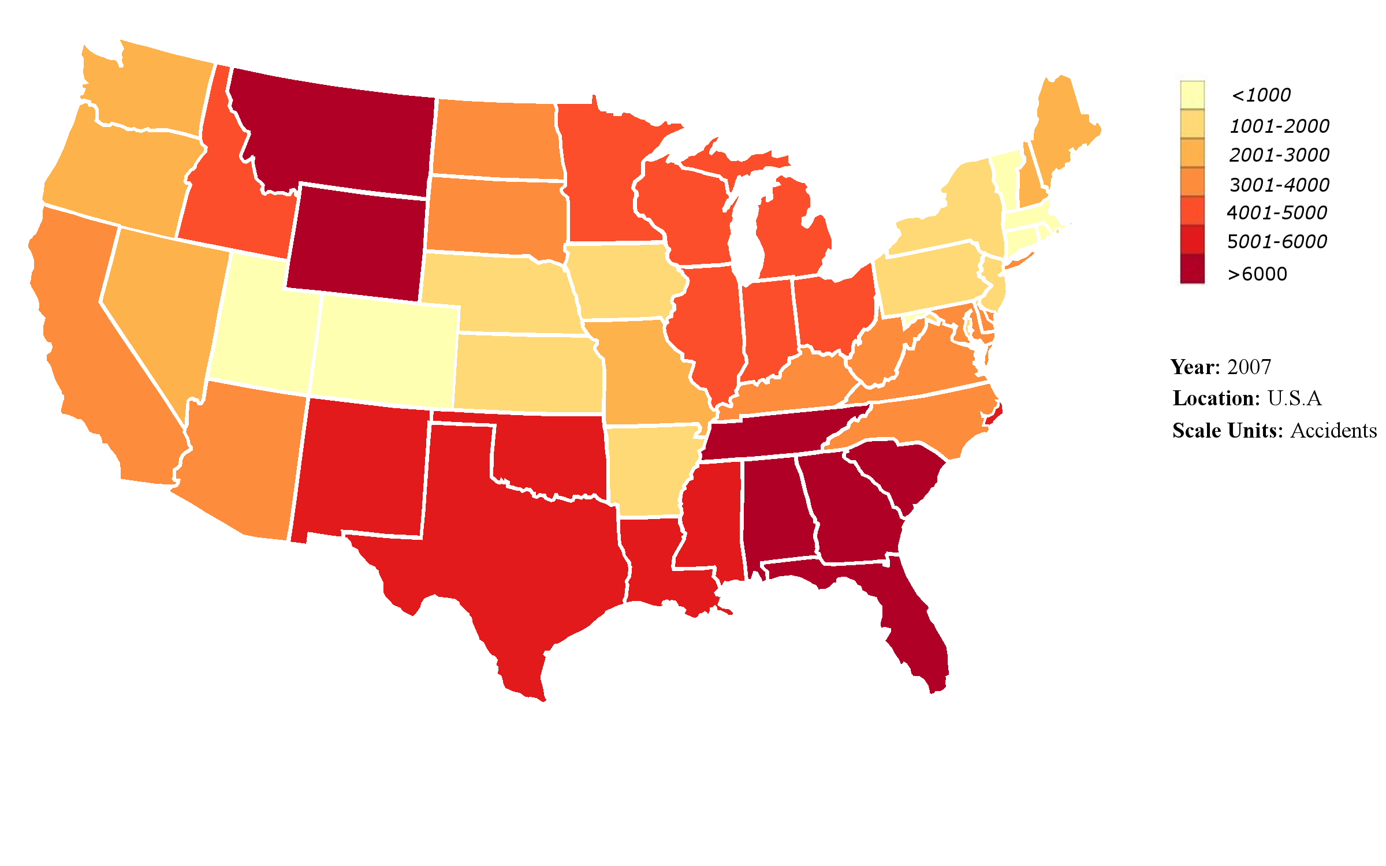
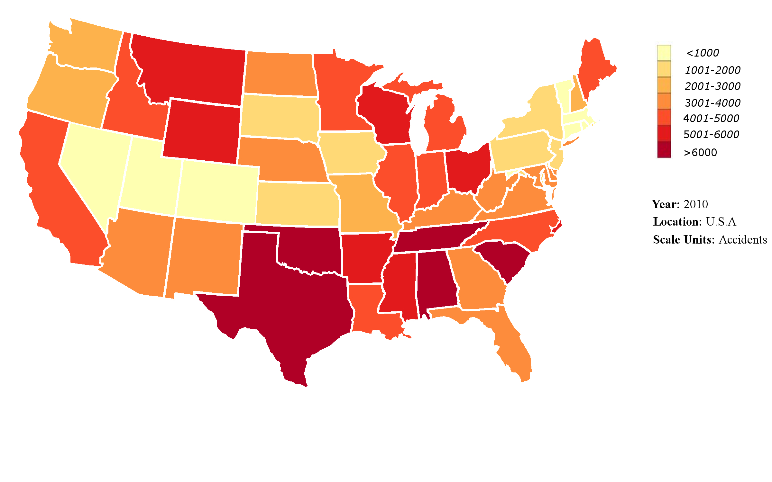

Slide 2
Distraction #1
Distraction #2
Number of accidents
Distraction #3
Age

Slide 3
