Slide 1
Topology Optimisation Concept Study

Slide 2
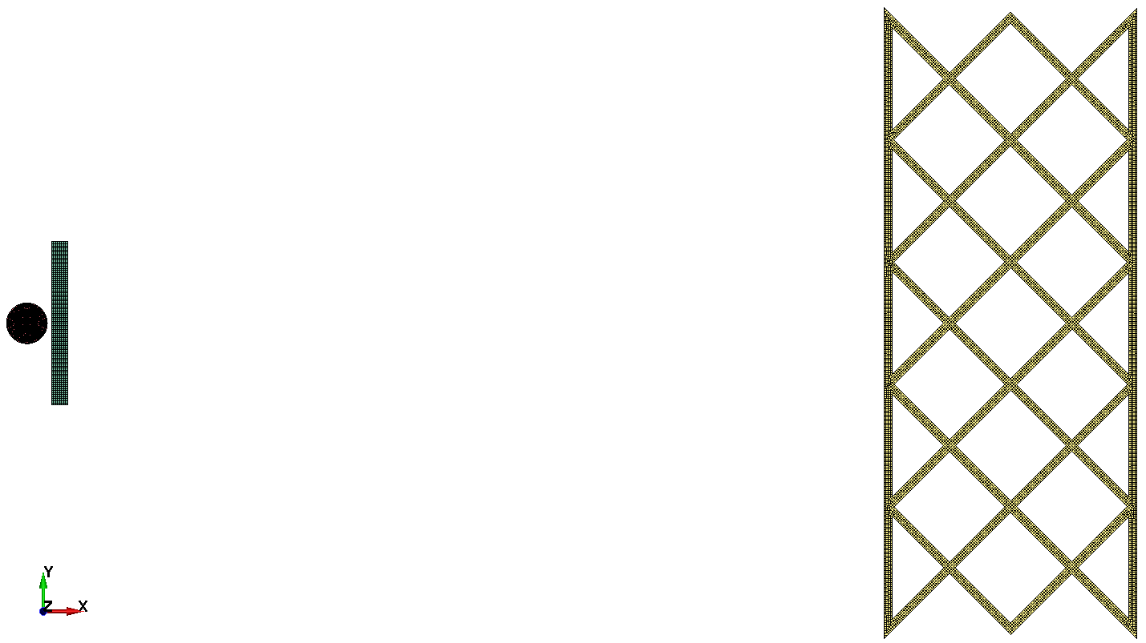
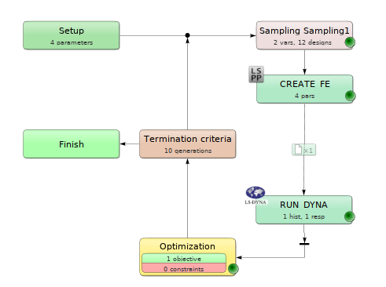
Updated topology
2 plate Whipple shield design
Back wall: 19 DOF
Optimised w.r.t back wall displacement (x-axis)
12 designs

Slide 3
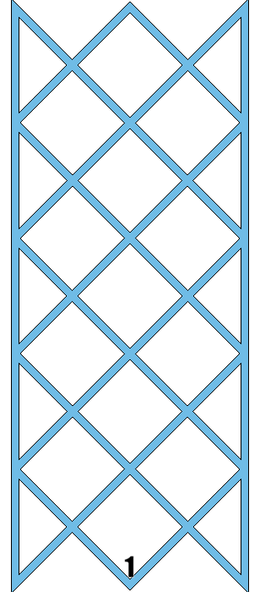
2D Optimisation results
Model | Average Displacement (mm)
2D un-optimised | 1.3778
2D optimised | 0.1916

Slide 4
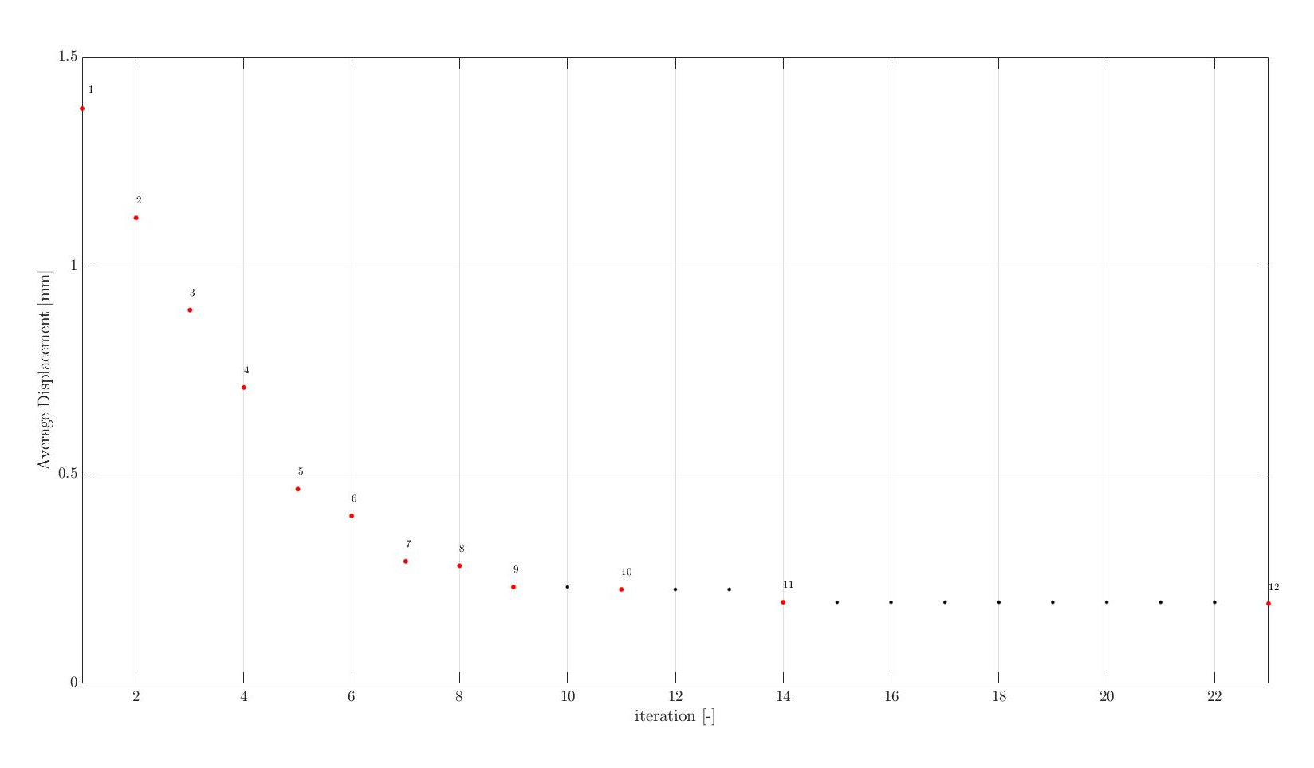

Slide 5
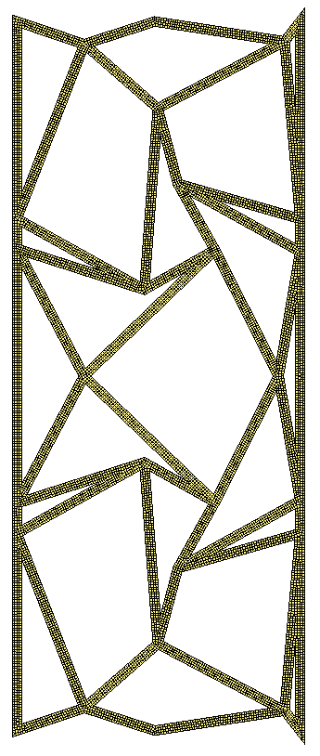
Final 2D Result
*Video of original 2d and optimised 2d

Slide 6
3D extension of 2D optimisation
Model | Average Displacement (mm)
3D un-optimised
3D extension of 2D optimisation

Slide 7
2D & 3D Monolithic models
*Video of 2d and 3d monolithic

