Slide 1
LS-OPT

Slide 2
Optimisation set-up
Variables:
Location in x
Location in y
Objective:
Maximise energy absorption
Constraints:
Within defined region
Equal mass/volume
y
x

Slide 3


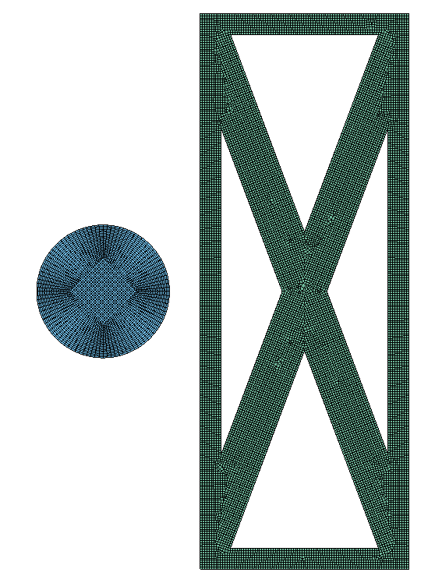
Progress
Parameter file included within LS-PREPOST command file
Updates structure & mesh according to input parameters

Slide 4
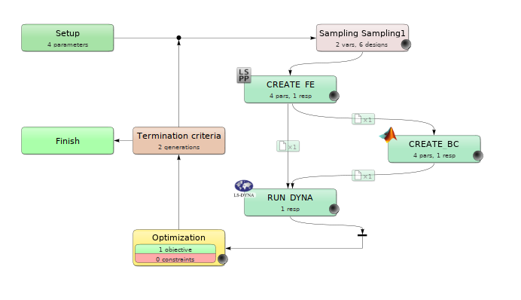
LS-OPT
Command file input
Variables stored
File transfers
Boundary conditions created in MATLAB - updated for each iteration
key file input (+BC info & lsppout)
Constraints & objectives defined

Slide 5
Problems & Questions
MATLAB/python on cluster?
Output file not created using LS-PREPOST

