Slide 1
LS-OPT RESULTS

Slide 2
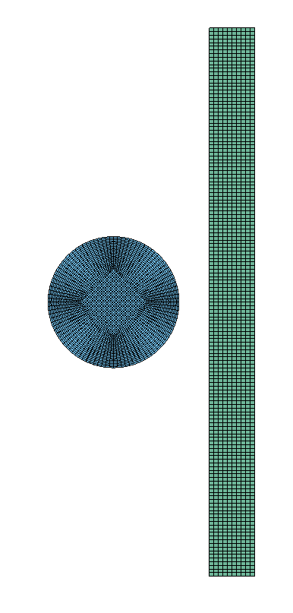
2D OPTIMISATION

Slide 3
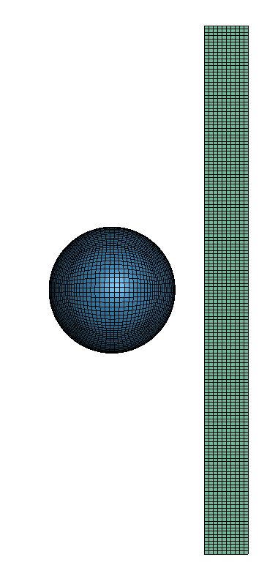
TRANSLATION TO 3D

