Slide 1
Results

Slide 2
FEM/DES vs SPH - DENSITY

Slide 3
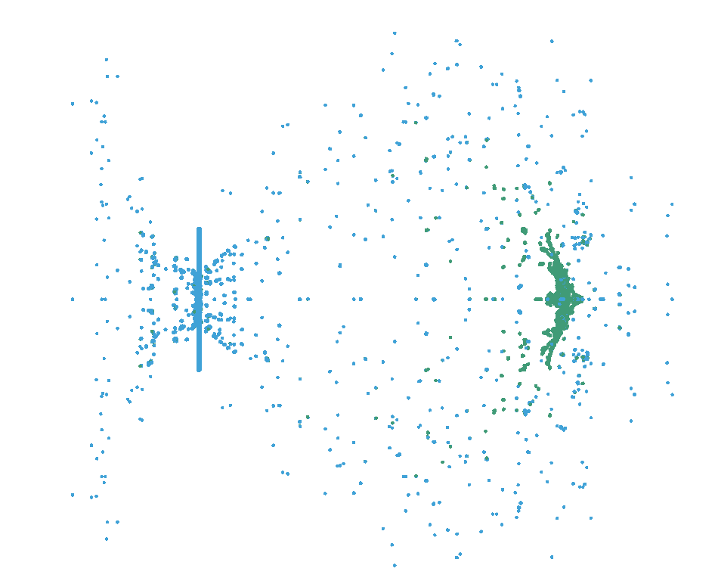
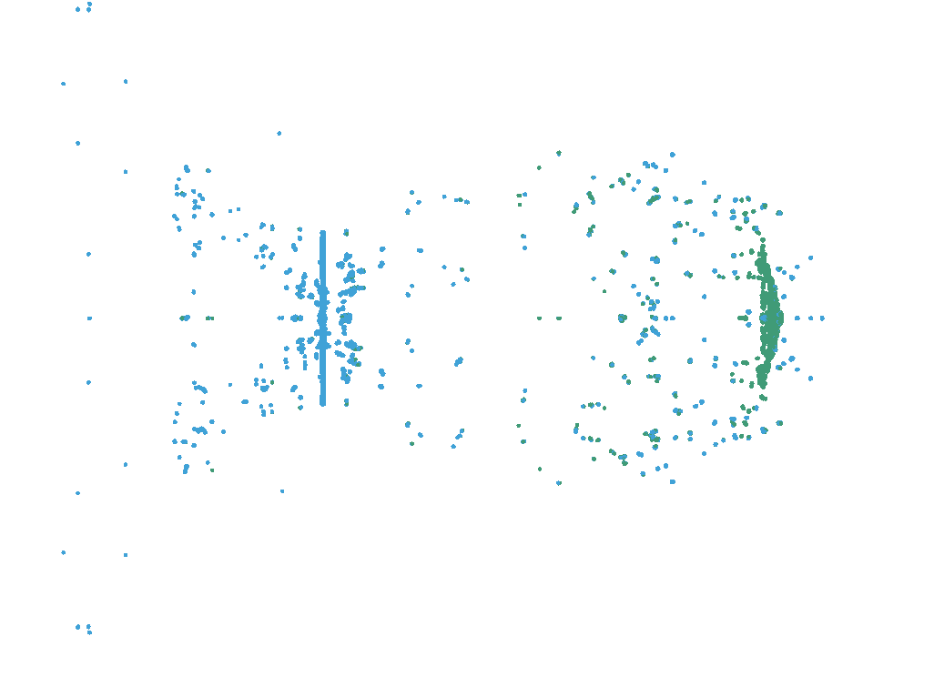
SPH STUDY
AA6061-T4
AISI 4340

Slide 4
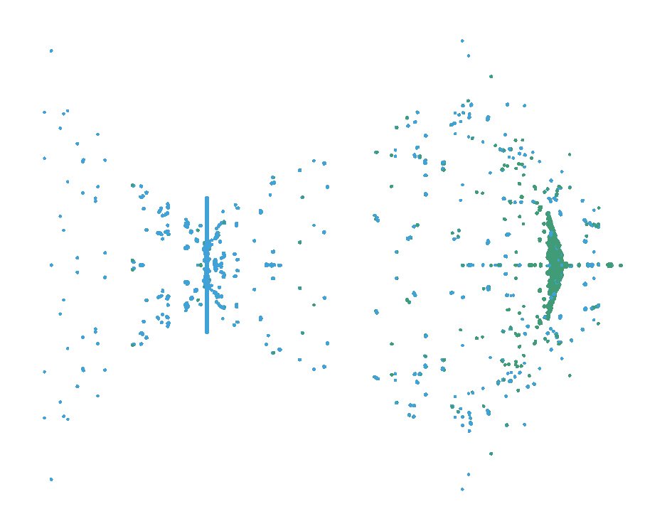
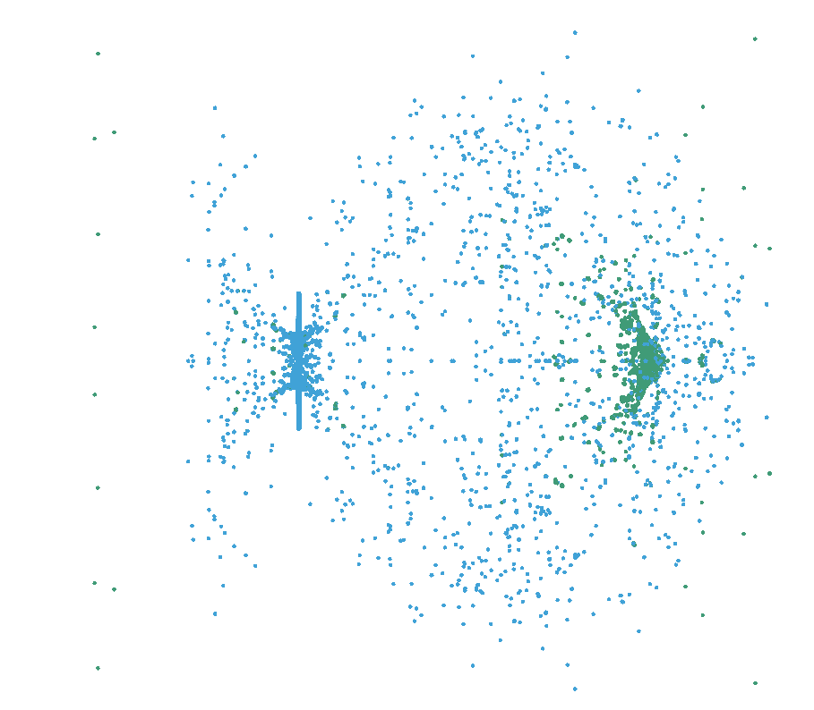
Ti-6Al-4V
TUNGSTEN ALLOY

Slide 5
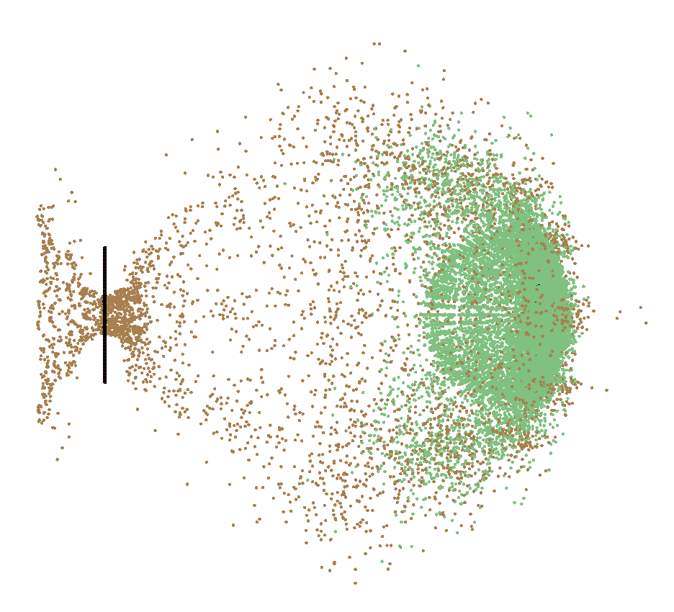
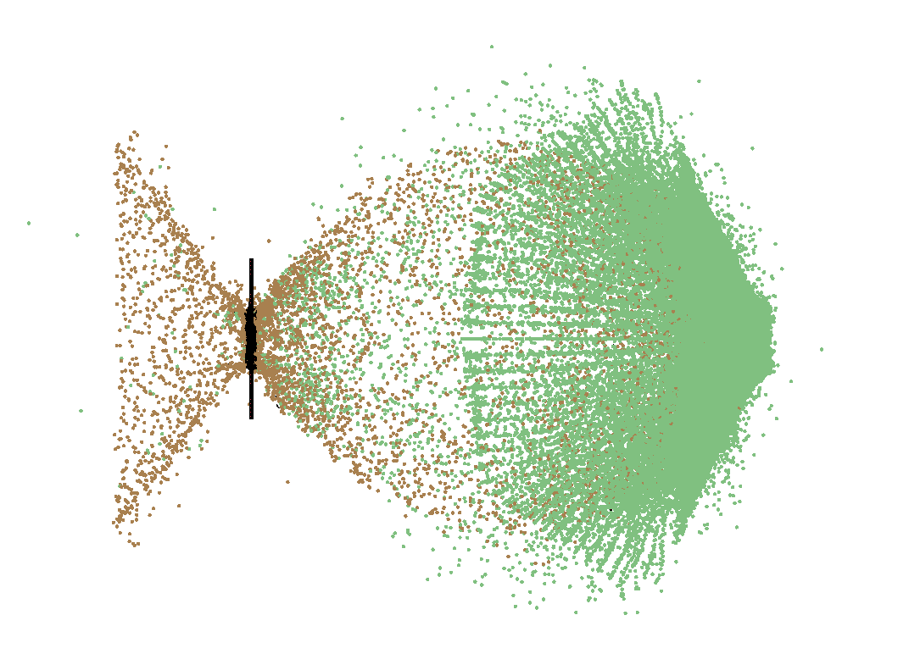
FEM/DES OBSERVATIONS
AA6070-0
AISI 4340

Slide 6
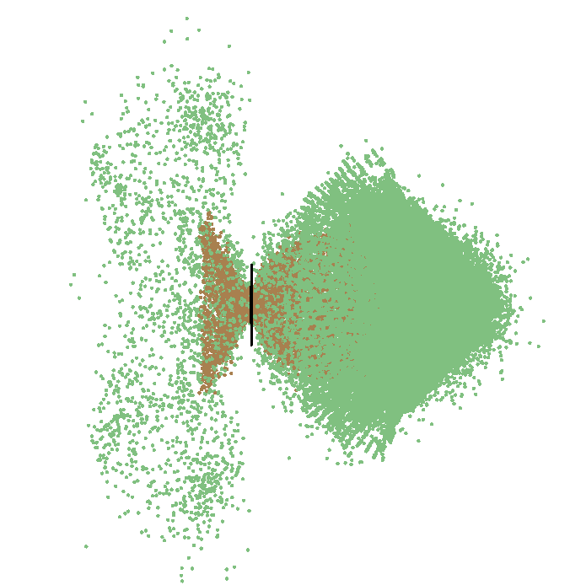
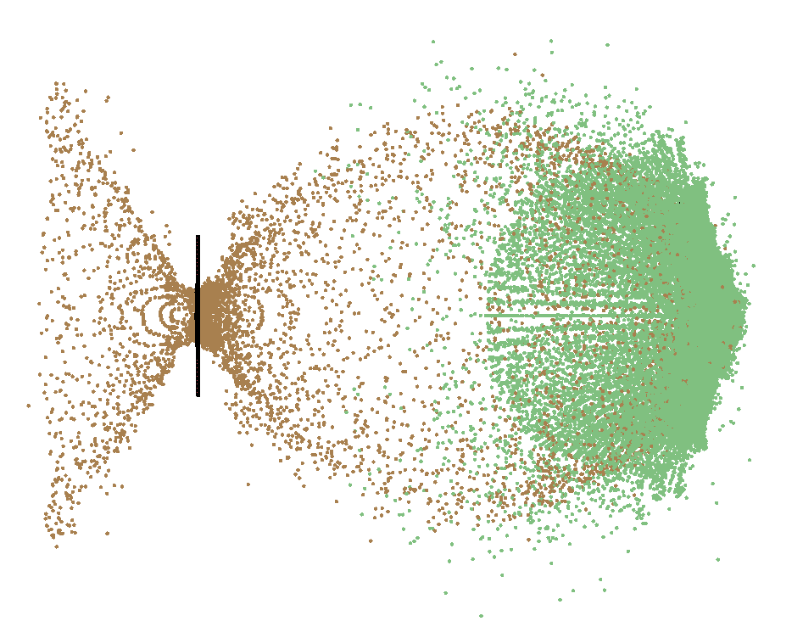
Ti-6Al-4V
TUNGSTEN ALLOY

Slide 7
CROSS-PARAMATER STUDY
4 MATERIALS:
AA6070-O
STEEL 4340
Ti-6Al-4V
TUNGSTEN ALLOY
3 t/d RATIOS:
0.042
0.084
0.126
3 VELOCITIES [km/s]:
5.5
6.7
7.5

Slide 8
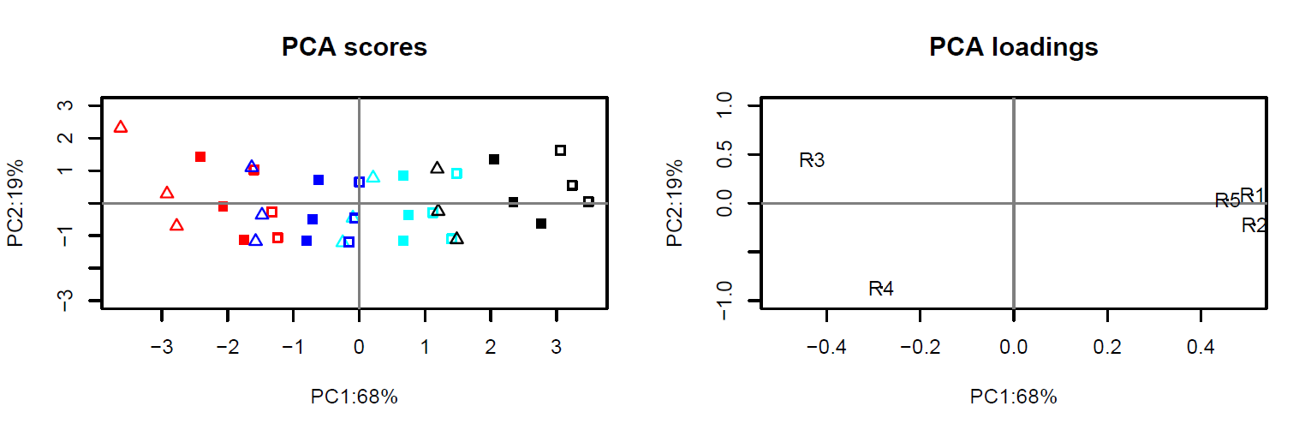
R1 = Target hole diameter
R2 = Debris cloud diameter
R3 = Percentage of solid material
R4 = Residual velocity
R5 = Conversion due to temperature
Red – Aluminium
Blue – Titanium
Cyan – Steel
Black – Tungsten
∆ - t/d = 0.0418
▪ - t/d = 0.0835
▫ - t/d = 0.1253
Observations:
PC1 > 3PC2
Equal spacing between material groups
Overlap between groups
E.g. Thick wall Alu. low vel. ≈ Thin wall Ti. low vel.

Slide 9
R1 = Target hole diameter
R2 = Debris cloud diameter
R3 = Percentage of solid material
R4 = Residual velocity
R5 = Conversion due to temperature
Target hole diameter, debris cloud diameter and conversion due to temperature are equally sensitive to all input parameter changes
Lower velocity simulations have a higher percentage velocity decrease
Increasing velocity does not strictly result in larger target hole diameter
Increasing t/d leads:
to lower percentage of solid material
higher conversion due to temperature
decreasing residual velocity
increased cloud diameter
increased hole diameter
Observations:
Material properties and t/d ratio affect all
Percentage of solid material more sensitive than residual velocity (horizontal axis)
Input velocity has little impact on:
Hole diameter
Cloud diameter
Conversion due to temperature
Input velocity affects: percentage of solid material & residual velocity
Inverse correlation between percentage of solid material and residual velocity

Slide 10
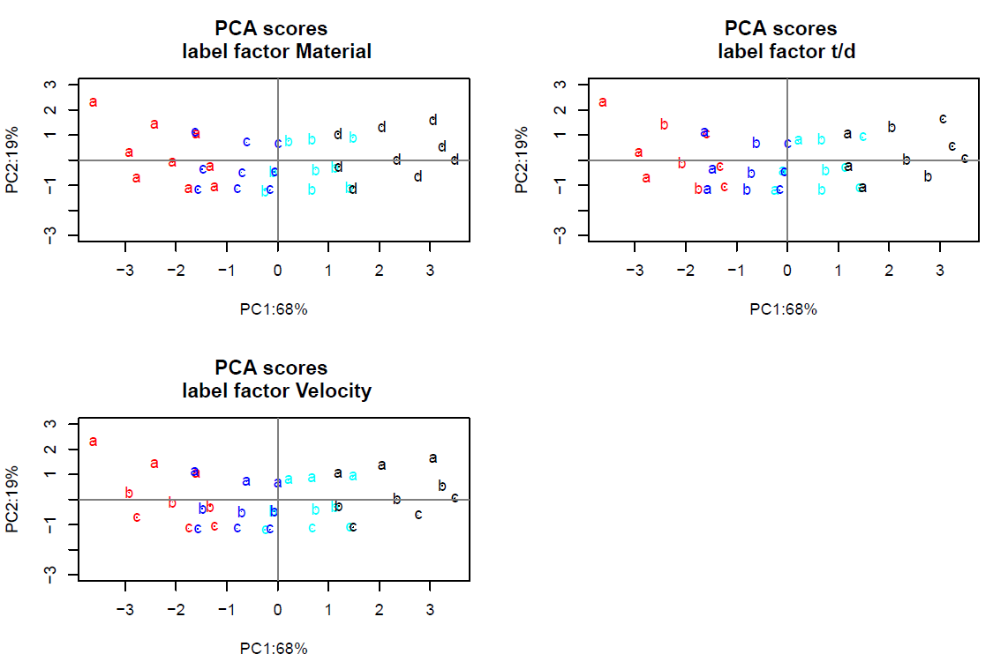

Slide 11
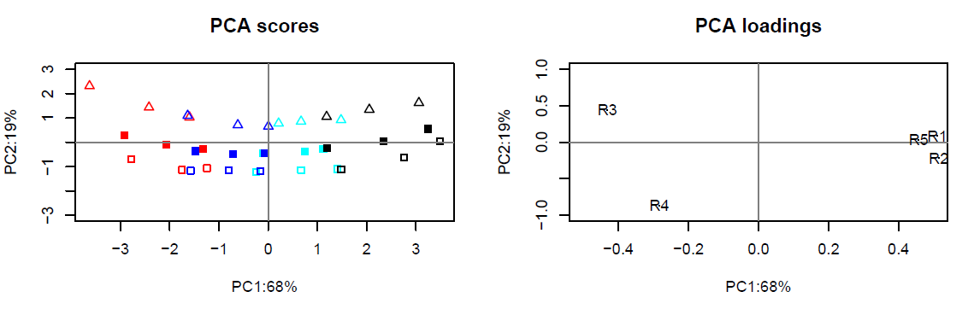
Alternative plot
Order = Material, velocity, t/d

Slide 12
Next steps
Ideally: Perform high velocity impact experiments to validate numerical simulations
Extent material parameter study:
Mesh size
Different set of materials
Different impactor material
…
Impact under an angle
Impactor shape

