Slide 1
Results

Slide 2
FEM/DES vs SPH - DENSITY

Slide 3
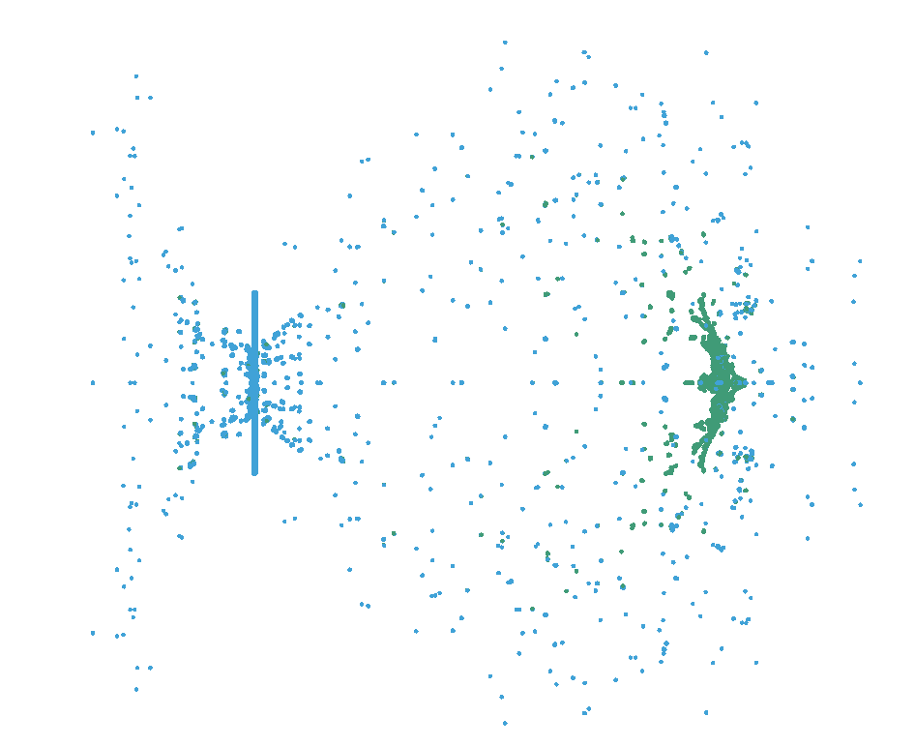
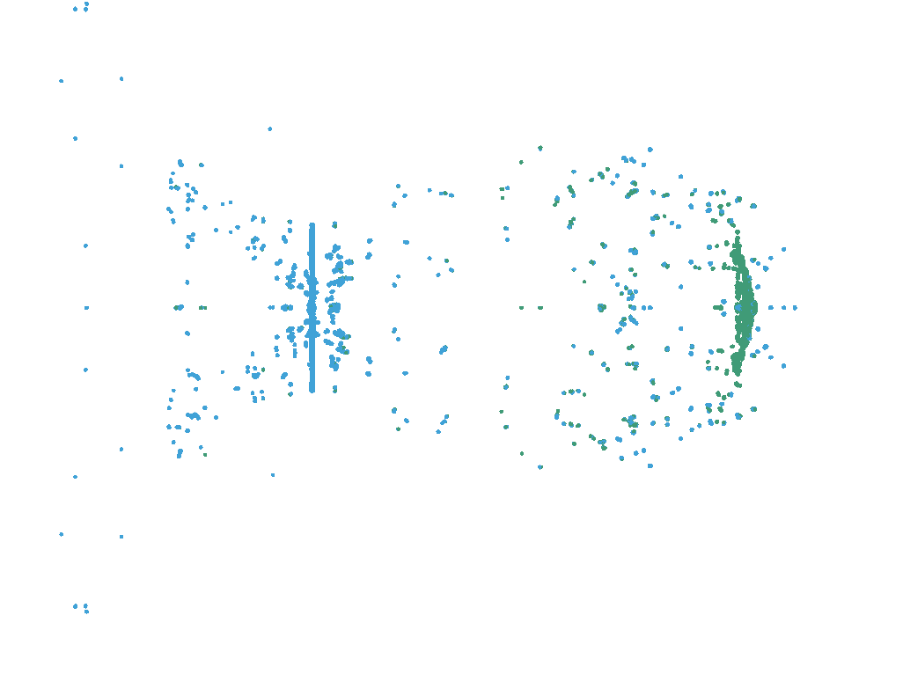
SPH STUDY
AA6061-T4
AISI 4340

Slide 4
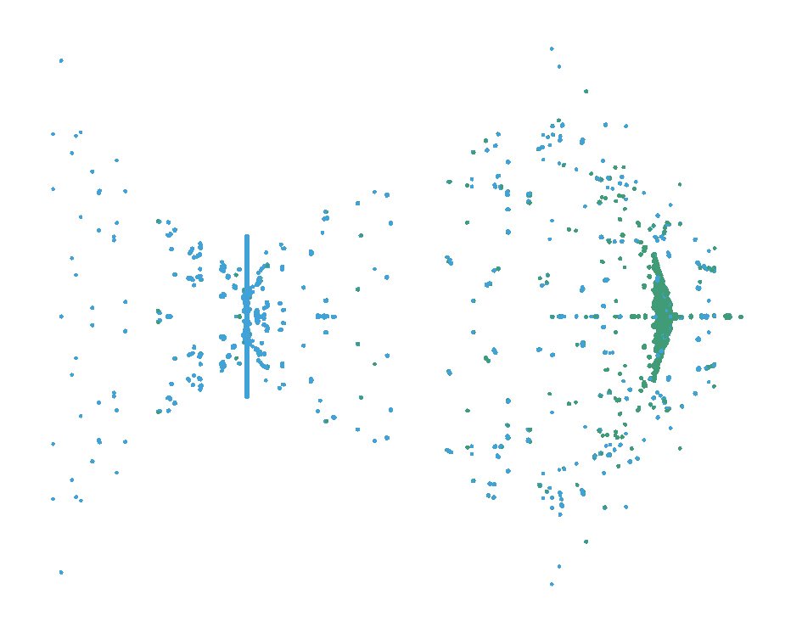
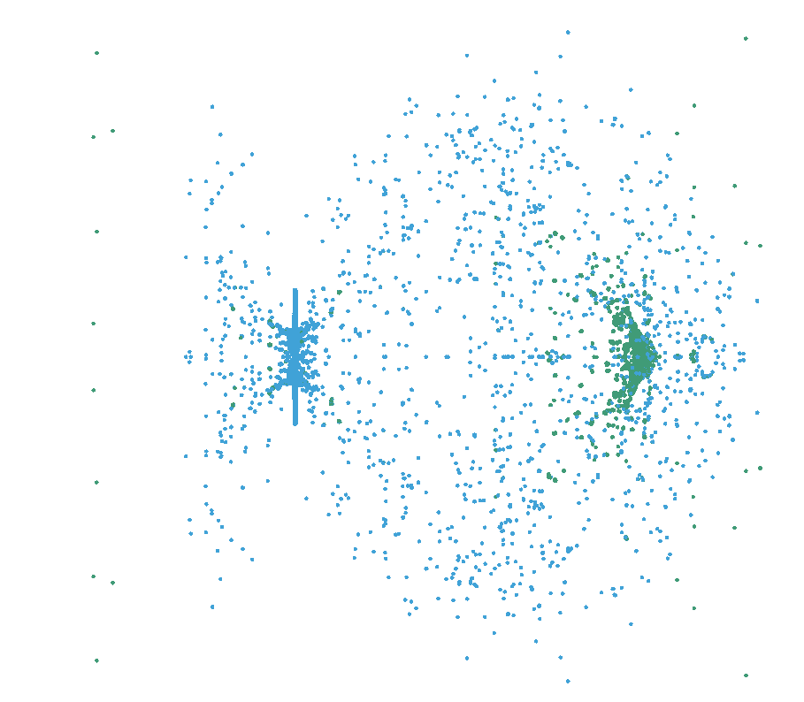
Ti-6Al-4V
TUNGSTEN ALLOY

Slide 5
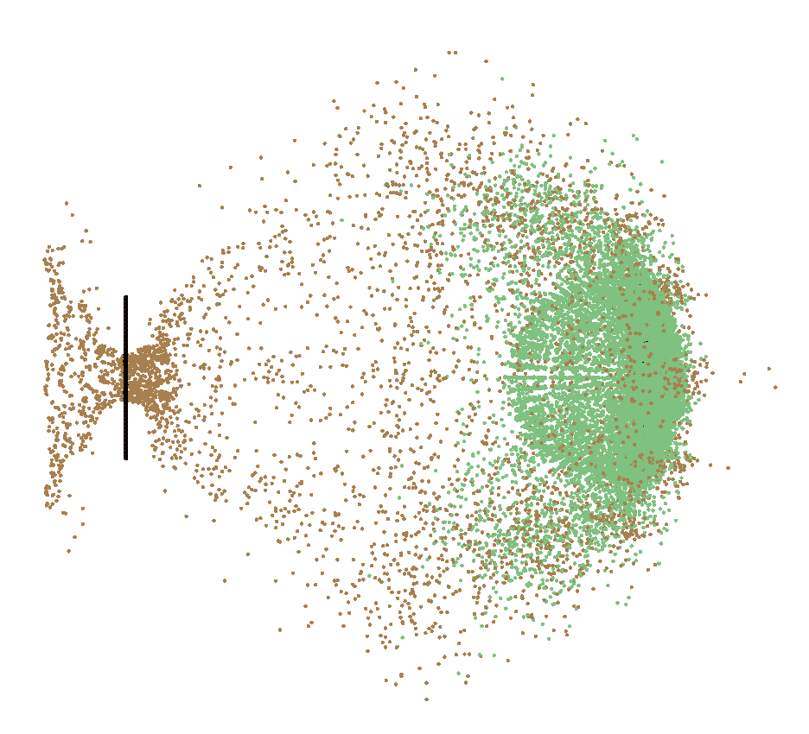
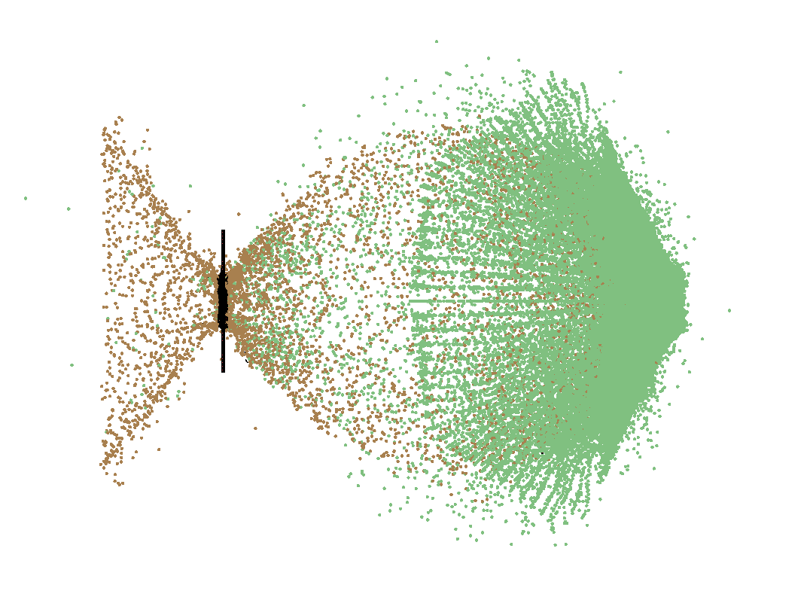
FEM/DES OBSERVATIONS
AA6070-0
AISI 4340

Slide 6
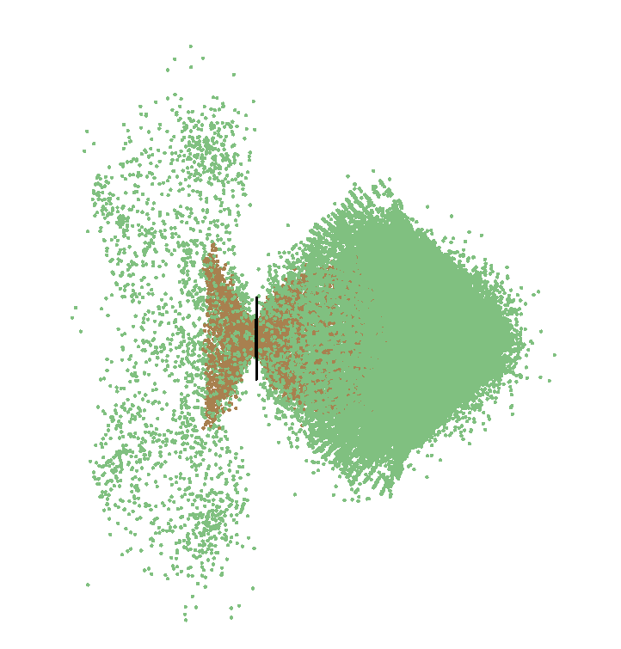
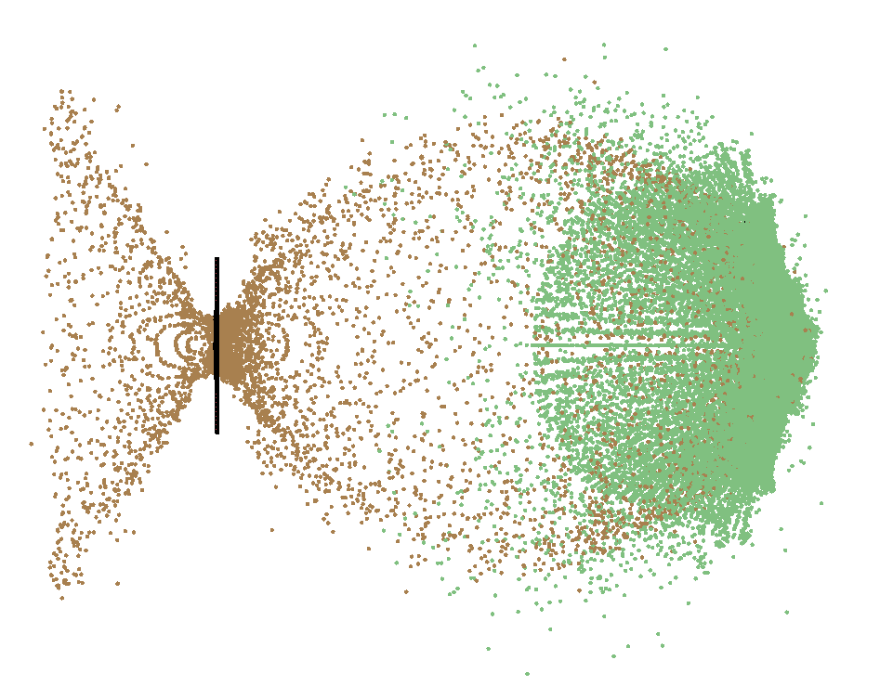
Ti-6Al-4V
TUNGSTEN ALLOY

Slide 7
AA6061-T4
AA6070-0
AISI 4340
Ti-6Al-4V
TUNGSTEN ALLOY

Slide 8
CROSS-PARAMATER STUDY
4 MATERIALS:
AA6070-O
STEEL 4340
Ti-6Al-4V
TUNGSTEN ALLOY
3 t/d RATIOS:
0.042
0.084
0.126
3 VELOCITIES [km/s]:
5.5
6.7
7.5

Slide 9
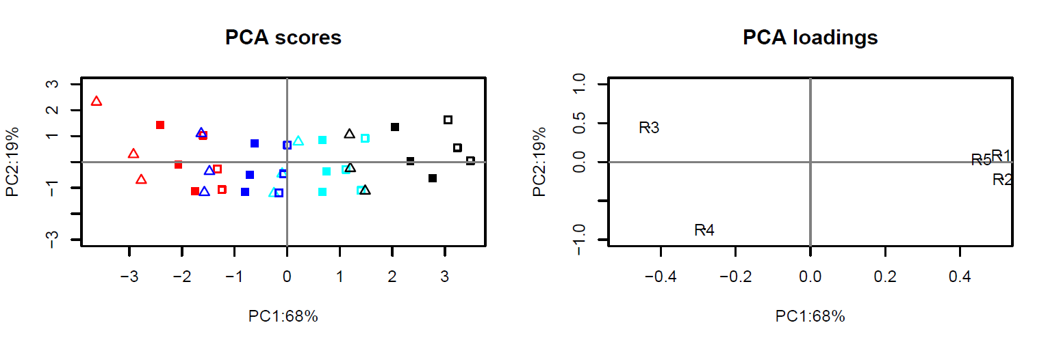
Red – Aluminium, Blue– Titanium, Cyan – Steel, Black – Tungsten
R1 = Target hole diameter
R2 = Debris cloud diameter
R3 = Percentage of solid material
R4 = Residual velocity
R5 = Conversion due to temperature
∆ - t/d = 0.0418, ▪ - t/d = 0.0835, ▫ - t/d = 0.1253
Observations:
PC1 > 3PC2
Equal spacing between material groups
Overlap between groups
E.g. Thick wall Alu. low vel. ≈ Thin wall Ti. low vel.
Material properties and t/d ratio affect all
Percentage of solid material more sensitive than residual velocity (horizontal axis)

Slide 10
R1 = Target hole diameter
R2 = Debris cloud diameter
R3 = Percentage of solid material
R4 = Residual velocity
R5 = Conversion due to temperature
Observations:
Input velocity has little impact on:
Hole diameter
Cloud diameter
Conversion due to temperature
Input velocity affects: percentage of solid material & residual velocity
Inverse correlation between percentage of solid material and residual velocity
Target hole diameter, debris cloud diameter and conversion due to temperature are equally sensitive to all input parameter changes
Lower velocity simulations have a higher percentage velocity decrease
Increasing velocity does not strictly result in larger target hole diameter
Increasing t/d leads:
to lower percentage of solid material
higher conversion due to temperature
decreasing residual velocity
increased cloud diameter
increased hole diameter

Slide 11
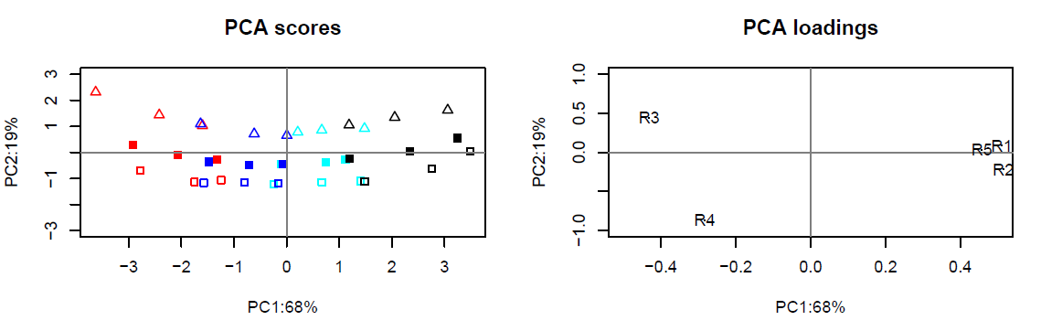
Alternative plot
Order = Material, velocity, t/d

Slide 12
Next steps
Ideally: Perform high velocity impact experiments to validate numerical simulations
Extent material parameter study:
Mesh size
Different set of materials
Different impactor material
…
Impact under an angle
Impactor shape

Slide 13
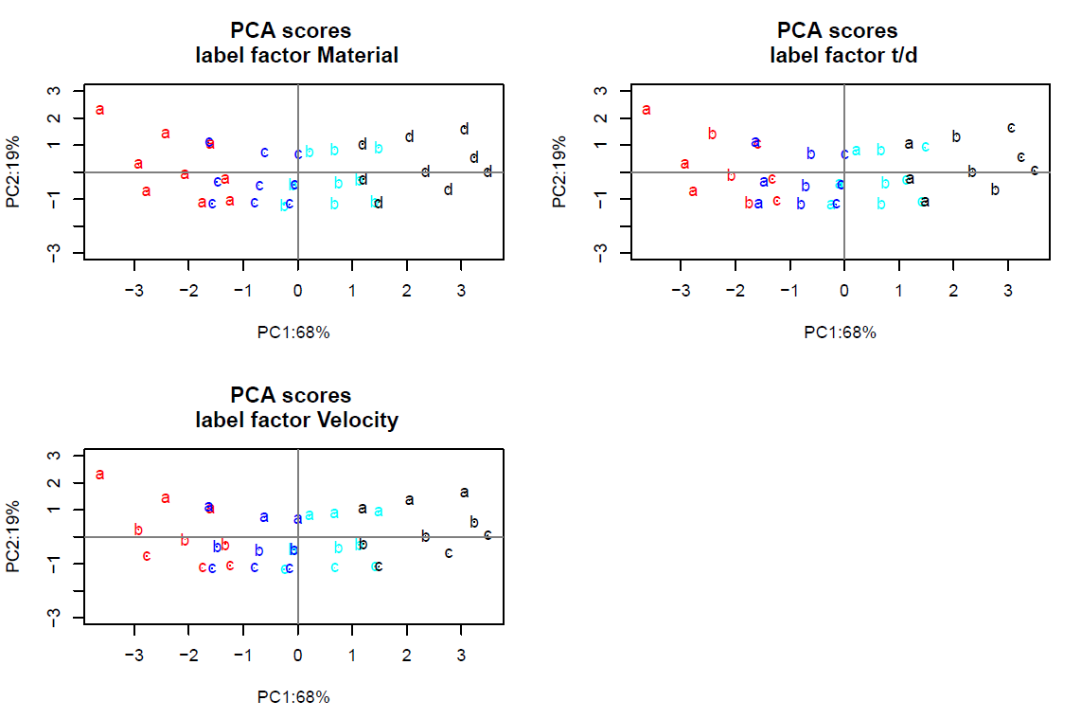

Slide 14
AA6070-0
AISI 4340
Ti-6Al-4V
TUNGSTEN ALLOY

