Slide 1
Results

Slide 2
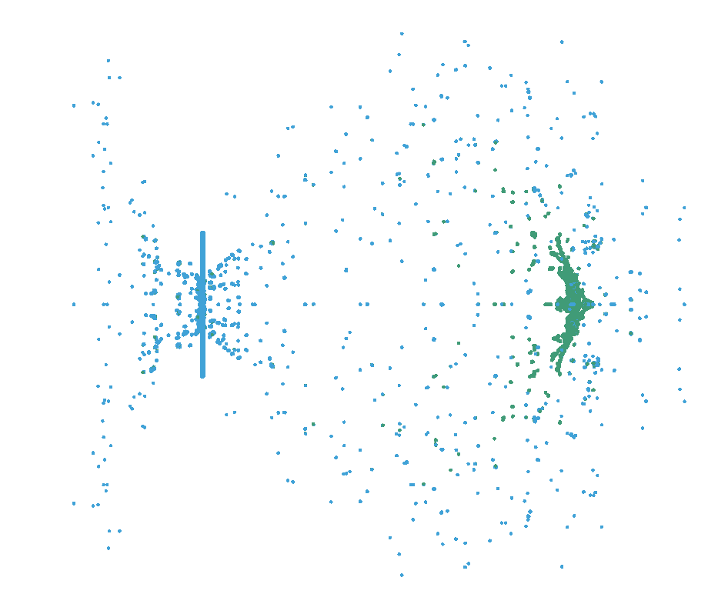
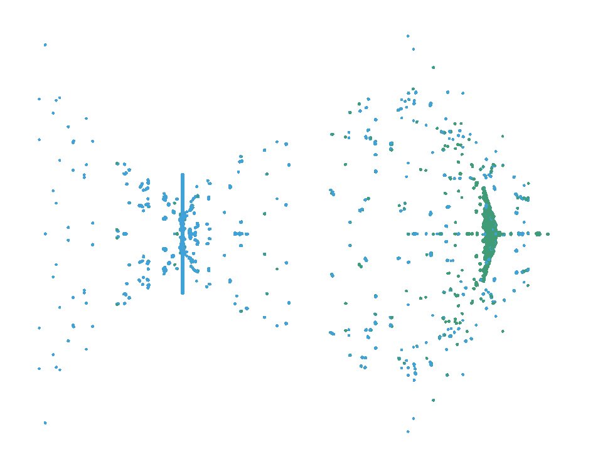
SPH OBSERVATIONS
AISI 4340
Ti-6Al-4V

Slide 3
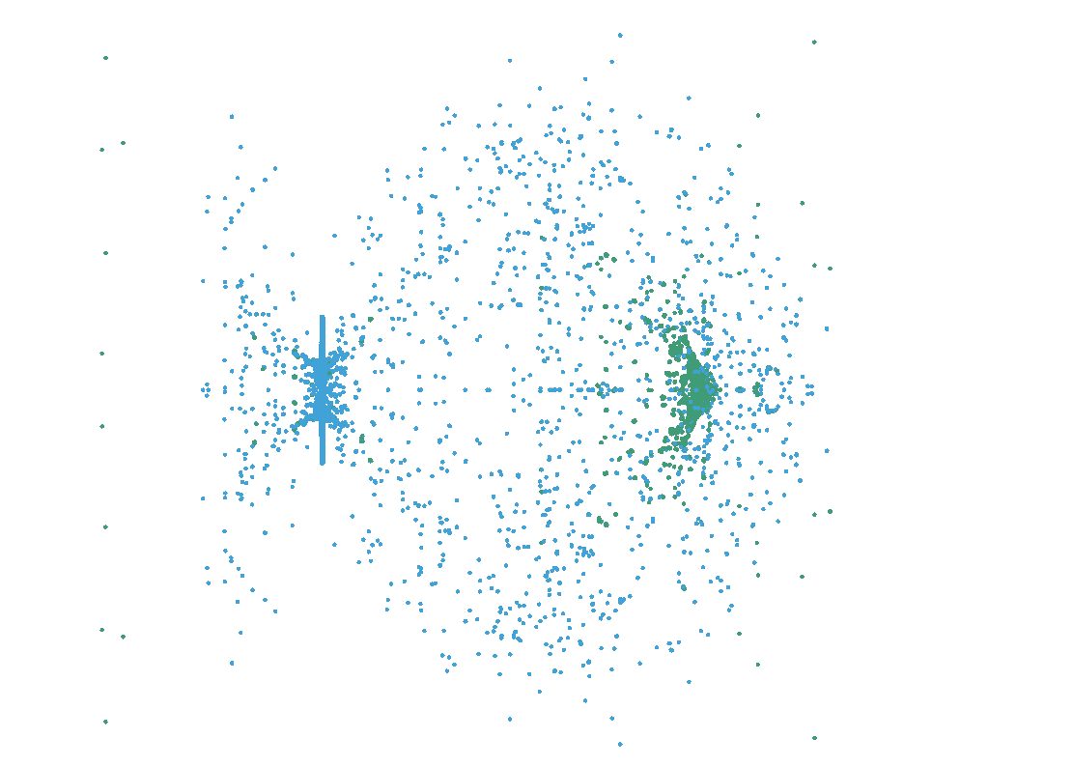
TUNGSTEN ALLOY

Slide 4
FEM/DES vs SPH - DENSITY

Slide 5
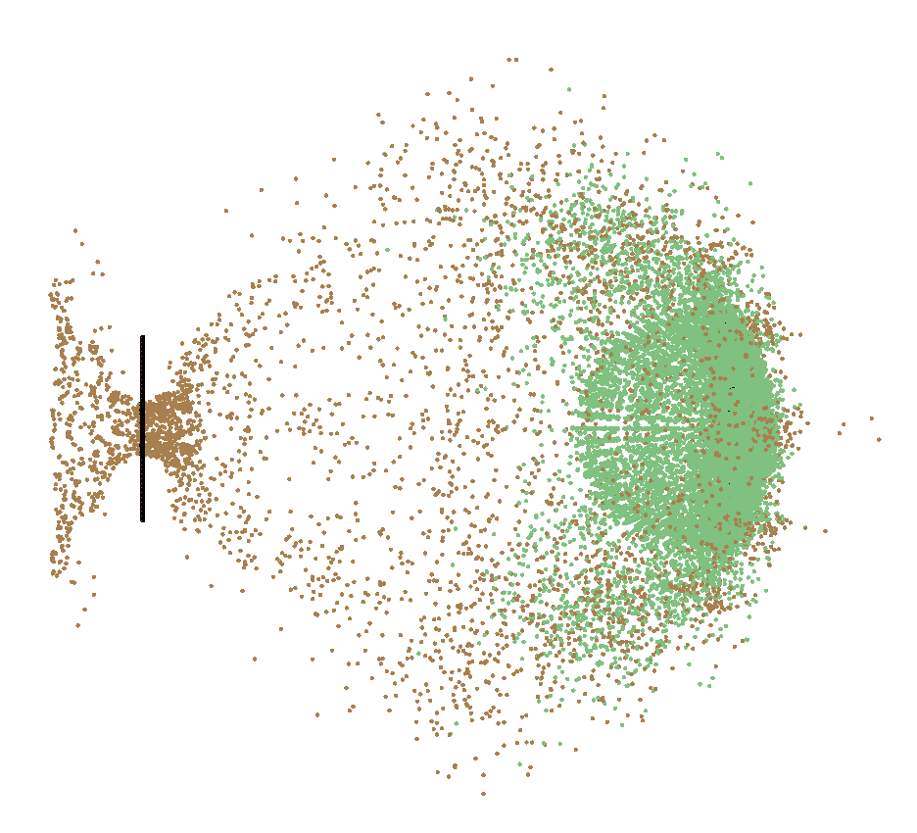
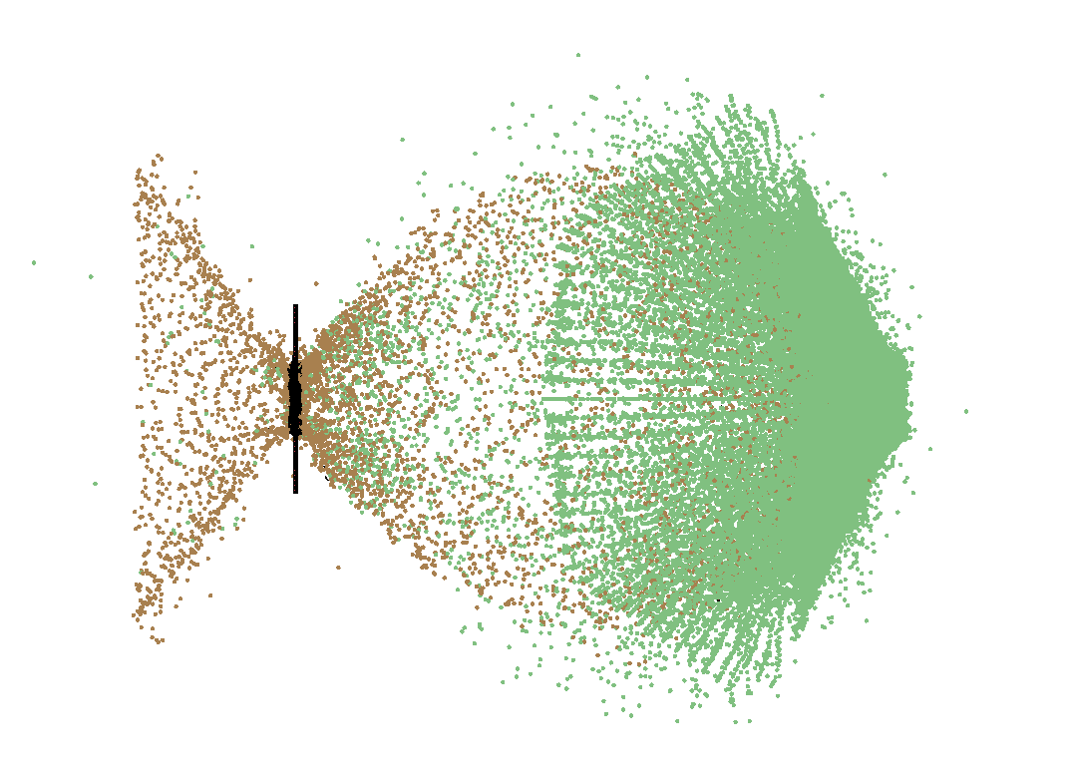
FEM/DES OBSERVATIONS
AA6070-0
AISI 4340

Slide 6
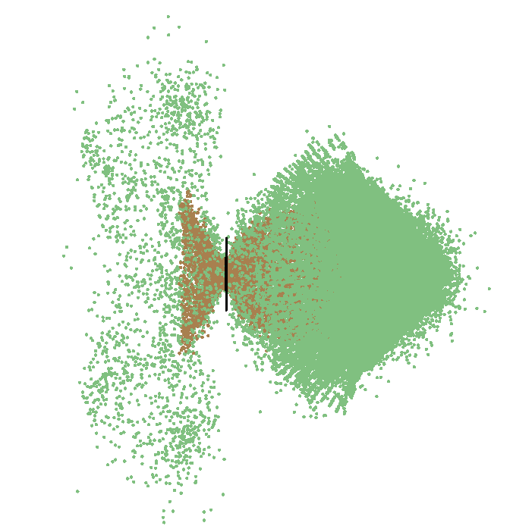
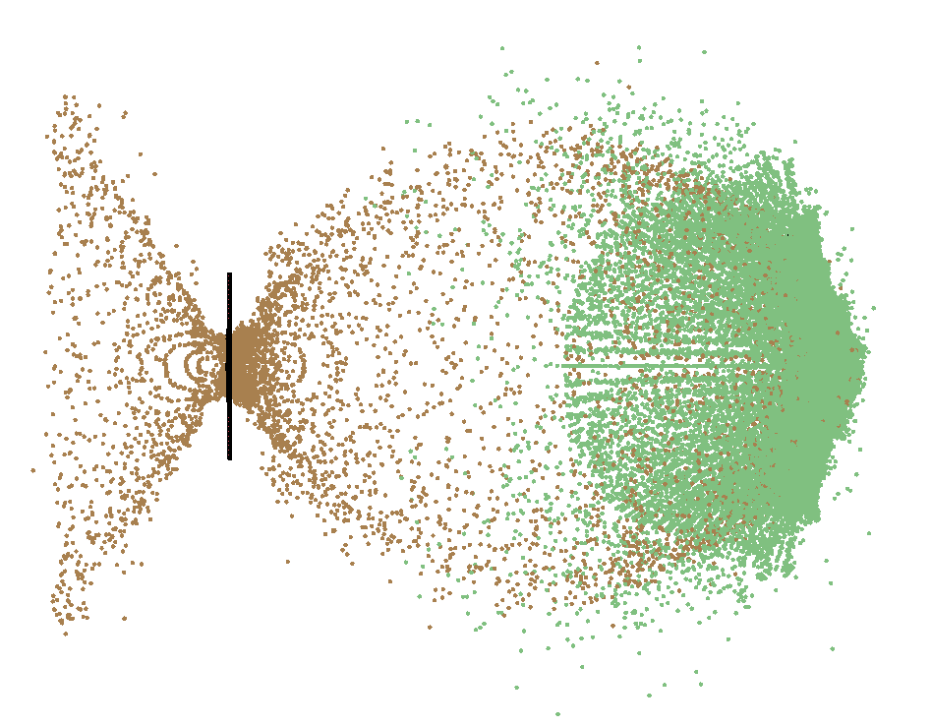
Ti-6Al-4V
TUNGSTEN ALLOY

Slide 7
CROSS-PARAMATER STUDY
4 MATERIALS: AA6070-O, STEEL 4340, Ti-6Al-4V, TUNGSTEN ALLOY
3 t/d RATIOS: 0.042, 0.084, 0.126
3 VELOCITIES: 5.5, 6.7, 7.5 km/s

