Slide 1
Tracking Face Recognition
Lluís-Pere de las Heras Caballero
Ahmed Mounir Gad
Mònica Piñol Naranjo

Slide 2
Tracking - Face Recognition
Index
Introduction
Segmentation
Detection
Representation
Tracking
Conclusions

Slide 3
Tracking - Face Recognition
Introduction – Segmentation – Detection – Representation – Tracking - Conclusions
Segmentation
Background Substractor
Selectivity
Detection
Face Recognition
Representation
Eigenbackground
Grey - World
Tracking
Face Detection
Velocity
Histograms
Blob Detection
Multiple targets

Slide 4
Tracking - Face Recognition
Introduction – Segmentation – Detection – Representation – Tracking – Conclusions
Segmentation
Background Substractor
Selectivity
Eigenbackground
Grey - World
Bi+1 = α*Fi + (1-α)*Bi
Bi+1(x,y) = α*Ft(x,y) + (1-α)*Bt(x,y) if Ft(x,y)is Background
Bi+1(x,y) = Bt(x,y) if Ft(x,y)is Foreground
PCA - First M eigenvectors
Grey-World to delete the illumination vary environment

Slide 5
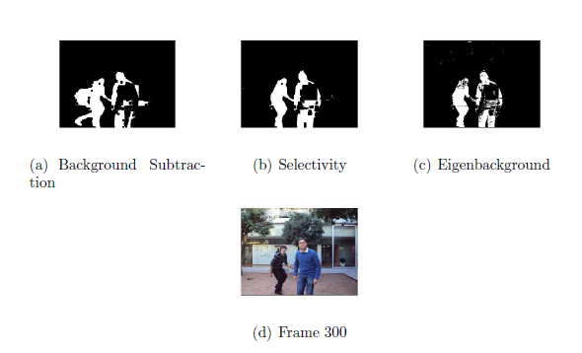
Tracking - Face Recognition
Introduction – Segmentation – Detection – Representation – Tracking – Conclusions

Slide 6
Tracking - Face Recognition
Introduction – Segmentation – Detection – Representation – Tracking – Conclusions
Detection
Face Recognition
Face Detection
Blob Detection
OpenCV
Viola-Jones frontal face
PCA & SVM
5 classes: {toni, ahmed, ekain, monica, lluis}
364 faces for training using K-fold strategy

Slide 7
Tracking - Face Recognition
Introduction – Segmentation – Detection – Representation – Tracking – Conclusions
Input names: { lluís, monica, ahmed, toni, ekain}
Takes the centroid and the bounding-box of all the blobs from the Segmenter-Image using Matlab regionprops
The interesting blobs should be larger than an appropriate threshold to avoid too small blobs– reducing time and complexity – .
For each blob the Detector tries to detect faces of interest. If a face is found, its blob is added to detectorK structure.
If a face is not found in a blob, this blob is added to the detectorUK structure

Slide 8
Tracking - Face Recognition
Introduction – Segmentation – Detection – Representation – Tracking – Conclusions
Representation
Velocity
Local Histogram
Multiple targets
Use centroid location in 2 consecutive frames
Color histogram
Correspondence problem
Match by name
Match by closest blob
Use tracking information
Use local histogram “Useless here”

Slide 9



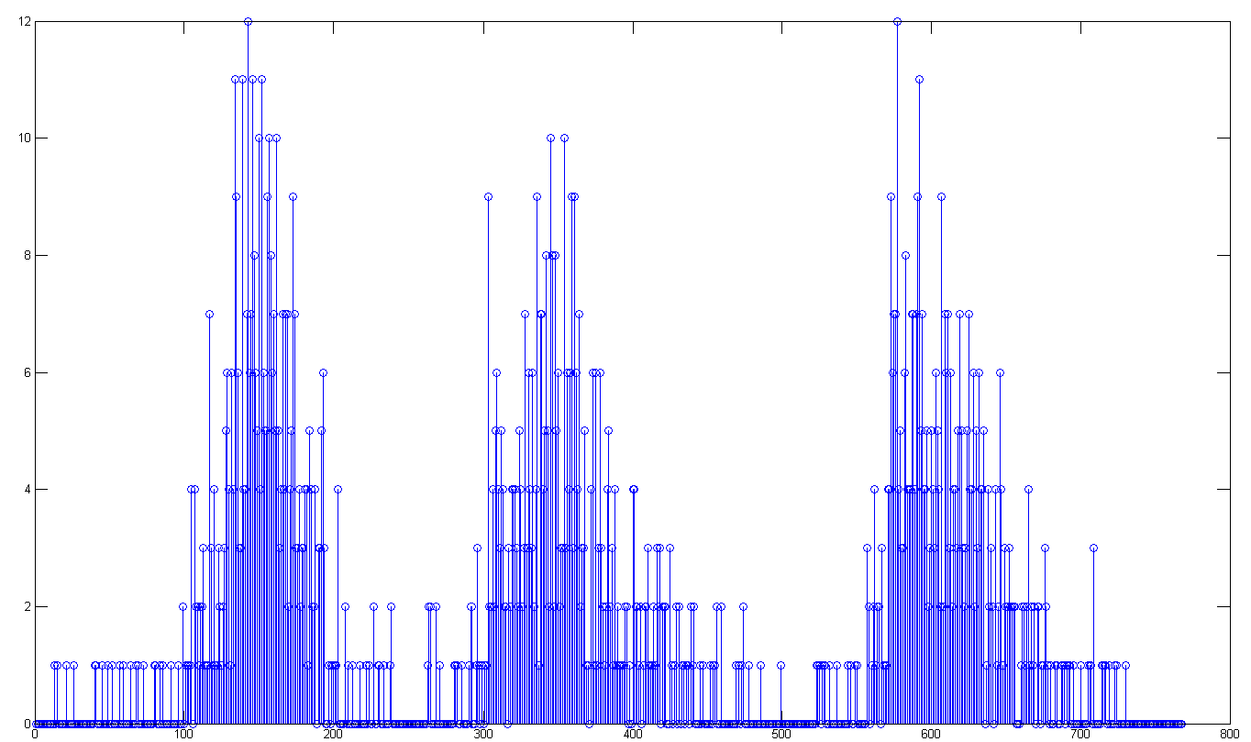
Tracking - Face Recognition
Introduction – Segmentation – Detection – Representation – Tracking – Conclusions
Representer:
[representer1, representer2, …]
representer1:
[Centroid1, BoundingBox1, Label1, Velocity1]
Color Histogram: R-G-B
counts
R-G-B bins

Slide 10
Tracking - Face Recognition
Introduction – Segmentation – Detection – Representation – Tracking – Conclusions
DetectorUK
Blob1: {Centroid1, BoundingBox1}
Blob2: {Centroid2, BoundingBox2}
DetectorK
Blob1: {Centroid1, BoundingBox1, Label1}
Blob2: {Centroid2, BoundingBox2, Label2}
Representer
representer1: {Centroid1, BoundingBox1, Label1, Velocity1}
representer2: {Centroid2, BoundingBox2, Label2, Velocity2}

Slide 11
Tracking - Face Recognition
Introduction – Segmentation – Detection – Representation – Tracking – Conclusions
Case1:
The DetectorK and the Representer
are empty.
The DetectorUK detects some blobs.
Nothing happens, the Representer is still
empty
DetectorK
{empty}
DetectorUK
Blob1: {Centroid1, BoundingBox1}
Blob2: {Centroid2, BoundingBox2}
Representer
{empty}
Representer
{empty}

Slide 12
Tracking - Face Recognition
Introduction – Segmentation – Detection – Representation – Tracking – Conclusions
Case2:
The DetectorK and the DetectorUK
detect some blobs.
The Representer has one representer
The Representer1 is updated
DetectorK_Blob2 is added to the Representer
DetectorK
Blob1: {Centroid1, BoundingBox1,Label1}
Blob2: {Centroid2, BoundingBox2,Label2}
DetectorUK
Blob1: {Centroid1, BoundingBox1}
Blob2: {Centroid2, BoundingBox2}
Representer
representer1: {Centroid1, BoundingBox1, … Label1, Velocity1}
Representer
representer1: {new_Centroid1, new_BoundingBox1,new_Label1,new_Velocity1}
representer2: {DetectorK_Blob2, Velocity = [0 0]}

Slide 13
Tracking - Face Recognition
Introduction – Segmentation – Detection – Representation – Tracking – Conclusions
Case3:
DetectorUK has some unlabeled
blobs.
The Representer has representer1.
It could be that the face that it was
being tracked was not detected in this frame.
How can we know which is the good blob in the
DetectorUK?
DetectorK
{empty}
DetectorUK
Blob1: {Centroid1, BoundingBox1}
Blob2: {Centroid2, BoundingBox2}
Representer
representer1: {Centroid1, BoundingBox1, … Label1, Velocity1}
Representer k+1
??
Solution:
The Tracker Prediction

Slide 14
Tracking - Face Recognition
Introduction – Segmentation – Detection – Representation – Tracking – Conclusions
Case3:
Euclidean distance between the Kalman Prediction centroid and the centroids of the blobs from DetectorUK.
We get the blob closest to the Prediction centroid and if it is smaller than an appropriate threshold the Representer assumes that this is the blob that it was looking for.
Otherwise it deletes the representer.
Possible improvements:
Take into account the predicted velocity to search just in this direction
Take into account the bounding-box size prediction.
Representer
representer1: {new_Centroid1, new_BoundingBox1,new_Label1,new_Velocity1}

Slide 15
Tracking - Face Recognition
Introduction – Segmentation – Detection – Representation – Tracking – Conclusions
Representer
representer1: {Centroid1, BoundingBox1, Label1, Velocity1}
representer2: {Centroid2, BoundingBox2, Label2, Velocity2}
Tracker
Kalman Filter1: {Velocity1}
KalmanFilter2: {Velocity2}

Slide 16


Tracking - Face Recognition
Introduction – Segmentation – Detection – Representation – Tracking – Conclusions
System State
T.H =
System Noise
T.Q = 0.1 eye (6)
Measurement Noise:
T.R = 5 * eye (6)

Slide 17
Tracking - Face Recognition
Introduction – Segmentation – Detection – Representation – Tracking – Conclusions
The Tracker tracks all the targets representations coming from the Representer.
If the Representer considers that a representer leaves the scene, the Tracker also does the same.
The tracker predicts the position, the velocity and the size of the target.
The tracker prediction is used to solve the Representer association problems.
In the last version of this software, the Tracker is able to track the whole person from its face.

Slide 18
Tracking - Face Recognition
RESULTS 1 – First version of the software

Slide 19
Tracking - Face Recognition
RESULTS 2 – Latest version of the software

Slide 20
Tracking - Face Recognition
Introduction – Segmentation – Detection – Representation – Tracking – Conclusions
Segmentation is strongly affected by external conditions like lighting conditions and camera quality.
Detection strongly depends on segmentation which may contain errors.
Representation depends on detection which may not be very accurate especially when the detector uses a classifier to recognize objects.
Tracking depends on representation and makes predictions that may be built on noisy measurements.
A Robust Face Detector is needed in order to track correctly faces.
Tracking is a VERY HARD problem

Slide 21
THANK YOU

