Slide 1
Tracking Face Recognition
Lluís-Pere de las Heras Caballero
Ahmed Mounir Gad
Mònica Piñol Naranjo

Slide 2
Tracking - Face Recognition
Index
Introduction
Segmentation
Detection
Representation
Tracking
Conclusions

Slide 3
Tracking - Face Recognition
Introduction – Segmentation – Detection – Representation – Tracking - Conclusions
Segmentation
Background Substractor
Selectivity
Detection
Face Recognition
Representation
Eigenbackground
Grey - World
Tracking
Face Detection
Histograms
Velocity

Slide 4
Tracking - Face Recognition
Introduction – Segmentation – Detection – Representation – Tracking – Conclusions
Segmentation
Background Substractor
Selectivity
Eigenbackground
Grey - World
Bi+1 = α*Fi + (1-α)*Bi
Bi+1(x,y) = α*Ft(x,y) + (1-α)*Bt(x,y) ifFt(x,y)is Background
Bi+1(x,y) = Bt(x,y) ifFt(x,y)is Foreground
PCA
First M eigenvectors

Slide 5
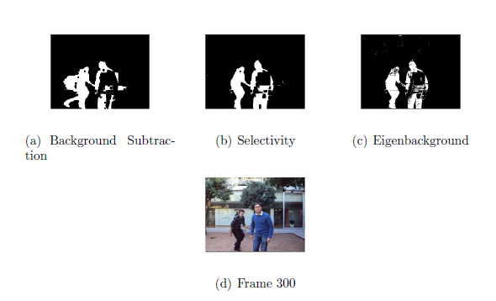
Tracking - Face Recognition
Introduction – Segmentation – Detection – Representation – Tracking – Conclusions

Slide 6
Tracking - Face Recognition
Introduction – Segmentation – Detection – Representation – Tracking – Conclusions
Detection
Face Recognition
Face Detection
OpenCV
HaarCascade frontal face
PCA & SVM

Slide 7
Tracking - Face Recognition
Introduction – Segmentation – Detection – Representation – Tracking – Conclusions
Representation
Histogram
velocity

Slide 8
Tracking - Face Recognition
Introduction – Segmentation – Detection – Representation – Tracking – Conclusions
Tracking

Slide 9
Tracking - Face Recognition
Introduction – Segmentation – Detection – Representation – Tracking – Conclusions

