Slide 1
Tracking Face Recognition
Lluís-Pere de las Heras Caballero
Ahmed Mounir Gad
Mònica Piñol Naranjo

Slide 2
Tracking - Face Recognition
Index
Introduction
Segmentation
Detection
Representation
Tracking
Conclusions

Slide 3
Tracking - Face Recognition
Introduction – Segmentation – Detection – Representation – Tracking - Conclusions
Segmentation
Background Substractor
Selectivity
Detection
Face Recognition
Representation
Eigenbackground
Grey - World
Tracking
Face Detection
Velocity
Histograms
Blob Detection
Multiple targets

Slide 4
Tracking - Face Recognition
Introduction – Segmentation – Detection – Representation – Tracking – Conclusions
Segmentation
Background Substractor
Selectivity
Eigenbackground
Grey - World
Bi+1 = α*Fi + (1-α)*Bi
Bi+1(x,y) = α*Ft(x,y) + (1-α)*Bt(x,y) if Ft(x,y)is Background
Bi+1(x,y) = Bt(x,y) if Ft(x,y)is Foreground
PCA - First M eigenvectors
Grey-World to delete the illumination vary environment

Slide 5
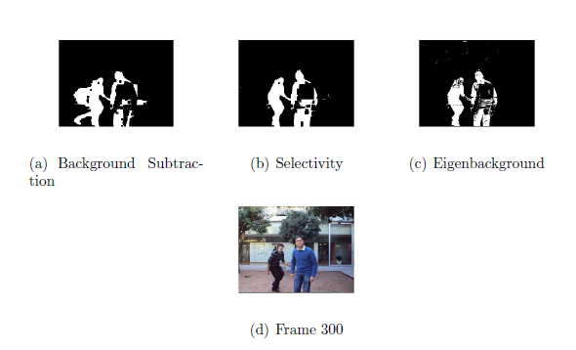
Tracking - Face Recognition
Introduction – Segmentation – Detection – Representation – Tracking – Conclusions

Slide 6
Tracking - Face Recognition
Introduction – Segmentation – Detection – Representation – Tracking – Conclusions
Detection
Face Recognition
Face Detection
Blob Detection
OpenCV
Viola-Jones frontal face
PCA & SVM

Slide 7
Tracking - Face Recognition
Introduction – Segmentation – Detection – Representation – Tracking – Conclusions
Representation
Velocity
Local Histogram
Multiple targets
Use centroid location in 2 consecutive frames
Color histogram
Correspondence problem
Match by name
Match by closest blob
Use tracking information
Use local histogram “Useless here”

Slide 8
Tracking - Face Recognition
Introduction – Segmentation – Detection – Representation – Tracking – Conclusions
Tracking

Slide 9
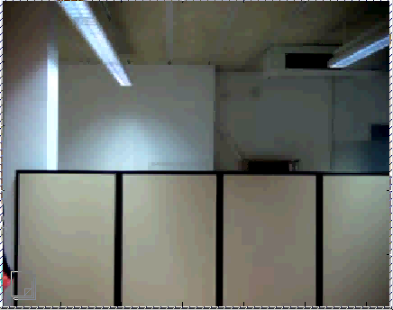
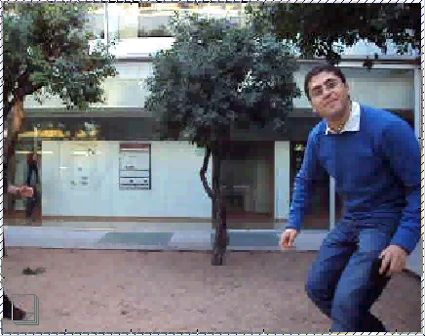
Tracking - Face Recognition
DEMO
Detection and solving correspondence problem
Recognizing and tracking multiple objects

Slide 10
Tracking - Face Recognition
Introduction – Segmentation – Detection – Representation – Tracking – Conclusions
Tracking is a VERY HARD problem.
Segmentation is strongly affected by external conditions like lighting conditions and camera quality.
Detection strongly depends on segmentation which may contain errors.
Representation depends on detection which may not be very accurate especially when the detector uses a classifier to recognize objects.
Tracking depends on representation and makes predictions that may be built on noisy measurements.

Slide 11
THANK YOU

