Slide 1
Tracking Face Recognition
Lluís-Pere de las Heras Caballero
Ahmed Mounir Gad
Mònica Piñol Naranjo

Slide 2
Tracking - Face Recognition
Index
Introduction
Segmentation
Detection
Representation
Tracking

Slide 3
Tracking - Face Recognition
Introduction – Segmentation – Detection – Representation – Tracking - Conclusions
Segmentation
Background Substractor
Selectivity
Detection
Face Recognition
Representation
Eigenbackground
Grey - World
Tracking

Slide 4
Tracking - Face Recognition
Introduction – Segmentation – Detection – Representation – Tracking – Conclusions
Segmentation
Background Substractor
Selectivity
Eigenbackground
Grey - World
Fi+1 = | Ii – Bi |
Bi+1(x,y) = α*Ft(x,y) + (1-α)*Bt(x,y) ifFt(x,y)is Background
Bi+1(x,y) = Bt(x,y) ifFt(x,y)is Foreground
First M eigenvectors

Slide 5
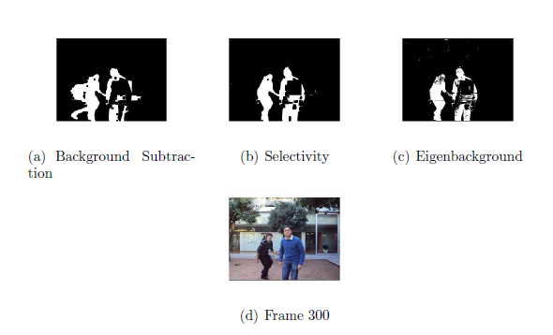
Tracking - Face Recognition
Introduction – Segmentation – Detection – Representation – Tracking – Conclusions

Slide 6
Tracking - Face Recognition
Introduction – Segmentation – Detection – Representation – Tracking – Conclusions

Slide 7
Tracking - Face Recognition
Introduction – Segmentation – Detection – Representation – Tracking – Conclusions

Slide 8
Tracking - Face Recognition
Introduction – Segmentation – Detection – Representation – Tracking – Conclusions

Slide 9
Tracking - Face Recognition
Introduction – Segmentation – Detection – Representation – Tracking – Conclusions

