Slide 1
CDC NNDSS Weekly Surveillance Prototype
BigQuery curation + coverage gating → Tableau dashboard
Portfolio Project/Resume March 2026
Anthony Mounts, MPH, MS OSH

Slide 2
Executive Summary
Built a CDC NNDSS weekly surveillance prototype (BigQuery pipeline + Tableau dashboard).
Fixed mixed-grain geography: restricted to U.S. states + Washington, D.C.; added trend eligibility metrics (trend mode, weeks observed, reporting recency).
Delivered two views: (A) weekly trend compared with other states’ average, (B) latest-week map with coverage/validity flags.
Recommendation: interpret direction using a 4-week moving average; separate a trend watchlist from a data-quality review queue for spikes/drops.

Slide 3
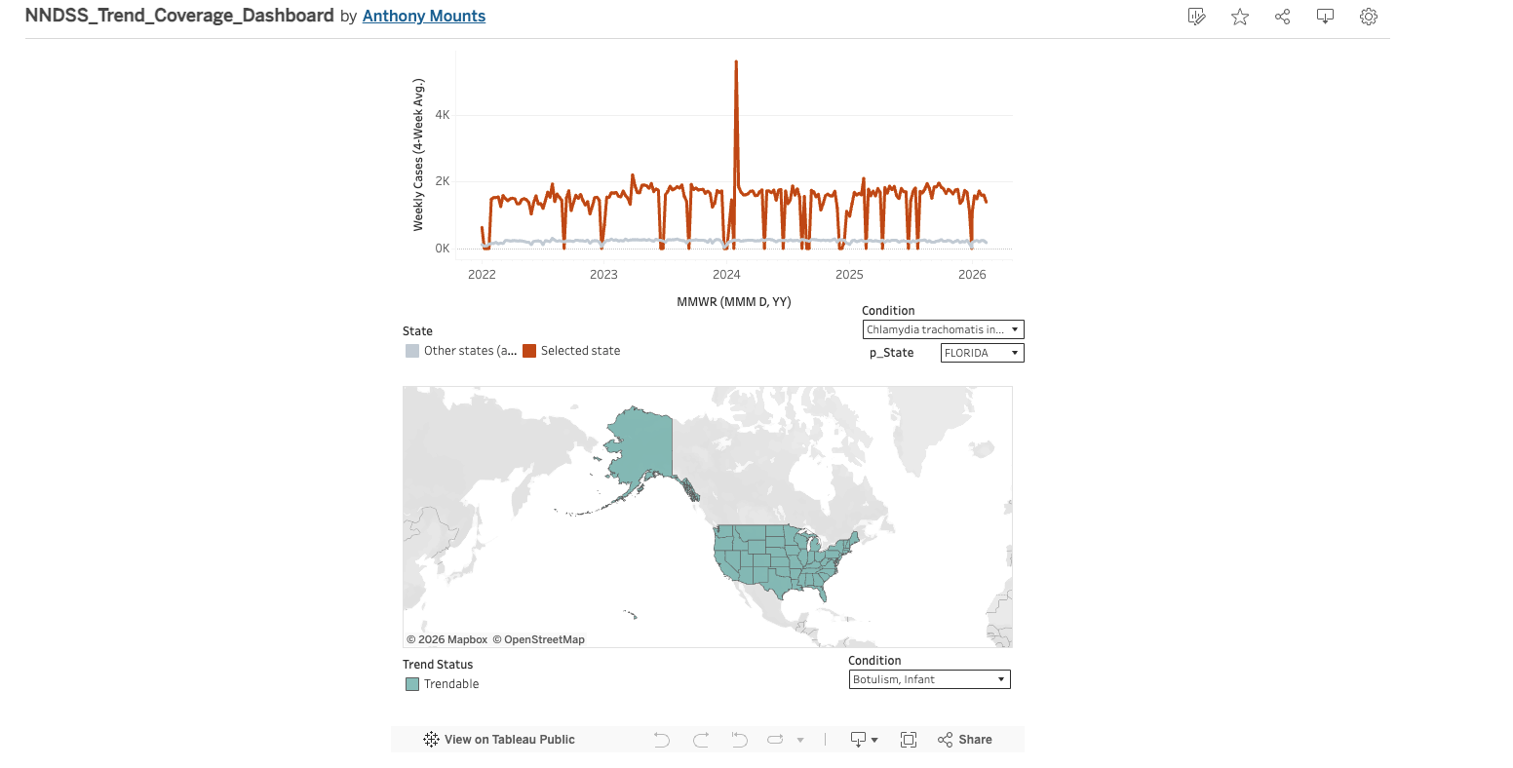
Dashboard Overview
Tableau Public: NNDSS_Trend_Coverage_Dashboard

Slide 4
Q1 — What is happening over time?
Weekly counts are noisy; direction is interpretable via a 4-week moving average.
Delivered a weekly time series at MMWR week grain.
Compared selected state vs other states’ average for context.
Primary interpretation rule: used a 4-week moving average, not single-week jumps.

Slide 5
Q2 — Where is burden highest right now?
State-only geography eliminates rollup/territory contamination.
Raw “Reporting Area” is mixed grain (totals/regions/states/territories).
Curation enforces U.S. states + D.C. only, with canonical names.
Latest-week map is paired with coverage/validity flags to prevent misread trends.

Slide 6
Q3 — Context vs prior weeks/prior year
Net-change rankings are defensible; percent change requires baseline thresholds.
Trendability varies by state×condition; many series are insufficient.
Separate operational “trend watchlist” from “data-quality review queue” for spikes/drops.
Avoided percent-change rankings without a minimum baseline (small denominators inflate percent change).

Slide 7
Q4 — Condition drivers within a jurisdiction
Explain movement using condition-level driver decomposition (not narrative).
For a selected state, identify top conditions by latest-week burden and recent net change.
Use contribution metrics that handle mixed direction (positive-share or absolute-share).

Slide 8
Data Quality Controls
Trend conclusions are conditioned on coverage/recency gating.
current_week_0: structural zeros used for stable plotting.
Coverage metadata: last available week, weeks observed, weeks behind max.
trend_mode: historical (1y/3y), recent monitoring partial, or insufficient.

Slide 9
Deliverables
BigQuery tables:
tbl_nndss_state_fact (state × condition × week)
tbl_nndss_state_condition_coverage (state × condition gating)
tbl_tableau_export (single Tableau-ready export)
Tableau dashboard:
A — Trend (selected state vs other states average; 4-week MA)
B — Geography snapshot (latest week with coverage flags)

Slide 10
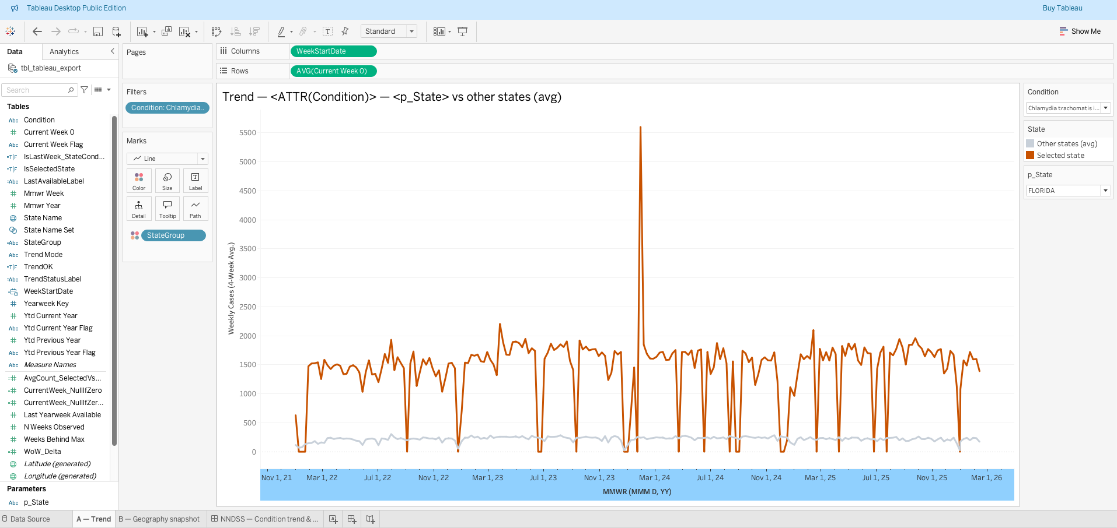
Appendix
Selected state vs other states (average)” (point to legend/colors)
Weekly time axis (MMWR week)” (point to x-axis)
4-week moving average used to interpret direction” (point to smoothing/line)

Slide 11
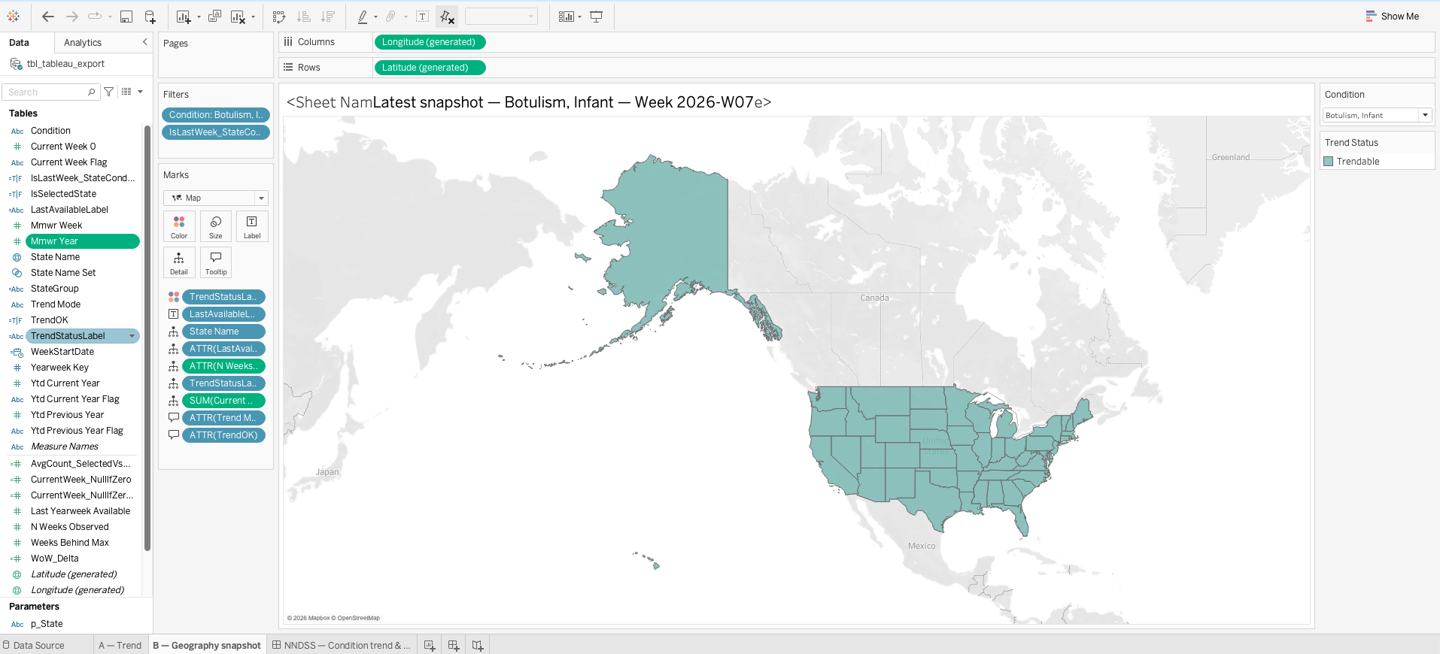
Appendix
Latest available week shown explicitly” (point to Last Available / Week)
Coverage gate: Trendable vs Insufficient coverage” (point to Trend Status/Mode)
Weeks observed (trend eligibility evidence)” (point to Weeks Observed)
“Interpret trends only when coverage is sufficient (see trend_mode).”

