Slide 1
Elektro
Software Development Challenge

Slide 2
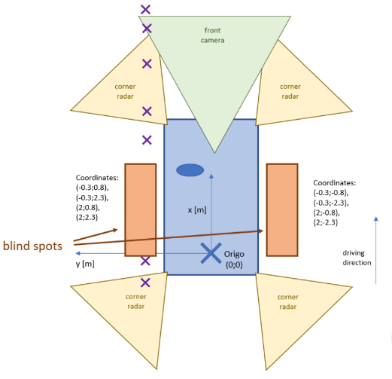
Part I : Object Tracking
World model layer.
Translating the data (Camera/Radars inputs) into visualizable, recognizable, trackable objects over time.
Different data, different sensors, same object. No Duplicates.

Slide 3
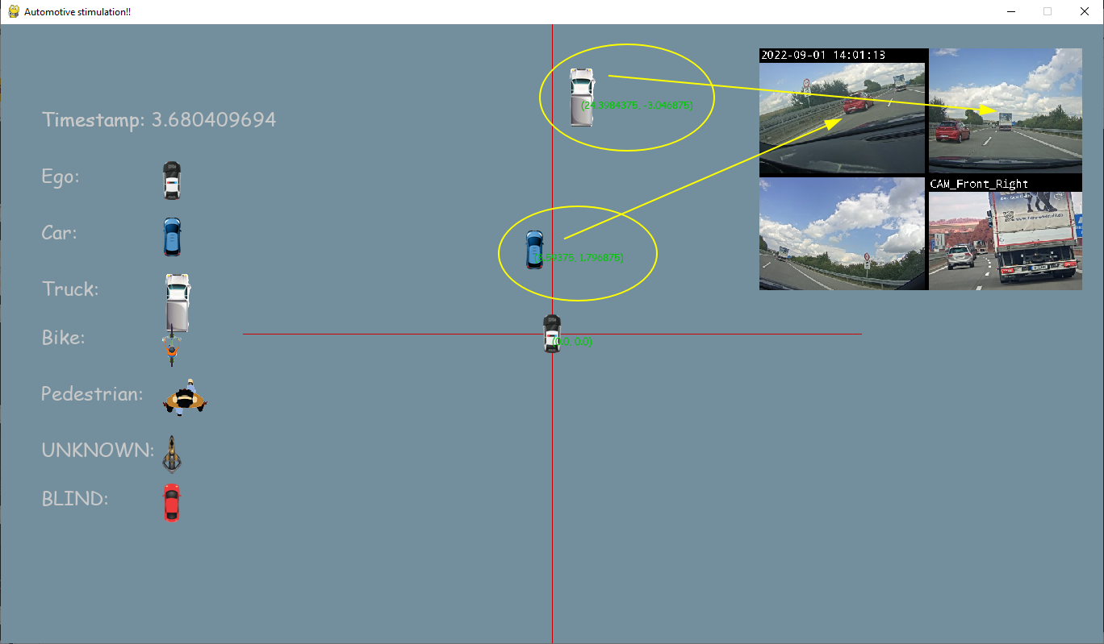
Part I : Object Tracking
Visualized with Python/PyGame/OpenCV.
The view is zoomed in to provide clearer visualization

Slide 4
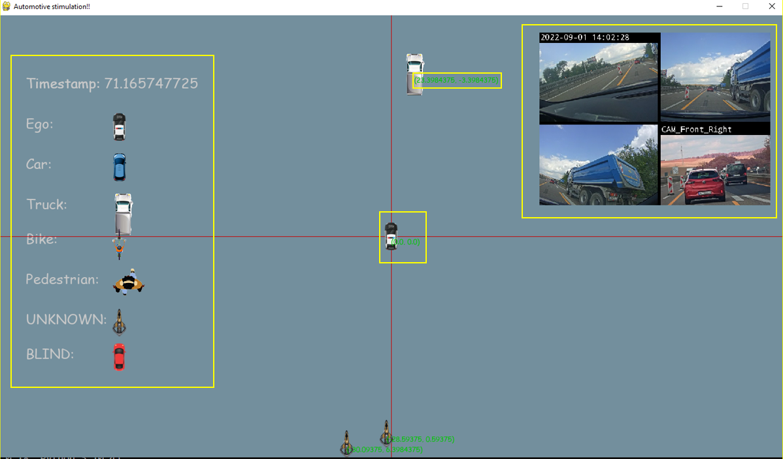
Part I : Object Tracking
Objects are generated from the data given by each sensor and radar
The synchronized front camera is shown to validate the simulation
Every object is shown with its shape and coordinates in relation to the host car

Slide 5
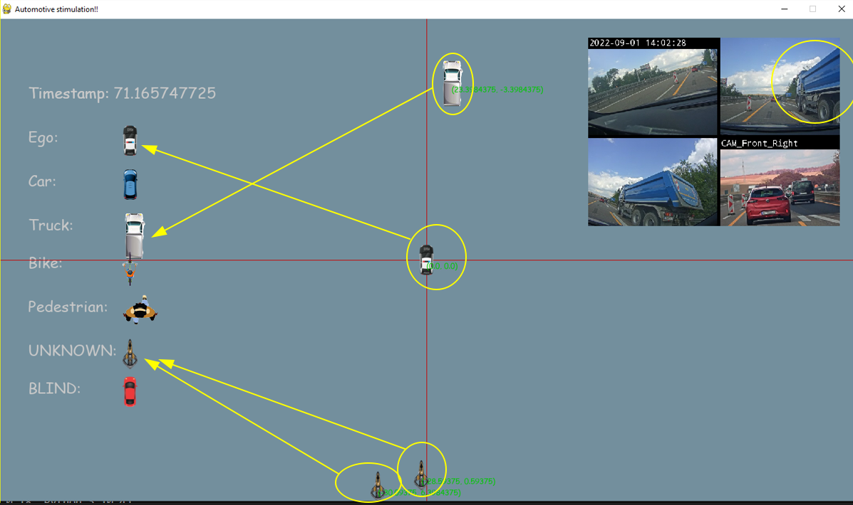
Part I : Object Tracking
Juxtaposing coordinates to eliminate redundancies.
Objects are compared with each other according to what they are.
Eg. trucks’ dimensions aren’t like cars

Slide 6
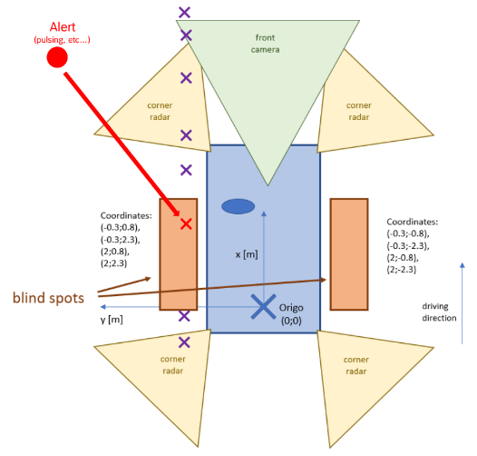
Part II : Blind Spot Detection
Function Layer.
The driver’s and the sensors’ incomplete FoV.
Alert the driver of a possible crash.
A car, a cyclist, a person, or a UFO.

Slide 7
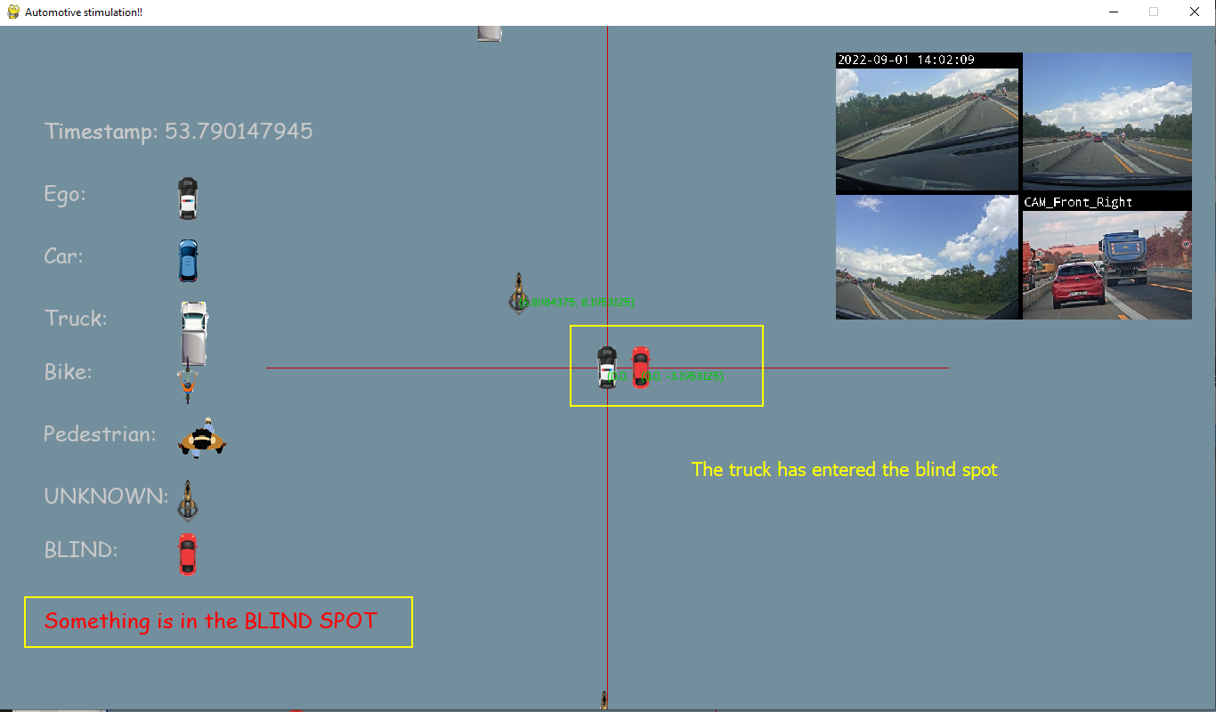
Part II : Blind Spot Detection
Estimated object in Ego’s red zone.

Slide 8
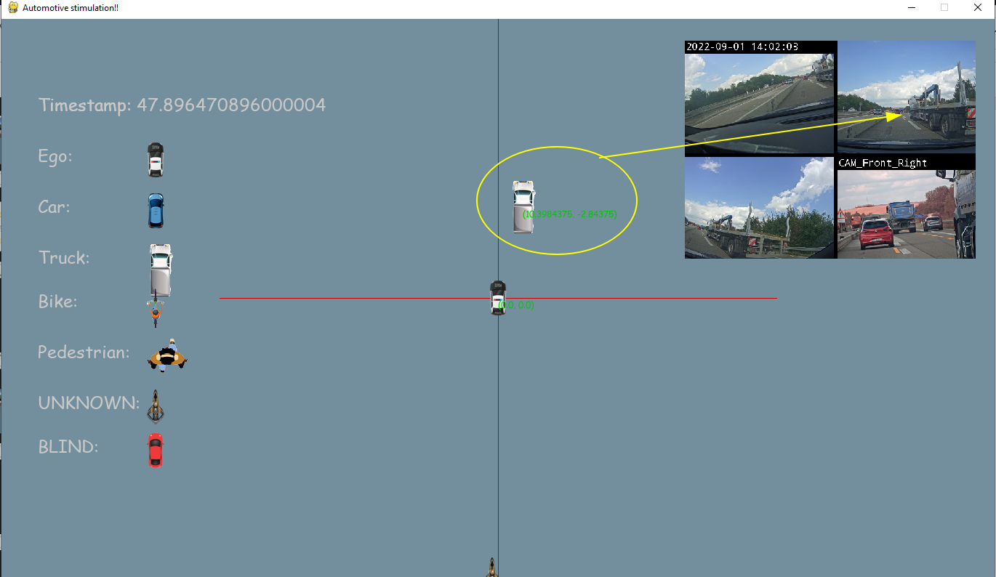
Part II : Blind Spot Detection
Using object tracking and estimation to fill the gaps.

Slide 9
Part II : Blind Spot Detection
Predicting an object’s position.
Each timestamp, current objects stored, duplicates removed, the rest added to the prediction list with new predicted values.
Next iteration, the values are compared, if they don’t match, either the object is too far or it’s in the blind spot. If they are in blind spot, the unmatched are stored in the prediction list and an alert is given.
If they match, duplicates removed, the rest in a unique list.
Draw the predicted list, predict the next values, repeat.

Slide 10
Part III : Further..
Detecting Driver Cognitive Alertness From Analysing Vehicle’s Lateral Motion Variations.

Slide 11
Drive Safely
Ahmed Elagami, Ahmed Mousa

