Slide 1


PyStager : General purpose parallel I/O & Pre/Post-Processing tool
Amirpasha Mozaffari, Martin Schultz | Earth System Data Exploration (ESDE)
2020.02.05 I ESM user forum I JSC

Slide 2








Data Staging
Necessity
Our I/O, pre/post – processing scripts

Slide 3





Data Staging
How to answer it ?
Exploit time – series hierarchical data structure
Written in easy & popular language compatible with HPC
Easy to use in compare to traditional MPI (mpi4py)
Easy to adopt to a working code

Slide 4
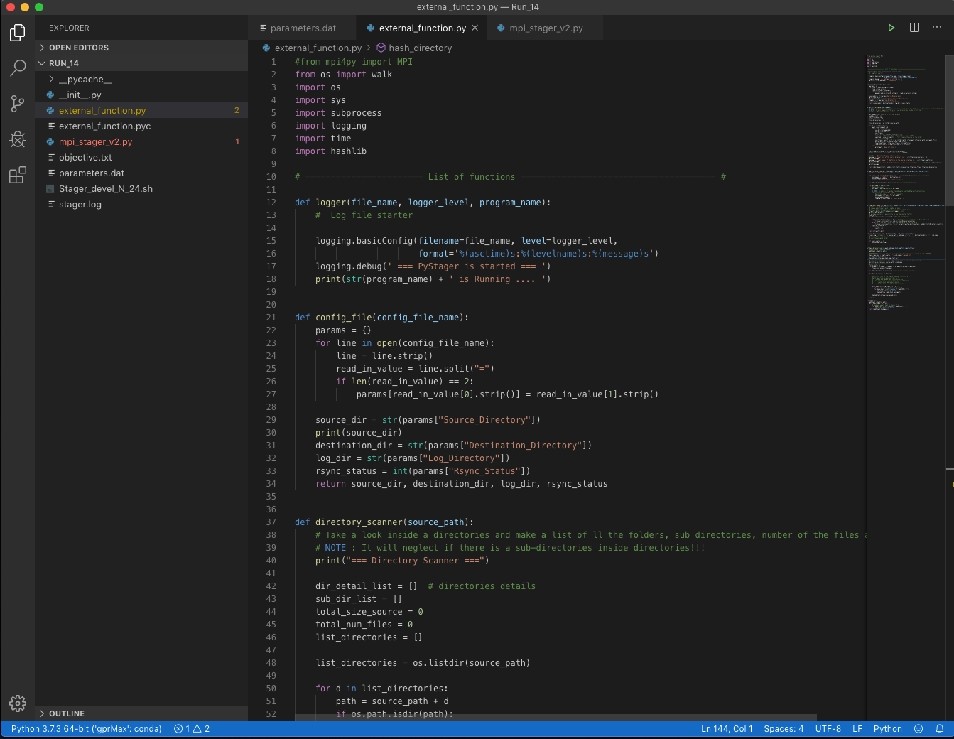


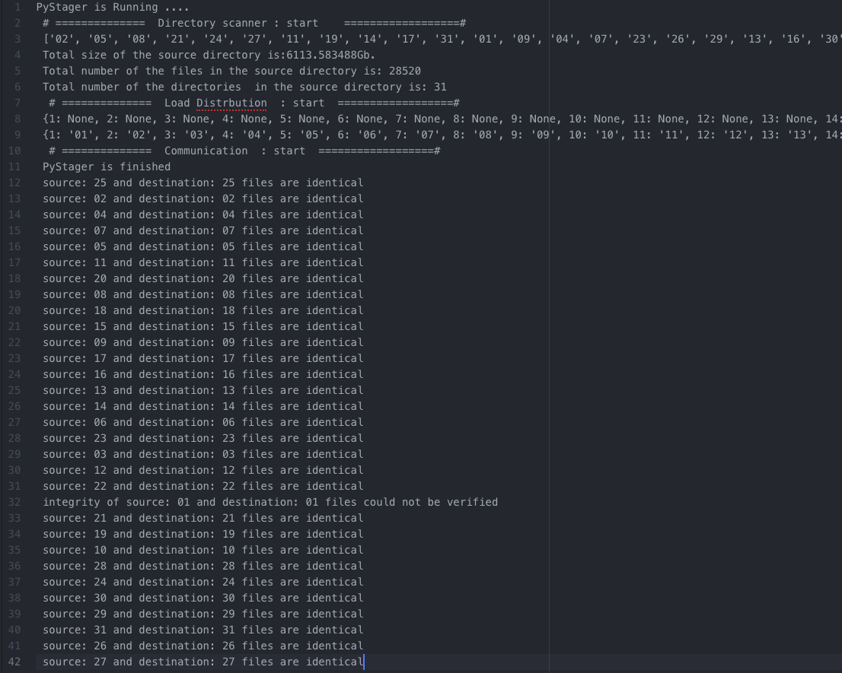
Data Staging
PyStager
General purpose parallel I/O and pre/post processing Written in Python (mpi4py)
rsync and checksum integrated
Logfile
http://bit.ly/PyStager1

Slide 5







Data Staging
PyStager : Folder Level
Communication 3
Sending confirmation
Communication 1
Staying open until getting conformation
Directory scanner
Scan the directory and build a data structure
Load distributor
Split the sub-dir based on available resources
.
.
.
.
Executing Jobs
Synchronization
Integrity check
Consolidate & Exit
Combine results
Close mpi and terminate
Communication 1
Send the job list to worker nodes and wait to get confirmation
Communication 2
Receiving the job lists

Slide 6

Data Staging
PyStager : Folder Level
Communication 3
Sending confirmation
Communication 1
Staying open until getting conformation
Directory scanner
Scan the directory and build a data structure
speed up depending on the directory hierarchy
Help to orchestrate a series of relatively small tasks
Load distributor
Split the sub-dir based on available resources
.
.
.
.
Executing Jobs
Synchronization
Integrity check
Consolidate & Exit
Combine results
Close mpi and terminate
Communication 1
Send the job list to worker nodes and wait to get confirmation
Communication 2
Receiving the job lists

Slide 7
Data Staging
PyStager : File Level
Communication 3
Sending confirmation
Communication 1
Staying open until getting conformation
Directory scanner
Scan the directory
Load distributor
Split the files based on available resources
.
.
.
.
Executing Jobs
Synchronization
Integrity check
Consolidate & Exit
Combine results
Close mpi and terminate
Communication 1
Send the job list to worker nodes and wait to get confirmation
Communication 2
Receiving the job lists

Slide 8
Data Staging
PyStager : File Level - – speedup
Communication 3
Sending confirmation
Communication 1
Staying open until getting conformation
Directory scanner
Scan the directory
Load distributor
Split the files based on available resources
.
.
.
.
Executing Jobs
Synchronization
Integrity check
Consolidate & Exit
Combine results
Close mpi and terminate
Communication 1
Send the job list to worker nodes and wait to get confirmation
Communication 2
Receiving the job lists

Slide 9




Data Staging
PyStager : Use Cases
Machine learning pre- processing
grb
netCDF
Data conversion
grb to netCDF4

Slide 10
Data Staging
PyStager : Use case 1 - Workflow, Parallelization
Courtesy of Bing Gong
Code: http://bit.ly/Workflow_Parallel_PredNet
Seite 10

Slide 11

Data Staging
PyStager : What is next
Multiple file simultaneous access and process
Breakdown of singe file into multiple smaller pieces
Granular asymmetrical dispatching system
Generating performance metrics on air for further use

Slide 12

Data Staging
PyStager : New use case ?
Interested in trying it?
We are happy to support you!

