Slide 1
Medical Image Classification using Deep Learning
Presented by
Tanmoy Tapos Datta
Roll - 1307006
&
Arunima Mandal
Roll - 1307018
Supervised by
Dr. Pintu Chandra Shill
Professor Department of Computer Science and Engineering, Khulna University of Engineering & Technology Khulna, Bangladesh.

Slide 2
Outline
Problem statement
Motivation
What is PCA
What is PCANet
Why PCANet ?
Medical Image Classification Using PCANet
Implementation
Simulated Result
Limitation
Future Work
Summary

Slide 3
Problem Statement

Slide 4
Problem Statement
Image classification based on visual content is a very challenging task.
Large amount of intra-class variability, arising from-
Different lighting conditions
Misalignment
Occlusion and corruptions.

Slide 5
Motivation

Slide 6
Motivation
Two simple goals:
To design a simple deep learning network.
Such a basic network could serve as a good baseline for more advanced processing components of deep
learning networks.

Slide 7
What is PCA ?

Slide 8
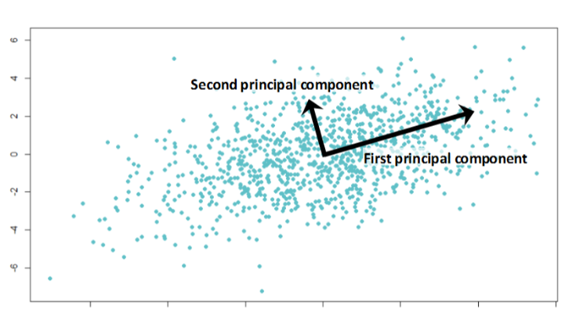
PCA
A statistical procedure that uses an orthogonal transformation to convert a set of observations of possibly correlated variables into a set of values of linearly uncorrelated variables called principal components.
Useful for eliminating dimensions.
Figure: PCA

Slide 9
What is PCANet ?

Slide 10
PCANet
A novel deep learning algorithm for feature learning.
The PCA is employed to learn multistage filter banks.
This is followed by simple binary hashing and block histograms for indexing and pooling.
This architecture is thus called the PCA network or PCANet.

Slide 11
Difference between PCANet and regular neural network
3 major differences from the most fashionable deep Neural Network techniques these days are:
PCANet does not use back propagation for training.
PCANet is trained by stacking. The layers are not trained jointly.
The layers are trained unsupervised.
11

Slide 12
Why PCANet

Slide 13
Why PCANet
Usual DL algorithms:
Parameter tuning
Time-costing
Need of much expertise knowledge

Slide 14
Why PCANet (2)
On the other hand, PCANet:
Consists of only three simple basic components.
Very simple with few parameters.
Competitive and even better performance for image classification compared with other DL algorithms.

Slide 15
Medical Image Classification Using PCANet

Slide 16
Working Procedure
In medical science PCANet has not been used widely so far.
In our work, we used a method to use PCANet for image classification that is based on very basic data processing components:
Kernel Generation using PCA
Hashing and Histogram
Classification using SVM

Slide 17
PCANet stages
Figure: Illustration of how PCANet extracts features from an image through the
three simplest processing components: PCA filters, binary hashing, and histograms.

Slide 18
PCANet stages (2)
Figure: A detailed block diagram of the two-stage PCANet

Slide 19
Implementation

Slide 20
Dataset
Breast histology images of size 50 x 50
Goal: To classify cancerous images (IDC : invasive ductal
carcinoma) vs. non-IDC images.
Figure: Class 0 (non-invasive ductal
carcinoma) image dataset.
Figure: Class 1 (invasive ductal
carcinoma) image dataset.

Slide 21
Training PCANet model with train dataset
Figure: Training PCANet model

Slide 22
Taking PCANet output corresponding to train dataset
Figure: Taking PCANet output corresponding to train dataset

Slide 23
Training SVM for Classification purpose
Figure: Training SVM for Classification purpose

Slide 24
Predicting results from SVM trained model
Figure: Predicting results from SVM trained model

Slide 25
Overall Prediction step
Figure: Overall Prediction step

Slide 26
Simulated Result

Slide 27
Result
12,000 random images to train PCANet and SVM.
4,474 images was checked as test data corresponding to the train dataset.
We get about 82% accuracy.
We have simulated the result for small dataset because of computation limitation. If it can be simulated for large dataset, then the accuracy result will be better.

Slide 28
Accuracy Curve
Figure: Accuracy curve over all the test dataset

Slide 29
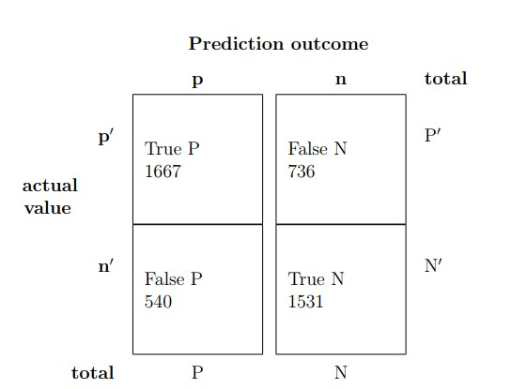
Confusion Matrix
Figure: Confusion Matrix

Slide 30
Limitation

Slide 31
Limitation
It is tested over only grey-scale images not original color images.
Traditional PCANet works good for classifying structured objects from images. It’s performance degrades when it is tested with abstract images.

Slide 32
Future Work

Slide 33
Future Work
We will try to modify the architecture of PCANet so make it better suited for classifying abstract images.
Due to limited computational resources we couldn’t make more deep architecture of this model. In future, we will try to implement more hidden layers and check the performance of the model.

Slide 34
Summary

Slide 35
Summary
Because the PCANet consists of only a (cascaded) linear map followed by binary hashing and block histograms, it is amenable to mathematical analysis and justification of its effectiveness.
There are unlimited opportunities to improve healthcare
system.

Slide 36
References
[1] T. H. Chan, K. Jia, S. Gao, J. Lu, Z. Zeng and Y. Ma, “PCANet: A Simple Deep Learning Baseline for Image Classification”, IEEE Transaction on Image Processing, vol. 24, issue. 12, pp. 5017-5033, 2015.
[2] G. E. Hinton, S. Osindero, and Y.-W. Teh, "A fast learning algorithm for deep belief nets,"Neural Computing, vol. 18, no. 7, pp. 1527-1554, 2006.
[3] Y. Bengio, A. Courville, and P. Vincent, “Representation learning: A review and new perspectives," IEEE Transaction Pattern Analysis, vol. 35, issue. 8, pp. 1798-1828, Aug. 2013.
[4] I. J. Goodfellow, D. Warde-Farley, M. Mirza, A. Courville, and Y. Bengio, \Maxout networks," in Proc. 30th ICML, pp. 1-9, 2013.
And more…

Slide 37
Thank You

Slide 38

Any Question

