Slide 1
Covid-19’s Impact on Global Trade
V-Shaped Recovery
Team
1. Harsha Vardhan Reddy
2. Heamesh Choudhary Nettem
3. Sajeev Singh
4. Ajinkya Phanse

Slide 2
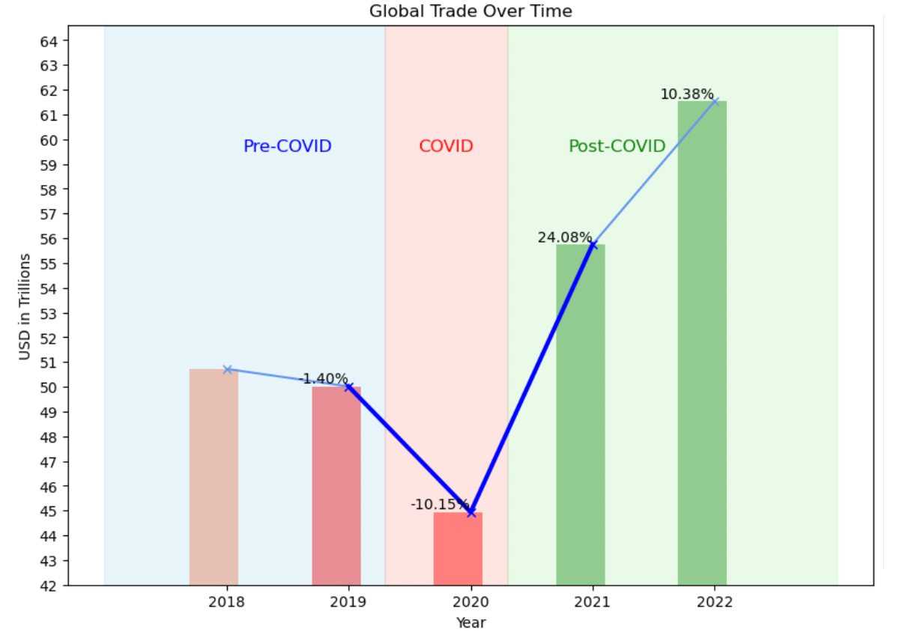
Global Trade
Covid’s Impact
Impact on Economy, Global Trade, ,Health, personal lives….
Profound Effect
2-3% change in global trade is huge.
Time Period
Only 2020!
V-Shaped Trend
2019-2020 -> 10% decline
2020-2021 -> 24% Increased

Slide 3
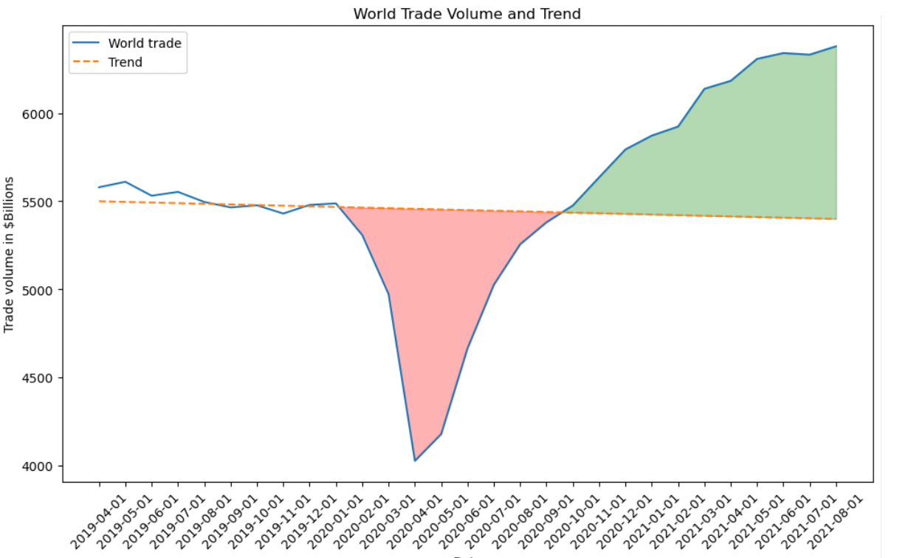

V-Shaped Trend
Why? (Limited Reasoning)
From Restocking warehouses
Change in User patterns
Countries Policies
Analysis
1. Agri & Food trade
2. Crude Oil
3. Tourism
4. Medical Supplies
5. IT Services

Slide 4
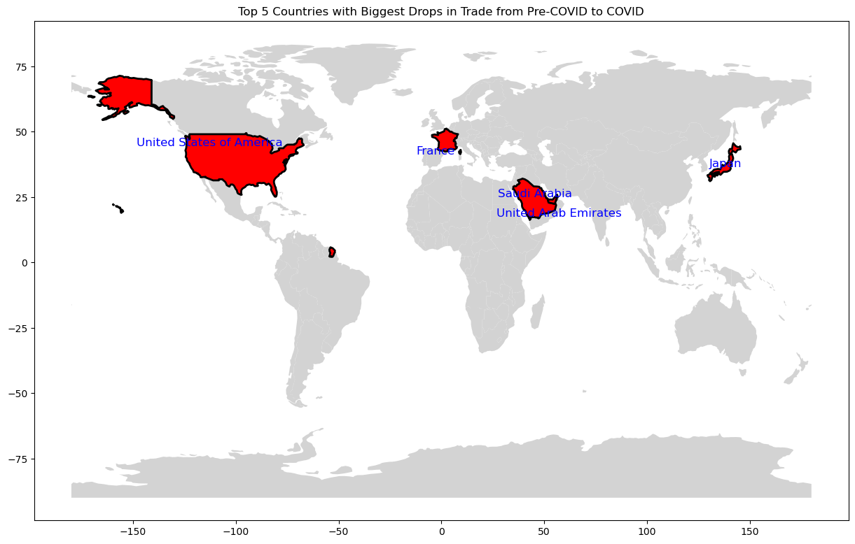

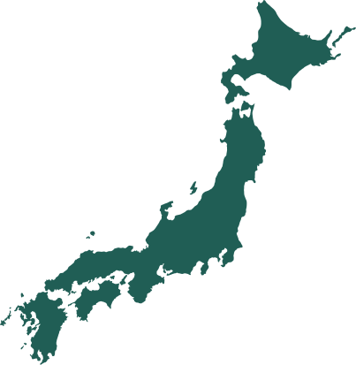



Negative Impact
1. Saudi Arabia
2. United Arab Emirates
3. Japan
4. United States
5. France

Slide 5
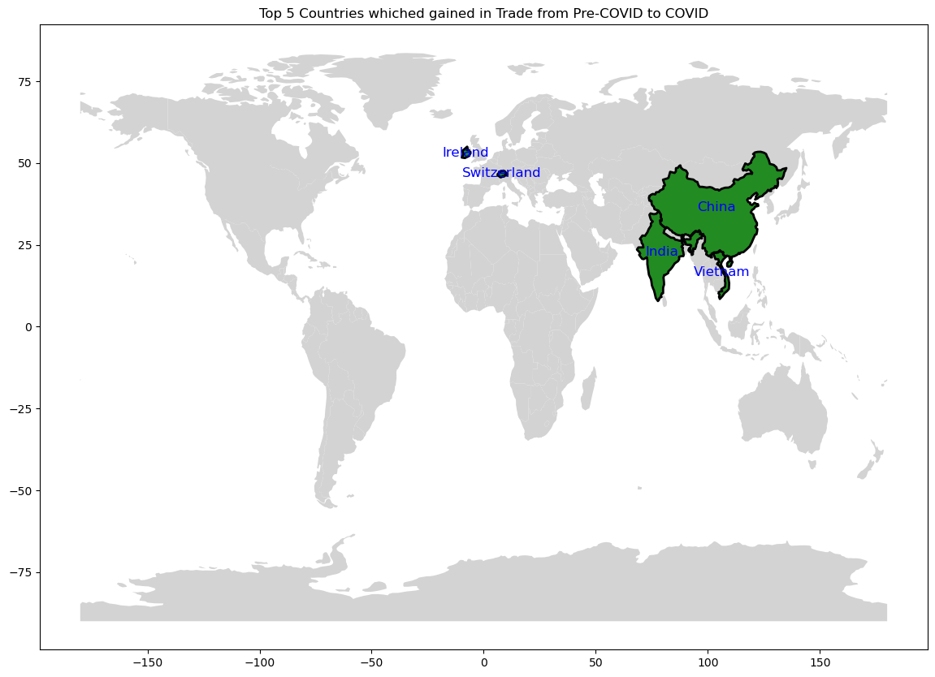




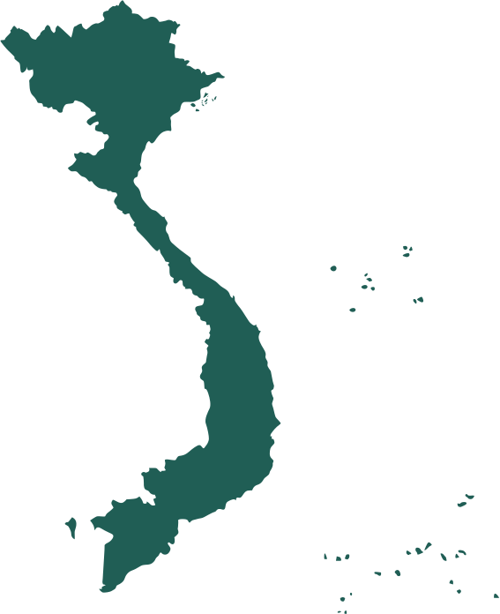
Positive Impact
1. China
2. India
3. Vietnam
4. Ireland
5. Switzerland

Slide 6
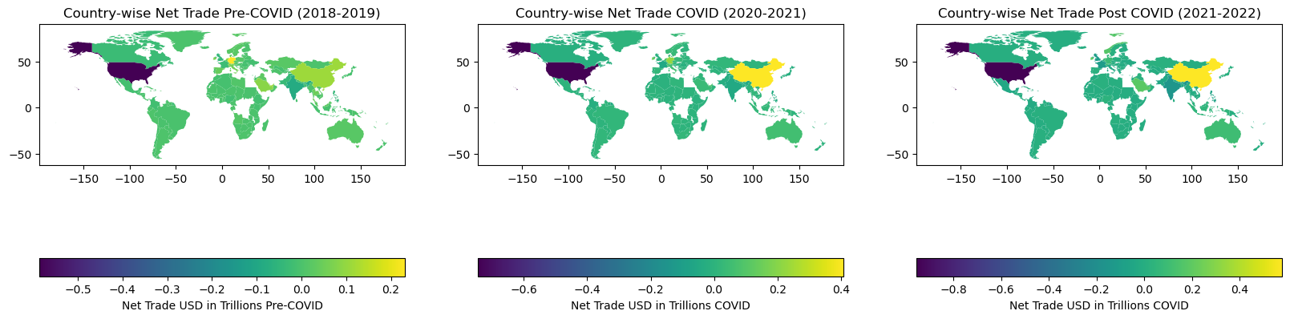
COUNTRY WISE

Slide 7
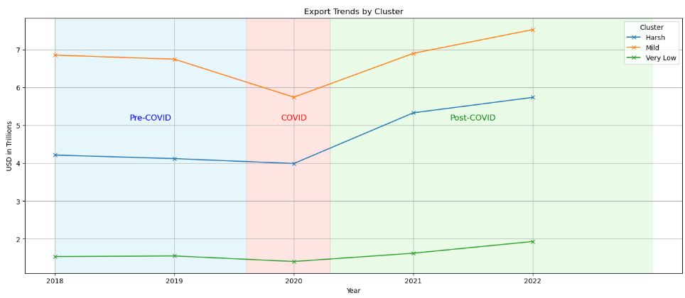
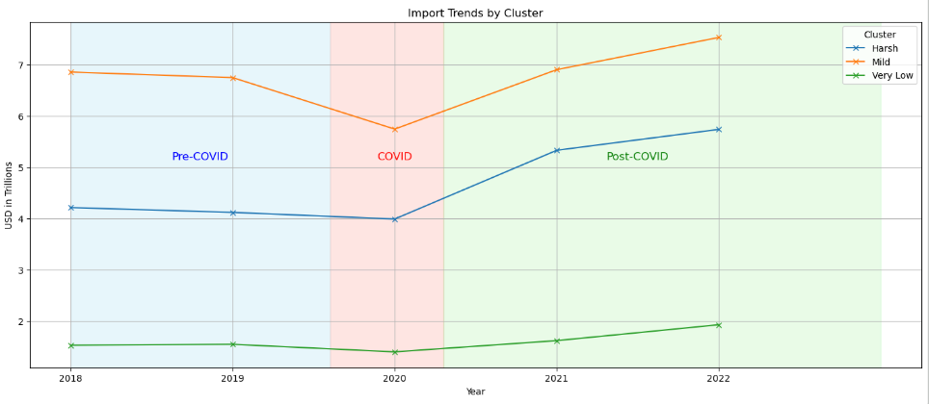
Countries Clustered
(Based on Countries Covid Policies)
Harsh Policy
“China", "India", "Russian Federation", "Iran"
Mild Policy
“United States", "United Kingdom", "France", "Italy", "Canada", "Japan", "Saudi Arabia", "Kuwait"
Very Mild (or No) Policy
"Qatar", "United Arab Emirates", "Australia", "Switzerland", "New Zealand"

Slide 8
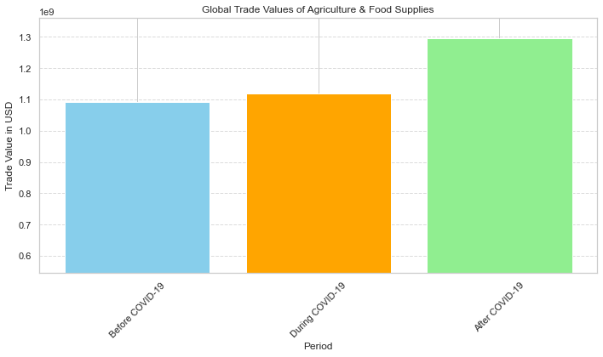
Agriculture & Food
Impact
\
No major impact of Covid
Trend
Slight increase during covid.
And significant increase after covid
Conclusions
Since it is a necessary commodity the trade of Agri products didn’t stop.
Only Reallocation happened..

Slide 9
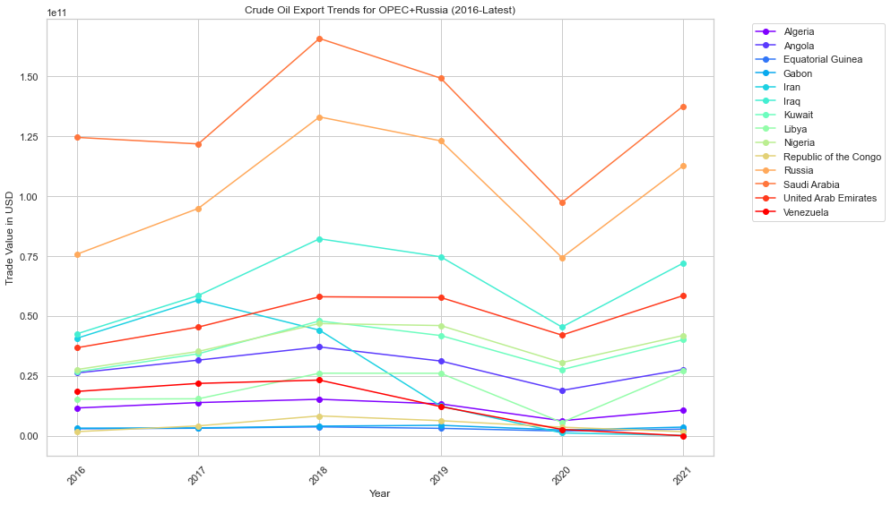
Crude Oil
Countries
OPEC+Russia
Impact
Significant Impact.
Trend
There is a significant dip during covid and recovered to pre covid levels
Conclusion
As Expected there is a huge dip and later balance of trade is not recovered

Slide 10
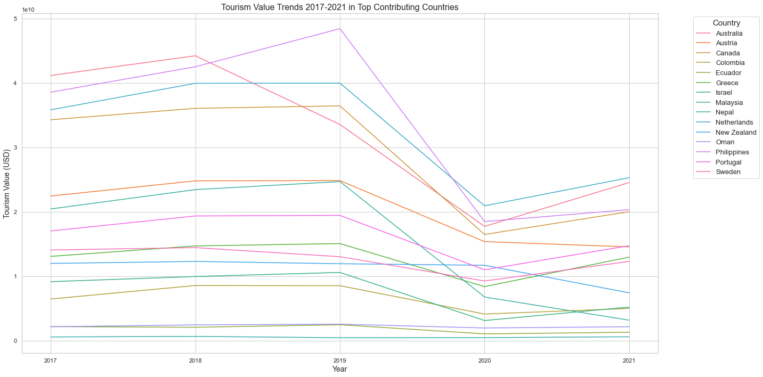
Tourism
Impact
Significant Impact
Trend
Significant drop as expected and didn’t recover to pre-covid levels.
Counter
What did the countries do to counter
A good example would be Europe
How
The countered the deficit from Agro, Medical and IT exports.

Slide 11
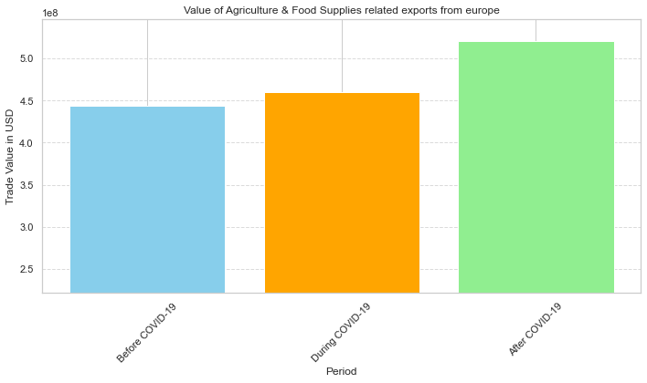
Agri Exports of Europe
Cont..
We can see that the agri exports of europe has increased in value during and after covid
Others?
Some countries which are too dependent on tourism and didn’t adapt had struggled to recover like Sri lanka, Maldives, etc..

Slide 12
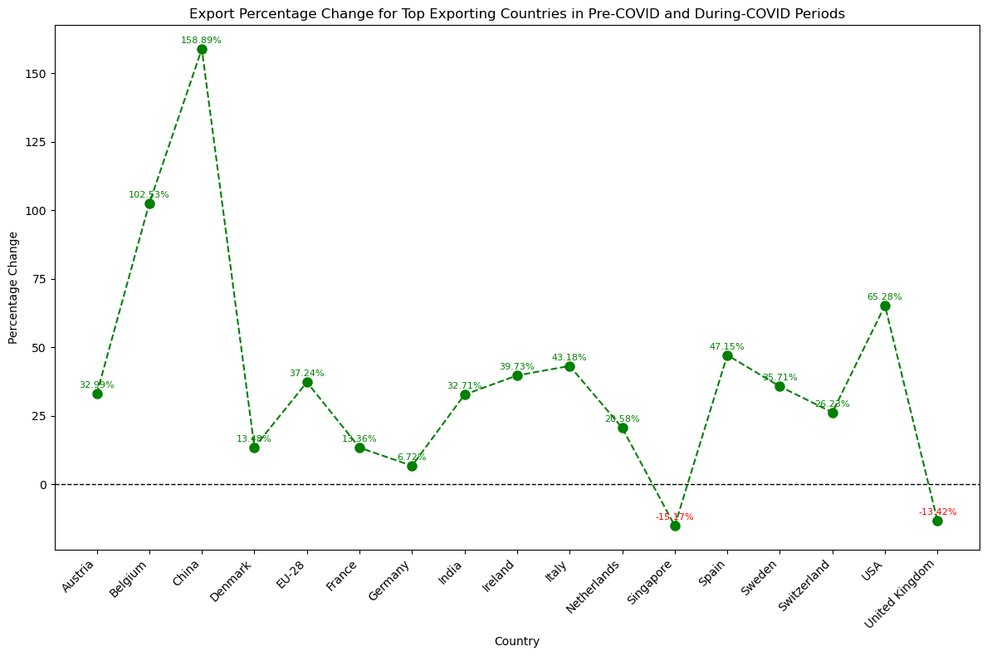
Medical Essentials
Countries
China, Europe, USA and other countries
Trend
Noticeable increasing trend for countries with good medical exports
Noteworthy Trend
High percentage increase for China Belgium
Noteworthy Trend
USA being in top exporters list saw overall negative % change during covid

Slide 13
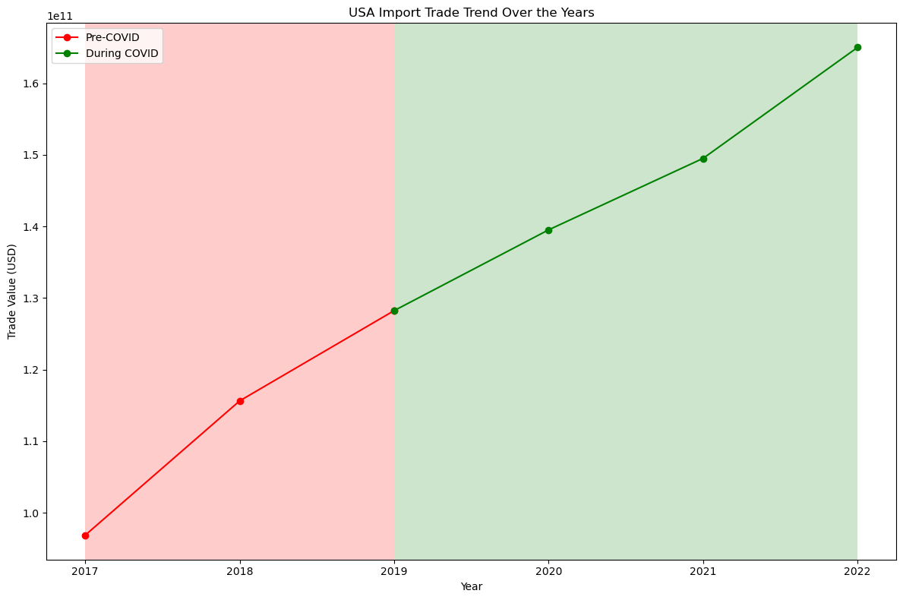



USA- Trend
Context
USA saw a substantial negative percentage change in exports.
Trend
Approximately linear increase in import values from 2019
Reason ?
Supply chain disruption
Surge in demand of medical supplies
Conclusion
USA saw a substantial increase in imports from years 2017-2022

Slide 14
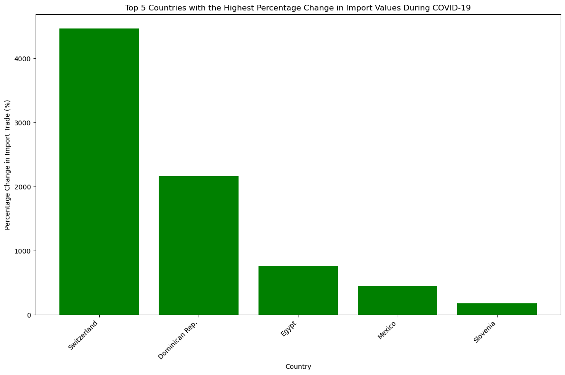
Medical Essentials
Trend
Top 5 countries with highest percentage change in imports
Reason
increase in demand for medical supplies during covid.
Conclusion
Countries with strong medical supplies saw an increase in exports except (USA and Singapore)

Slide 15
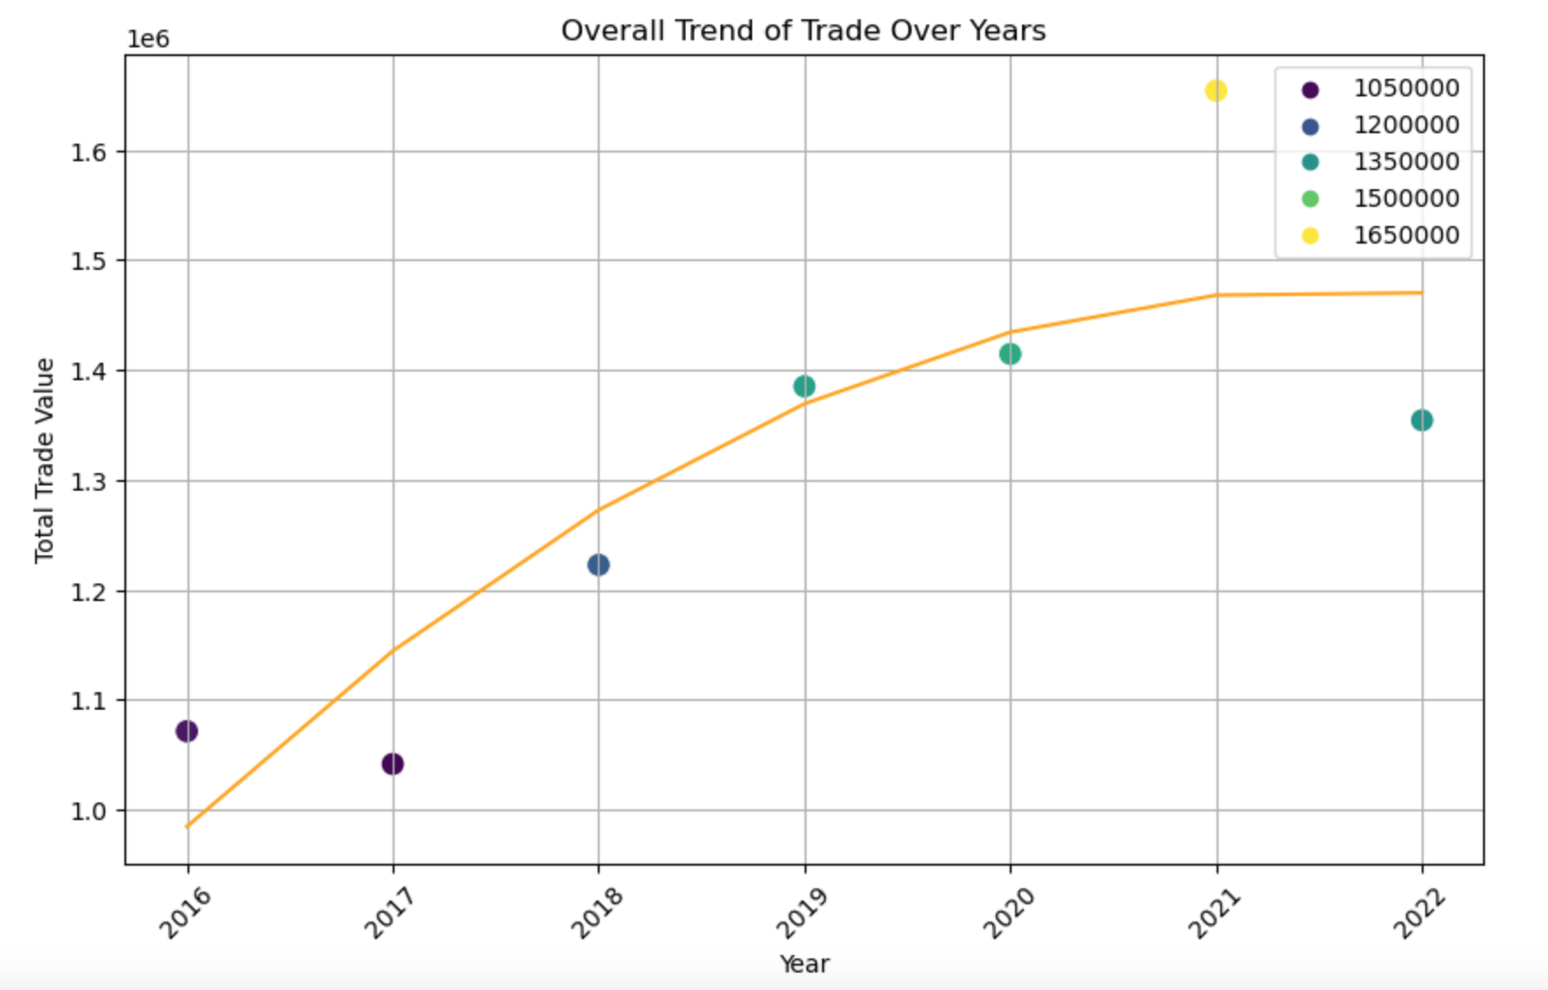
IT Industry Trend
Objective
Find Impact of COVID-19 on IT Industry Trends Across Major Global Economies
Dataset
Contains trade values of all the countries from 2016 to 2022
Analysis
Plot depicts overall trend of IT trades over years 2016 to 2022
Conclusion
The IT Industry experienced a major boom in trade values due to COVID.

Slide 16
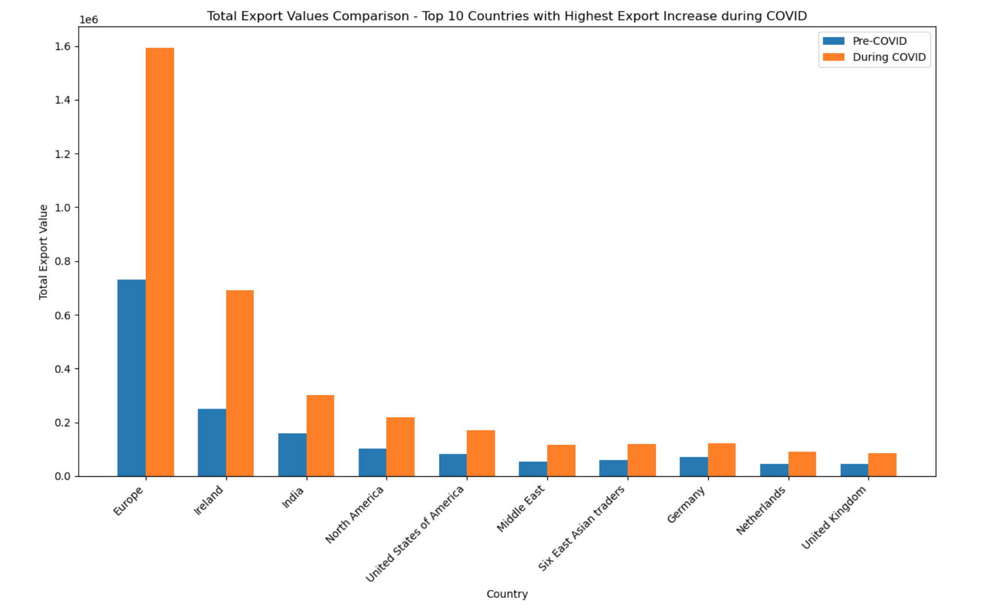
Top Gainers
Objective
Find countries that gained the most due to the impact of COVID on IT trade
Dataset
Contains trade values of all the countries from 2016 to 2022
Analysis
Plot depicts top 10 major gainers and their increase in trade
Conclusion
While some economies did not fare well due to poor IT infrastructure, many gained a lot

Slide 17
Conclusion
Thank you

