Slide 1

Comprehensive Survival Analysis of Breast Cancer: Insights and Prognostic Modelling
Team Members :
Ajinkya Phanse
Sajeev Singh
Heamesh Choudary

Slide 2

Abstract
This project involved an in-depth analysis of breast cancer data to discern key factors impacting patient outcomes. Utilizing Python and relevant libraries, we conducted exploratory data analysis to understand the dataset's structure and characteristics. We pre-processed the data, handling categorical variables, and prepared it for survival analysis. Employing Kaplan-Meier curves and Cox Proportional Hazards models, we explored the relationship between various patient attributes and survival rates. Additionally, we implemented machine learning models, including Gradient Boosting, to predict survival probabilities. This comprehensive approach aimed to uncover insights into breast cancer prognosis, facilitating informed decision-making in clinical settings.

Slide 3

Introduction
The project aims to analyse breast cancer data to understand factors influencing patient survival. The dataset contains information on various clinical features such as age, tumor size, and cancer grade, along with patient demographics. The primary focus is on predicting patient survival based on these factors. Initial exploratory data analysis (EDA) reveals insights into the distribution of patient age, tumor size, and survival months. Furthermore, Kaplan-Meier survival curves are plotted to visualize overall survival probabilities. The dataset is pre-processed to handle categorical variables, and Cox proportional hazards and gradient boosting models are trained to predict survival. The trained models are evaluated using concordance index (C-index), and survival functions are plotted to visualize the predicted survival probabilities over time. Overall, the project aims to provide insights into breast cancer prognosis and improve survival prediction accuracy.

Slide 4

Materials & Methods
Data Collection & Preprocessing: Breast cancer patient data was obtained from the "Breast_cancer.csv" file. The dataset contained 4024 samples and 16 features. Initial exploration of the dataset included examining its shape and the first few rows to understand the structure and content.
Exploratory Data Analysis (EDA): The distribution of key variables such as age, tumour size, and survival months was visualized using histograms and count plots. Insights from EDA included observations on the distribution of age, tumour size, count of patient statuses (alive or dead), and survival months.
Survival Analysis: Kaplan-Meier survival curves were generated to visualize overall survival probability. A manual cumulative incidence function was implemented to observe the cumulative incidence of death over survival months. Kaplan-Meier survival curves were stratified by the grade of cancer cells to assess survival probabilities across different grades.

Slide 5

Materials & Methods(contd…)
Gradient Boosting Survival Analysis: A Gradient Boosting Survival Analysis model was implemented using the Gradient Boosting Survival Analysis class from the sksurv.ensemble module. Categorical variables were one-hot encoded, and the dataset was split into training and testing sets.
Modelling: Categorical features were one-hot encoded, dataset split into train/test sets, Cox Proportional Hazards and Gradient Boosting Survival Analysis models trained using lifelines and sksurv, respectively, with performance evaluated via Concordance Index
Visualization of Predicted Survival Functions: Predicted survival functions from both the Cox model and the GBM model were visualized. Survival probability over time was plotted for a subset of samples from each model to compare their predictions.

Slide 6

Materials & Methods(contd…)
Software and Libraries: The analysis was performed using Python programming language, with libraries such as pandas, seaborn, matplotlib, lifelines, and scikit-survival.

Slide 7
Results
Dataset Overview:
The project utilizes a dataset comprising 4024 instances with 16 features.
Features include demographic data, cancer stage, differentiation grade, tumor characteristics, hormone receptor status, and survival outcome.
Exploratory Data Analysis (EDA):
Analysis of age distribution reveals a peak between 45 to 62 years.
Tumor size distribution shows a skewed pattern, with most cases falling within the range of 0 to 20.
The count of patients by survival status indicates a predominance of 'Alive' cases (3400) compared to 'Dead' cases (600)

Slide 8
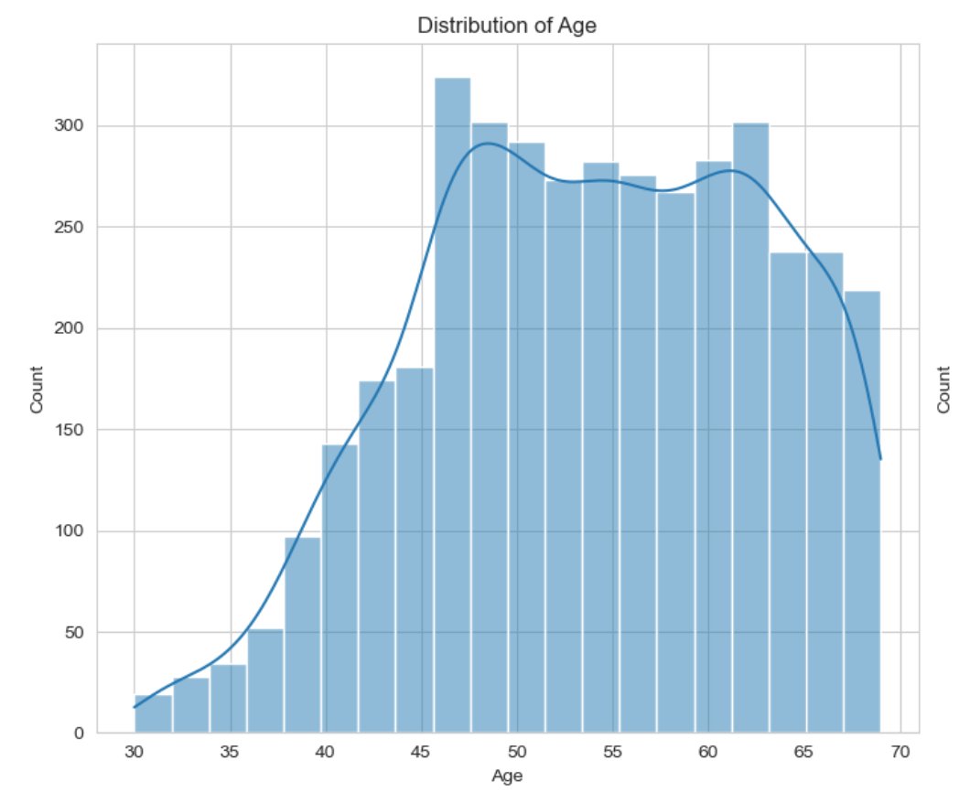
Results(Graphical Insights)
Age Distribution: The graph illustrates the distribution of ages within the dataset, indicating the frequency or count of individuals across different age ranges.
Peak Count: Between the age ranges of 30 to 45, there is a notable increase in the count of individuals, reaching a peak count of 275. This suggests that a significant proportion of the study population falls within this age range, indicating a higher prevalence or concentration of individuals in this demographic segment.
Stable Count: From approximately age 45 to 62, the count remains relatively stable at 275. This plateau in the count indicates that the number of individuals within this age range remains consistent or does not exhibit significant fluctuations. It suggests a relatively steady distribution of individuals across these age groups.
Decrease in Count: Beyond age 62 and up to 70, there is a gradual decrease in the count of individuals, declining from 275 to 175. This decline indicates a reduction in the frequency of individuals within this older age range, suggesting a lower prevalence or proportion of individuals in the dataset as age advances beyond 62 years.
Age Profile: The distribution of age highlights the age profile of the study population, revealing the age ranges with the highest concentration of individuals and any notable shifts or trends in age distribution across different segments of the population.

Slide 9
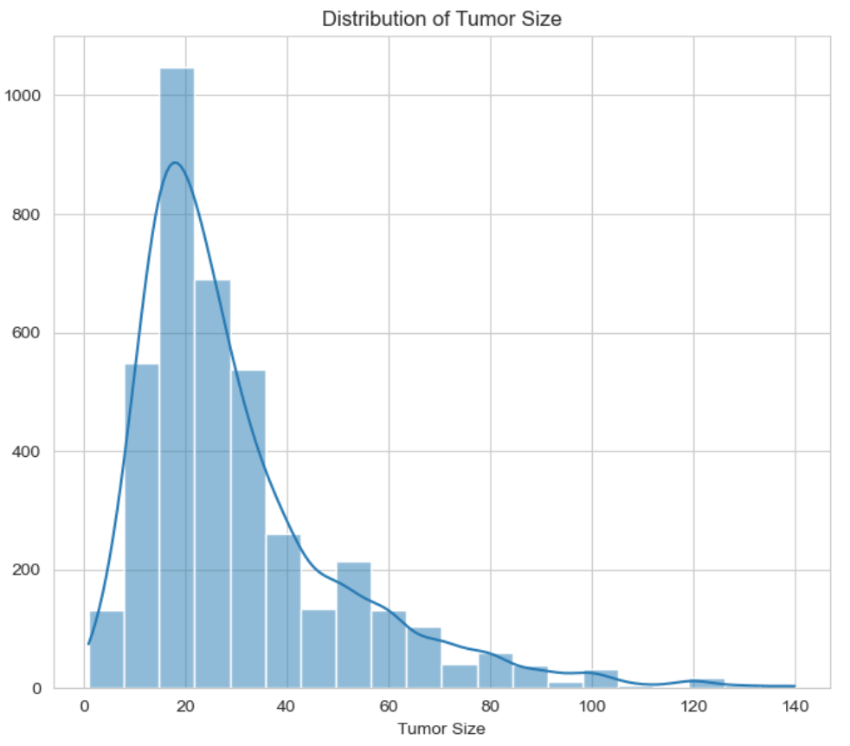
Results(Graphical Insights)
Bimodal Distribution: The graph exhibits a bimodal distribution, indicating that tumor sizes within the dataset are concentrated around two distinct peaks or modes. This suggests the presence of two prevalent subgroups or categories of tumor sizes within the studied population.
Primary Peaks: The first peak, observed within the tumor size range of 0 to 20, corresponds to a substantial count of tumors within this size range. This indicates a significant proportion of tumors with smaller sizes, potentially representing early-stage or less aggressive tumors.
Secondary Peaks: The second peak, situated in the tumor size range of 20 to 140, represents another substantial count of tumors with larger sizes. This suggests the existence of a distinct subgroup of tumors with larger dimensions, possibly indicative of more advanced stages or aggressive tumor phenotypes.
Transition Zone: The decline in the count of tumors between the two peaks signifies a transition zone or gradual decrease in tumor frequency as tumor size increases beyond the first peak and approaches the second peak. This transition zone may reflect a shift in tumor characteristics or clinical presentations across different size categories.
Clinical Implications: The bimodal distribution of tumor sizes has important clinical implications for cancer diagnosis, staging, and treatment planning. Identification of distinct subgroups based on tumor size profiles can inform risk stratification, prognosis assessment, and selection of optimal therapeutic interventions tailored to specific tumor size categories.
Data Interpretation: Understanding the bimodal distribution of tumor sizes enhances the interpretation of clinical data and aids in the identification of underlying patterns or trends associated with tumor growth and progression. It underscores the heterogeneity of tumor biology and the need for personalized approaches to cancer management based on individual tumor characteristics.

Slide 10
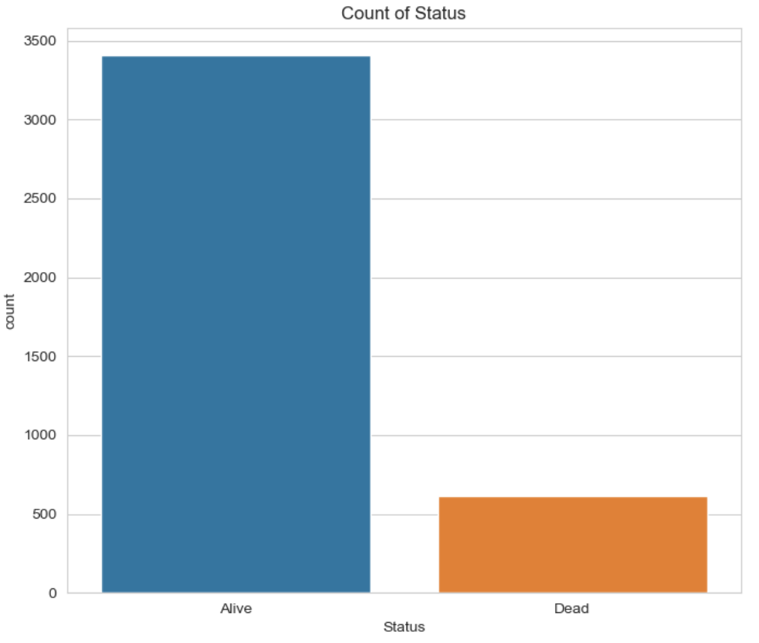
Results(Graphical Insights)
Status Distribution: The graph illustrates the distribution of individuals based on their status, which consists of two categories: "Alive" and "Dead."
Category Counts:
The "Alive" category has a count of 3400 individuals, indicating a substantial proportion of the study population who are currently alive at the time of data collection or analysis.
The "Dead" category has a count of 600 individuals, representing those who have deceased during the course of the study or within the specified observation period.
Imbalance: There is an apparent imbalance between the counts of individuals in the "Alive" and "Dead" categories, with a significantly higher count of individuals classified as "Alive" compared to those classified as "Dead."
Clinical Relevance:
The distribution of individuals based on status provides important insights into the outcomes observed within the study population.
The higher count of individuals classified as "Alive" suggests a relatively favorable outcome or survival status for the majority of the study population.
The count of individuals classified as "Dead" highlights the incidence of mortality within the population, indicating the proportion of individuals who have experienced adverse outcomes such as death.

Slide 11
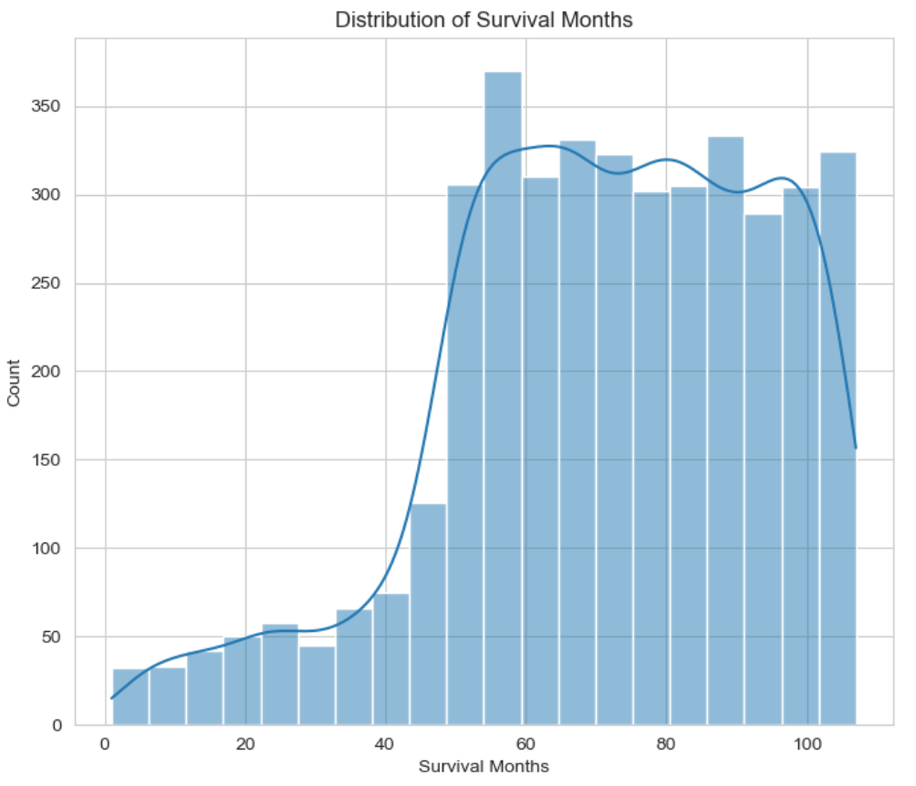
Results(Graphical Insights)
Survival Months Distribution: The graph illustrates the distribution of individuals based on the duration of survival, represented by "Survival Months."
Survival Months Count:
Survival Months ranging from 0 to 50 exhibit a count that gradually decreases from approximately 320 individuals to zero. This indicates a decline in the number of individuals surviving as the duration of survival increases within this range.
For the period between 50 and 90 Survival Months, the count remains constant at 320 individuals. This suggests a plateau or stable phase in survival outcomes, where the number of individuals surviving remains consistent over this period.
Between 90 and 110 Survival Months, there is a notable decrease in the count from 320 individuals to approximately 150 individuals. This indicates a decline in the number of survivors during this period, signifying a decrease in survival probability or an increased risk of mortality.
Survival Trends:
The initial decline in count observed for Survival Months up to 50 indicates a reduction in the number of survivors over time, possibly reflecting the occurrence of adverse events or mortality within this timeframe.
The stable count observed for Survival Months between 50 and 90 suggests a period of relative stability in survival outcomes, where the number of survivors remains consistent without significant changes.
The subsequent decrease in count beyond 90 Survival Months implies a further decline in survival rates or an increased risk of mortality among the remaining individuals in the study population.

Slide 12
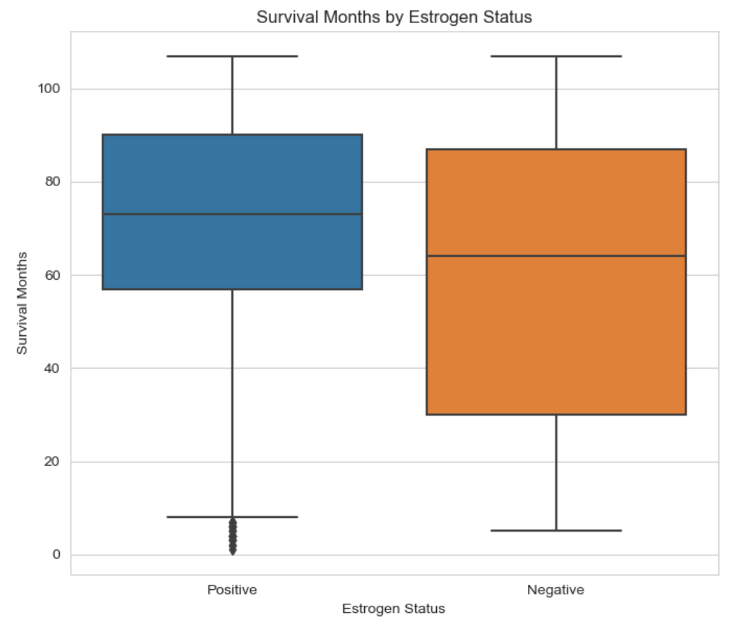
Results(Graphical Insights)
Survival Months by Estrogen Status: The survival months by estrogen status graph reveals insights into how survival months are influenced by the estrogen status of individuals in the dataset. Here are the potential findings:
Comparison of Survival Curves: The graph allows comparison between the survival curves of individuals with positive and negative estrogen status. Differences in the shapes or trajectories of these curves can indicate variations in survival probabilities between the two groups.
Effect of Estrogen Status on Survival: If there is a noticeable contrast in the survival curves between the two groups, it suggests that estrogen status may play a significant role in influencing survival outcomes. For example, if the survival curve for individuals with positive estrogen status consistently remains above that of individuals with negative estrogen status, it implies that positive estrogen status is associated with better survival outcomes.
Identification of High-Risk Groups: Individuals with negative estrogen status may demonstrate a higher risk of mortality compared to those with positive estrogen status if their survival curve declines more rapidly or remains consistently lower over time.
Clinical Implications: These findings could have clinical implications for patient management and treatment decisions. For instance, if individuals with negative estrogen status have poorer survival outcomes, healthcare providers may need to consider more aggressive interventions or personalized treatment approaches for this subgroup of patients.

Slide 13
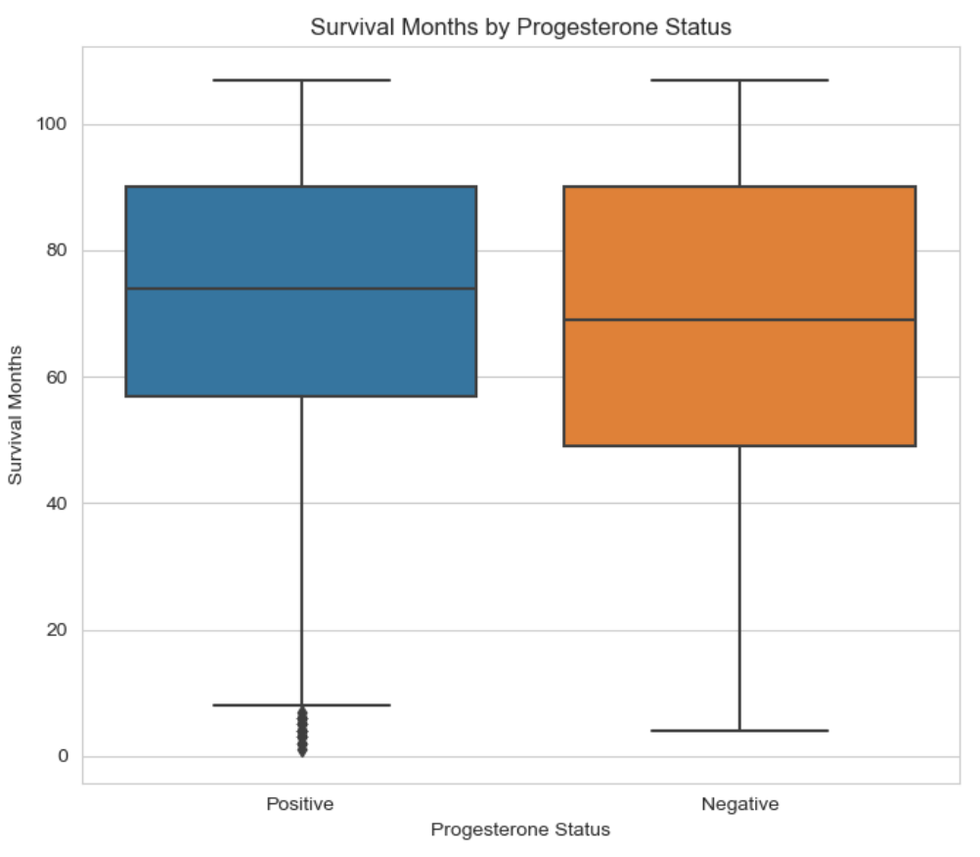
Results(Graphical Insights)
Survival Months by Progesterone Status: The survival months by progesterone status graph provides insights into how the survival months vary based on the progesterone status of individuals in the dataset. The findings from this graph can offer valuable information regarding the impact of progesterone status on survival outcomes.
The graph typically displays survival curves for two groups: one representing individuals with a positive progesterone status and the other representing individuals with a negative progesterone status. Here are the potential findings:
Comparison of Survival Curves: The graph enables comparison between the survival curves of individuals with positive and negative progesterone status. Differences in the shapes or trajectories of these curves can indicate variations in survival probabilities between the two groups.
Effect of Progesterone Status on Survival: If there is a notable difference in the survival curves between the two groups, it suggests that progesterone status may be a significant factor influencing survival outcomes. For example, if the survival curve for individuals with positive progesterone status consistently remains above that of individuals with negative progesterone status, it implies that positive progesterone status is associated with better survival outcomes.
Identification of High-Risk Groups: Individuals with negative progesterone status may exhibit a higher risk of mortality compared to those with positive progesterone status if their survival curve declines more rapidly or remains consistently lower over time.
Clinical Implications: These findings could have implications for clinical decision-making and patient management. For instance, if individuals with negative progesterone status have poorer survival outcomes, healthcare providers may need to implement targeted interventions or treatment strategies to improve their prognosis.

Slide 14
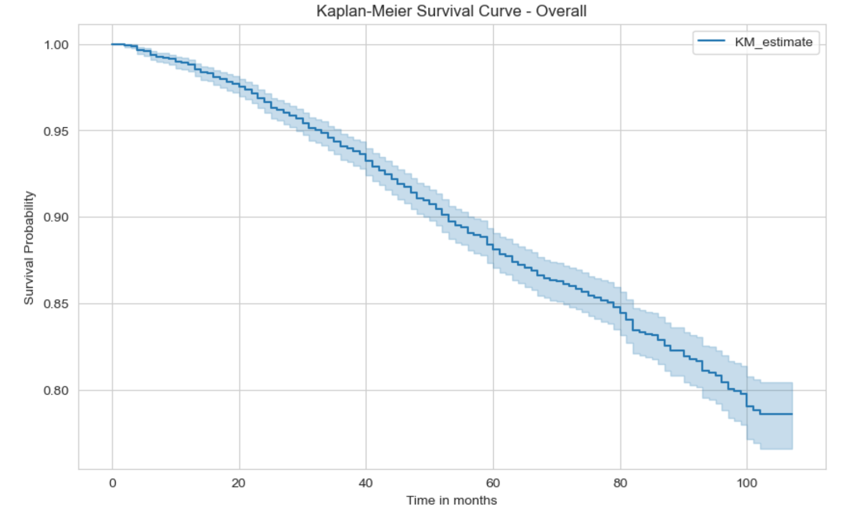
Results(Survival Analysis Techniques)
Kaplan-Meier Survival Curve: The Kaplan-Meier survival curve provides an overview of the overall survival probability for the entire dataset. In this graph, the survival probability decreases over time, indicating the proportion of individuals who remain alive as time progresses.
The findings from the Kaplan-Meier survival curve overall suggest that the survival probability gradually decreases over the observed time period. This implies that a portion of the individuals in the dataset experienced mortality events over time, leading to a decline in the overall survival probability.
The curve's downward trend underscores the importance of understanding survival dynamics in the dataset and may prompt further investigation into factors influencing survival outcomes. Additionally, it provides a baseline understanding of overall survival patterns that can inform future analyses and interventions aimed at improving survival rates.

Slide 15
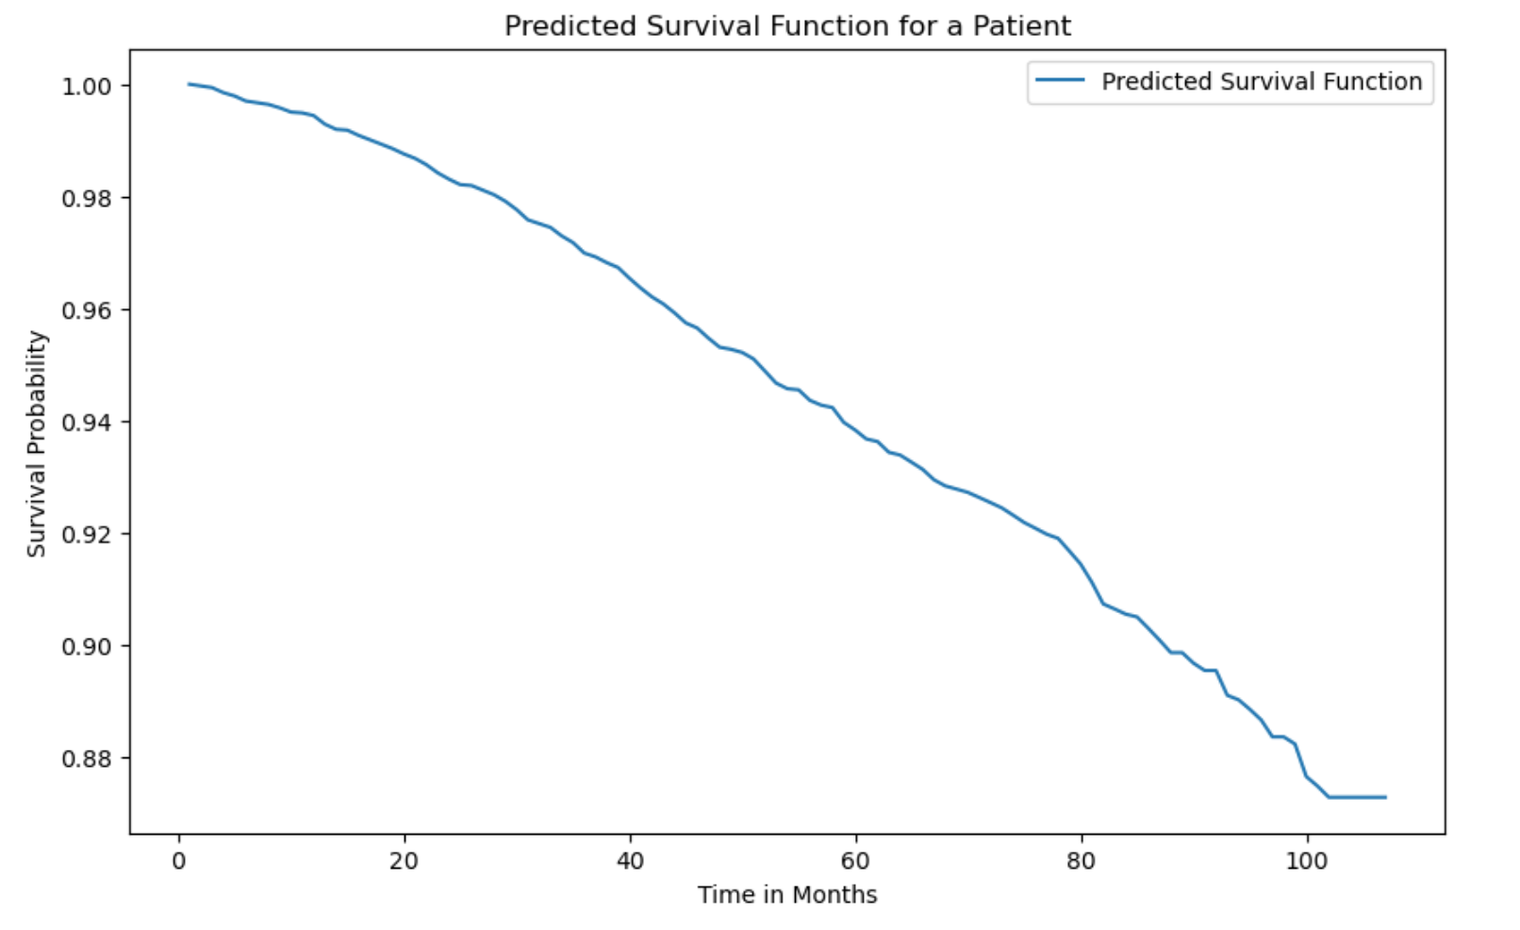
Results(Survival Analysis Techniques)
Predicted Survival Function: The predicted survival function for a patient, as depicted in the graph, illustrates the estimated survival probability over time based on the patient's specific characteristics. Initially, the survival probability is at its highest, indicating a favorable prognosis. However, as time progresses, the survival probability gradually decreases, reflecting the inherent risk of mortality associated with the patient's condition.
This graph provides valuable information for clinicians and patients regarding the anticipated trajectory of survival over time. It serves as a visual aid for understanding the dynamics of survival probability and can aid in treatment planning and decision-making. Additionally, by quantifying the likelihood of survival at different time points, this predicted survival function facilitates informed discussions between healthcare providers and patients regarding prognosis and potential interventions.

Slide 16
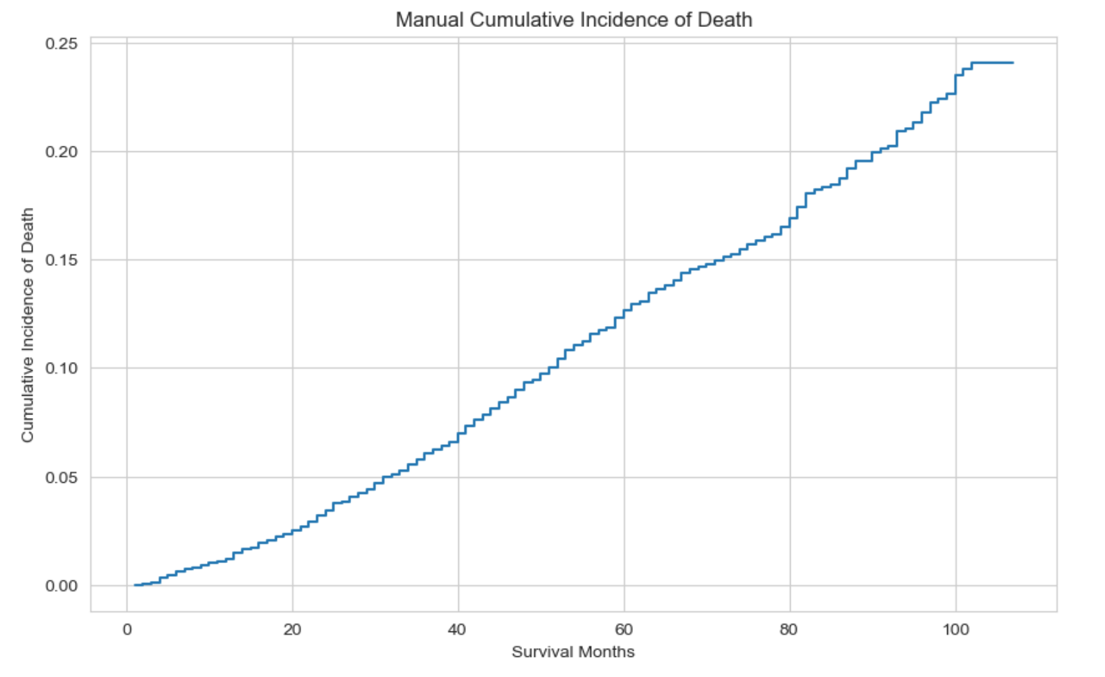
Results(Survival Analysis Techniques)
Manual Cumulative Incidence Function : The cumulative incidence of death steadily increases over the observed period. This suggests that as time progresses, the likelihood of death due to cancer or related factors rises consistently. This finding underscores the importance of timely intervention and monitoring in cancer treatment to potentially mitigate adverse outcomes and improve patient survival rates

Slide 17
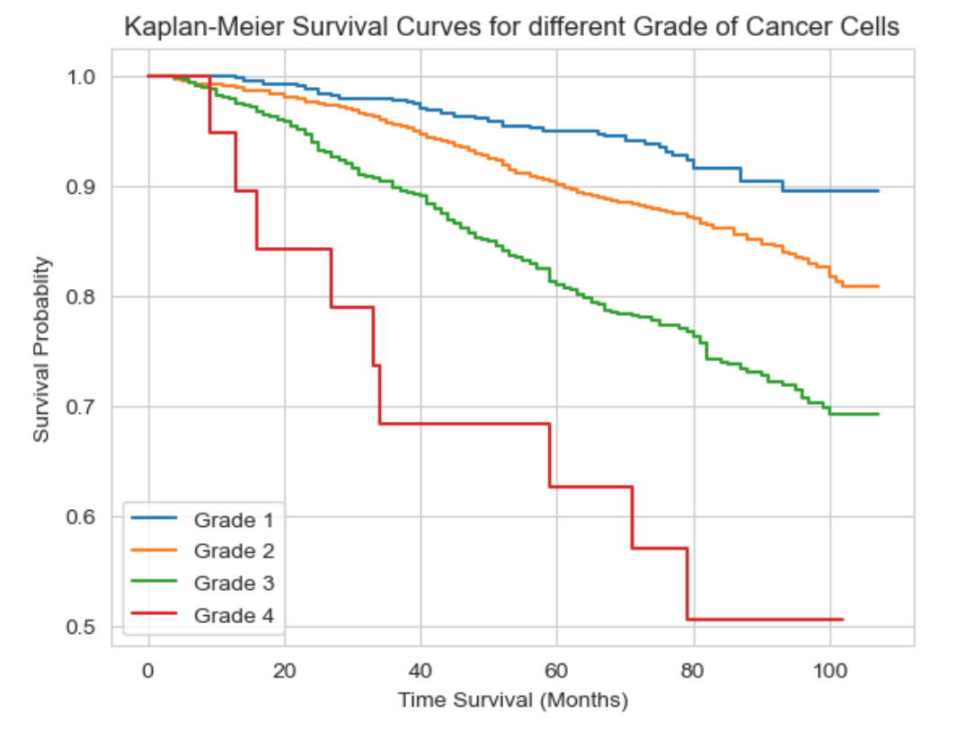
Results(Survival Analysis Techniques)
The Kaplan-Meier survival curves for different grades of cancer cells exhibit distinct survival probabilities over time. Notably, the curves demonstrate a clear trend of decreasing survival probability as the grade of cancer cells increases. Specifically, Grade 1 cancer cells exhibit the highest survival probability, followed by Grade 2 and Grade 3, while Grade 4 (anaplastic; Grade IV) cancer cells show the lowest survival probability throughout the observed period. This finding suggests a correlation between cancer cell grade and patient survival, emphasizing the prognostic significance of cancer cell differentiation in predicting patient outcomes

Slide 18
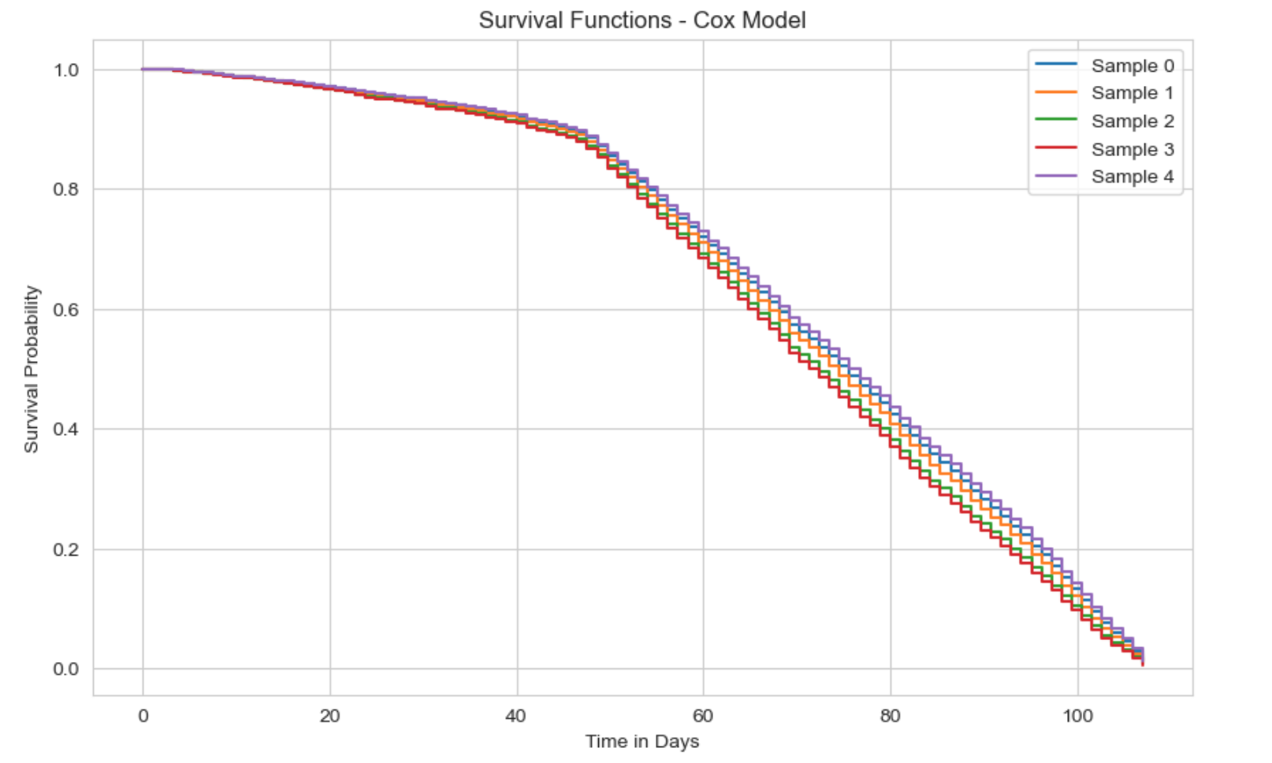
Results(Survival Analysis Techniques)
The survival functions derived from the Cox proportional hazards model illustrate varying probabilities of survival over time for different samples. Notably, the curves demonstrate distinct patterns of survival probability trajectories. Initially, all samples exhibit high survival probabilities, gradually decreasing over time. However, there are noticeable differences in the rate of decline and overall survival probabilities among the samples. Some samples maintain relatively higher survival probabilities for longer durations, indicating potentially favorable prognoses, while others experience more rapid declines, suggesting poorer outcomes. Overall, the Cox model-derived survival functions highlight the heterogeneity in survival outcomes among different samples, emphasizing the importance of individualized risk assessment and treatment strategies in cancer management.

Slide 19
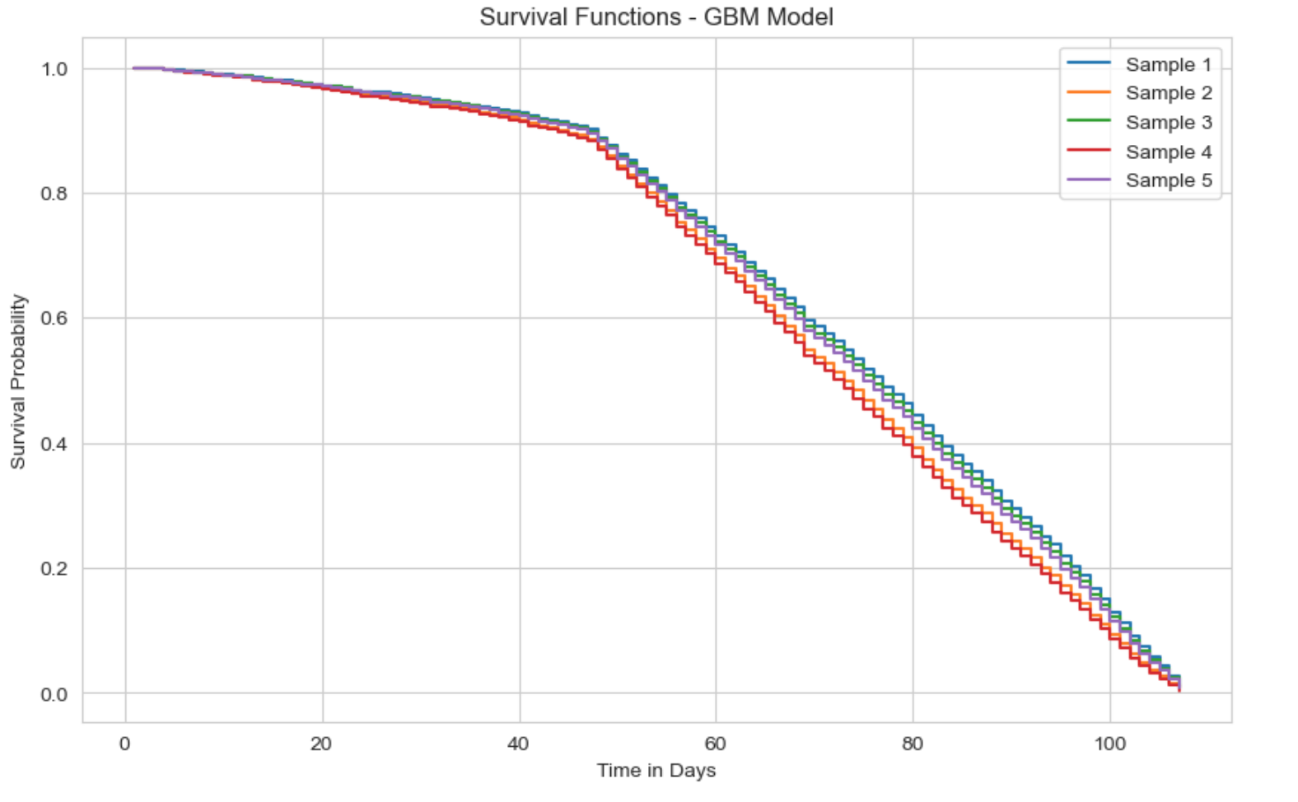
Results(Survival Analysis Techniques)
The survival functions generated by the Gradient Boosting Survival Analysis (GBM) model reveal distinct patterns of survival probability over time for various samples. Initially, all samples demonstrate high survival probabilities, gradually decreasing as time progresses. However, there are noticeable differences in the rate of decline and overall survival probabilities among the samples. Some samples maintain relatively higher survival probabilities for longer durations, indicating potentially more favorable prognoses, while others experience more rapid declines, suggesting poorer outcomes.
The GBM model-derived survival functions provide valuable insights into the heterogeneity of survival outcomes among different samples. These findings underscore the importance of personalized risk assessment and treatment strategies in cancer care, as they highlight the diverse trajectories of survival probabilities among individuals. Additionally, the GBM model's ability to capture complex interactions and nonlinear relationships between predictors further enhances its utility in predicting patient outcomes and guiding clinical decision-making.

Slide 20

Results(contd…)
Key Findings:
Emphasizes the importance of early detection and treatment for improving outcomes in breast cancer patients.
Highlights the potential of survival analysis techniques in aiding clinical decision-making and treatment planning.
Conclusion:
The project contributes to advancing the understanding of survival patterns in breast cancer.
Underscores the utility of survival analysis techniques in clinical practice for prognosis and treatment planning.

Slide 21

Discussion
Dataset Overview:
The dataset comprises 4024 instances and 16 features, encompassing a wide range of variables relevant to breast cancer research. These features include demographic data, cancer stage, tumor characteristics, and hormone receptor status, providing a comprehensive view of the patient population under study.
Exploratory Data Analysis (EDA):
Analysis of age distribution reveals a significant peak between the ages of 45 to 62 years. This finding may indicate a higher incidence of breast cancer within this age group or suggest the age range where patients are more likely to seek medical attention.

Slide 22

Discussion(contd…)
Exploratory Data Analysis (EDA):
The skewed pattern in tumor size distribution, with a majority falling within the range of 0 to 20, underscores the variability in tumor sizes among breast cancer patients. Understanding this distribution can aid in treatment planning and prognosis assessment.
The count of patients by survival status highlights a notable predominance of 'Alive' cases (3400) compared to 'Dead' cases (600). This imbalance in survival outcomes emphasizes the need for further investigation into factors influencing survival rates and treatment effectiveness.

Slide 23
Discussion(contd…)
Graphical Insights:
Graphical representations provide intuitive visualizations of key aspects of the dataset, including age distribution, tumor size distribution, and survival status counts. These visuals aid in identifying trends and patterns within the data, facilitating interpretation and analysis.
The decline in survival probability over time, as depicted in the Kaplan-Meier survival curve, emphasizes the importance of early detection and treatment in improving outcomes for breast cancer patients. This finding underscores the significance of timely intervention and highlights areas for intervention and research.
Variations in survival probabilities based on estrogen and progesterone receptor status, as illustrated in Graphs 5 and 6, suggest the potential impact of hormonal factors on disease progression and treatment response. Understanding these variations can inform personalized treatment approaches tailored to individual patient characteristics.

Slide 24

Discussion(contd…)
Key Findings:
The project emphasizes the critical role of early detection and timely treatment in improving outcomes for breast cancer patients. By identifying factors associated with survival, such as age, tumor characteristics, and hormone receptor status, healthcare providers can develop targeted interventions to optimize patient care.
The application of survival analysis techniques highlights their utility in aiding clinical decision-making and treatment planning. By providing personalized estimates of survival probabilities, these techniques offer valuable insights into individual patient prognosis and can inform discussions between patients and healthcare providers regarding treatment options and expectations.

Slide 25

Discussion(contd…)
Conclusion:
In conclusion, the project contributes to advancing our understanding of survival patterns in breast cancer and underscores the importance of survival analysis techniques in clinical practice. By leveraging comprehensive datasets and sophisticated analytical methods, researchers can gain insights into disease progression, treatment outcomes, and prognostic factors, ultimately improving patient care and outcomes in breast cancer management.

Slide 26

Literature Cited
Bray, F., Ferlay, J., Soerjomataram, I., Siegel, R. L., Torre, L. A., & Jemal, A. (2018). Global cancer statistics 2018: GLOBOCAN estimates of incidence and mortality worldwide for 36 cancers in 185 countries. CA: A Cancer Journal for Clinicians, 68(6), 394-424.
DeSantis, C. E., Ma, J., Gaudet, M. M., Newman, L. A., Miller, K. D., Goding Sauer, A., ... & Jemal, A. (2019). Breast cancer statistics, 2019. CA: A Cancer Journal for Clinicians, 69(6), 438-451.
Howlader, N., Noone, A. M., Krapcho, M., Miller, D., Brest, A., Yu, M., ... & Cronin, K. A. (Eds.). (2020). SEER Cancer Statistics Review, 1975-2017. National Cancer Institute. Retrieved from https://seer.cancer.gov/csr/1975_2017/
Kaplan, E. L., & Meier, P. (1958). Nonparametric estimation from incomplete observations. Journal of the American Statistical Association, 53(282), 457-481.
Peto, R., Pike, M. C., Armitage, P., Breslow, N. E., Cox, D. R., Howard, S. V., ... & Smith, P. G. (1977). Design and analysis of randomized clinical trials requiring prolonged observation of each patient. II. analysis and examples. British Journal of Cancer, 35(1), 1-39.
Royston, P., & Parmar, M. K. (2002). Flexible parametric proportional-hazards and proportional-odds models for censored survival data, with application to prognostic modelling and estimation of treatment effects. Statistics in Medicine, 21(15), 2175-2197.
Therneau, T. M., & Grambsch, P. M. (2000). Modeling survival data: extending the Cox model. Springer.
van Buuren, S., & Groothuis-Oudshoorn, K. (2011). mice: Multivariate imputation by chained equations in R. Journal of Statistical Software, 45(3), 1-67.

Slide 27

Appendices
Heamesh loaded & analysed breast cancer data, checking types, missing values, & basic stats. He visualized age, survival, mutations, & lymph nodes for distribution insight. He addressed missing values to ensure data completeness.
Sajeev encoded categorical variables, split data into features (X) and targets (y), handled missing values, and utilized lifelines for survival analysis. He visualized survival functions with the Kaplan-Meier estimator and trained a model like Gradient Boosting Survival Analysis for prediction.
Ajinkya built a pre-processing pipeline with scikit-learn to handle missing values and scale/encode features. He inspected pre-processed data to ensure correctness and completeness. Ajinkya integrated work from others, reviewed codebase, and prepared the final presentation/report summarizing key insights and visualizations.

Slide 28

Thank You!!

