Slide 1
jQuery
Mohamed Mayow
Nikhil Vinay
Akash Chopda
Chen Cai
Omar Ibrahim
Nabil Wadih

Slide 2
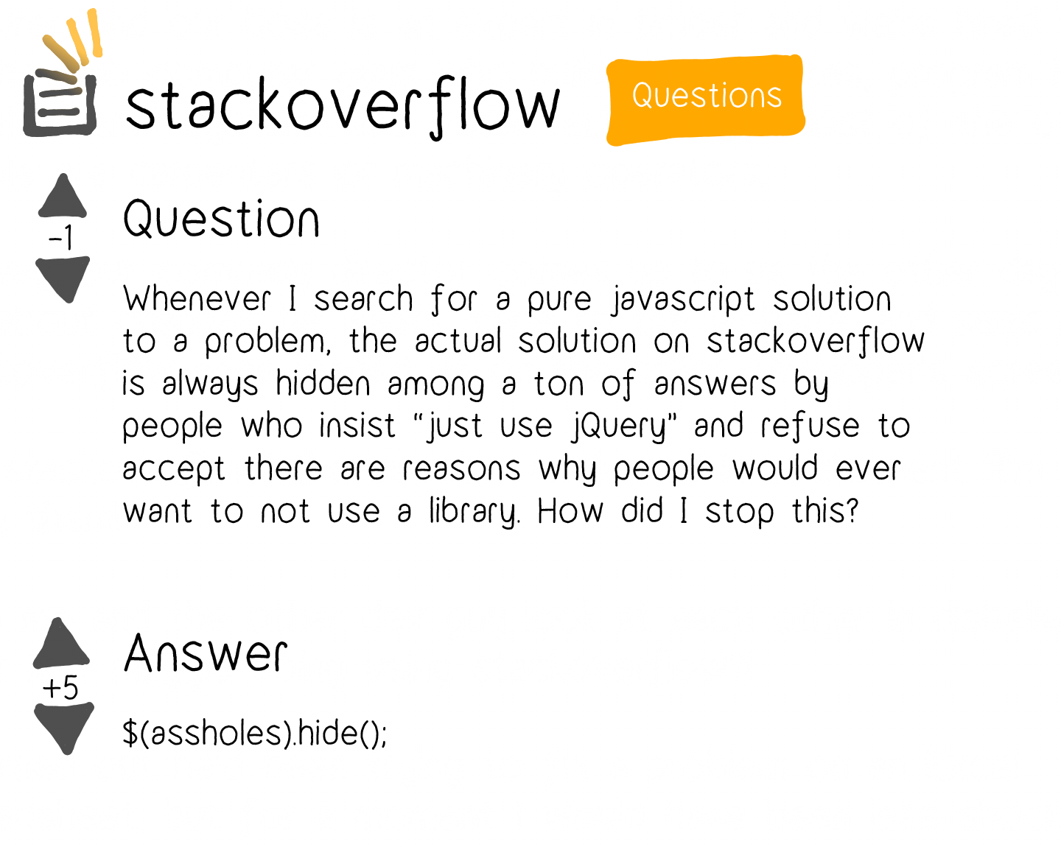
JavaScript vs jQuery

Slide 3

Introduction
What is jQuery?
A Javascript library created by John Resig in 2006
“Write less, do more”
The purpose is to make using javascript easier
It takes common tasks that require many lines of Javascript code and wraps them in a method you can call in one of code

Slide 4
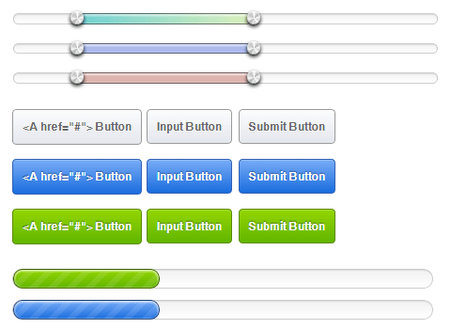
Main Functions
HTML/DOM manipulation
Makes it easier to select, traverse, and modify the content of DOM elements
CSS manipulation
Allows for getting or setting CSS style properties
Event Handling
Elegant way to capture wide variety of events
Eg: user clicking a link
Effects and Animations
Comes with built in animation effects which you can use in your websites
AJAX
Allows you to create Asynchronous web pages
Lightweight and cross-browser
Functions across all browsers and is only 19KB in size

Slide 5
Syntax

Slide 6
Selectors
JQuery is used for selecting HTML elements and performing some action on the elements.
Basic syntax is $(selector).action()
A $ sign to define/access jQuery
A (selector) to "query (or find)" HTML elements
A jQuery action() to be performed on the element(s)
Selecting elements is the same as CSS
Selecting element type of P and hiding it : $("p").hide();
Selecting class elements named test and hiding it: $(“.test”).hide();
Selecting id elements named number and hiding it: $(“#number).hide( )

Slide 7
Events
An event represents the precise moment when something happens.
Examples include:
moving a mouse over an element
selecting a radio button
clicking on an element

Slide 8
Events
Examples of events include
https://jsfiddle.net/q2opg745/7/
Mouse Events | Keyboard Events | Form Events | Document/Window Events
click | keypress | submit | load
dblclick | keydown | change | resize
mouseenter | keyup | focus | scroll
mouseleave |  | blur | unload

Slide 9
Effects

Slide 10
Hide/Show
The hide(speed, callback) method can be used to hide HTML elements
$(“p”).hide( );
The show(speed, callback) method can be used to display hidden HTML elements
$(“p”).show( );
The toggle(speed, callback) method can be used to alternate elements between being displayed and hidden
$(“button”).click(function( ) { $(“p”).toggle( ); } );
All methods can take an input to vary the rate that elements are shown/hidden
$(“p”).show(1000);
$(“p”).toggle(“slow”);

Slide 11
Fading
The fading methods function very similar to those seen in the previous slide
The fadeOut(speed, callback) method can be used to fade out elements while the fadeIn(speed, callback) method can be used to fade in elements
$(“p”).fadeOut( )
$(“p”).fadeIn( )
The fadeToggle(speed, callback) method can be used to incorporate the fadeOut( ) and fadeIn( ) methods into one button
$(“button”).click(function( ) { $(“p”).toggle( ); } );
The fadeTo(speed, opacity, callback) method is used to fade objects to a specific opacity between 0 and 1
$(“p”).fadeTo(“slow”, 0.3);

Slide 12
Sliding
The slideDown(speed, callback) method can be used to slide down elements
$(“p”).slideDown( );
The slideUp(speed, callback) method can be used to slide up elements
$(“p”).slideUp( );
The slideToggle(speed, callback) method can be used to alternate between the slideDown( ) and slideUp( ) methods
$(“button”).click(function( ) { $(“p”).slideToggle( ); } );
All methods can take an input to vary how quickly the elements slide
$(“p”).slideDown(1000);
$(“p”).slideUp(“slow”);
Notes:
https://jsfiddle.net/eboxy1wc/

Slide 13
Animation
The animate( { params } , speed, callback) used to create animations for various CSS properties
$(“button”).click(function( ) { $(“div”).animate( { left: ‘250px’} );
The { params } parameter allows multiple changes to be made to an element
$(“button”).click(function( ) { $(“div”).animate( { left: ‘250px’, opacity: ‘0.5’, height: ‘150px’, width: ‘150px’ } ); } );
It is also possible to create relative changes
$(“button”).click(function( ) { $(“div”).animate( { height: ‘+=150px’, width: ‘+=150px’ } ); } );
It is also possible to queue multiple method calls one after another
Notes:
https://jsfiddle.net/nzj47ogr/

Slide 14
HTML

Slide 15
Attributes
The attr( ) method can be used to fetch the value of an attribute from the first element in the matched set.
var title = $("em").attr("title");
The attr(name, value) method can be used to set attribute values onto all elements in the wrapped set using the passed value.
$("#myimg").attr("src", "/jquery/images/jquery.jpg");
This method also allows you to set multiple attributes at the same time.
$(“myid”).attr( { “title”: “jQuery”, “href”: “https://jquery.com/” } );
Notes:
1. This example fetches “title” attribute of <em> tag. 2. This example sets “src” attribute of an image tag. 3. This example demonstrates how to set both the title and href attributes at the same time.

Slide 16
DOM Manipulation
One very important part of jQuery is the possibility to manipulate the DOM.
It comes with a bunch of DOM related methods that make it easy to access and manipulate elements and attributes.
You can get, set, add, and remove HTML elements/content using jQuery.
Get and Set Content:
text( ) - Sets or returns the text content of selected elements.
html( ) - Sets or returns the HTML content of selected elements.
val( ) - Sets or returns the value of form fields.

Slide 17
DOM Manipulation (cont.)
Add Content:
append( ) - Inserts content at the end of the selected elements.
prepend( ) - Inserts content at the beginning of the selected elements.
after( ) - Inserts content after the selected elements.
before( ) - Inserts content before the selected elements.
Remove Content/Elements:
empty( ) - Removes the child elements from the selected element.
remove( ) - Removes the selected element (and its child elements). It also accepts one parameter, which allows you to filter the elements to be removed.

Slide 18
CSS Manipulation
addClass( ) - Adds one or more classes to the selected elements.
$(“h1, h2”).addClass(“important”);
$(“#divid1”).addClass(“important highlight”);
removeClass( ) - Removes one or more classes from the selected elements.
$(“h2”).removeClass(“important”);
toggleClass( ) - Toggles between adding/removing classes from the selected elements.
https://jsfiddle.net/djxthrkn/1/
css( ) - Sets or returns the style attribute.
$(“p”).css(“background-color”, “yellow”);
$(“p”).css(“background-color”);
$("p").css( {"background-color": "yellow", "font-size": "200%"} );
Notes:
1. This example adds class attribute to header <h1> and <h2> tags.
2. You can specify multiple classes within the addClass( ) method separated by space (important and highlight are 2 classes).
3. Open link and click “toggle” to demonstrate the example.
4. This example sets the background-color value for ALL matched elements to yellow.
5. This example returns the background-color value of the FIRST matched element.
6. You can set multiple CSS properties as shown in the example. It will set yellow background-color and 200% font-size.

Slide 19
Traversing

Slide 20
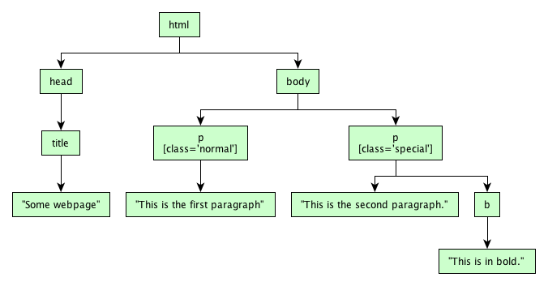
Recall HTML tree

Slide 21
Traversing through the tree
Traversing is used to find or select HTML element based on tree structure(DOM).
You can move:
Up : to find ancestors
Down : to find descendants
Sideways (Sibling) : to find brothers
From current selected element.

Slide 22
Ancestors
parent( )
- return the direct parent element of the selected element (a single level up)
- example:
$(document).ready(function( ) {
$("span").parent( );
} );
parents( ): return all ancestor elements
parentsUntil( ): return all ancestor elements between selected element and parameter

Slide 23
Descendants
children( )
- return all direct children of selected element(a single level down)
$(document).ready(function(){
$("div").children();
});
find( )
- return all descendant elements of selected element(all the way down)

Slide 24
Siblings
siblings( ): return all sibling elements of selected element
next( ): return next sibling element of selected element
nextAll( ):return all next sibling elements of selected element
nextUntil( ): return all next sibling elements between selected element and parameter
prev( ), prevAll( ) and prevUntil( ) work similarly but reverse the functionality

Slide 25
Filtering from a group
first( ), last( ) and eq( ) allow you to select element from a group based on its position
$(document).ready(function(){
$("div p").first();
});
filter( ) and not( ) allow you to select element from a group which match or don’t match a certain criteria
$(document).ready(function(){
$("p").not(".intro");
})

Slide 26
Conclusion
Jquery is great because of its
Easy of use
Large Library
Ability to do many different things
Large open source community
One may have to use javascript in some cases
Notice JQuery javascript file is required

Slide 27
Game Time!!!

Slide 28
Effects

Slide 29
Questions (cont.)
Which of the following methods cannot be used to hide elements
A) hide()
B) fadeToggle()
C) toggle()
D) hideToggle()

Slide 30
Questions (cont.)
Create a button that can be used to slide a panel up and down
$(“#flip”).click(function(){ $(“#panel’).slideToggle(); });

Slide 31
Attributes

Slide 32
Questions (cont.)
Which of the following jQuery method sets attributes of an element?
A - attr(name, value)
B - setAttr(name, value)
C - setAttributes(name, value)
D - attribute(name, value)

Slide 33
DOM

Slide 34
Questions (cont.)
Which of the following jQuery method set the value of an element?
A - setContent(val)
B - setValue(val)
C - val(val)
D - setVal(val)

Slide 35
CSS

Slide 36
Questions (cont.)
Which of the following jQuery method apply a style on an element?
A - addStyle(classes)
B - addClass(classes)
C - addCSSClass(classes)
D - css(classes)

Slide 37
Questions (cont.)
Which of the following applies a blue background color to <h1> and changes font size to 36px?
A - $("h1").css( {"background-color": "blue", "font-size": "36%"} );
B - $("h1").addClass( {"background-color": "blue", "font-size": "36px"} );
C - $("p").css( {"background-color": "blue", "font-size": "36px"} );
D - $("h1").css( {"background-color": "blue", "font-size": "36px"} );

Slide 38
Syntax

Slide 39
Questions (cont.)
True or false. You select an id element with a ‘#’ sign

Slide 40
Questions (cont.)
Which one of the following is considered an event?
click
keypress
mouseleave
All of the above

Slide 41
Traversing

Slide 42
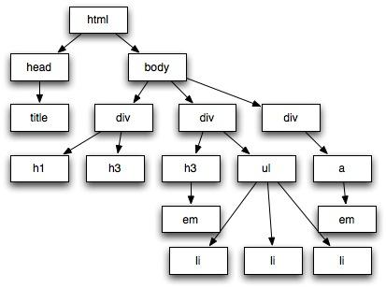
Question
Given HTML tree on the right.
Set your current position at title and write the
Code to return all h3.

