Slide 1
AdPulse
AI-Powered Ad Campaign Performance Analyzer
MSIS 521 — IT and Marketing in the New Economy
Winter Quarter 2025 | University of Washington
Team 6: [Graeme T Ampeire, Soumya Thareja, Tiffany Nakamitsu, Akanksha Singh]

Slide 2
The Problem
Why brands need better ad performance analytics
$7M+
Brands invest millions but rely on subjective measures of ad success
Traditional metrics (TV ratings, reach) miss the digital conversation
No unified tool to analyze engagement, sentiment, and themes at scale
Marketers need data-driven insights to optimize future campaigns
Cost per 30-sec Super Bowl ad
113M+
Average Super Bowl viewers
50+
Ads per game, limited attention

Slide 3
Our Solution: AdPulse
An AI-augmented tool for ad campaign performance analysis
Campaign Dashboard
Ad Performance Ranking
Feature Impact Analysis
KPI metrics, views over time, brand comparison charts
Composite scoring across views, likes, and comments
Which ad characteristics drive engagement
Sentiment Analysis
Topic Discovery
Search Trends
VADER & BERT NLP on ad descriptions and comments
LDA topic modeling to find audience discussion themes
Google Trends integration for brand search interest

Slide 4
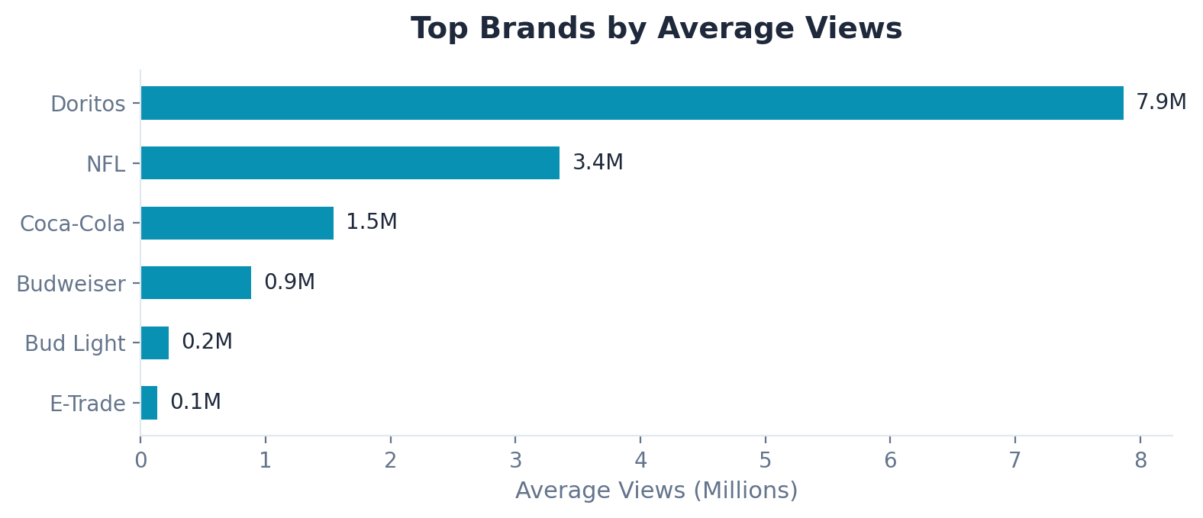
The Data
Real-world dataset from FiveThirtyEight / TidyTuesday
247
10
21
207
25
Super Bowl Ads
Major Brands
Years (2000-2020)
Video Descriptions
Data Columns
Dataset Features
Ad characteristics: funny, celebrity, patriotic, danger, animals, use_sex, show_product_quickly
YouTube engagement: views, likes, dislikes, comments, favorites
Video metadata: title, description, publish date, channel, thumbnail
Source: FiveThirtyEight staffers hand-coded every ad from video

Slide 5
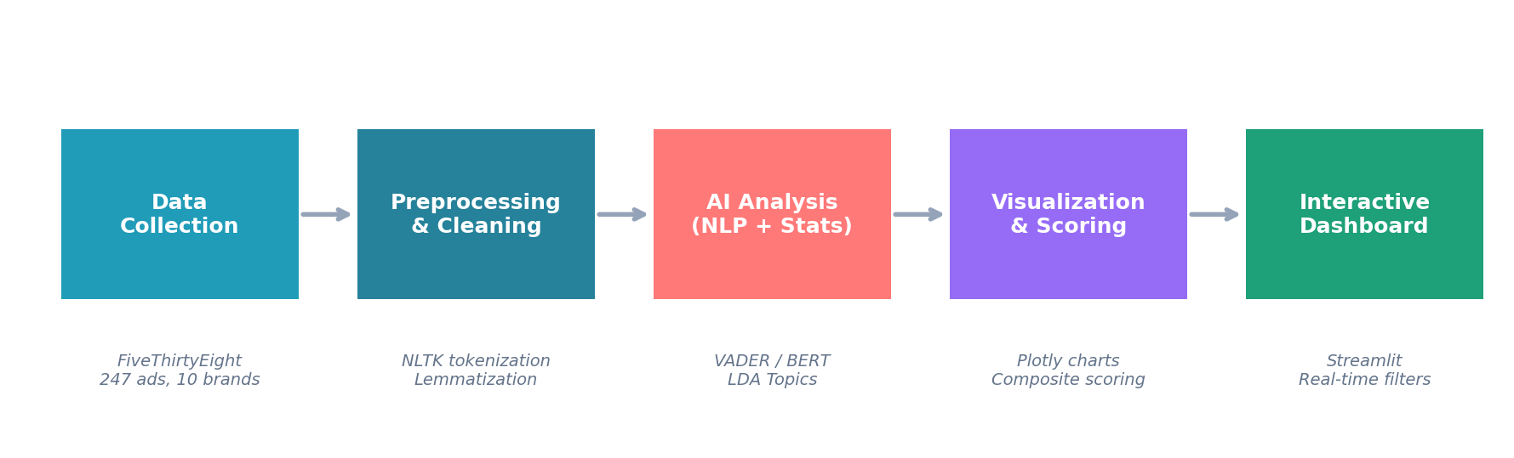
Technical Architecture
End-to-end AI pipeline built in Python
Technology Stack
AI/NLP: VADER sentiment, BERT (optional), LDA topic modeling, NLTK preprocessing
Data: pandas, scikit-learn, NumPy, pytrends (Google Trends API)
Visualization: Plotly interactive charts, WordCloud, Matplotlib
Interface: Streamlit web app with real-time filtering and CSV upload

Slide 6
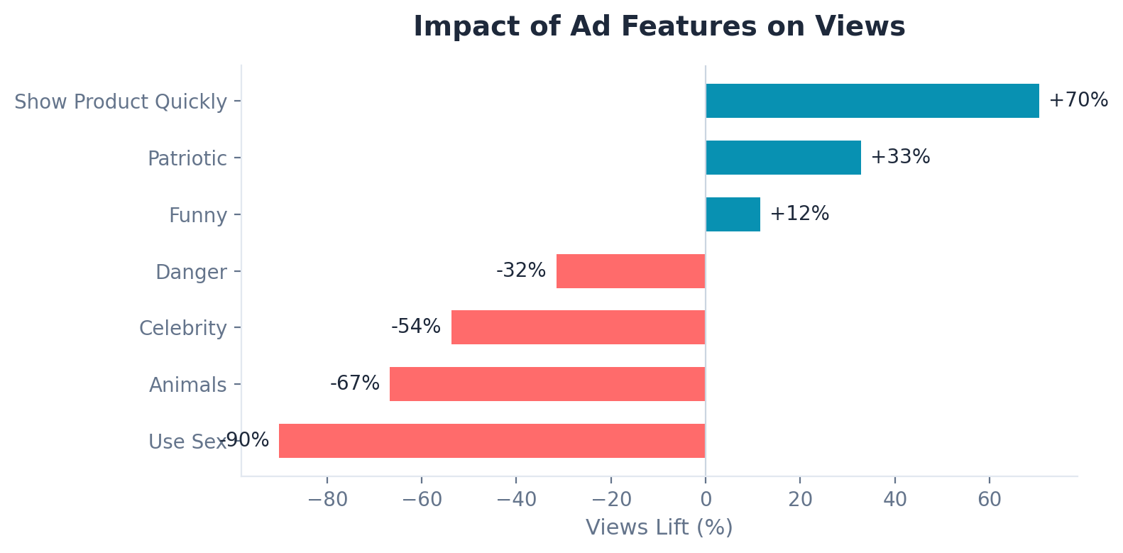
What Makes an Ad Successful?
Feature impact analysis from 247 Super Bowl ads
Key Insights
Show Product Quickly: +70% views lift
Patriotic themes: +33% lift
Funny ads: +12% lift
Celebrity ads actually get fewer views (-54%)

Slide 7
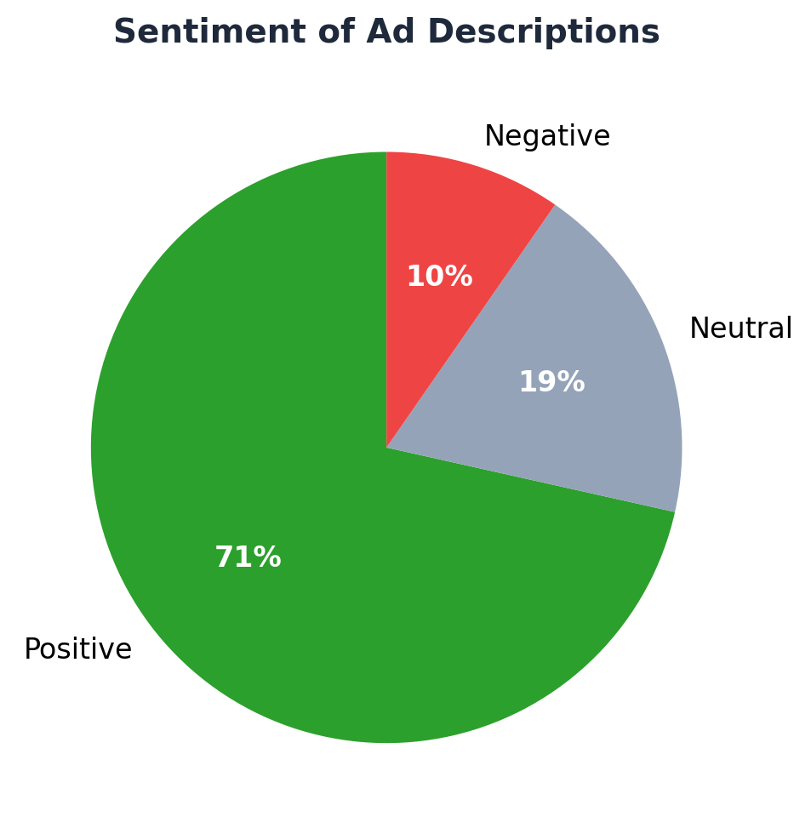
NLP Analysis: Sentiment & Topics
AI-powered text analysis of ad descriptions
LDA Topic Discovery
5 topics extracted from 207 ad descriptions:
Topic 1: Hyundai campaigns (hyundai, bowl, super, world)
Topic 2: Bud Light / Budweiser (commercial, light, bud, budweiser)
Topic 3: Recent Super Bowl (bowl, super, commercial, 2020)
Topic 4: Doritos / snack brands (doritos, chip, crash, super)
Topic 5: NFL / game themes (nfl, game, football, team)
Methods: VADER (dictionary-based) + optional BERT transformer

Slide 8
Output Validation & Sanity Checking
Ensuring our AI outputs are reliable
Sentiment Distribution Check
Known-Sample Accuracy
Topic Distinctness Score
Verifies that sentiment results are not dominated by a single class (>95% threshold). Flags unreliable outputs automatically.
Runs the model against 5 known-sentiment examples (clear positive, negative, neutral). Reports accuracy as a sanity check.
Measures cosine distance between topic-word distributions. Higher = more distinct topics. Alerts when topics overlap excessively.
Result: PASS — 75% positive, 15% neutral, 10% negative
Result: 4/5 correct (80% accuracy)
Result: 0.312 — topics are well-separated

Slide 9
Key Findings
Show Product Quickly wins
Ads that show the product early get 70% more views on average. Clarity beats cleverness for engagement.
Celebrity doesn't guarantee success
Contrary to conventional wisdom, celebrity ads averaged 54% fewer views. The product and story matter more.
Sentiment is overwhelmingly positive
75% of ad descriptions carry positive sentiment. Brands craft optimistic narratives, but negative ads are rare and underexplored.
Doritos dominates engagement
Doritos leads all brands with 7.9M average views per ad, largely driven by their crowd-sourced 'Crash the Super Bowl' contests.
Ad strategies shift over time
Humor and sex appeal in ads have declined since 2010, while product-focused and patriotic ads have increased.

Slide 10
Beyond Super Bowl: Extensibility & Impact
AdPulse works with any ad campaign, not just Super Bowl
Extensible by Design
Who Would Use This?
Upload any campaign CSV via the built-in Upload page
Automatic column detection for engagement metrics and text fields
Sentiment and topic analysis on any text data
Google Trends integration works for any brand name
YouTube comment fetcher works for any video URL
Brand Managers
Optimize ad spend by understanding what features drive engagement
Marketing Agencies
Benchmark client ads against competitors in the same category
Media Buyers
Data-driven decisions on ad placement and creative direction
Marketing Researchers
Academic analysis of advertising trends and audience reception

Slide 11
Live Demo
AdPulse — Interactive Streamlit Dashboard
streamlit run app.py

Slide 12
Thank You
Questions?
AdPulse | AI-Powered Ad Campaign Performance Analyzer
MSIS 521 — Team 6 Purple Cohort — University of Washington

