Slide 1
AdPulse
AI-Powered Ad Campaign Performance Analyzer
MSIS 521 -- IT and Marketing in the New Economy
Winter Quarter 2025 | University of Washington
Team 6 -- Purple Cohort
Graeme Ampeire | Soumya Thareja | Tiffany Nakamitsu | Akanksha Singh

Slide 2
The Problem
Why brands need better ad performance analytics
$7M+
Brands invest millions but rely on subjective measures of ad success
Traditional metrics (TV ratings, reach) miss the digital conversation
No unified tool to analyze engagement, sentiment, and themes at scale
Marketers need data-driven insights to optimize future campaigns
Cost per 30-sec Super Bowl ad
113M+
Average Super Bowl viewers
50+
Ads per game, limited attention

Slide 3
Our Solution: AdPulse
An 11-page AI dashboard covering 21 course techniques across 5 sessions
Dashboard & Rankings
Feature Impact
Sentiment Analysis
KPI metrics, composite scoring, brand comparison
Which ad characteristics drive engagement (lift %)
VADER & BERT NLP on ad descriptions
Text Analysis & Clustering
Network & Crowd Intel
SEM Performance Lab
TF-IDF, Word2Vec, K-Means, hierarchical clustering, t-SNE
Brand networks, centrality, Wisdom of Crowds scoring
CPV, CPE, Quality Score, ROI (Air France case approach)

Slide 4
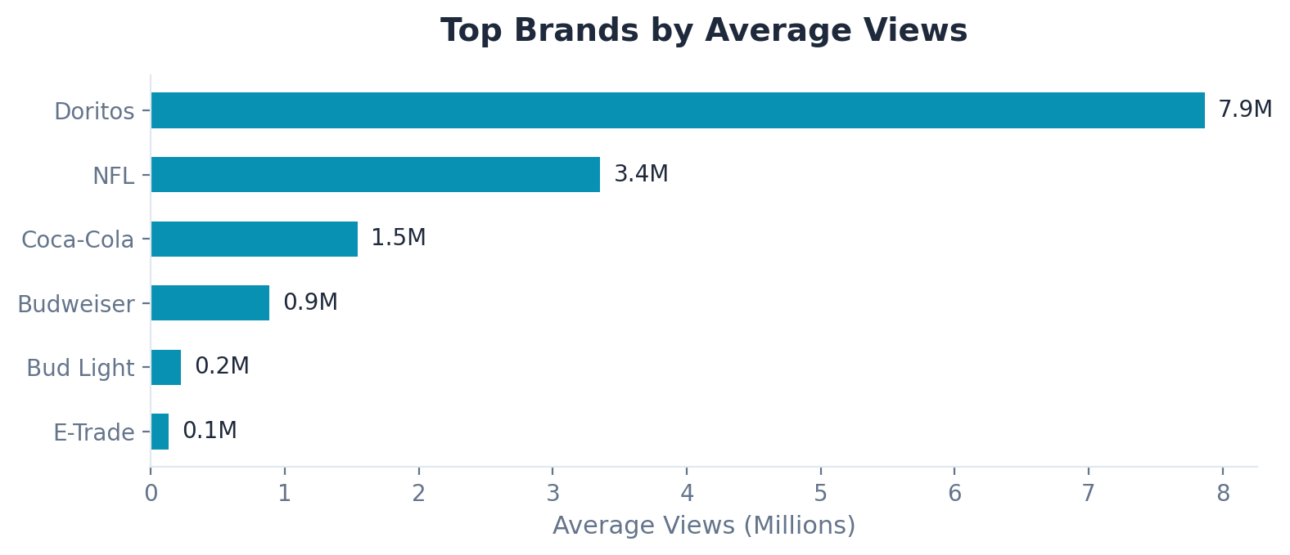
The Data
Real-world dataset from FiveThirtyEight / TidyTuesday
247
10
21
207
25
Super Bowl Ads
Major Brands
Years (2000-2020)
Video Descriptions
Data Columns
Ad characteristics: funny, celebrity, patriotic, danger, animals, use_sex, show_product_quickly
YouTube engagement: views, likes, dislikes, comments, favorites
Video metadata: title, description, publish date, channel, thumbnail URL

Slide 5
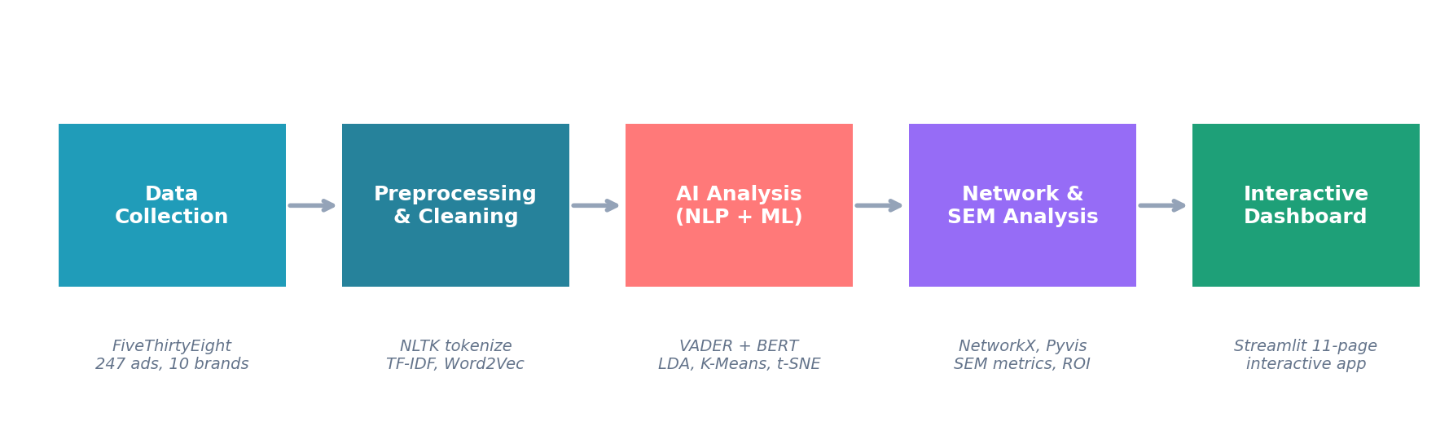
Technical Architecture
End-to-end AI pipeline built in Python
AI/NLP: VADER + BERT sentiment, LDA topics, Word2Vec embeddings, TF-IDF, K-Means, t-SNE
Networks: NetworkX graph analysis, Pyvis visualization, PageRank, 4 centrality measures
SEM: CPV/CPE/ROI metrics, Quality Score proxy, keyword strategy, publisher comparison
Viz + App: Plotly interactive charts, Streamlit 11-page dashboard, real-time filtering

Slide 6
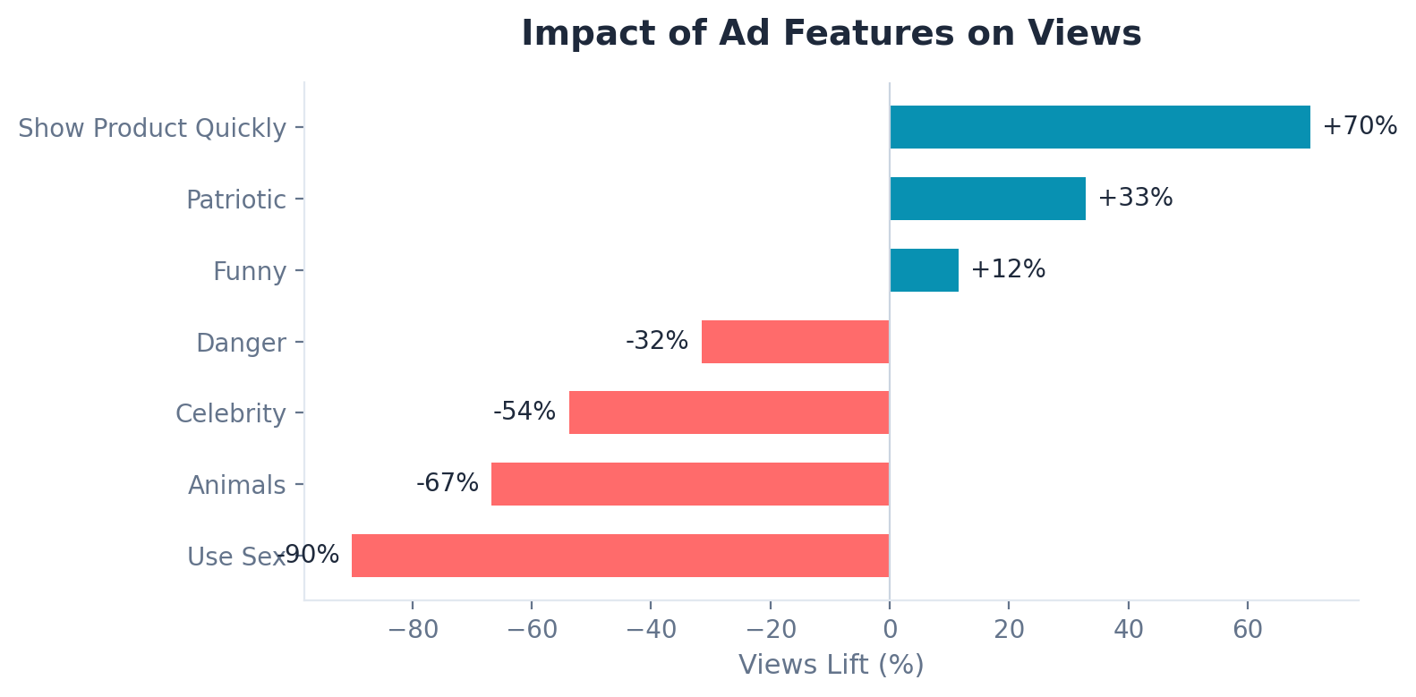
What Makes an Ad Successful?
Feature impact analysis from 247 Super Bowl ads
Key Insights
Show Product Quickly: +70% views lift
Patriotic themes: +33% lift
Funny ads: +12% lift
Celebrity ads actually get fewer views (-54%)

Slide 7
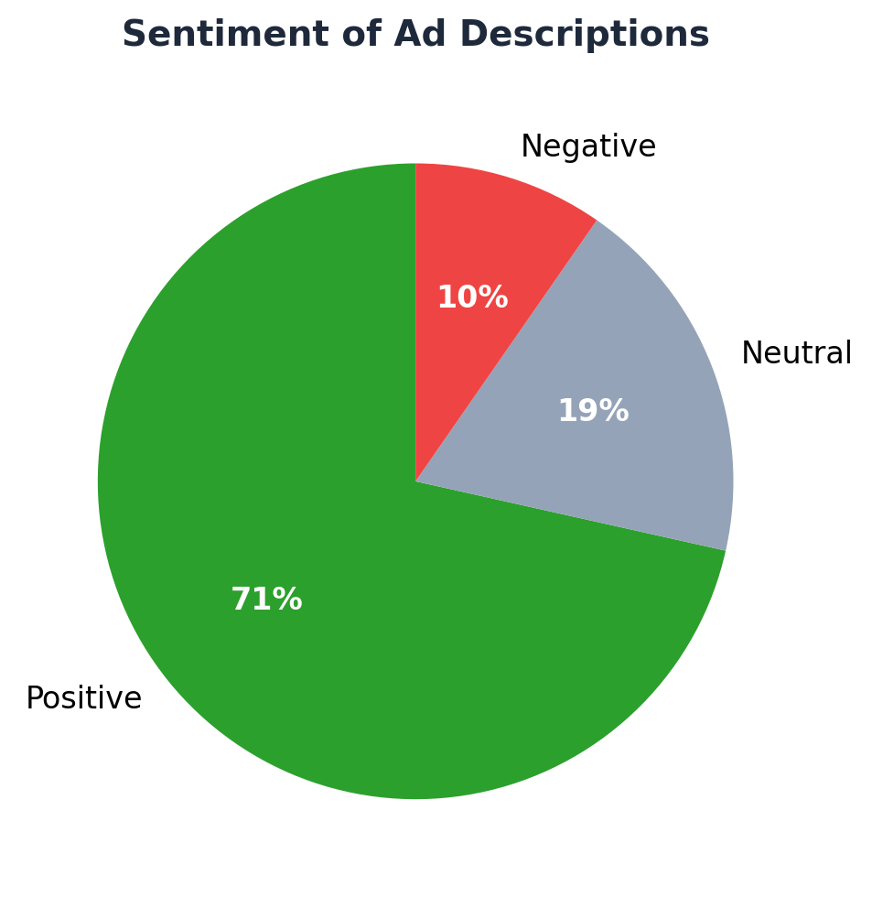
NLP Analysis: Sentiment & Topics
VADER + BERT sentiment, LDA topic modeling
Dual Sentiment + Topic Modeling
VADER: Rule-based lexicon scoring (fast, interpretable)
BERT: Deep learning contextual analysis (nlptown model)
Side-by-side comparison reveals agreement and divergence
LDA topic modeling discovers 5 latent themes in ad copy
Word clouds and topic quality scoring (distinctness metric)

Slide 8
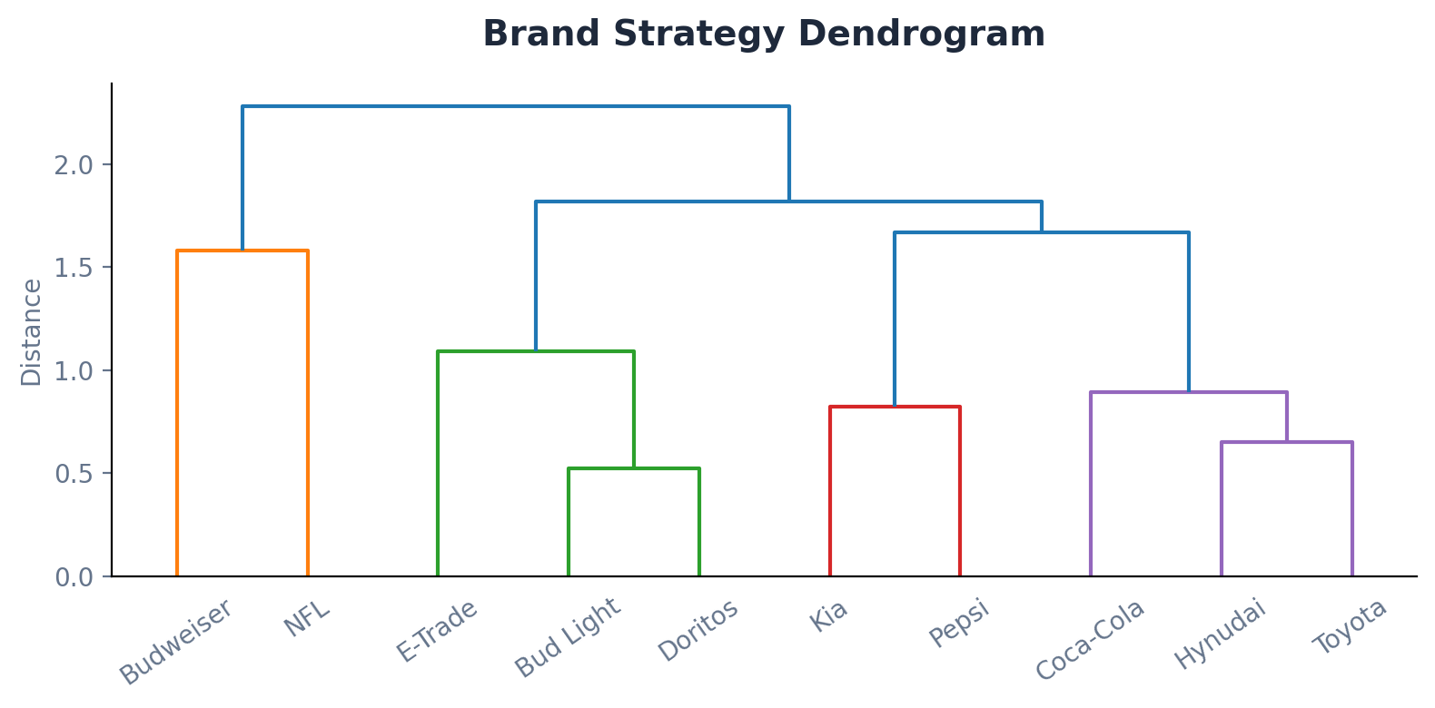
Text Analysis & Clustering
TF-IDF, Word2Vec, cosine similarity, K-Means, hierarchical clustering (Sessions 2 & 3)
TF-IDF Vectorization
Identifies each brand's most distinctive ad vocabulary
Word2Vec Embeddings
Learns semantic word relationships from ad corpus
t-SNE Visualization
Projects high-dim embeddings to interactive 2D scatter
Cosine Similarity
Measures content similarity between ad descriptions
Jaccard Similarity
Compares brands by shared feature profiles
K-Means Clustering
Groups ads by content + features into clusters
Hierarchical Clustering
Dendrogram reveals brand strategy relationships

Slide 9
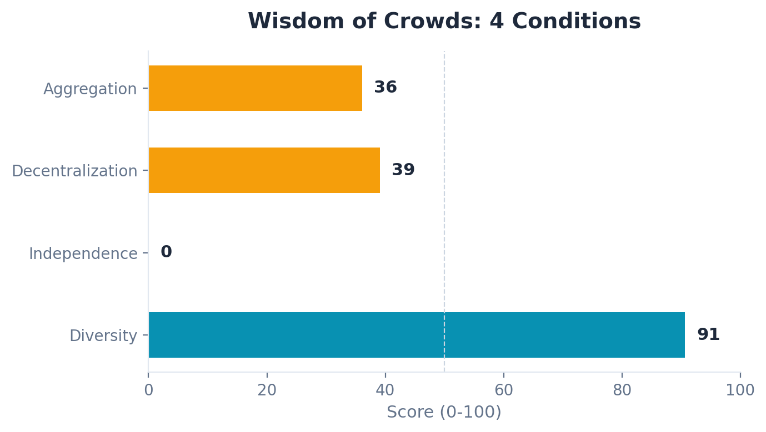
Network & Crowd Intelligence
Brand influence networks, centrality analysis, Wisdom of Crowds (Session 6)
Brand Strategy Network
10 brand nodes, edges weighted by strategy similarity
Interactive Pyvis force-directed graph in dashboard
Node size = total engagement, edge width = similarity
Centrality Measures
Degree: connectivity / popularity
Betweenness: bridge role between clusters
Closeness: accessibility to all other ads
PageRank: influence based on connection quality
Surowiecki's 4 conditions evaluated against the Super Bowl ad ecosystem

Slide 10
SEM Performance Lab
Super Bowl ads through an SEM lens (Session 5 -- Air France case study approach)
CPV
CPE
Quality Score
ROI
Cost Per View
Cost Per Engagement
0-10 Proxy
Return on Ad Spend
Estimated ad cost / YouTube view count
Estimated ad cost / (likes + comments)
Engagement rate + like ratio + views rank
Engagement score / estimated $ spent
Publisher-Style Brand Comparison
Ranks 10 brands like SEM publishers (mirroring Air France case)
Brands compared by CPV, CPE, ROI, and Quality Score
Keyword strategy analysis with TF-IDF term categorization
Feature-based strategy recommendation engine

Slide 11
Course Concept Coverage
21 techniques spanning 5 of 6 course sessions
21
5/6
11
6
Techniques Implemented
Course Sessions Covered
Dashboard Pages
Validation Methods
S1: Web Analytics
Google Trends integration
S2: Word Embedding
TF-IDF, Word2Vec, t-SNE
S3: Text Analysis & LLMs
VADER, BERT, cosine similarity, Jaccard, K-Means, hierarchical clustering, LDA
S5: SEM/SEO
CPV, CPE, ROI, Quality Score, keyword strategy, publisher comparison
S6: Social Networks
NetworkX, degree/betweenness/closeness/PageRank centrality, Wisdom of Crowds

Slide 12
Output Validation
6 validation methods ensuring AI outputs are reliable
Sentiment Distribution
Known-Sample Accuracy
Topic Distinctness
Flags if >95% single class
5 test cases, 80% accuracy
Cosine distance score: 0.312
BERT vs VADER
Wisdom of Crowds
SEM Benchmarking
Agreement rate comparison
4-condition scoring system
Industry cost validation

Slide 13
Key Findings
Show Product Quickly wins
Ads that show the product early get 70% more views. Clarity beats cleverness.
Celebrity doesn't guarantee success
Celebrity ads averaged 54% fewer views. The product and story matter more.
Brands cluster into strategy groups
Hierarchical clustering reveals beer brands (Bud Light, Budweiser) and tech brands (Hyundai, Kia, Toyota) use similar strategies.
Network analysis reveals bridge brands
Some brands' ads bridge different content clusters, connecting humor-based and product-focused strategies.
Crowd wisdom is moderate
The Super Bowl ad ecosystem scores ~41/100 on Wisdom of Crowds -- showing herding behavior among brands.
SEM efficiency varies 10x across brands
Cost per view ranges from $0.50 to $50+ across brands, revealing massive efficiency gaps.

Slide 14
Live Demo
AdPulse v2 -- 11-Page Interactive Streamlit Dashboard
streamlit run app.py

Slide 15
Thank You
Questions?
Team 6 -- Purple Cohort
Graeme Ampeire | Soumya Thareja | Tiffany Nakamitsu | Akanksha Singh
AdPulse | AI-Powered Ad Campaign Performance Analyzer
MSIS 521 -- Winter 2025 -- University of Washington

