Slide 1
Efficient processing of ATLAS events analysis in platforms with accelerator devices
André Pereira
Prof. Alberto Proença (Advisor)
Prof. António Onofre (Co-Advisor)

Slide 2
Index
Motivation
State of the Art
Heterogeneous Platforms
Software
The ttH_dilep Analysis Application
Future Work

Slide 3
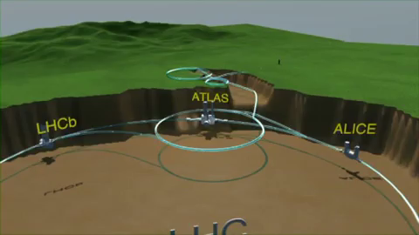
Motivation

Slide 4
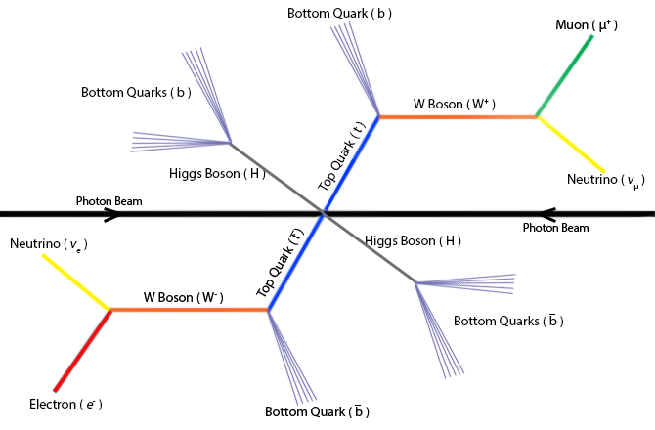
Motivation
ttbar system + Higgs decay

Slide 5
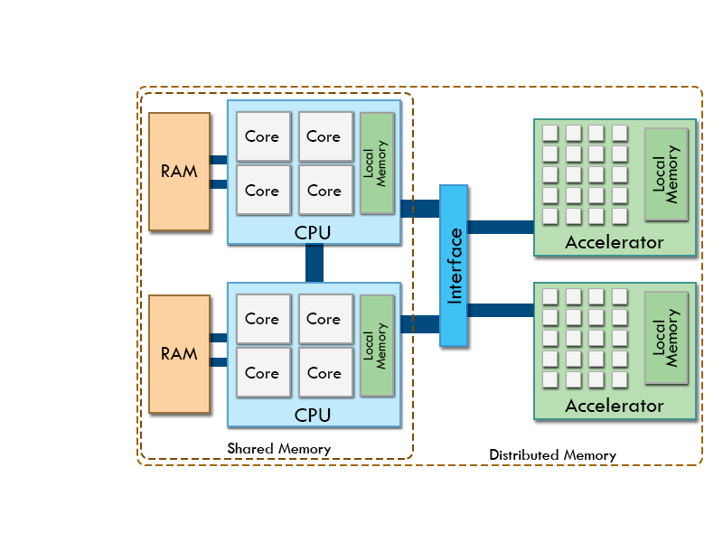
Heterogeneous Platforms

Slide 6
Heterogeneous Platforms
Several challenges
Different architectures
Different programming paradigms
Load balancing
Debugging
Notes:
1. Hierarquias de memória diferentes

Slide 7
Accelerator Devices
Usually based on the SIMD model
Graphics Processing Units architectures
NVidia Fermi
NVidia Kepler
Intel Many Integrated Core architecture
Intel Xeon Phi
Notes:
Normalmente orientados para tarefas especificas – GPU para image rendering
GPUs: Archs com devices orientados para scientific computing; bons para problemas compute bound
MIC: resposta da intel, um pouco diferente, apenas um device para memory bound problems

Slide 8
Development Frameworks
Available frameworks
OpenMP (Homogeneous Platforms)
OpenACC (Heterogeneous Platforms)
GAMA (Heterogeneous Platforms only with GPUs)
Notes:
Objectivo de abstrair as complexidades das arquitecturas, facilitando a tarefa dos programadores inexperientes
OpenMP: Open Multi-Processing, framework baseada em pragmas para paralelizaçao de tarefas em ambientes shared memory CPU
OpenACC: Open Accelerator, framework baseada em pragmas para paralelização de tarefas em ambientes heterogeneos, para ja apenas com GPUs
GAMA: GPU and Multicore Aware, framework mais “low-level” que as restantes, com uma curva de aprendizagem maior mas que teoricamente oferece melhor performance

Slide 9
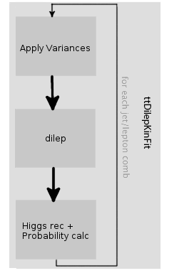
The ttH_dilep Analysis Application
Series of filters applied to the events;
Reconstruct the ttbar system and Higgs bosons;
Critical region: ttDilepKinFit
Notes:
Tenta reconstruir o sistem ttbar e bosões de Higgs, cada evento deve passar uma série de filtros até poder ser reconstruído;
Impossivel de paralelizar porque as tasks sao repetidas no loop

Slide 10
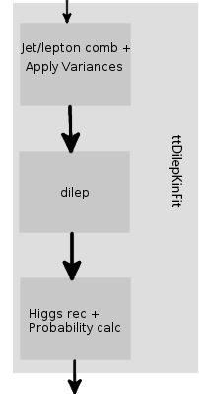
Future Work
Refactor ttDilepKinFit
Current
Proposed

Slide 11
Future Work
Parallelization on heterogeneous platforms
Comparing accelerator devices
OpenACC vs GAMA
Notes:
Parallelization: Usar os devices apresentados e comparar a sua performance
Avaliar a usabilidade e performance do OpenACC e GAMA

Slide 12
Efficient processing of ATLAS events analysis in platforms with accelerator devices
André Pereira
Prof. Alberto Proença (Advisor)
Prof. António Onofre (Co-Advisor)

