Slide 1

Efficient processing of ATLAS events analysis in homogeneous and heterogeneous platforms with accelerator devices
University of Minho
Department of Informatics
André Pereira
Prof. Alberto Proença (Advisor)
Prof. António Onofre (Co-Advisor)

Slide 2
Overview
Motivation
Structure of ttH_dilep
Analysis of critical regions
Improving efficiency through parallelism
On shared memory homogeneous systems
On heterogeneous systems with a GPU accelerator
On heterogeneous systems with a MIC accelerator
Efficient data & workload scheduling

Slide 3
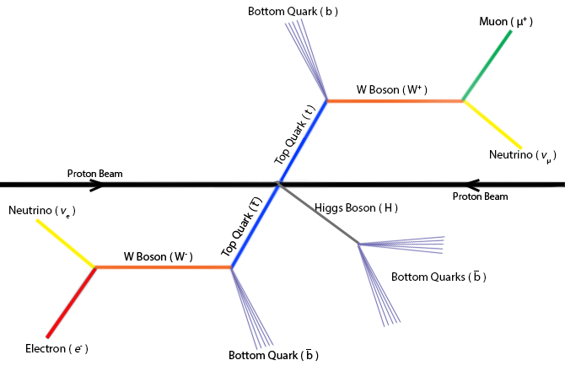

Motivation
The target model for an event
Reconstruction of the Top Quarks (t&ī) system with Higgs boson
the analysis and reconstruction code => ttH_dilep
Goal: to develop efficient ttH_dilep code

Slide 4
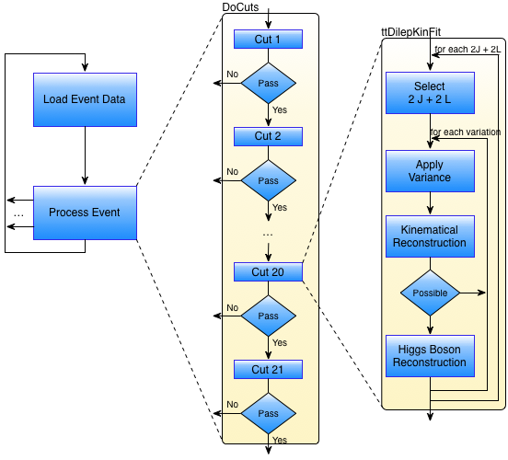
Structure of ttH_dilep (3)
Cut #20
Complex filter: ttDilepKinFit aka KinFit

Slide 5
Critical regions in ttH_dilep
# variations per event

Slide 6
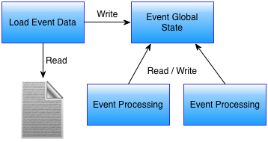
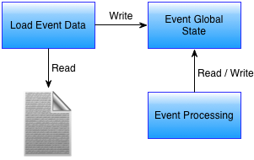
Improving efficiency with parallelism…
Sequential
Parallel
...

Slide 7
… no way with single global state!
Sequential
Parallel
...

Slide 8
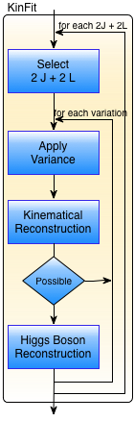
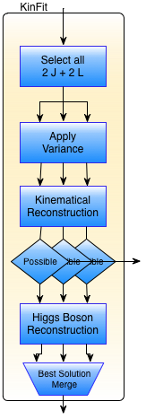
Alternative1a: parallelize KinFit, shared memory, no h/w accelerators
Sequential
Parallel
Selects all sets of 2 jets & 2 leptons, and builds a new data structure for each set
In parallel:
applies a tolerance (variation) to each measure
performs a kinematical reconstruction
reconstructs the Higgs Boson
selects the best solution (reduction)
The new data structure:
all data are replicated; or
common data share a pointer

Slide 9
Performance analysis (1)
System: c.n. 711
# of variations per event

Slide 10
Performance analysis (3)

Slide 11
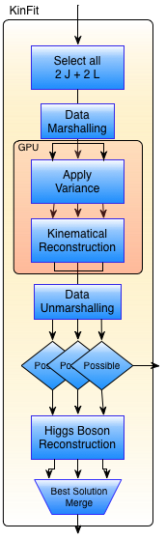
Alternative 1b: parallelize KinFit, with GPU accelerator (distributed memory)
Parallel, no accelerator
Parallel: multicore + GPU
Data marshalling:
Transform ROOT (and application classes) in arrays to transfer to the GPU
In the GPU:
Apply the variance on the inputs
Perform the kinematical reconstruction
Data unmarshalling:
Transform the data on the arrays in the original classes with the updated info
Parallel reconstruction of the Higgs boson

Slide 12
Performance analysis (1)

Slide 13
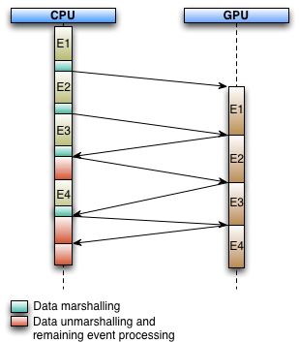
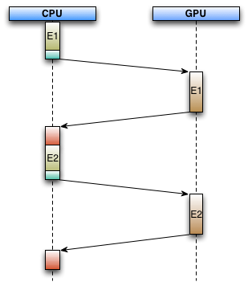
Performance analysis (2)
Ideal execution
Current execution
For 256 variations the CPU is idle
31% of the time…
A single global state
prevents simultaneous CPU & GPU processing
Notes:
Grafico aqui do idle?

Slide 14

Alternative 1c: parallelize KinFit, 1x CPU-core with MIC accelerator
(i) MIC native
(ii) MIC offload
MIC native:
Whole application runs on Xeon Phi (1 core reserved for OS)
Frameworks, libraries and application compiled for the device
Simple port (Intel claims)
All input data must be manually copied to the device, prior to execution
MIC offload:
Similar to the GPU implementation
Xeon Phi can use all cores
ROOT classes do not work on the device in this configuration
Data transfers between CPU and Xeon Phi for every event…

Slide 15
Alternative 1c: parallelize KinFit, 1x CPU-core with MIC accelerator
(i) MIC native
(ii) MIC offload
MIC native limitations:
ROOT compilation for this architecture released on a patch, but with a bug
Other required libraries not so easy to port to the device
Implementation left on hold
MIC offload limitations:
No ROOT classes on the device – not viable to have a version simultaneously compiled for the device and CPU
High latency data transfers between device and CPU for each event
Drivers are still too “young” causing many setbacks to the preliminary implementation

Slide 16
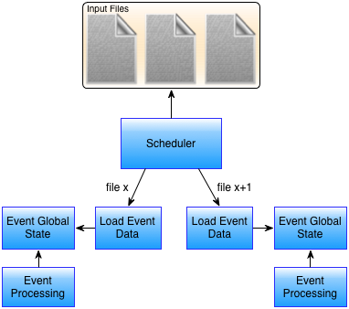
Alternative 3: events from different files
Sequential
Parallel
...

Slide 17
Performance analysis (1)
# of variations

Slide 18
Performance analysis (2)

Slide 19
Efficient processing of ATLAS events analysis in platforms with accelerator devices
University of Minho
Department of Informatics
André Pereira
Prof. Alberto Proença (Advisor)
Prof. António Onofre (Co-Advisor)

