Slide 1



Removing Inefficiencies from Scientific Code
André Pereira UM/LIP
António Onofre UM/LIP
Alberto Proença UM
Notes:
interface com fisica

Slide 2
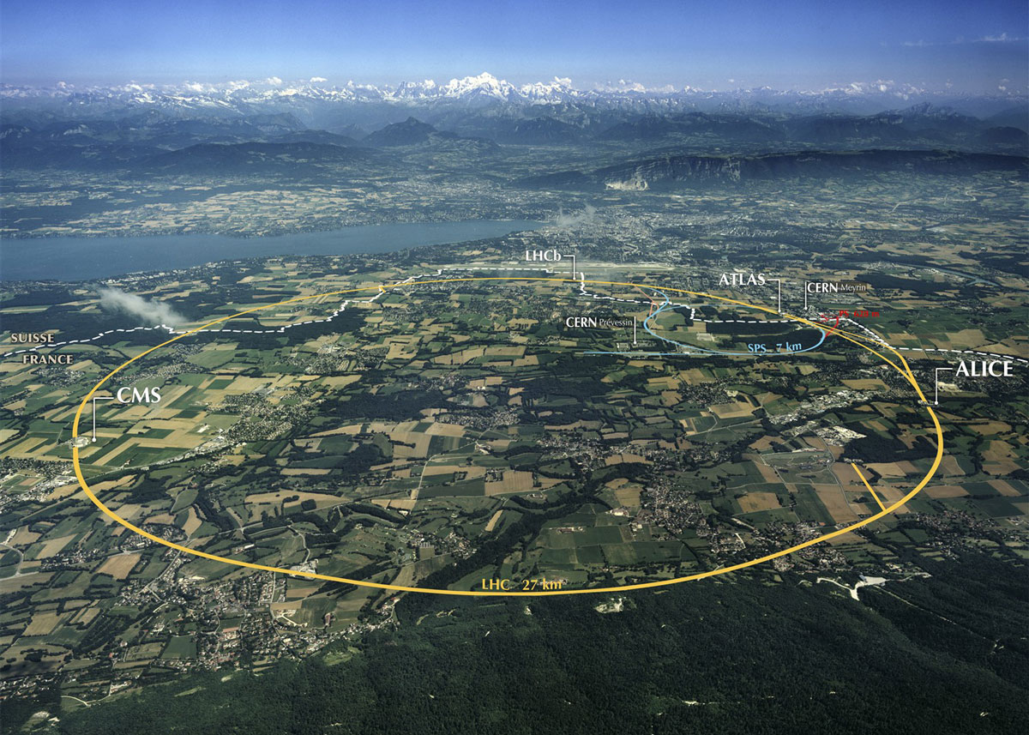
CERN

Slide 3
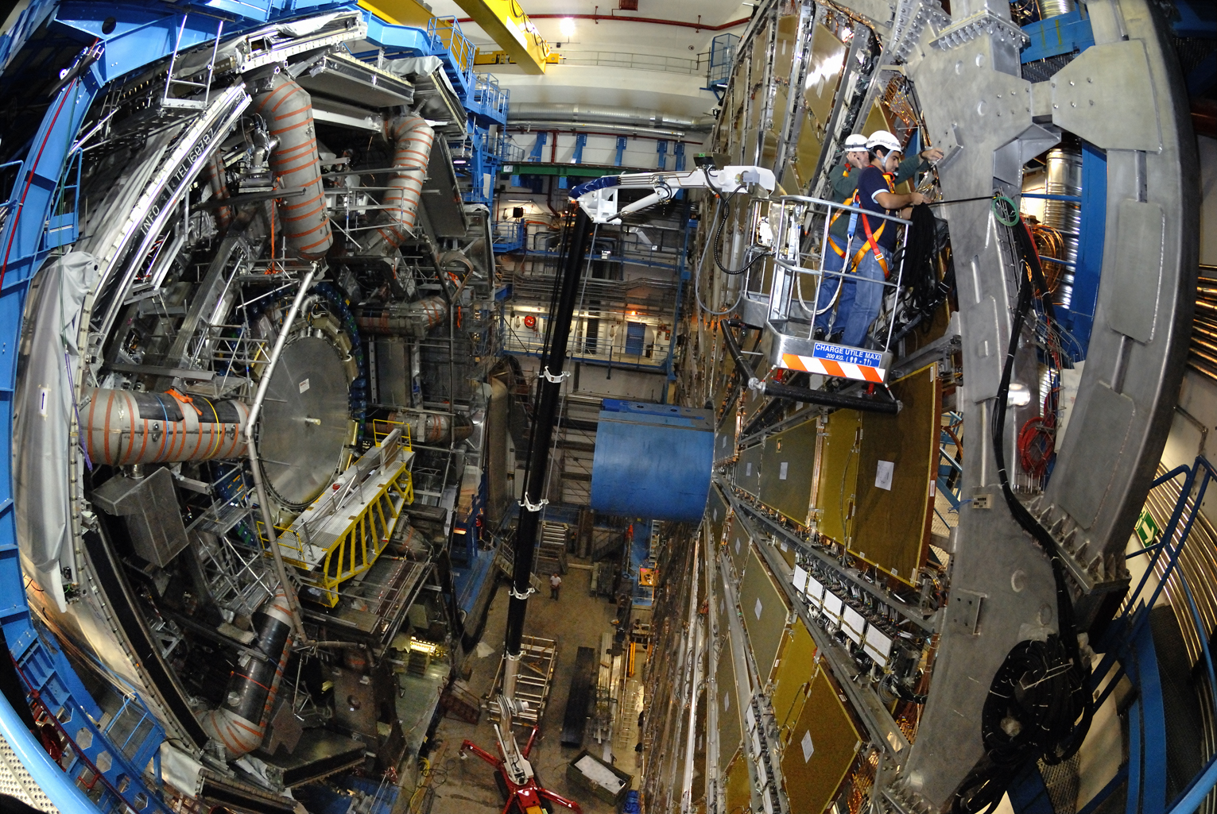
The ATLAS Particle Detector
800 million collisions/sec

Slide 4
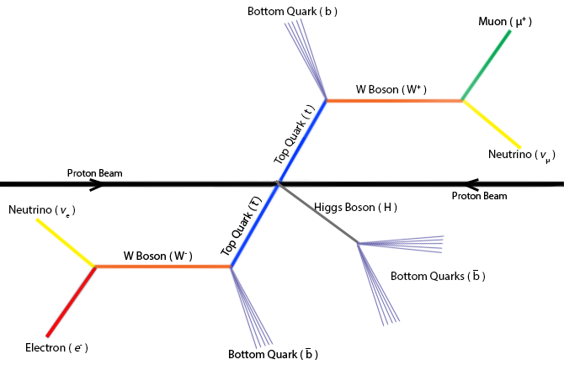
Top Quark and Higgs Boson Decay

Slide 5
Top Quark and Higgs Boson Decay

Slide 6
Top Quark and Higgs Boson Decay
200 events/sec to be processed (bundled!)

Slide 7
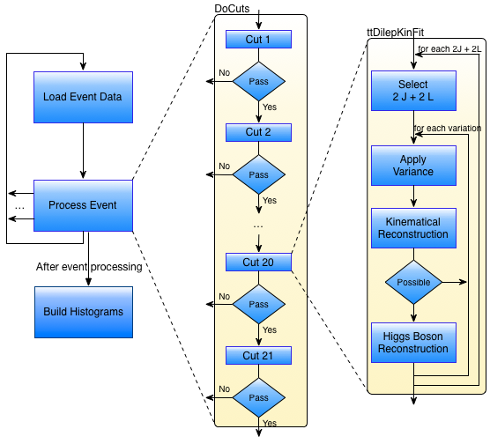
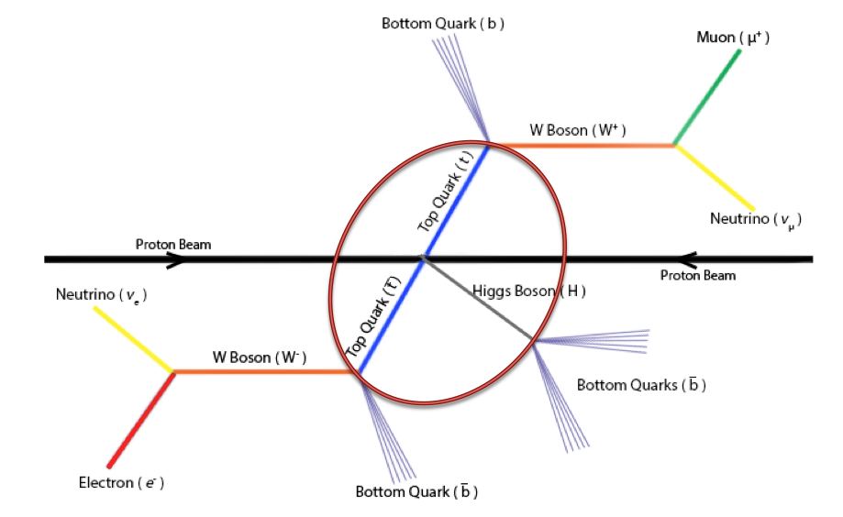
The Original Software
Notes:
Coded by self taught programmers

Slide 8
The Original Software
Runs event by event on a single computer (aka single-core)
< 3k events/sec on a 2.6GHz processor
Considers detector data as accurate, but they are not: ±1% uncertainty

Slide 9
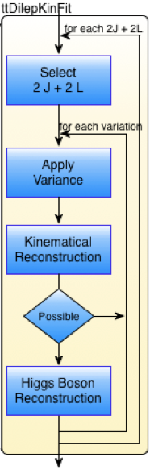
Higgs Boson: Improving Accuracy & Decay Rate
Improve accuracy of the detector outputs
Random variation ±1% of measured values
~1k variations (slows down to 5 events/sec)
Improve software throughput
By removing code inefficiencies
Through execution parallelism:
exploring multi-core devices

Slide 10
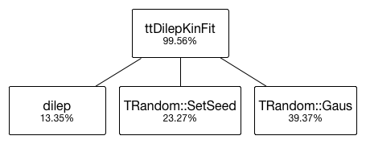
Coding Inefficiencies (1)
Pseudo-random number generation (profile)
For 256 variations

Slide 11
Coding Inefficiencies (1)
Pseudo-random number generation (profile)
Reset seed every 18 PRNs !!!
For 256 variations

Slide 12
Coding Inefficiencies (1)
Pseudo-random number generation (profile)
Reset seed every 18 PRNs
.
Removing SetSeed => 71% performance improvement
For 256 variations

Slide 13
Coding Inefficiencies (2)
Data structure inefficiencies
Event-data structured on a LIP library toolbox (LipMiniAnalysis)
This structure only allows processing one event at a time => events from the same batch file cannot be simultaneously processed

Slide 14
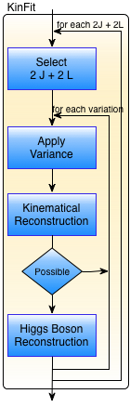
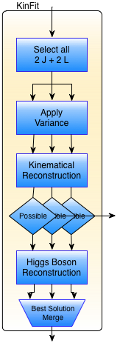
Parallelization Approach
Sequential
Parallel
1k variations
KinFit takes
99.8% overall
execution time!

Slide 15
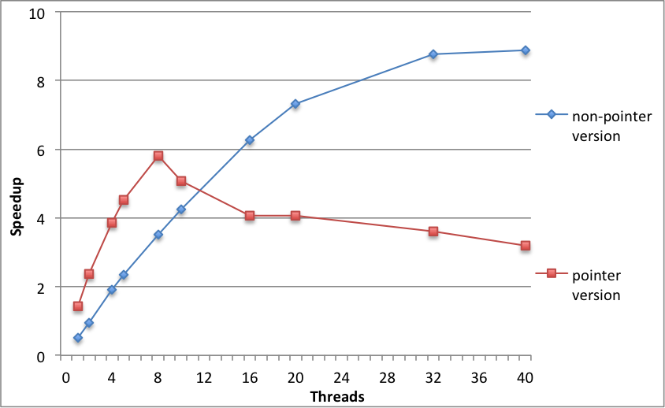
Parallelization Approach
2x 10-core Intel Xeon E5-2670v2, with Hyperthreading, 64GB RAM
Notes:
Dados partilhados, NUMA accesses

Slide 16
Runtime Inefficiencies
Multithreading inefficiencies limit scalability…
Hybrid parallelization may remove the bottlenecks

Slide 17
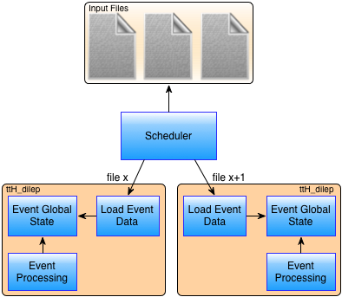
Runtime Inefficiencies
Multithreading inefficiencies limit scalability…
Hybrid parallelization may remove the bottlenecks

Slide 18
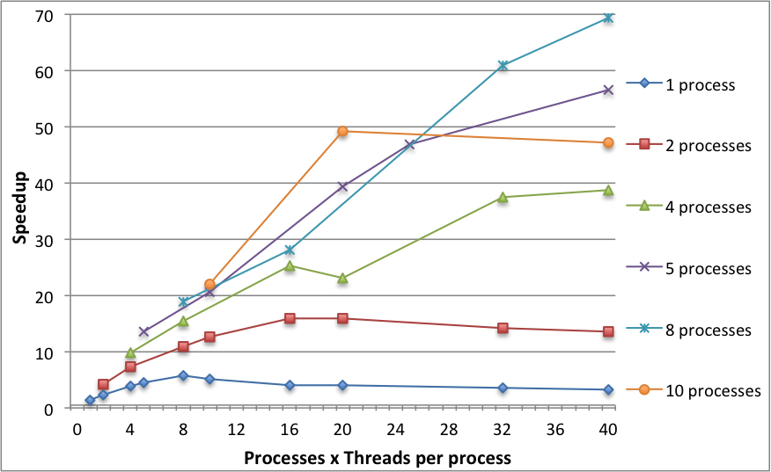
Removing Runtime Inefficiencies
2x 10-core Intel Xeon E5-2670v2, with Hyperthreading, 64GB RAM

Slide 19
Runtime Inefficiencies
Multithreading inefficiencies limit scalability…
Core affinity inefficiencies
Better cache and thread management on NUMA
Notes:
Preliminary
Why: because on the pointer the threads were being changed among cores, ruins the cache

Slide 20
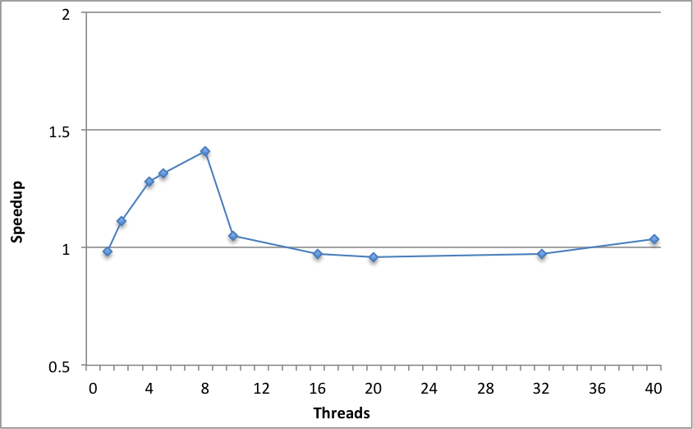
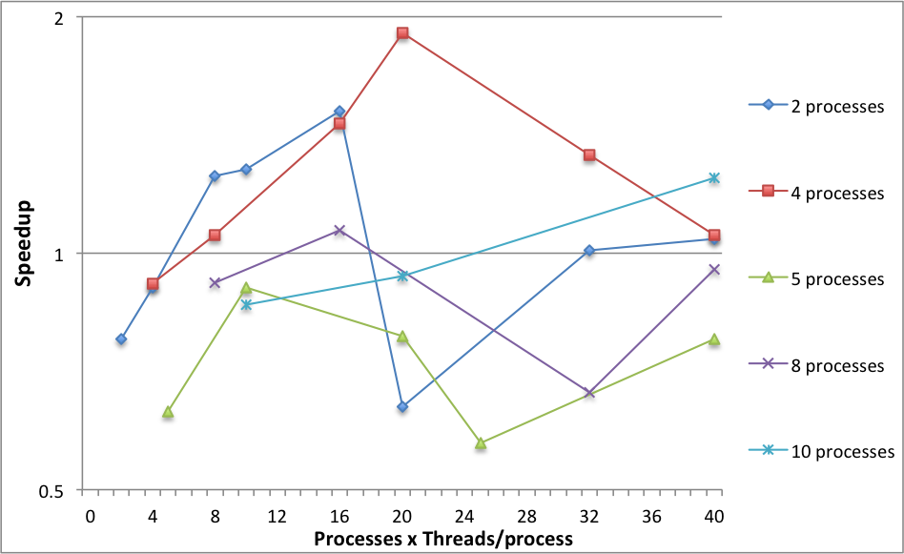
Reducing Runtime Inefficiencies
Fig: Single process pointer implementation
Fig: Scheduler
2x 10-core Intel Xeon E5-2670v2, with Hyperthreading, 64GB RAM

Slide 21
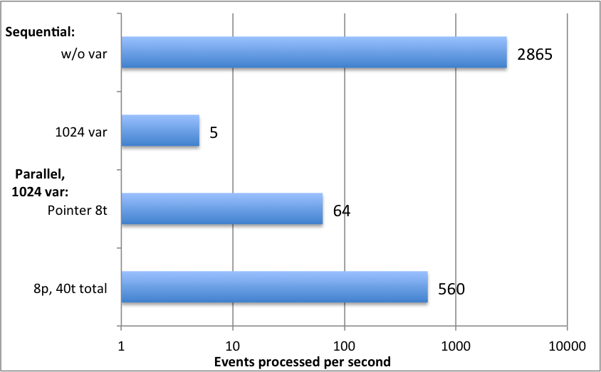
Efficiency improvement (overview)
2x 10-core Intel Xeon E5-2670v2, with Hyperthreading, 64GB RAM

Slide 22
Conclusions
Efficiency improvement of a factor of 112
On a single CPU device, core affinity may improve efficiency
Simple code mistakes can lead to large performance drops

Slide 23
Future Work
Automatic tuning of the #threads/process by the scheduler
Redesign the LipMiniAnalysis event-data structure
Parallelization in heterogeneous platforms
Custom implementation
Frameworks for efficient load balancing

Slide 24
Removing Inefficiencies from Scientific Code
André Pereira UM/LIP
António Onofre UM/LIP
Alberto Proença UM
Notes:
interface com fisica

