Slide 1


Tuning Pipelined Scientific Data Analysis
For Multicore Execution
André Pereira – LIP/UMinho
António Onofre – LIP
Alberto Proença – UMINHO
HPCS 2016

Slide 2
Agenda
Motivation
Scheduling with Pipeline Reordering
Real World Case Study
Scheduler Efficiency
Conclusions and Future Work

Slide 3
Motivation (1)
Most scientific data analysis compute tasks on large sets of independent data
Code typically organized as a pipeline of conditional irregular tasks
The order of computationally intensive tasks may impact the application performance
Scientists need to adapt their code to the current highly parallel systems
Implement common parallelization approaches for embarrassingly parallel applications
Not suited for every code – the pipeline may be compute, memory or I/O bound
Sophisticated mechanisms are required to efficiently use the computational resources

Slide 4
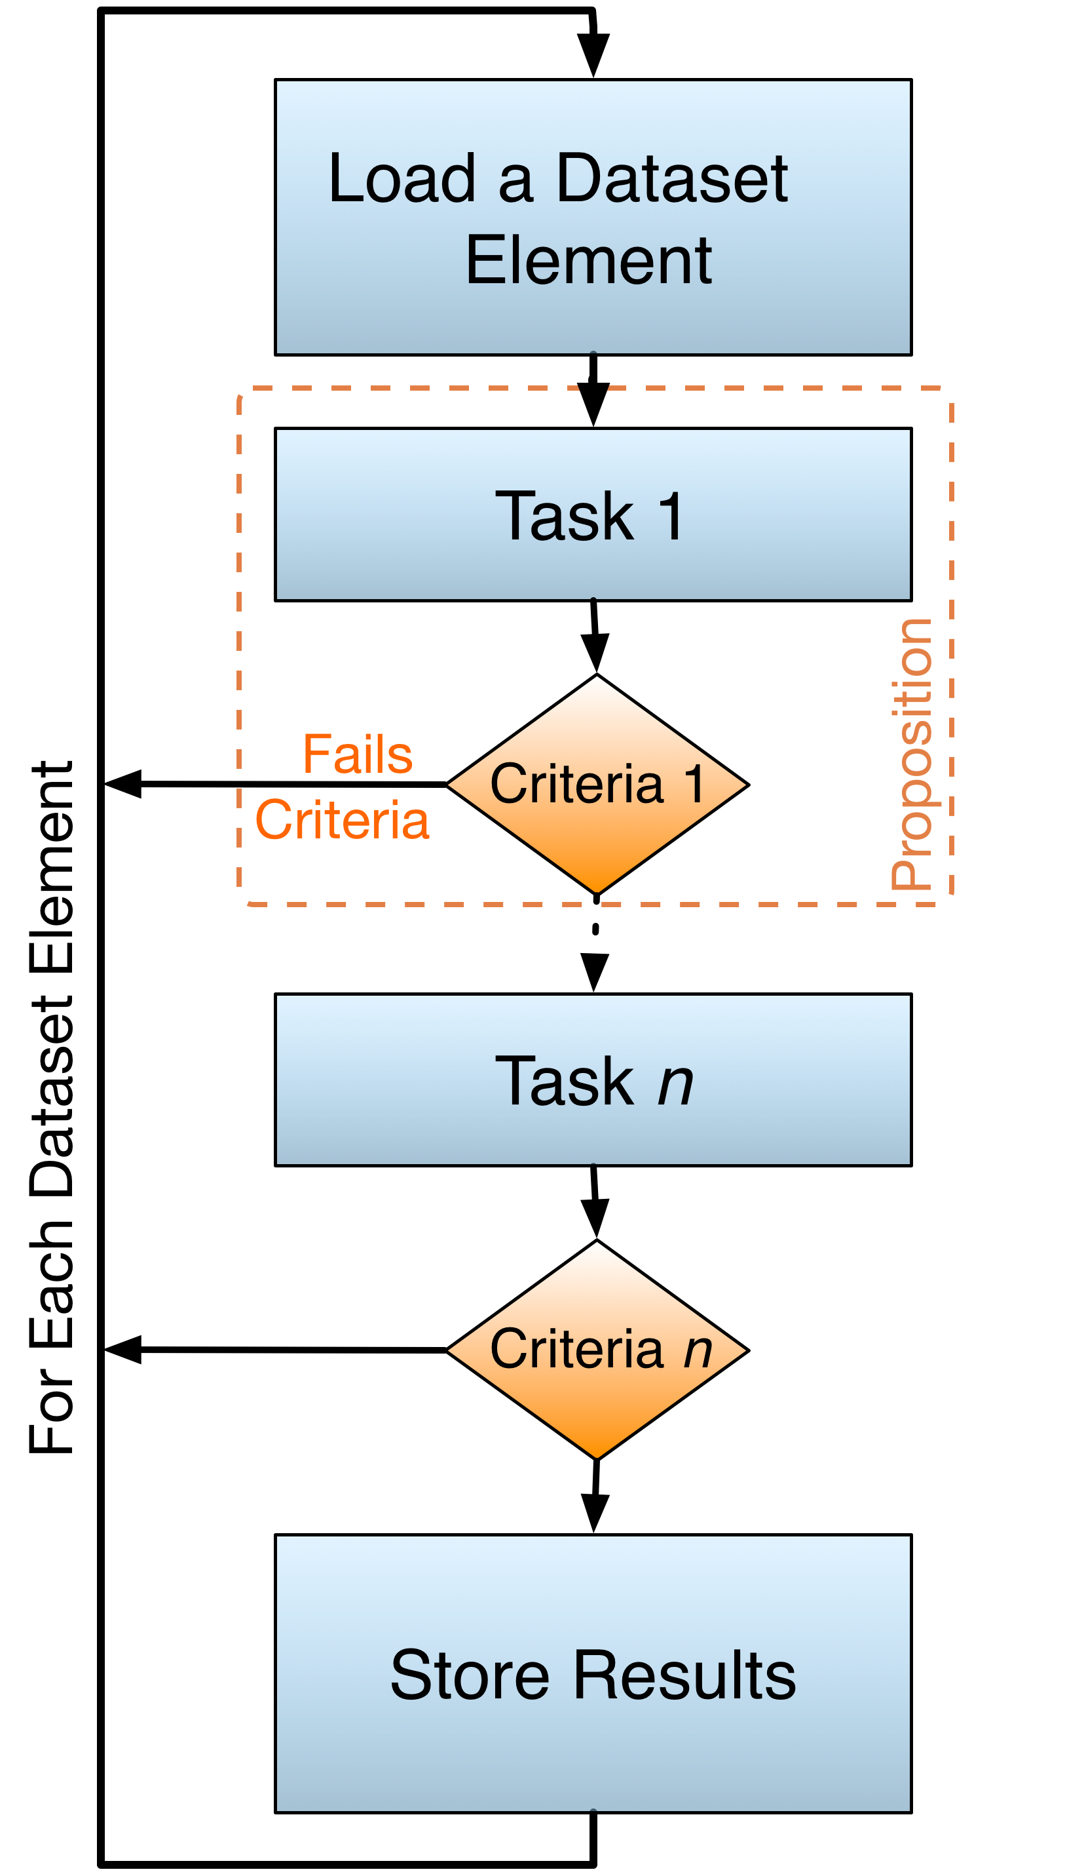
Motivation (2)
Structure of pipelined scientific applications (our view)
Handle independent datasets
Execute a chain of irregular tasks (a pipeline)
The execution of each task may depend on other(s) task(s)
Performance may be improved by reordering the pipeline stages
Real world examples
Modeling/simulation
Scientific data analysis

Slide 5
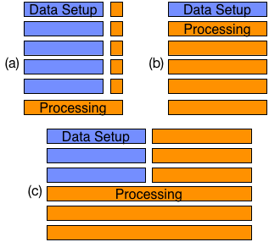
Scheduling with Pipeline Reordering (1)
It works in two stages
Simultaneous reading/processing of data
Threads assigned as readers and processers
Scheduling of data and tasks among processers
Parallel processing of tasks
Tasks organized in a table, based on their dependencies, execution time & filtering ratio
Task order updated on regular intervals

Slide 6
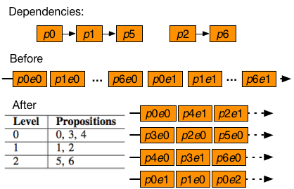
Scheduling with Pipeline Reordering (2)
It works in two stages
Simultaneous reading/processing of data
Threads assigned as readers and processers
Scheduling of data and tasks among processers
Parallel processing of tasks
Tasks organized in a table, based on their dependencies, execution time & filtering ratio
Task order updated on regular intervals

Slide 7
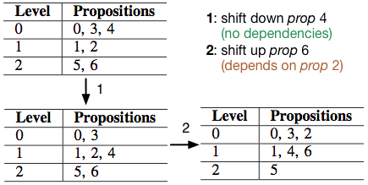
Scheduling with Pipeline Reordering (3)
It works in two stages
Simultaneous reading/processing of data
Threads assigned as readers and processers
Scheduling of data and tasks among processers
Parallel processing of tasks
Tasks organized in a table, based on their dependencies, execution time & filtering ratio
Task order updated on regular intervals

Slide 8
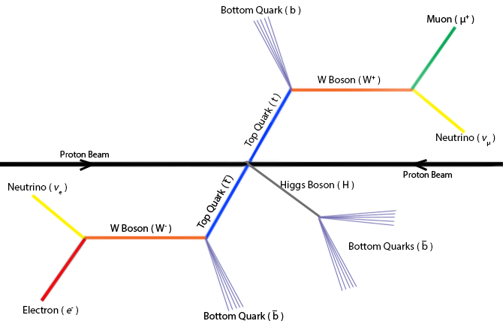
Real World Case Study (1)
A particle physics data analysis
Developed by physics researchers for the ATLAS Experiment (CERN)
Studies the couplings of top quarks to the Higgs boson (ttHdilep)
Millions of events (proton beam collisions)
Each event: a 17 stage pipeline (ordered by the physics researcher)
3 configurations
ttH_as – memory bound
ttH_sci – compute bound
ttH_scinp – compute bound, modified pipeline

Slide 9
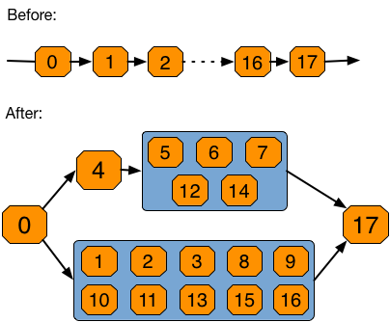
Real World Case Study (2)
For each event
Tasks originally executed sequentially
Tasks can be reordered respecting their inter-dependencies

Slide 10
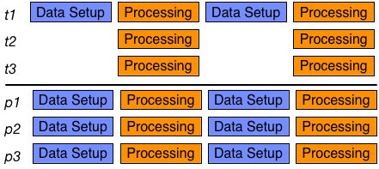
Testbed Configuration
Server with dual 12-core Intel Xeon E5-2695v2 Ivy Bridge @ 2.4GHz
Speedup measurements vs
Fully sequential code
Sequential Data Setup + Multi-Threaded processing, S+MT (top)
Fully Multi-Processing, MP (bottom)

Slide 11
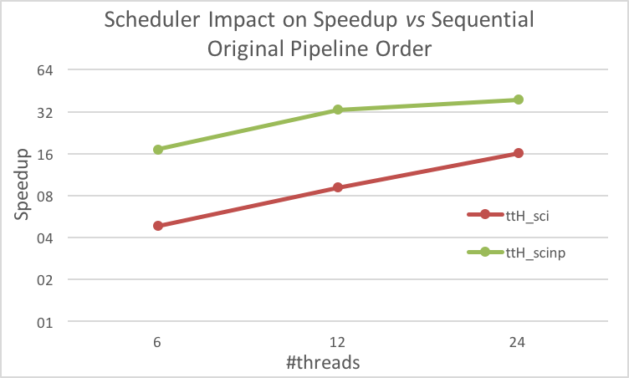
Scheduler Performance (1)

Slide 12
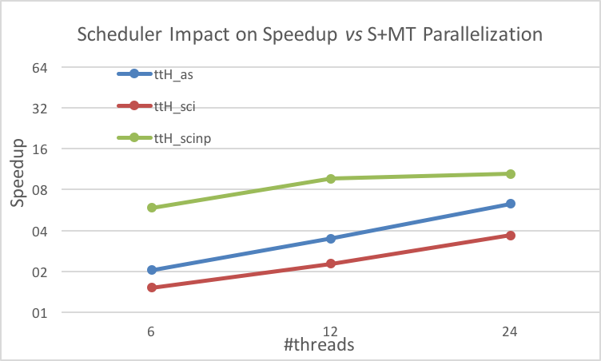
Scheduler Performance (2)

Slide 13
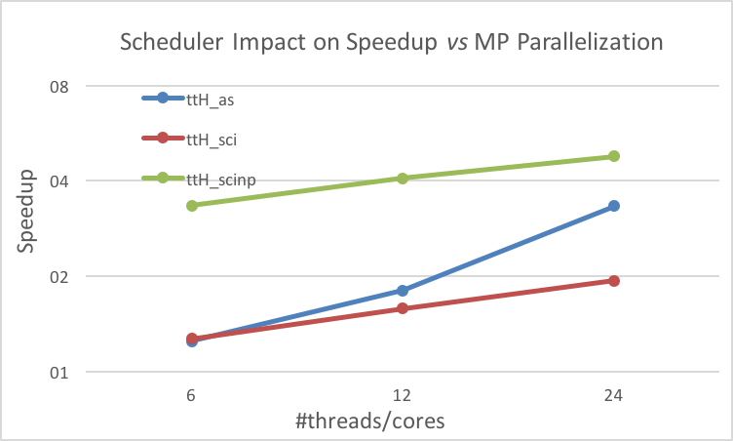
Scheduler Performance (3)

Slide 14



Conclusions
Common parallelization strategies used by scientists are not always the best approach to develop efficient embarrassingly parallel code
Our scheduler outperforms common parallelization strategies for pipelined scientific code; our case study:
Is up to 8x faster for the same #CPU cores
Is 39x faster than the sequential version
Shows good CPU usage in compute bound code
Memory bound code still uses the CPU inefficiently
Inadequate pipeline ordering leads to an increased scheduler efficiency
ttH_as
ttH_sci
ttH_scinp

Slide 15
Key Topics for Future Work
To assess the feasibility of offloading data processing to many-core devices
Intel Xeon Phi
NVidia GPUs
To dynamically balance the number of reader and processer activities according to the computation/memory intensity
To extend current server solution to a cluster environment

Slide 16
Tuning Pipelined Scientific Data Analysis
For Multicore Execution
ampereira90@gmail.com
HPCS 2016

