Slide 1


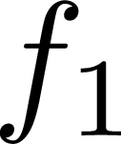
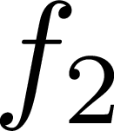
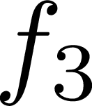
LR Patch
2x64x64
Conv
Tensor
x64x64
Tensor
x64x64
SR Patch
2x64x64
ReLU
Conv
ReLU
Conv
ReLU

Slide 2



Blocks
OLD
LR Patch
2x64x64
Tensor
x64x64
Conv
Tensor
2x64x64
+
SR Patch
2x64x64
Conv
ReLU
ReLU
Conv
ReLU

Slide 3
Blocks
LR Patch
2x64x64
Tensor
x64x64
Conv
+
SR Patch
2x64x64
Conv
ReLU
ReLU
Conv
ReLU

Slide 4

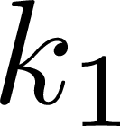
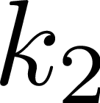
Residual Blocks
LR Patch
2x64x64
Tensor
x64x64
Conv
+
+
Tensor
x64x64
SR Patch
2x64x64
BN
PReLU
Conv
BN
Conv
Conv
BN
PReLU
Conv
PReLU
Conv
PReLU
Conv

Slide 5
(a) SRCNN
LR Patch
2x64x64
Conv
Tensor
x64x64
Tensor
x64x64
SR Patch
2x64x64
ReLU
Conv
ReLU
Conv
ReLU
(b) VDSR
Blocks
LR Patch
2x64x64
Tensor
x64x64
Conv
+
SR Patch
2x64x64
Conv
ReLU
ReLU
Conv
ReLU
(c) SRResNet
Residual Blocks
LR Patch
2x64x64
Tensor
x64x64
Conv
+
+
Tensor
x64x64
SR Patch
2x64x64
BN
PReLU
Conv
BN
Conv
Conv
BN
PReLU
Conv
PReLU
Conv
PReLU
Conv

