Slide 1

Andrew McDonald
Development Intern
Hyland Software
5.29.19

Slide 2
Design Overview
Graphics.cs
string[] board_art
List<int[]> spaces_player
List<int[]> spaces_houses
Random dice
Program.cs
int free_parking
int bank_hotels
int bank_houses
List<Property> board
List<Player> players
List<Card> chance
List<Card> chest
Property.cs
Player.cs
Card.cs
Card.cs
Property.cs
Player.cs
Card.cs
Card.cs
Property.cs
Player.cs
Card.cs
Card.cs

Slide 3
Property.cs
Methods
Property(string[] params)
sets()
gets()
void buy(Player p)
bool owned()
bool is_buildable(List<Property> monopolies)
void build()
void sell_house()
bool mortgaged()
int mortgage()
void unmortgage()
void return_to_bank()
int get_rent(int dice_roll = 0)
string override ToString()
Fully encapsulated OOP approach
Attributes
string name
string space_type
string color
int position
int price
int mortgage_price
int price_build
int[6] rent
int num_houses
bool is_owned
bool is_mortgaged
Player owner
Configuration
Purchasing
Houses
Mortgaging
Helpers

Slide 4
Player.cs
Methods
Player(string name, string character, int start_money, int go_value, int go_bonus)
sets()
gets()
void buy(Property p)
void pay(int amount)
void pay_rent(Player p, int amount)
void receive_payment(int amount)
int get_net_worth()
List<Property> get_tradable_properties()
int get_double_count()
void increment_double_count()
void reset_double_count()
int jailed()
void go_to_jail()
void increment_jail()
void release_from_jail
void pay_for_jail(int amount)
bool has_jail_free_card()
void use_jail_free_card()
Fully encapsulated OOP approach
Attributes
private string character
private string name
private int money
private int go_value
private int go_bonus
private int position
private int start_roll
private int turns_jailed
private int double_count
private Card get_out_of_jail_free
private List<Property> properties_owned
private List<Property> properties_mortgaged
private List<Property> monopolies
private List<Property> railroads
private List<Property> utilities
Configuration
Property Management
Jail

Slide 5
Player.cs
Methods (continued)
void advance(int num_spaces)
void send_property(Player p, Property property)
void receive_property(Property property)
void mortgage_property(Property property)
void unmortgage_property(Property property)
void take_card_action(Card card, ref List<Player> players, ref bool has_moved)
void refresh_properties()
void kill()
string override ToString()
Game Dynamics
Trading
Mortgaging
Chance/Chest
Helpers

Slide 6


Card.cs
Fully encapsulated OOP approach
Attributes
string tag
string type
string category
string name
string description
int effect
Methods
sets()
gets()
string override ToString()

Slide 7
Program.cs
Serves as main game manager class
Declare static global level variables and constants
Parse objects into memory from CSVs
board (List<Property> board),
cards (List<Card> chance, List<Card> chest),
graphics (string[] board_art), and
graphics indices (List<int[]> spaces_player, List<int[]> spaces_houses)
Configure basic game settings, create players & determine starting order
Run game until one player remains
declare()
parse()
setup()
while (players.Count > 1)
foreach (Player p in players)
while (!turn_is_over)
generate_options()
take_action()
…
helper_methods()

Slide 8
Program.cs: declare()
List<Property> board
Declare global-level constants
Command strings
Starting money
Passing go money
Free parking default
Income / Luxury taxes
Jail fee
Declare global-level variables
List<Player> players
List<Property> board
List<Card> chance
List<Card> chest
List<int[]> spaces_player
List<int[]> spaces_houses
string[] board_art
Random dice
int free_parking
int bank_houses
int bank_hotels
Property.cs
List<Player> players
Player.cs
List<Card> chance
Card.cs
List<Card> chest
Card.cs

Slide 9
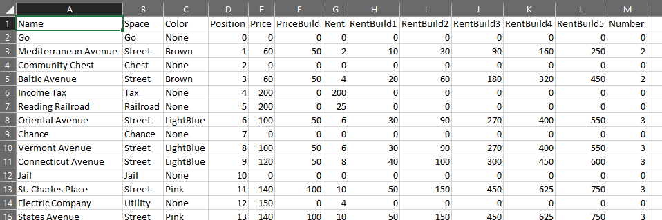
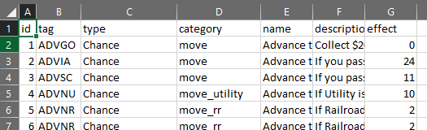
Program.cs: parse() & setup()
Parse objects into memory from CSVs
board.csv → List<Property> board
cards.csv → List<Card> chance, List<Card> chest
spaces_player.csv → List<int[]> spaces_player
spaces_houses.csv → List<int[]> spaces_houses
board_art.txt → string[] board_art
Setup game following user input
Set starting money
Set passing go money
Set landing go bonus
Set free parking bonus
Set number of players
Take player name
Select player character
Roll dice to determine starting order
Begin game!
board.csv
cards.csv

Slide 10
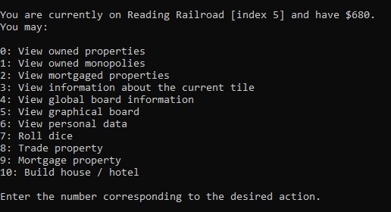
Program.cs: generate_options()
Given player and associated contextual attributes, determines what actions a player may take
Returns potential actions as a string array of constant literals
User selects action from list; then, take_action() is called
Input parameters:
Player p
bool turn_is_over
bool has_rolled
bool rent_paid
Output
List<string> options

Slide 11
Program.cs: take_action()
Given constant string literal action chosen from list of possibilities returned by generate_options, appropriate objects are updated to reflect the action
Cases handled individually, with helper methods called where applicable
Input parameters
Player p
List<string> options
int choice
ref bool turn_is_over
ref bool has_rolled
ref bool turn_ended
ref bool rent_paid
ref int dice_roll
Output: void (but note reference variables and objects may change)

Slide 12
Program.cs: Helper Methods
int roll_dice(Random random) // for game setup
int roll_dice(Random random, ref bool doubles) // for actual rolls
void reset_free_parking()
void add_free_parking(int amount)
int input_int(string message, int min, int max)
string input_string(string message, int min_len, int max_len)
void shuffle_cards(ref List<Card> cards)
Dice Management
Free Parking Management
User I / O
Card Management

Slide 13
Graphics.cs
Static support class approach
Generates and returns current board upon call from menu
Public Methods
public static string[] render(List<Player> players, List<Property> board, List<int[]> spaces_player, List<int[]> spaces_houses, string[] original_board_art, int free_parking)
Declares board_art = original_board_art
Iterates through properties on board, calling place_player and place_house to alter strings in board_art
Returns board_art to be printed to console
Private (Helper) Methods
private static void place_player(Player p, ref string[] board_art, int row, int col)
Given row (index of string in board_art) and col (index of char in board_art[row]), replace a substring in board_art with a character’s initial
private static void place_house(Property property, ref string[] board_art, int row, int col)
Given row (index of string in board_art) and col (index of char in board_art[row]), replace a substring in board_art with a character’s initial

Slide 14
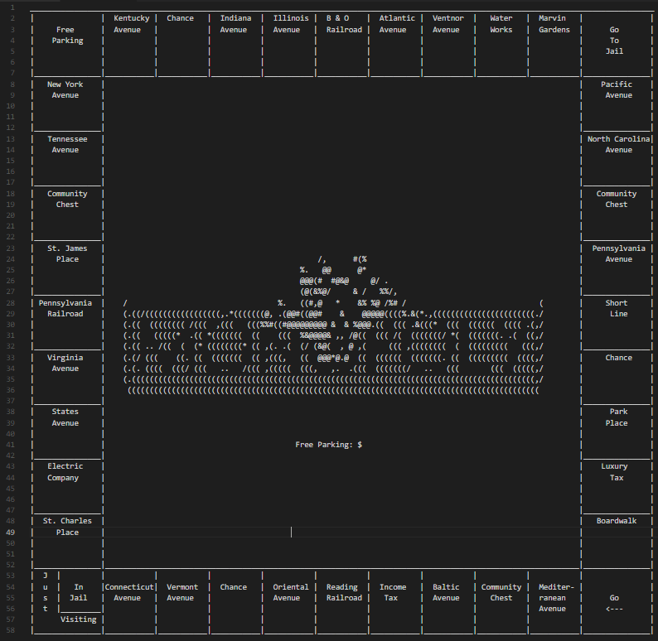
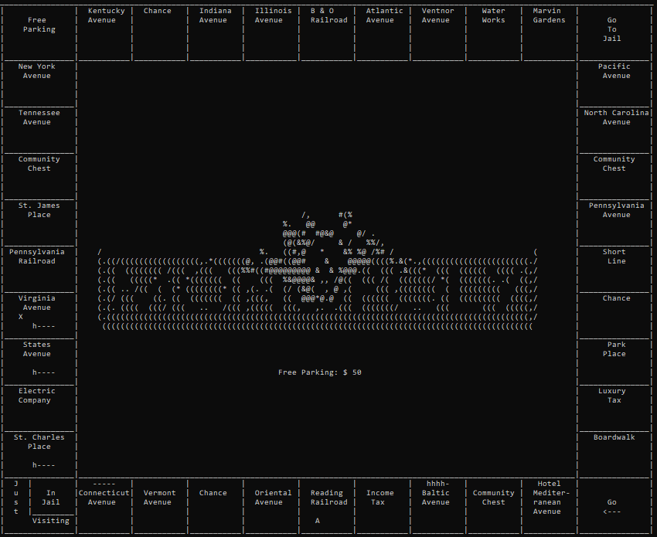
Graphics.cs

Slide 15
Reflections
Strengths
Depth of functionality
Robust
Object-oriented approach makes for easy scaling
Graphics!
Weaknesses
Scaling artifacts & retrofits
Class organization
Resistance to misuse
Single author architecture
Lessons
Importance of planning for scalability, flexibility, agility, and integrability
Importance of regular, rigorous, systematic testing
Importance of regular reflection, review, and revision
Importance of collaboration, creativity, and approach diversity

