Slide 1
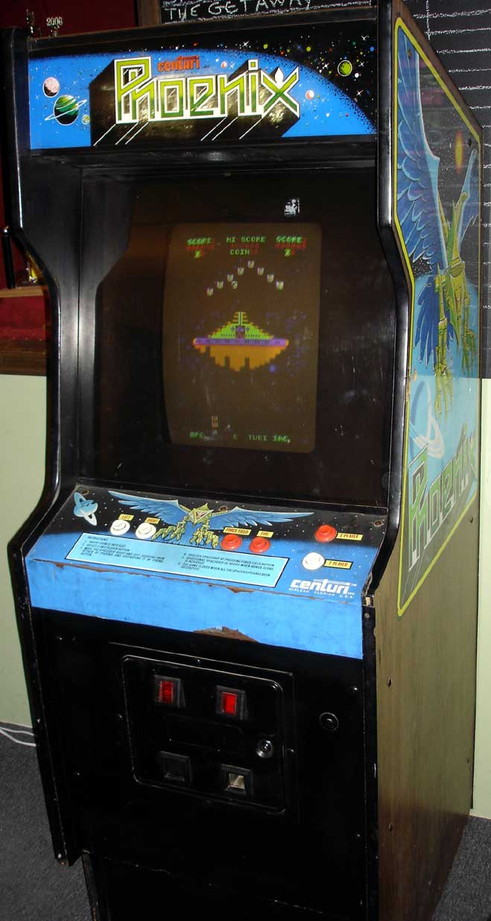
Phoenix
Final Project on classic
arcade game
Eduardo Nava
eddienvx@gmail.com

Slide 2
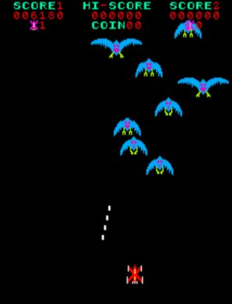
Overview
Phoenix is based on the classic arcade game phoenix
Similar to other space shooters except:
No barricades
dynamic enemy pathing

Slide 3
Accomplishments
Single player game
Top ten list
3 levels of difficulties
Satisfies:
2D array constraint: The terminal acts as a 2d field

Slide 4
What was fun, what was not
Playing the game
Learning the curses library
Transferring ideas from paper to the terminal
Setting up the initial conditions
Troubleshooting glitches and bugs

Slide 5
DEMO
Acknowledgements:
TA's and Teaching Fellows for helping to answer questions
Timothy Pettit for his version of Space Invaders which provided a basis from which this game was derived.
Various students for testing the game
Amstar Electronics and Centuri for developing and releasing Phoenix in 1980.

Slide 6
Demo
https://www.youtube.com/watch?v=XTLDroD4GCw

