Slide 1
Salamander exposures chlorpyrifos, 24d

Slide 2
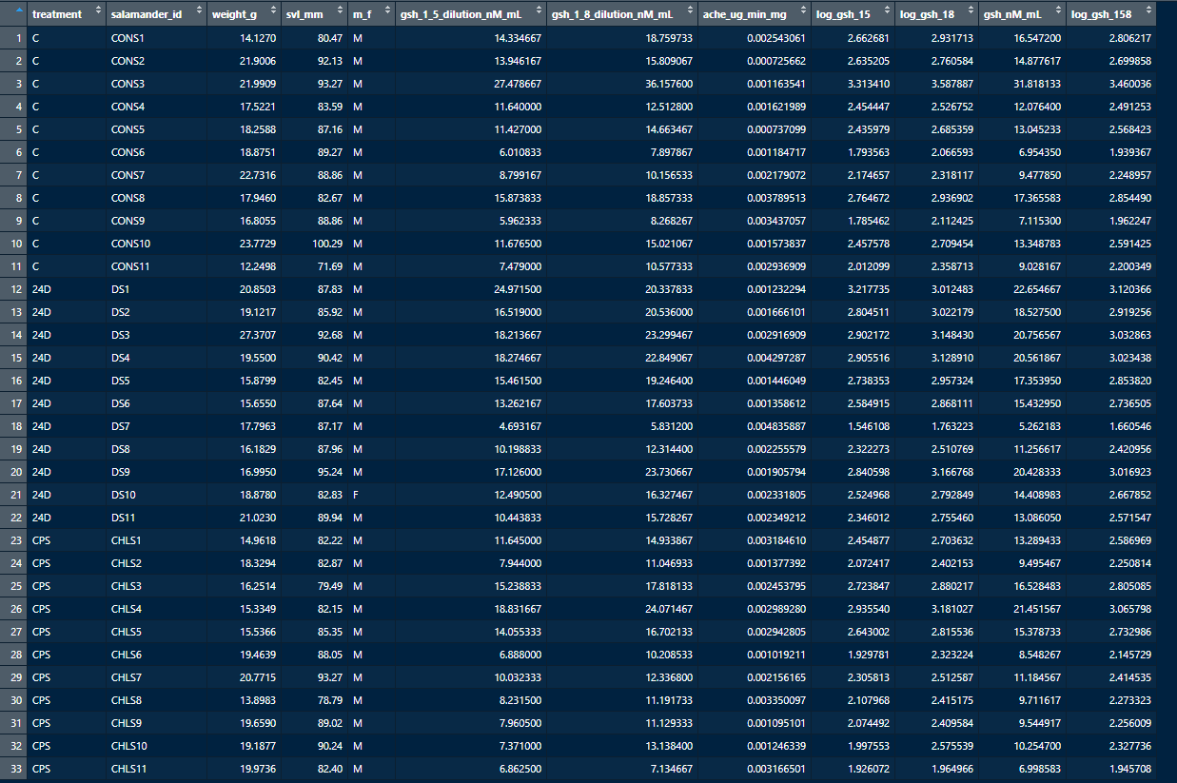

Slide 3



Summary stats for glutathione and acetylcholinesterase before investigating outliers (and the swab data for glutathione. Note that this summary for ache only reported to one significant digit, but the data and tests go deeper.

Slide 4
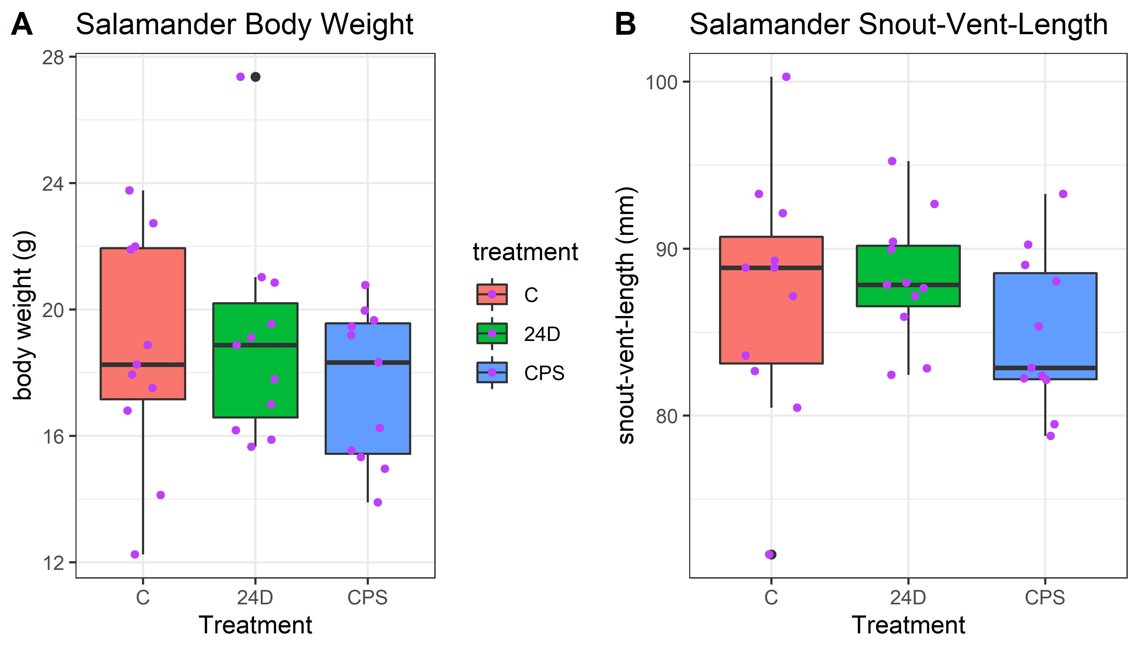
Body weight and SVL plot. Chlorpyrifos treatment ended up using slightly smaller salamanders, but this ended up not being an issue for the analysis (the points plot appears to be doubling the outlier, but that is a combination of the boxplot showing the outlier (black) and the jittered point plot (purple). This figure is not necessarily for the manuscripts main text, if used at all. The higher body weight outlier 24D salamander is the low concentration outlier on the next plot.

Slide 5
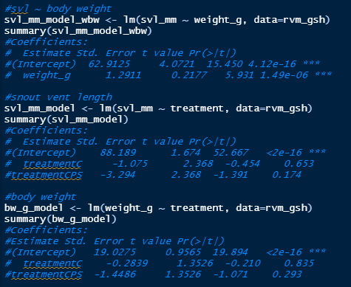
Snout-vent-length and body weight significantly related (as expected), but not a big deal for treatment

Slide 6
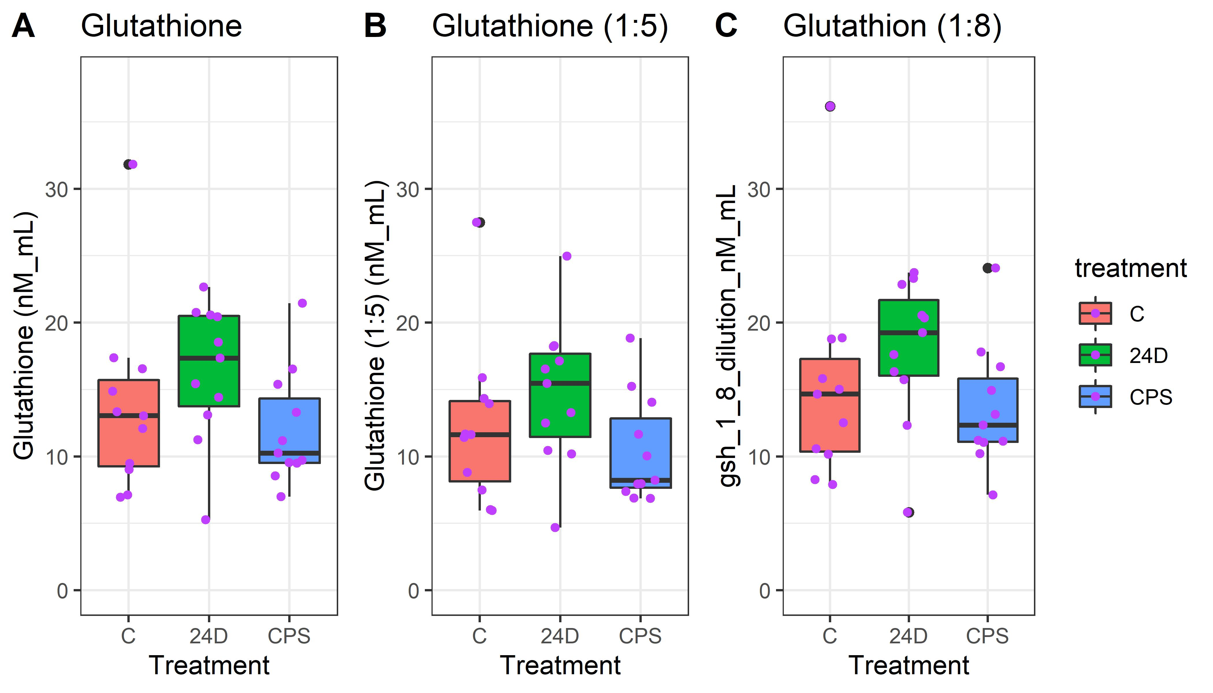
Glutathione variants. Glutathione used 1:5 and 1:8 dilutions, we are using the averaged concentration for the manuscript. The high control was dropped for the statistical comparisons. The points plot appears to be doubling that outlier, but that is a combination of both the boxplot showing that as an outlier and the points plot--these are now differentiated with the colors of black (part of the boxplot) and purple (the jittered sample point). We do not plan to use this plot for the manuscript, it is simply fyi.

Slide 7
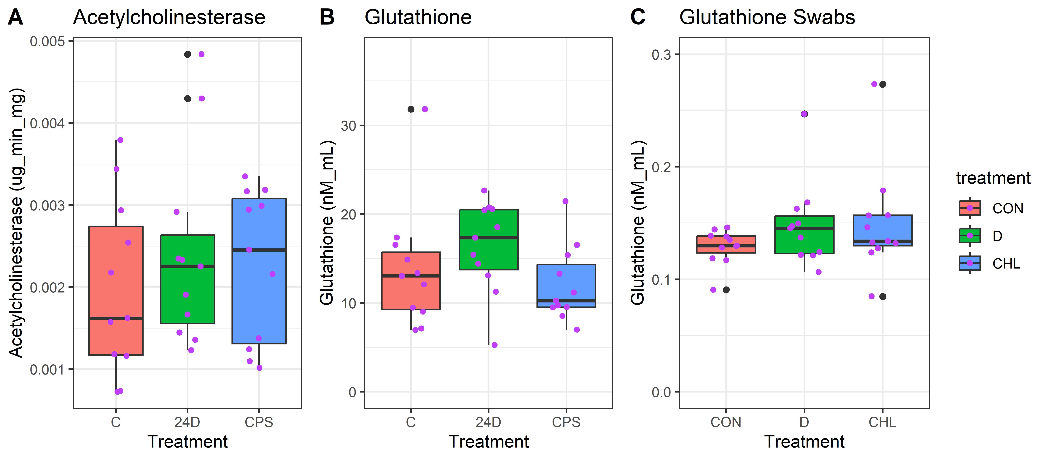
This is the descriptive concentration figure for the manuscript with acetylcholinesterase and the averaged glutathione concentrations versus the treatments. The high control for glutathione, the low 24D glutathione, and 2 high acetylcholinesterase points were all dropped for the statistical comparisons. For the glutathione swab data (we don’t have acetylcholinesterase swab data), multiple outliers were also dropped. The points plot appears to be doubling outliers, but that is a combination of both the boxplot showing that as an outlier and the points plot--these are now differentiated with the colors of black (part of the boxplot) and purple (the jittered sample point). The only significant results is the glutathione data for 24D (with the high glutathione and the low 24D value dropped for normality reasons).

Slide 8
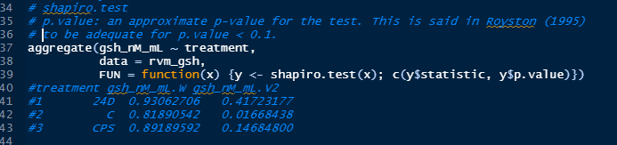
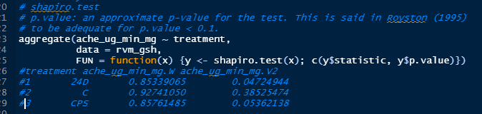
Normality tests for gsh and ache. We run Shapiro tests to test for normality. Red boxes include those sets with data that reject a normality assumption (orange nearly reject).

Slide 9
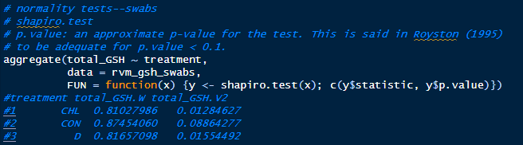
Normality tests for gsh swab data. We run Shapiro tests to test for normality. Red boxes include those sets with data that reject a normality assumption (orange nearly reject). Swab data is not normally distributed.

Slide 10
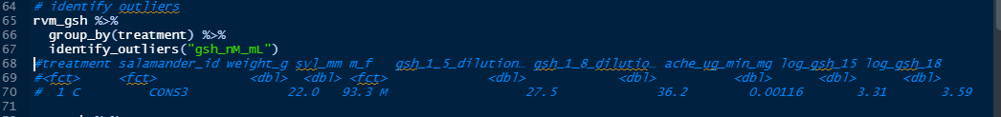
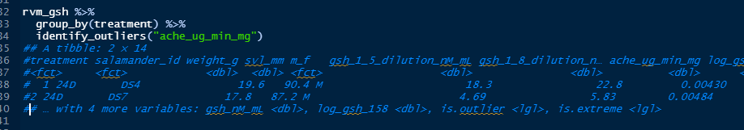
Identify outliers for averaged gsh, the high CONS3 value is identified as an outlier.
Identify outliers for ache, the two high concentrations (DS4 and DS7) are identified as outliers.

Slide 11
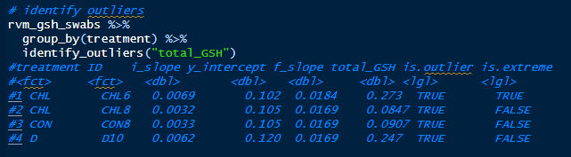
Identify outliers for gsh swab data, 4 points identified.

Slide 12
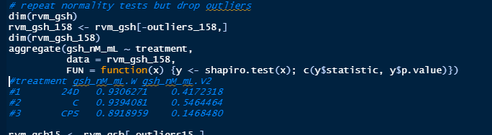
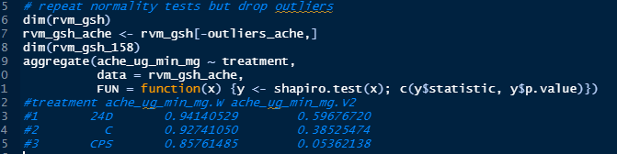
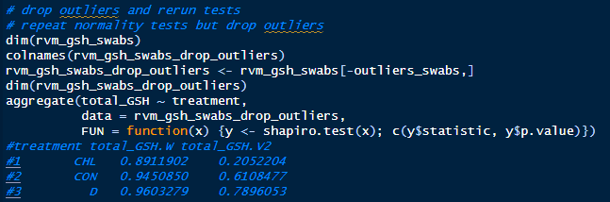
Normality tests for gsh and ache cleared up after dropping outliers, although ache for chlorpyrifos is still on the edge of rejection (only 24D samples were dropped) due to overdispersion in both directions. GSH swab data also fails to reject normality after dropping outliers. Also looked at logging for acetylcholinesterase but this did not improve the normality fits overall.

Slide 13
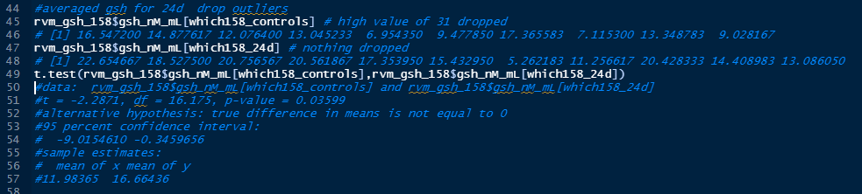
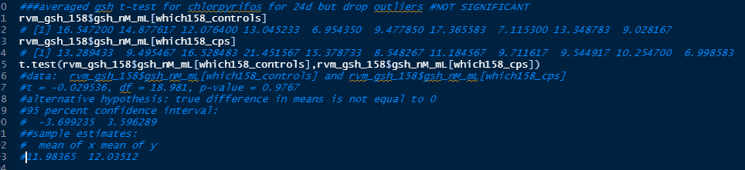
gsh
24d
Significant
gsh
Chlorpyrifos
Not significant

Slide 14
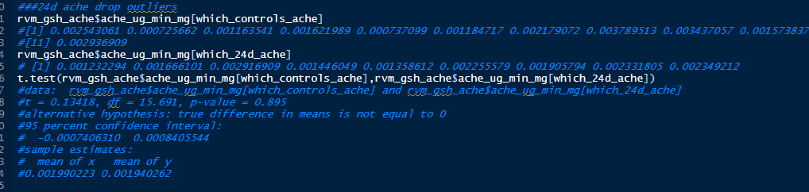
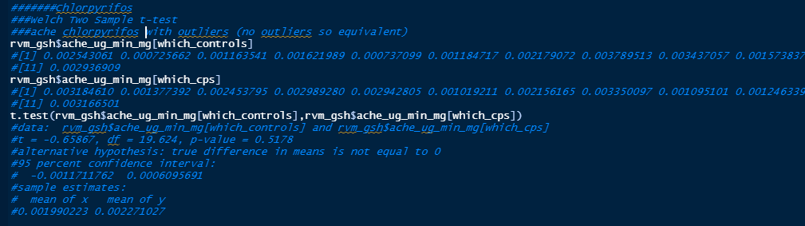
ache
24d
Not significant
ache
Chlorpyrifos
Not significant

Slide 15
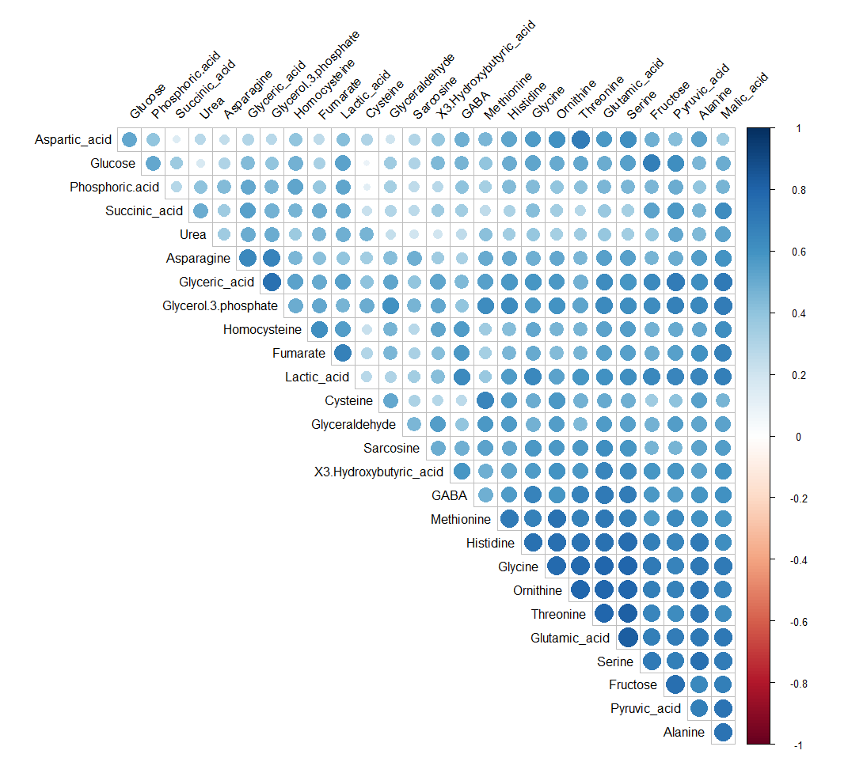

Slide 16
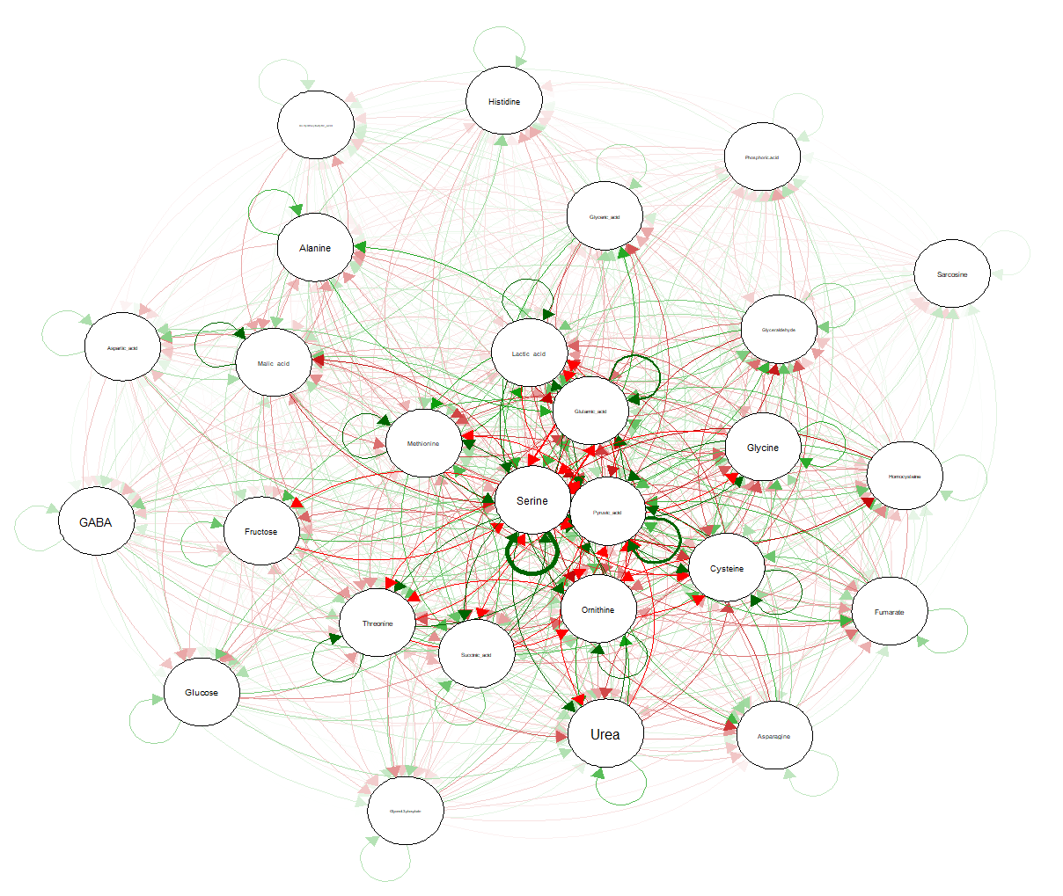

Slide 17
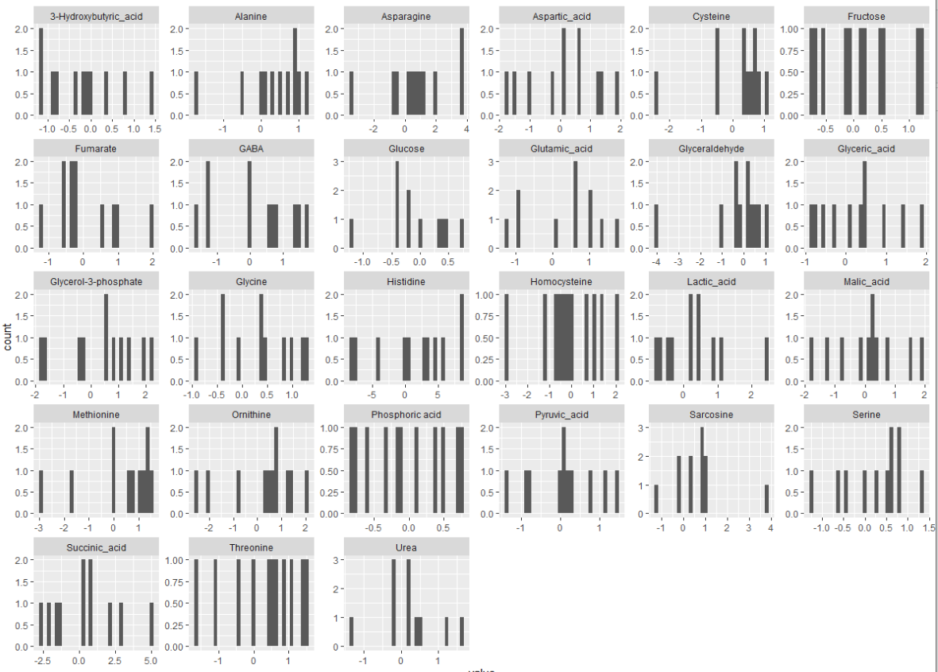
Chlorpyrfos, log2 v control

Slide 19
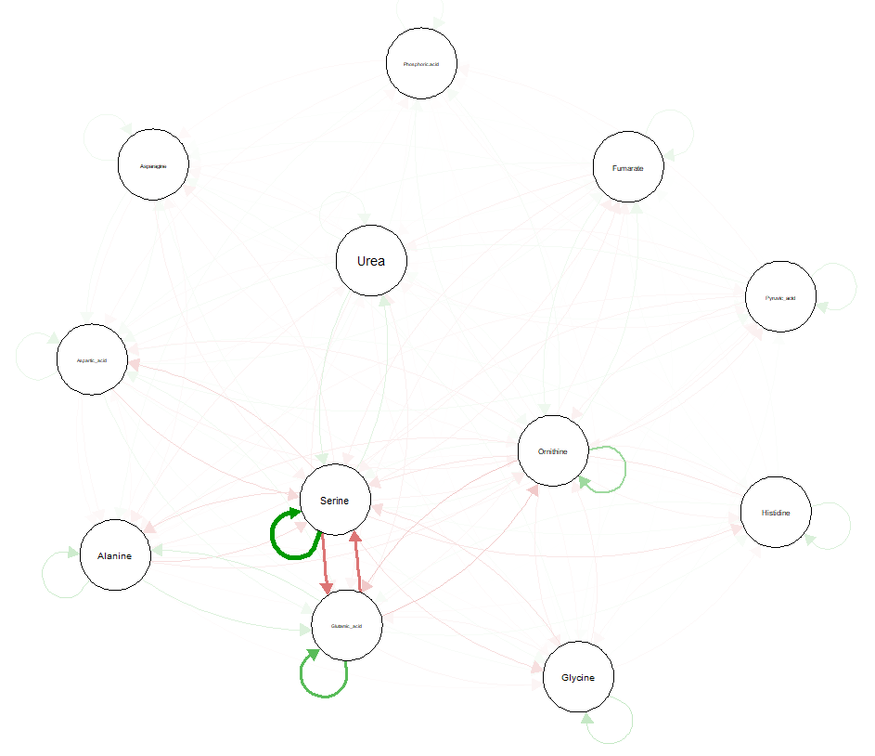
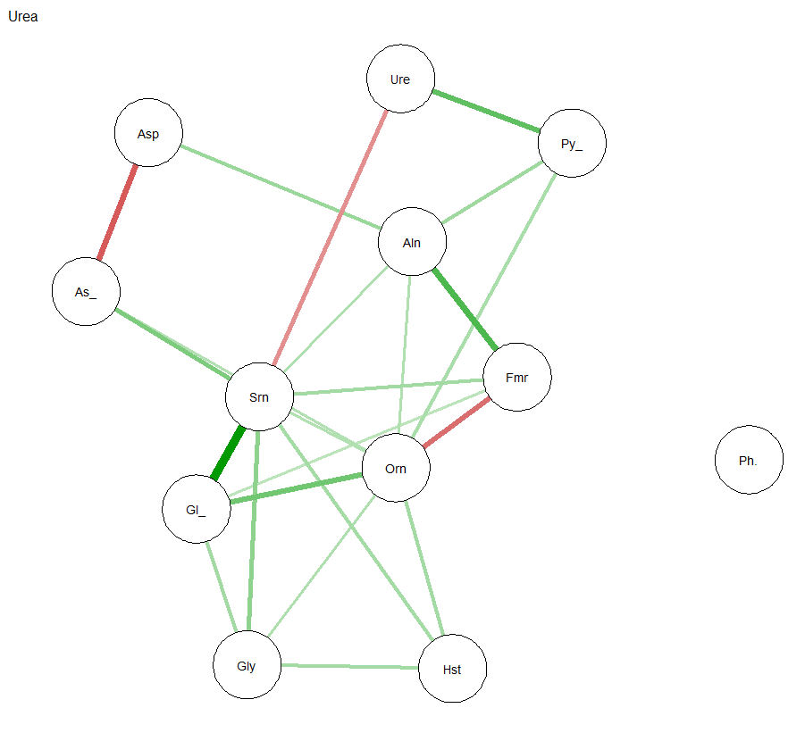
Urea

Slide 20
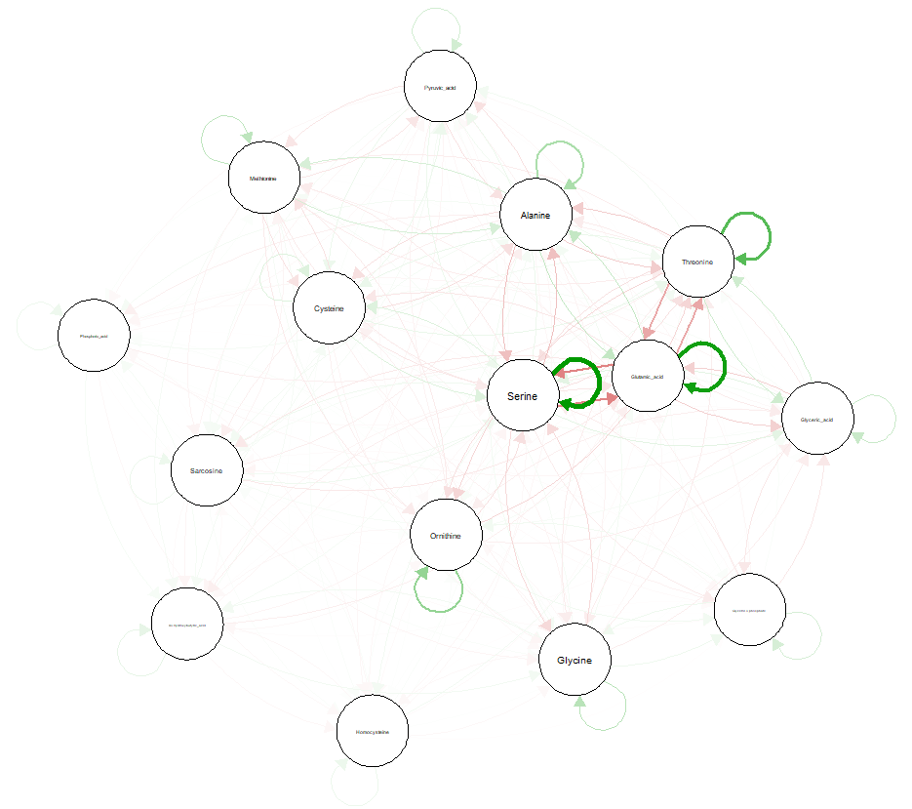
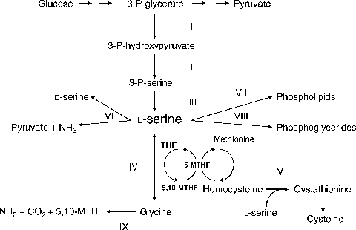
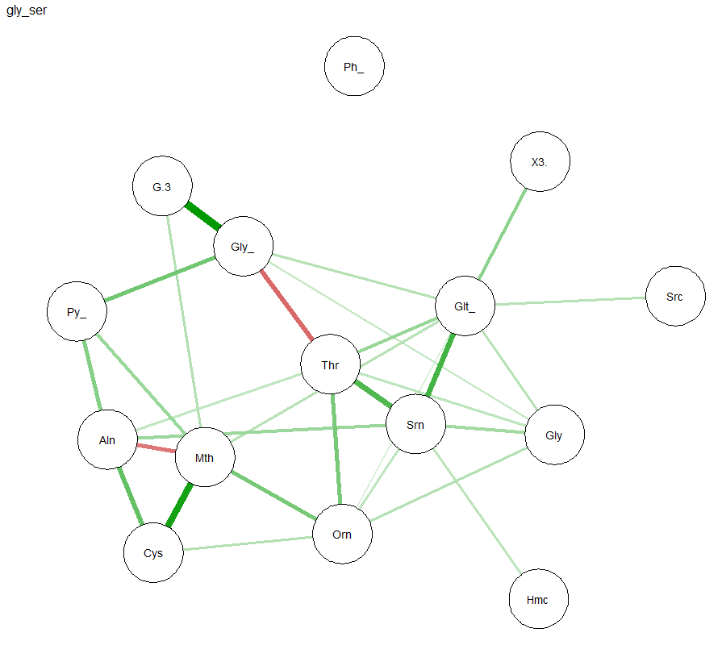
Gly Ser Metabolism

Slide 21
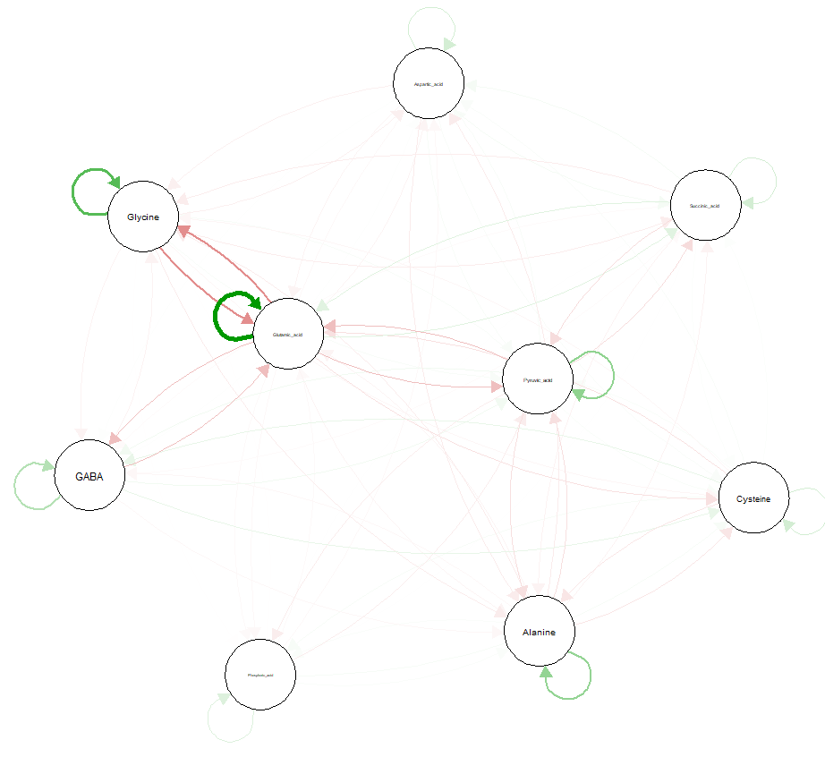
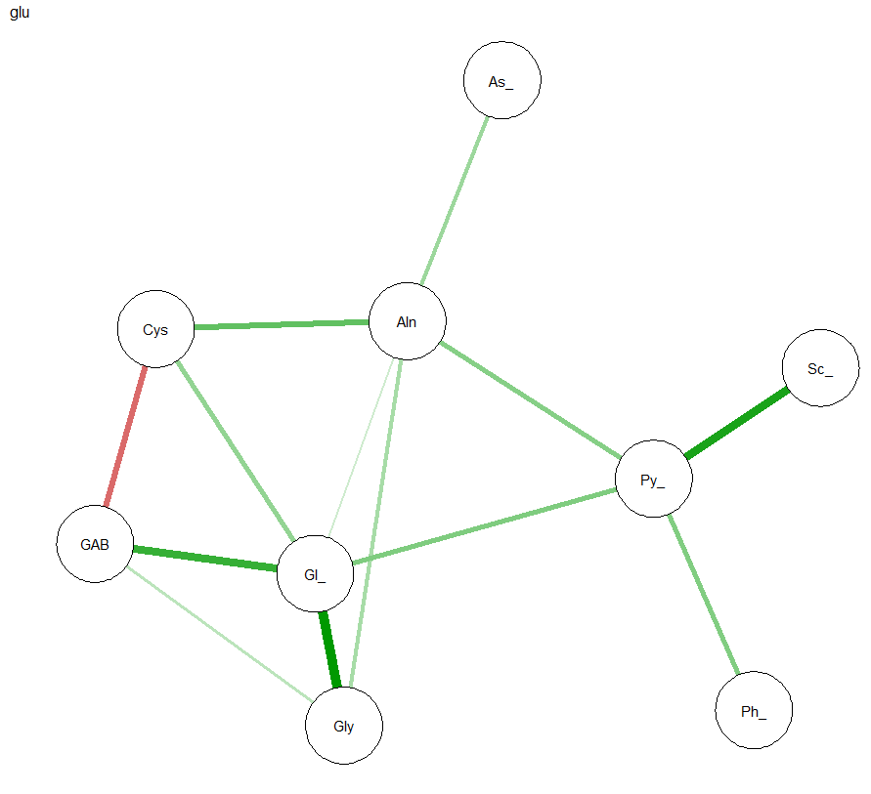
Glu metabolism

Slide 22
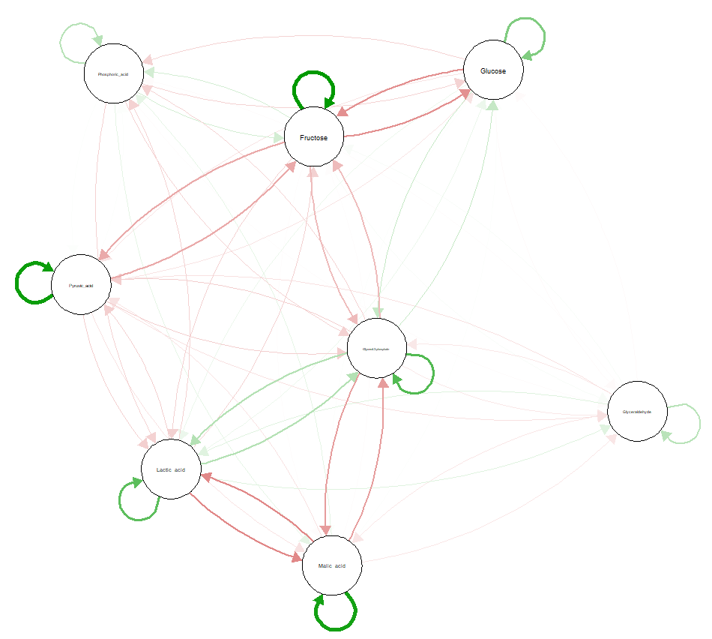
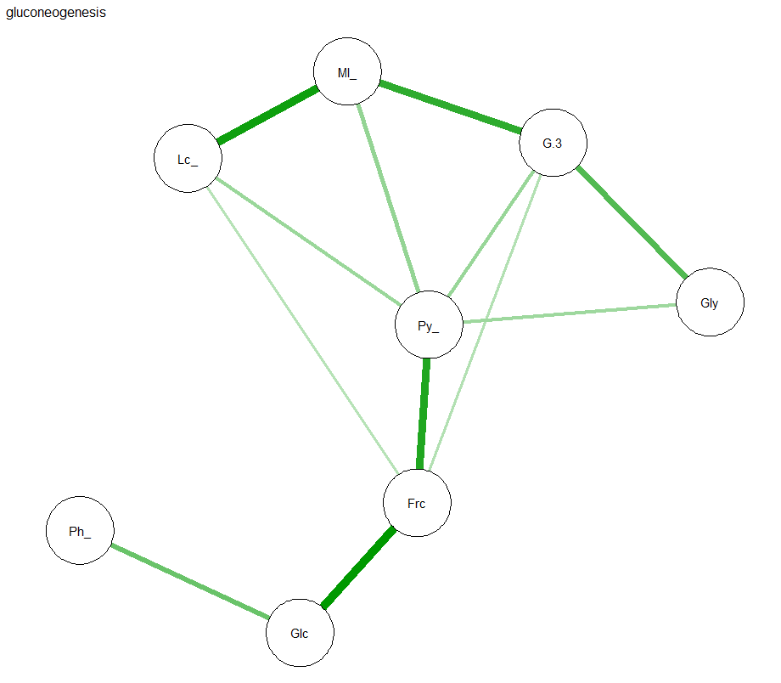
Gluconeogenesis

Slide 23
Glu Ala Cycle

Slide 24
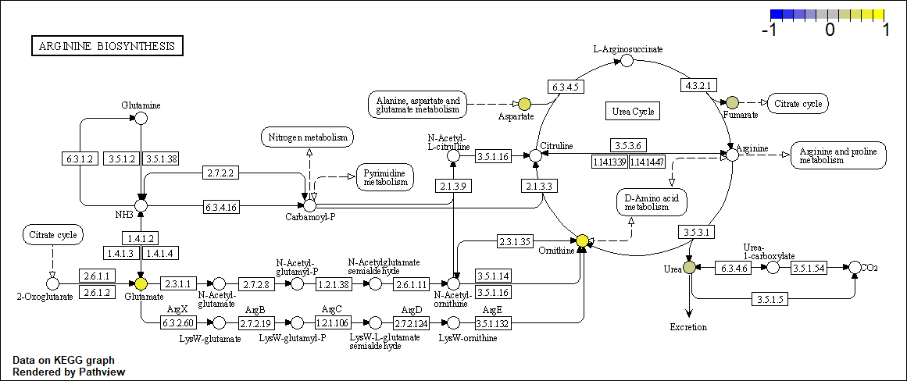
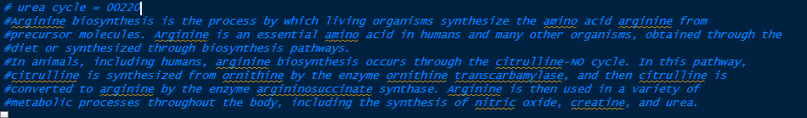
xla; Chlorpyrifos—Arginine biosynthesis (Urea cycle); xla=hsa

Slide 25
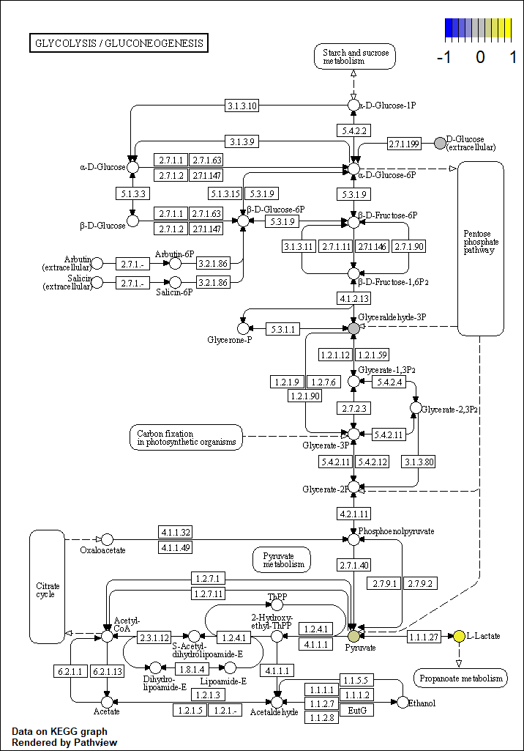
xla; Chlorpyrifos—; xla=hsa

Slide 26
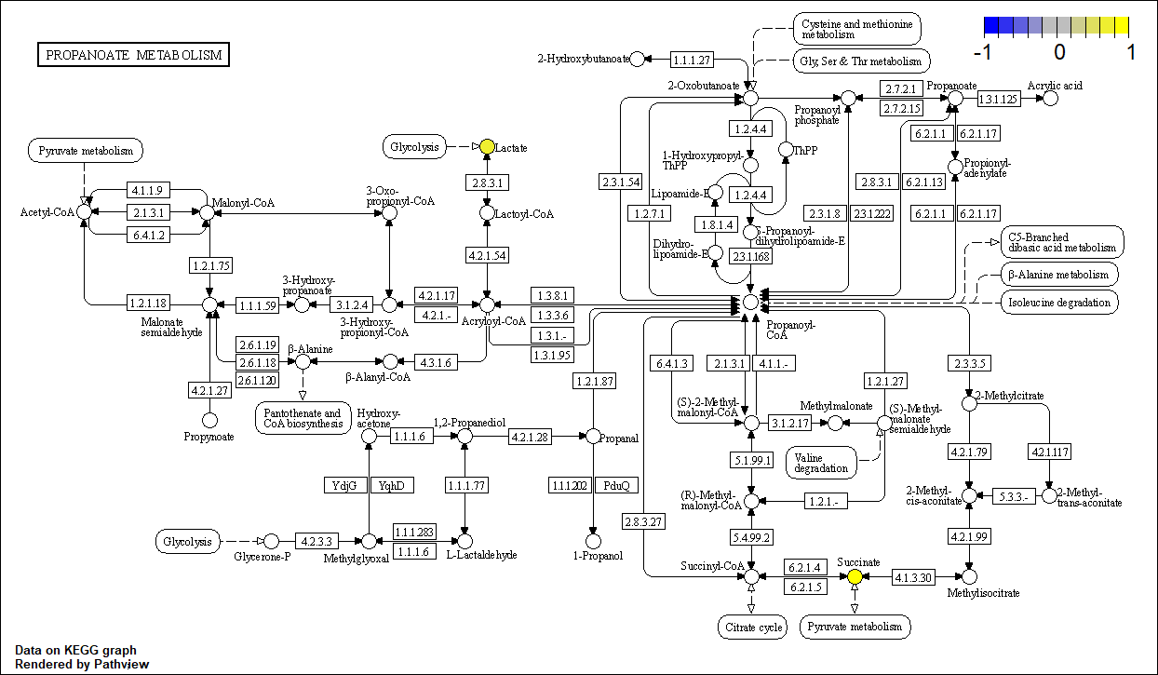
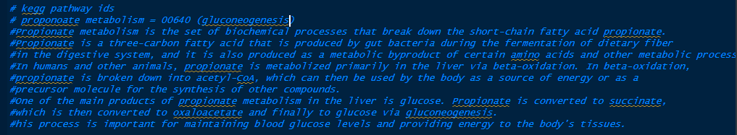
xla; Chlorpyrifos— Proponoate metabolism (Gluconeogenesis); xla=hsa

Slide 27
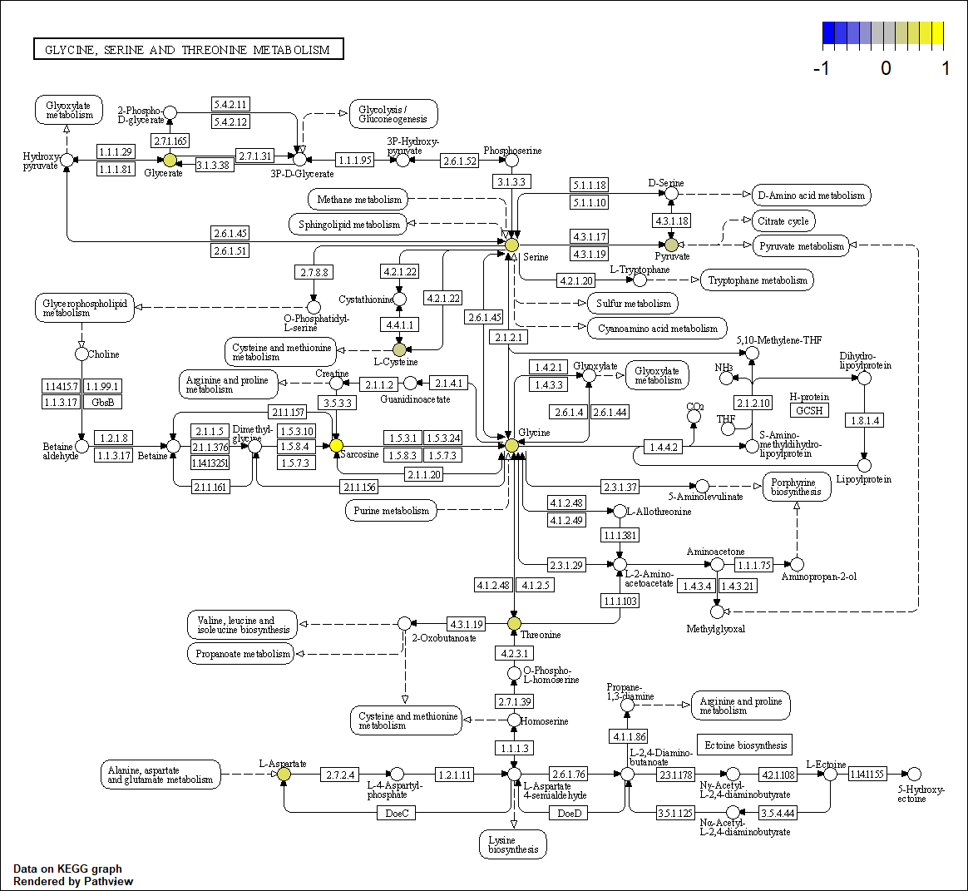
xla; Chlorpyrifos—Glycine, serine, and threonine metabolism; xla=hsa

Slide 28
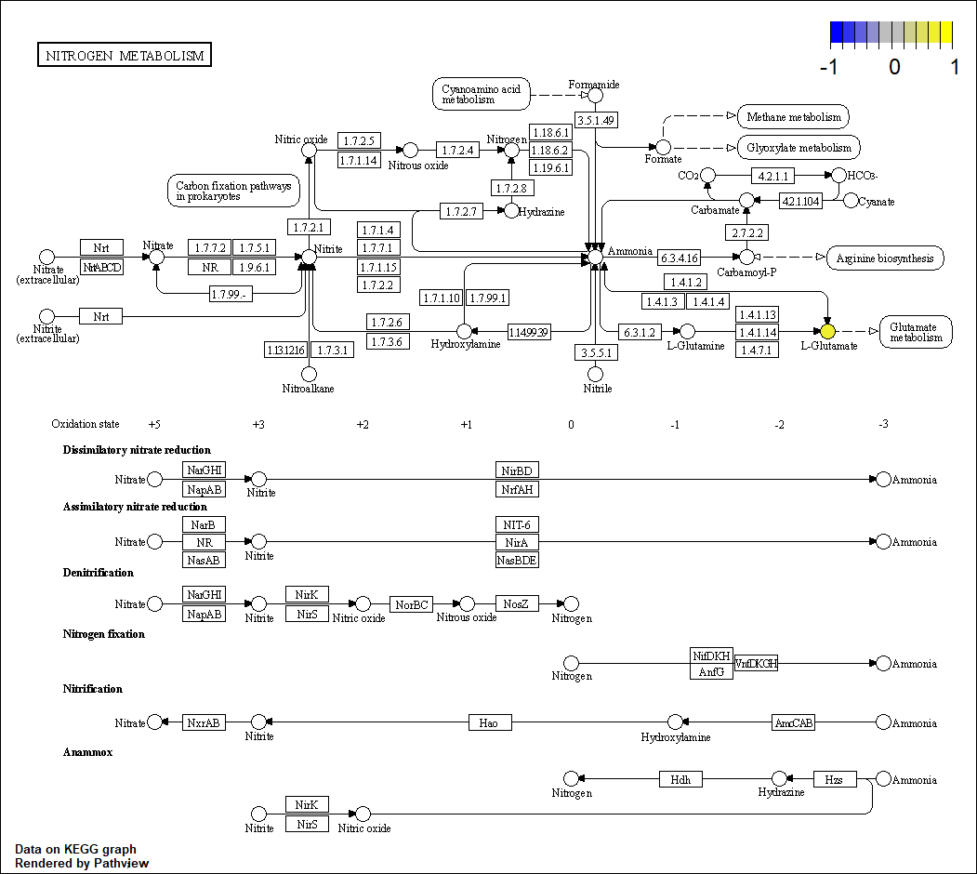
xla; Chlorpyrifos—Glucose alanine cycle; xla=hsa

Slide 29
xla; 24D—; xla=hsa

Slide 30
xla; 24D—; xla=hsa

Slide 31
xla; 24D—; xla=hsa

Slide 32
xla; 24D—; xla=hsa

Slide 33
xla; 24D—; xla=hsa

