Slide 1
Salamander exposures chlorpyrifos, 24d

Slide 2
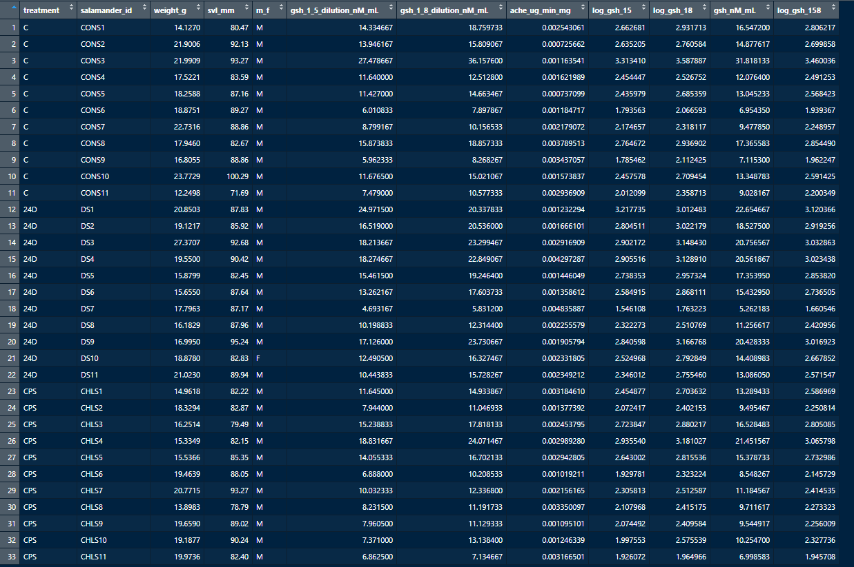

Slide 3



Summary stats for glutathione and acetylcholinesterase (all data)
Summary stats for glutathione and acetylcholinesterase before investigating outliers (and the swab data for glutathione. Note that this summary for ache only reported to one significant digit, but the data and tests go deeper.

Slide 4
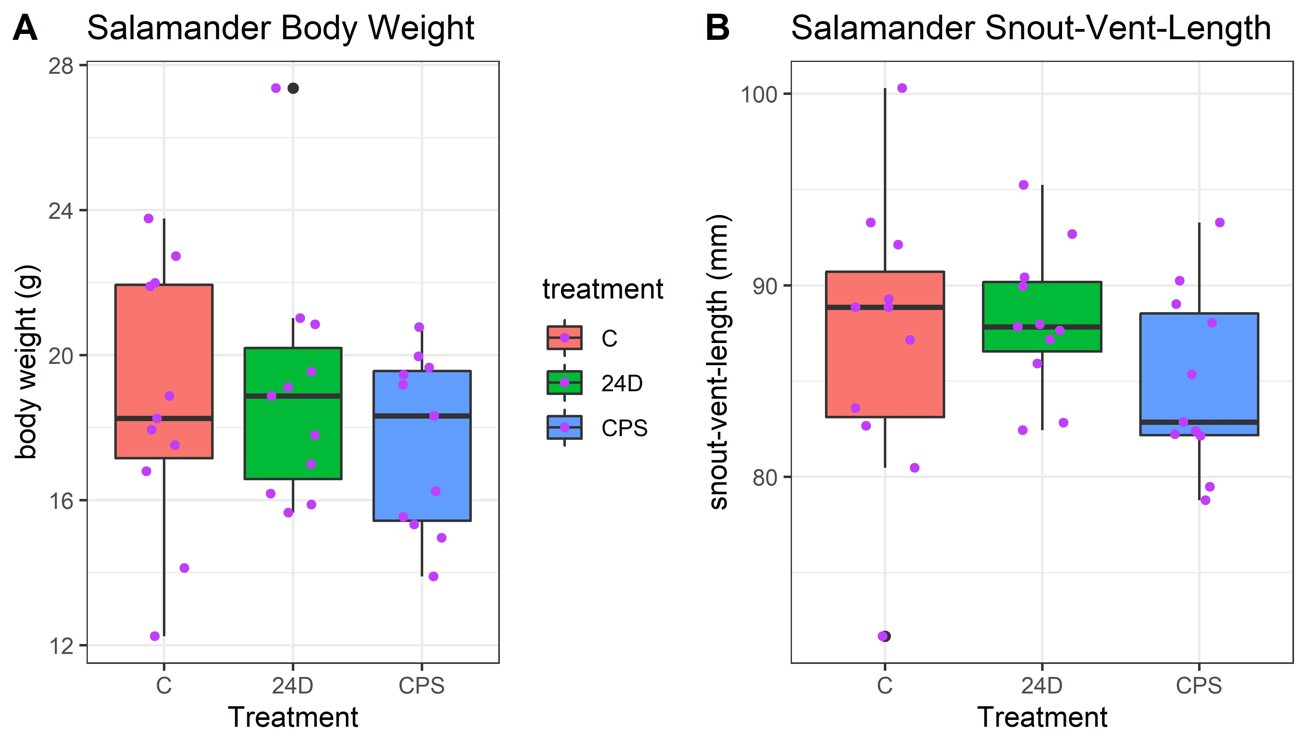
Amphibian body weights and SVLs
Body weight and SVL plot. Chlorpyrifos treatment ended up using slightly smaller salamanders, but this ended up not being an issue for the analysis (the points plot appears to be doubling the outlier, but that is a combination of the boxplot showing the outlier (black) and the jittered point plot (purple). This figure is not necessarily for the manuscripts main text, if used at all. The higher body weight outlier 24D salamander is the low concentration outlier on the next plot.

Slide 5
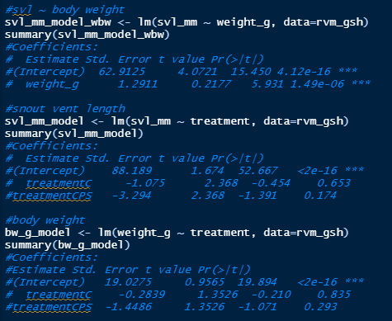
Relationship between body weight and SVL
Snout-vent-length and body weight significantly related (as expected), but not a big deal for treatment

Slide 6
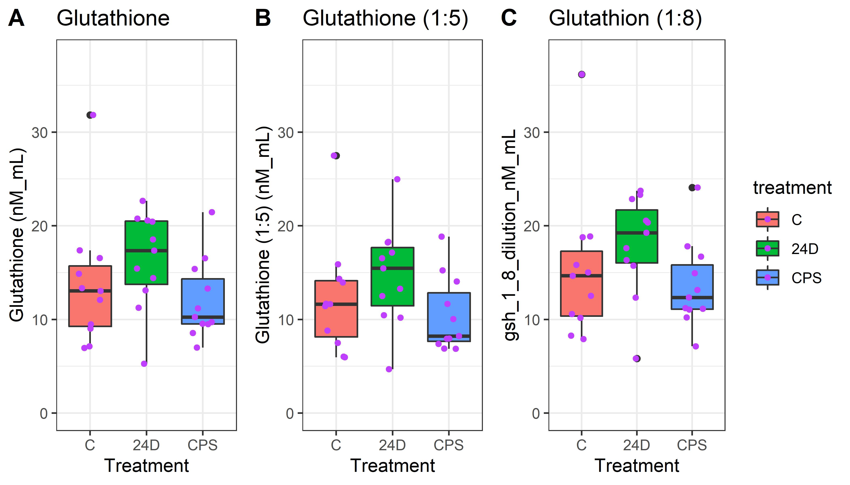
Glutathione concentration variants (different dilutions)
Glutathione variants. Glutathione used 1:5 and 1:8 dilutions, we are using the averaged concentration for the manuscript. The high control was dropped for the statistical comparisons. The points plot appears to be doubling that outlier, but that is a combination of both the boxplot showing that as an outlier and the points plot--these are now differentiated with the colors of black (part of the boxplot) and purple (the jittered sample point). We do not plan to use this plot for the manuscript, it is simply fyi.

Slide 7
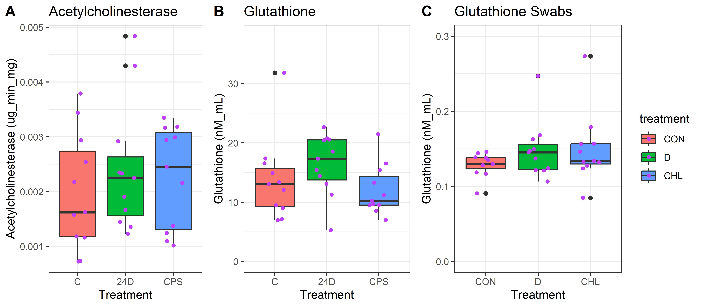
Manuscript figure—boxplots for glutathione and acetylcholinesterase (all data)
This is the descriptive concentration figure for the manuscript with acetylcholinesterase and the averaged glutathione concentrations versus the treatments. The high control for glutathione, the low 24D glutathione, and 2 high acetylcholinesterase points were all dropped for the statistical comparisons. For the glutathione swab data (we don’t have acetylcholinesterase swab data), multiple outliers were also dropped. The points plot appears to be doubling outliers, but that is a combination of both the boxplot showing that as an outlier and the points plot--these are now differentiated with the colors of black (part of the boxplot) and purple (the jittered sample point). The only significant results is the glutathione data for 24D (with the high glutathione and the low 24D value dropped for normality reasons).

Slide 8
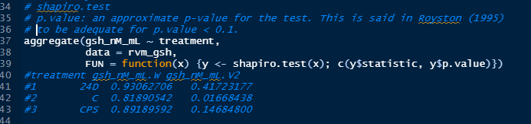
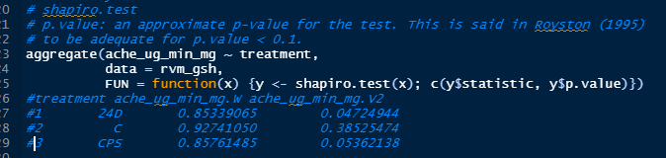
Normality tests for glutathione and acetylcholinesterase—liver data
Normality tests for gsh and ache. We run Shapiro tests to test for normality. Red boxes include those sets with data that reject a normality assumption (orange nearly reject).

Slide 9
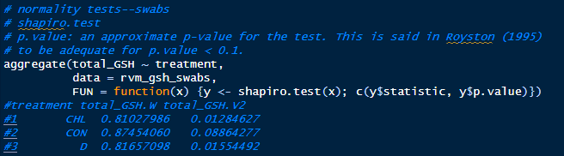
Normality tests for glutathione—swab data
Normality tests for gsh swab data. We run Shapiro tests to test for normality. Red boxes include those sets with data that reject a normality assumption (orange nearly reject). Swab data is not normally distributed.

Slide 10
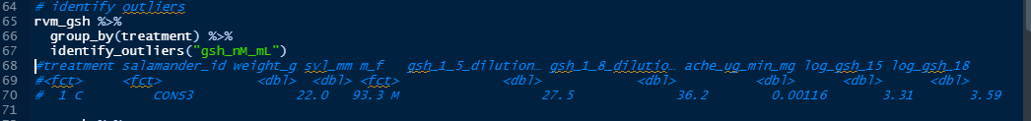
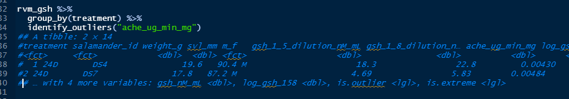
Identifying outliers for glutathione and acetylcholinesterase—liver data
Identify outliers for averaged gsh, the high CONS3 value is identified as an outlier.
Identify outliers for ache, the two high concentrations (DS4 and DS7) are identified as outliers.

Slide 11
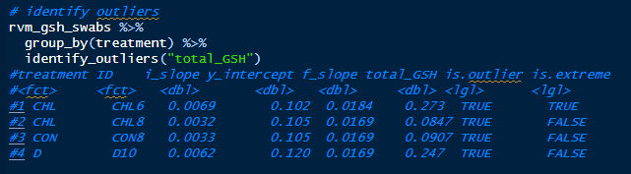
Identifying outliers for glutathione—swab data
Identify outliers for gsh swab data, 4 points identified.

Slide 12
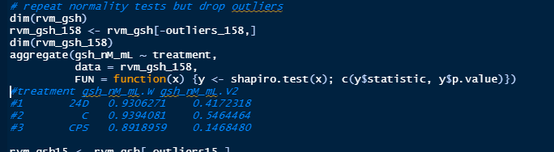
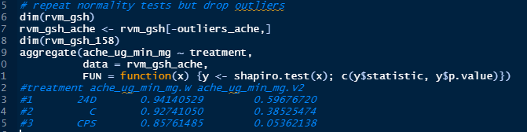
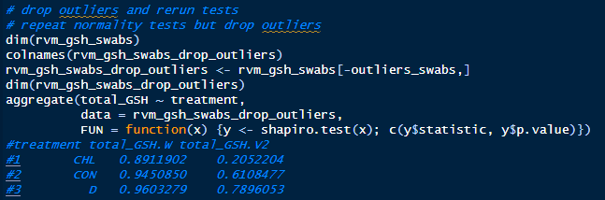
Normality tests for glutathione and acetylcholinesterase after dropping outliers—liver and swab data
Normality tests for gsh and ache cleared up after dropping outliers, although ache for chlorpyrifos is still on the edge of rejection (only 24D samples were dropped) due to overdispersion in both directions. GSH swab data also fails to reject normality after dropping outliers. Also looked at logging for acetylcholinesterase but this did not improve the normality fits overall.

Slide 13
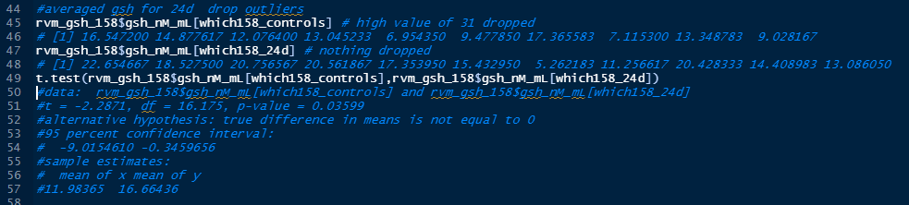
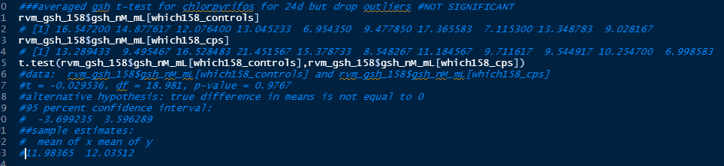
t-tests (after dropping outliers)—liver data; glutathione
gsh
24d
Significant
gsh
Chlorpyrifos
Not significant

Slide 14
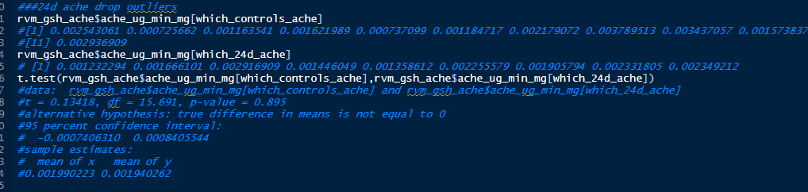
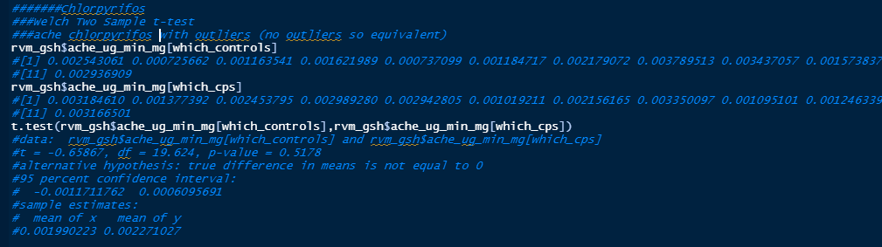
t-tests (after dropping outliers)—liver data; acetylcholinesterase
ache
24d
Not significant
ache
Chlorpyrifos
Not significant

Slide 15
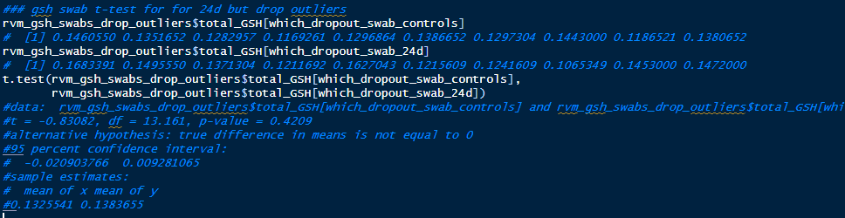
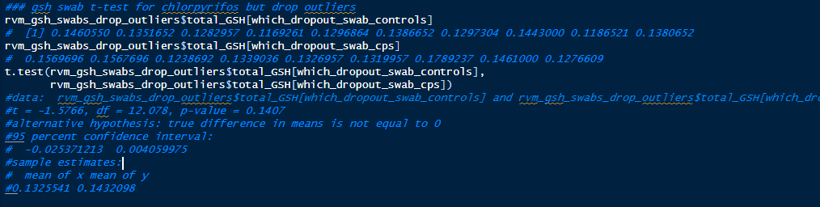
t-tests (after dropping outliers)—swab data; glutathione
Gsh-swabs
24d
Not significant
Gsh-swabs
Chlorpyrifos
Not significant

Slide 16
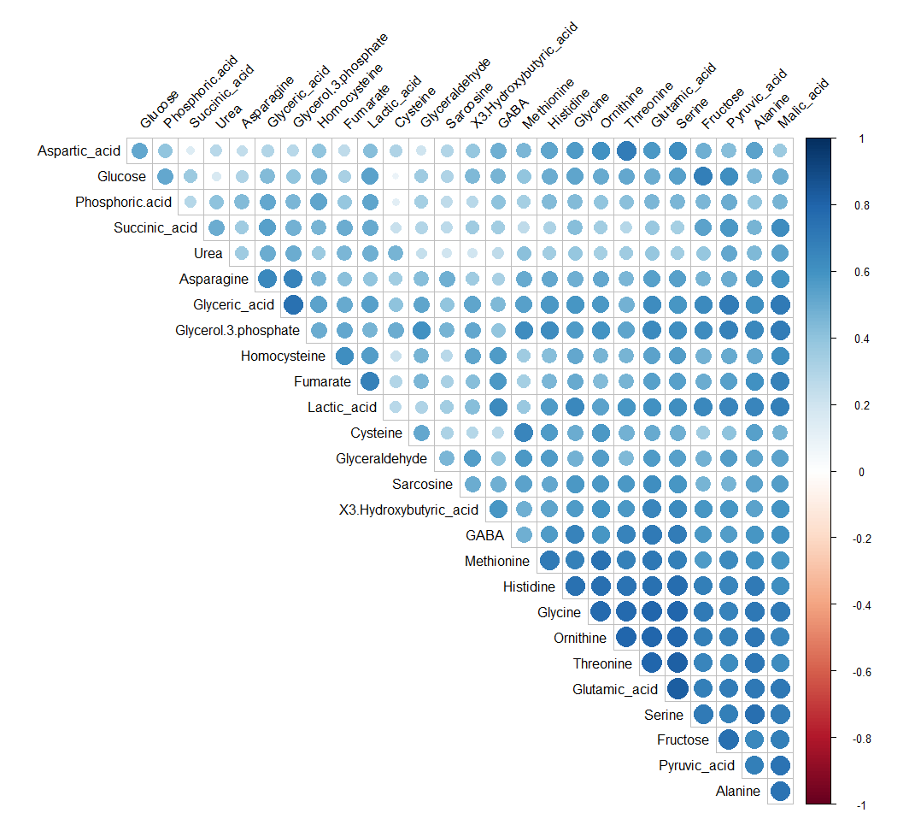
Metabolite correlations
Across all treatments

Slide 17
Metabolic pathway networks
None of the network diagrams are satisfactory
Methods work for some pathways if all the treatments are lumped together, but that is not helpful for the manuscript
To do specific treatments, need to be more careful about the tuning parameter, optimize it not on results but on number of retained metabolites, essentially it quickly flips from having too many metabolites (not enough degrees of freedom to calculate the partial correlations) to aggressively dropping all the metabolites and not having an interesting network to look at
Kernel density plots are useful for visualizing the overall differences in (z score transformed) metabolite concentrations between treatments

Slide 18
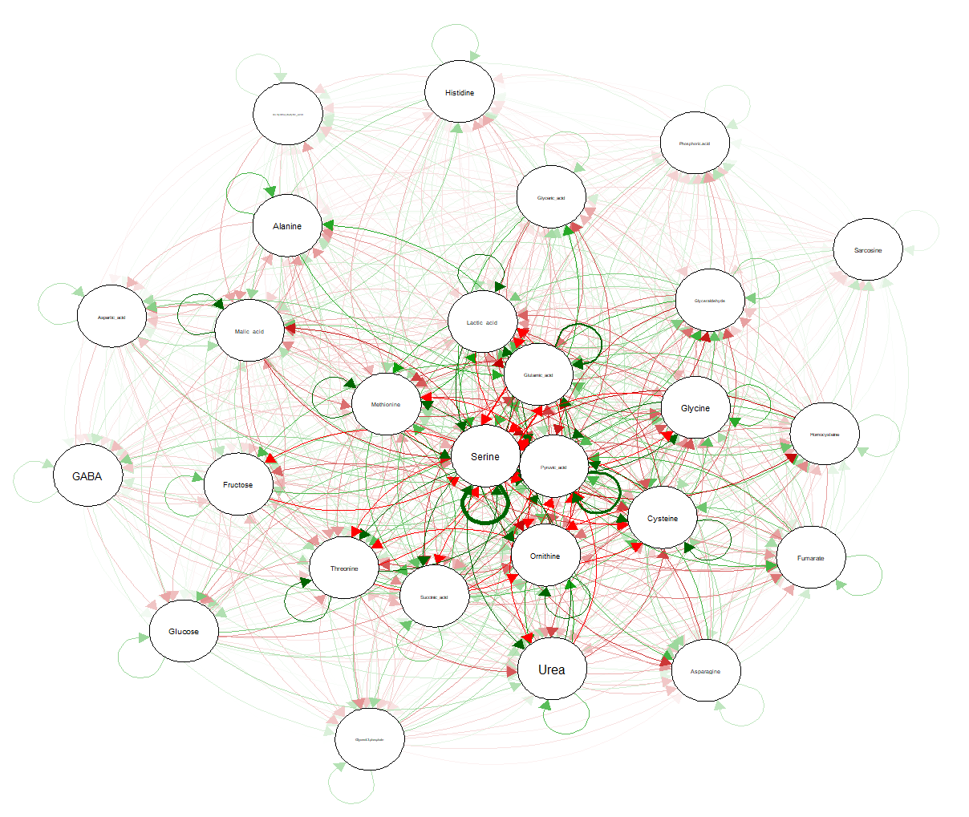

Slide 19
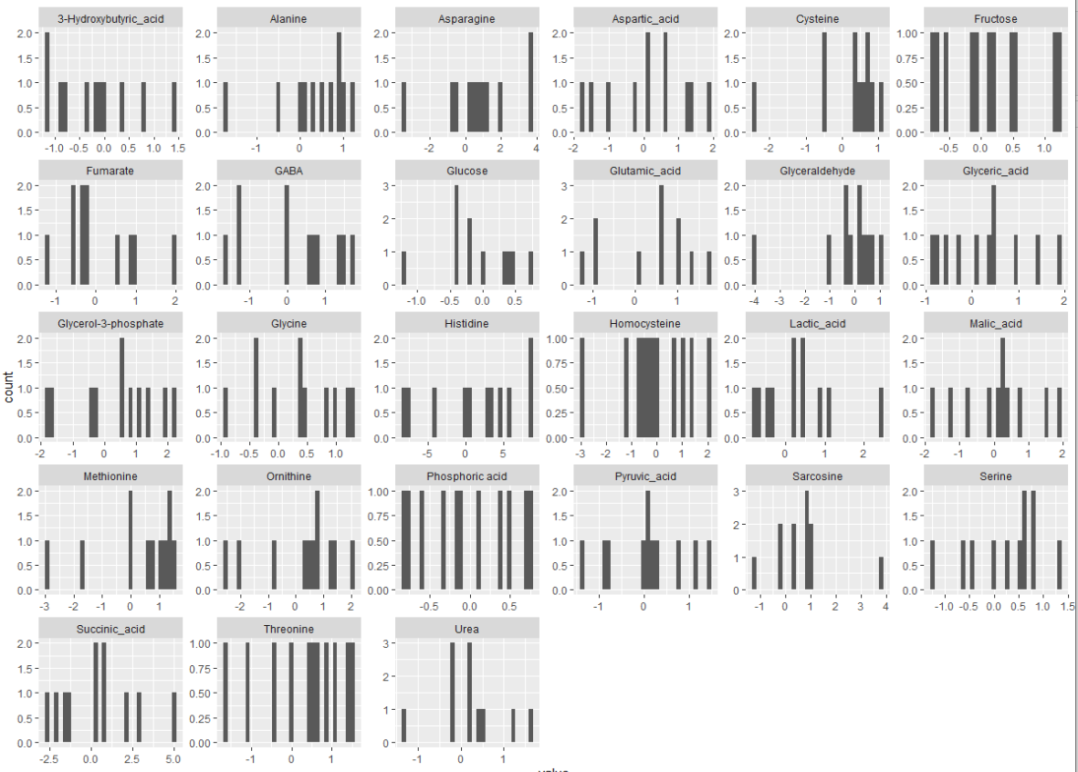
Chlorpyrfos, log2 v control

Slide 20
Urea cycle

Slide 21
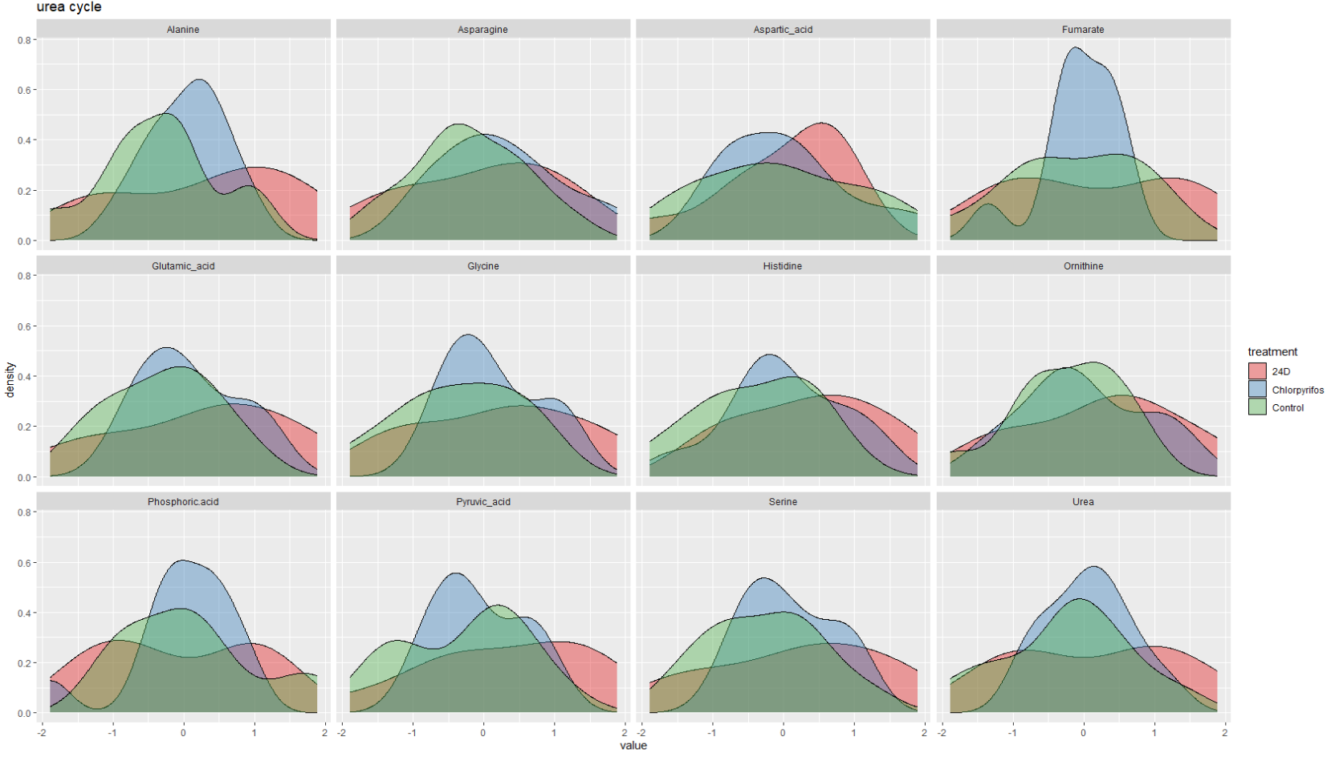

Slide 22
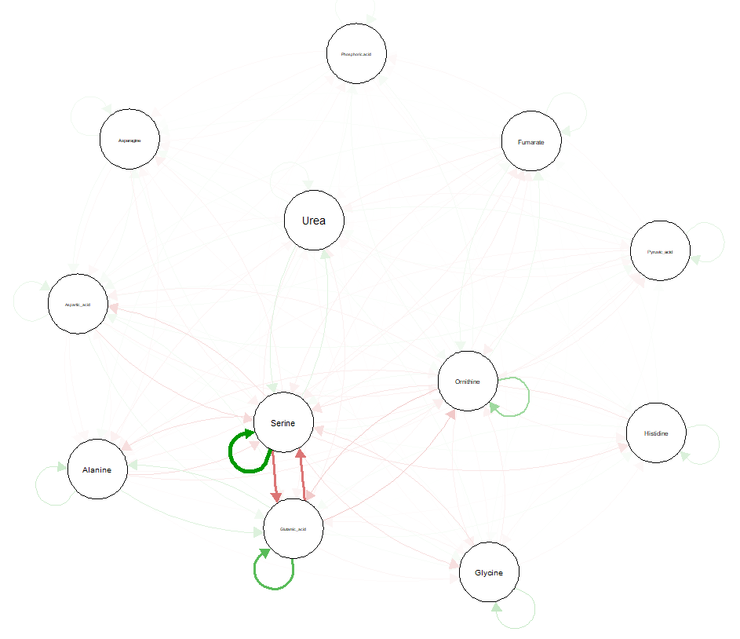
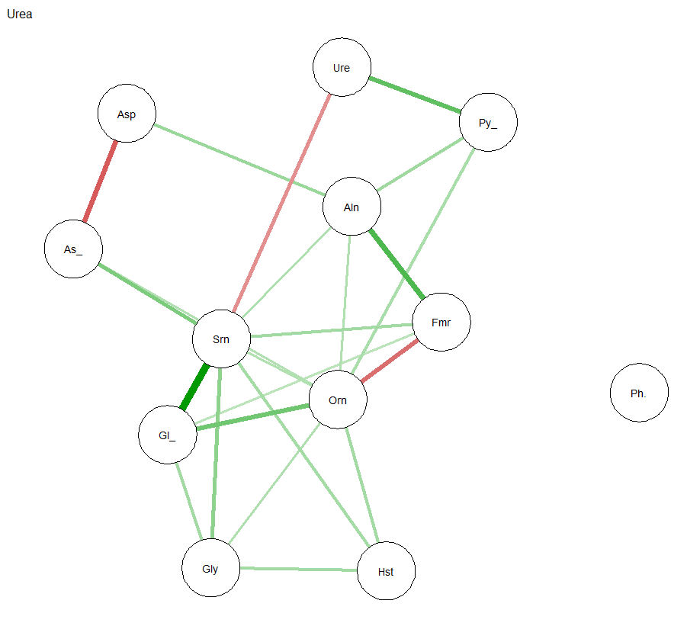
Urea

Slide 23
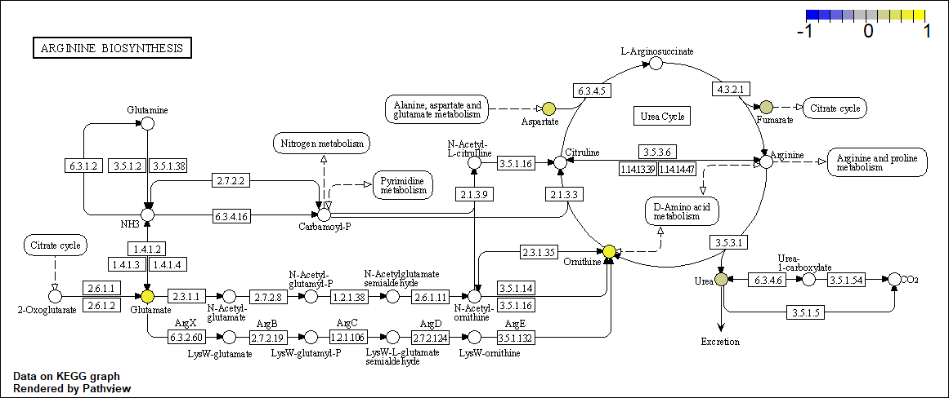
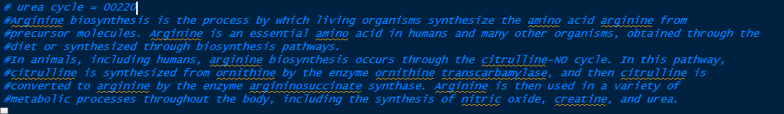
xla; Chlorpyrifos—Arginine biosynthesis (Urea cycle); xla=hsa

Slide 24
Gly ser metabolism

Slide 25
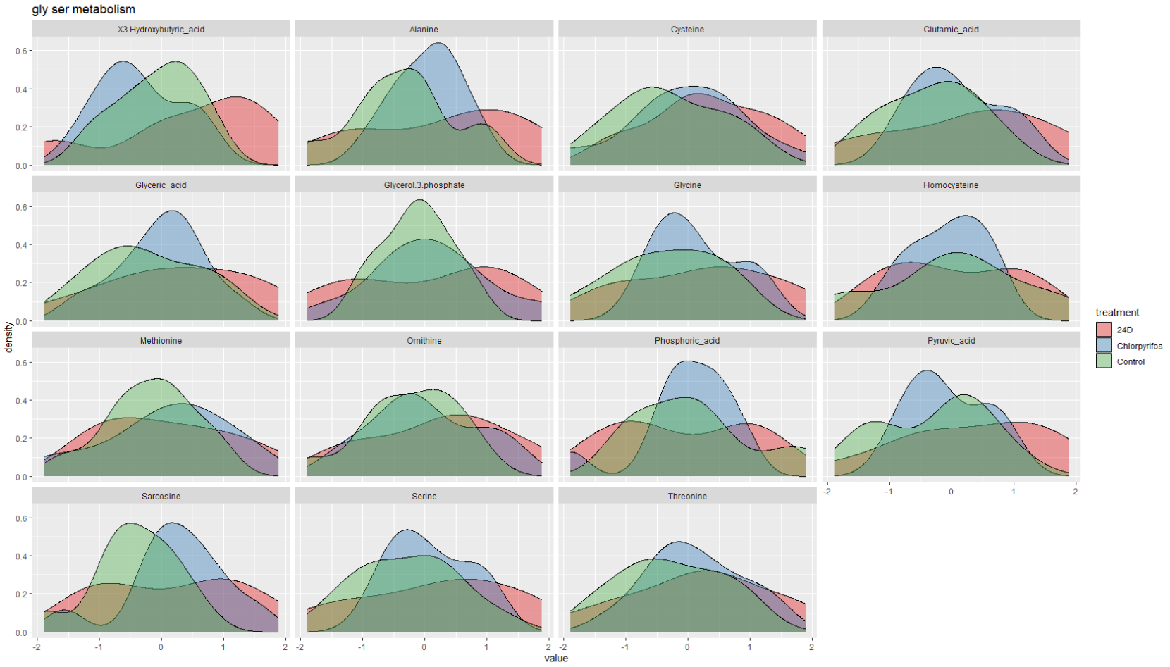

Slide 26
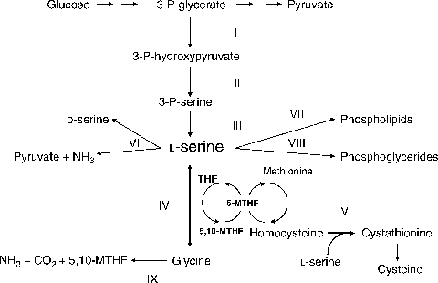
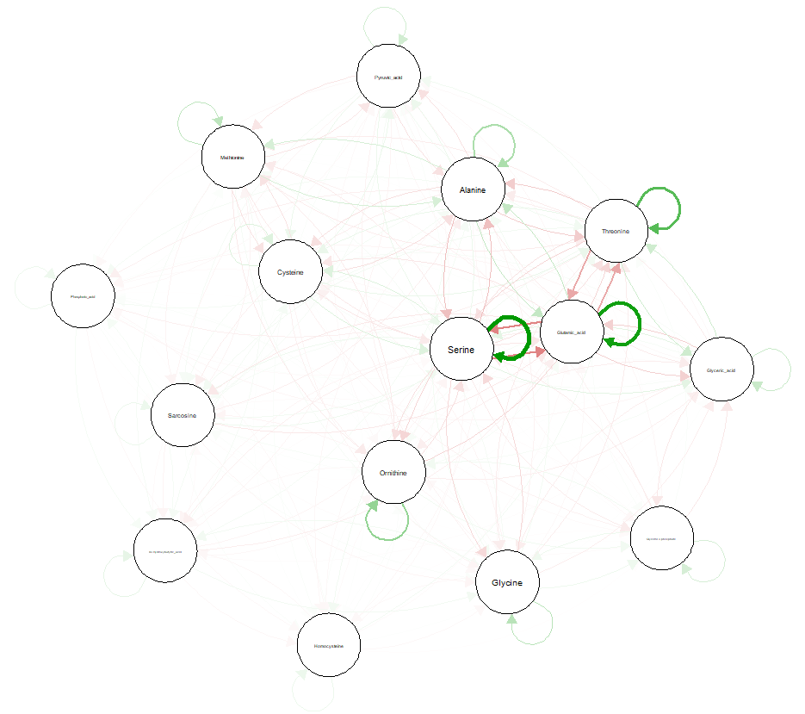
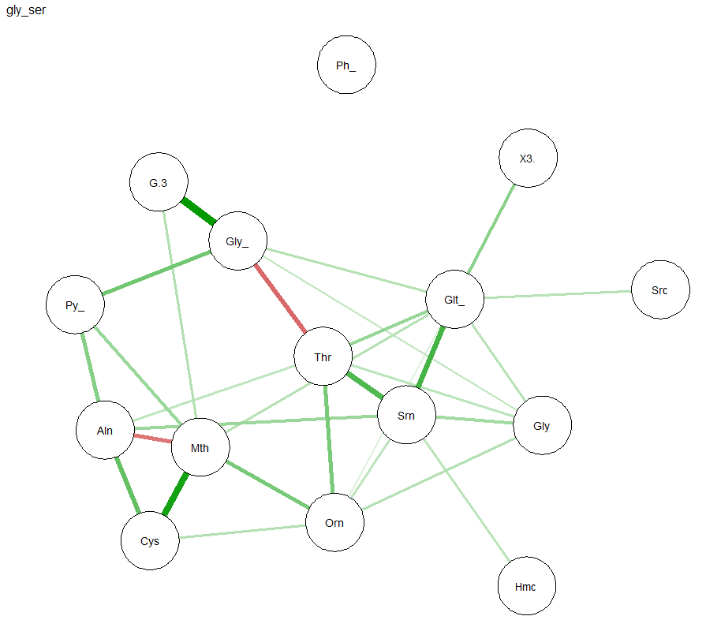
Gly Ser Metabolism

Slide 27
Glu metabolism

Slide 29
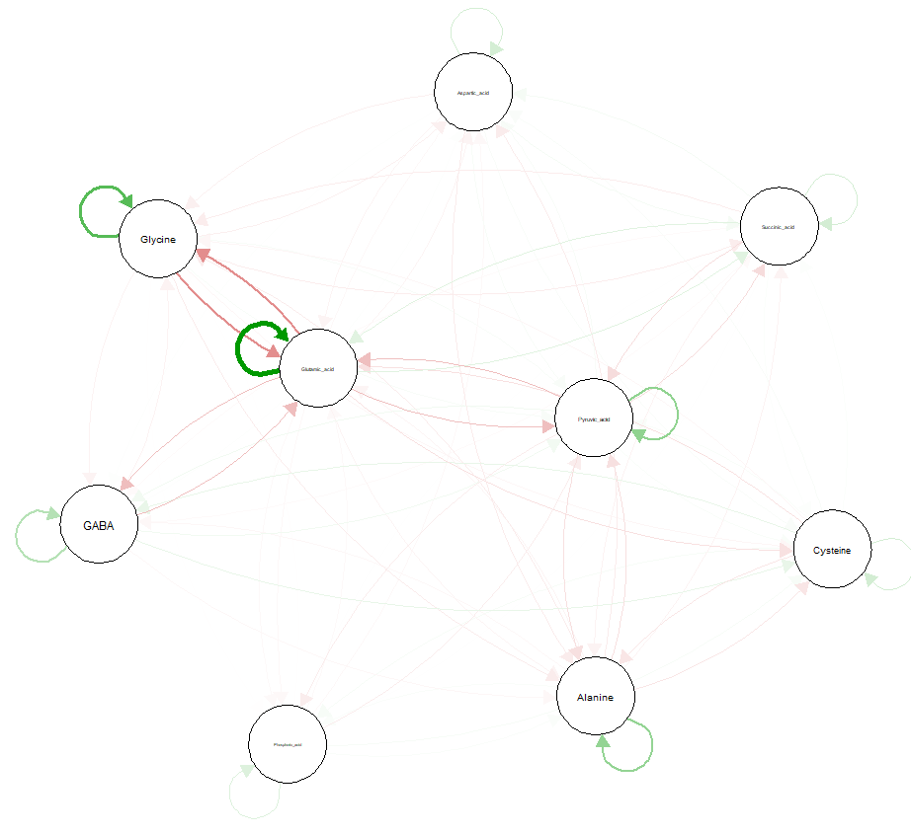
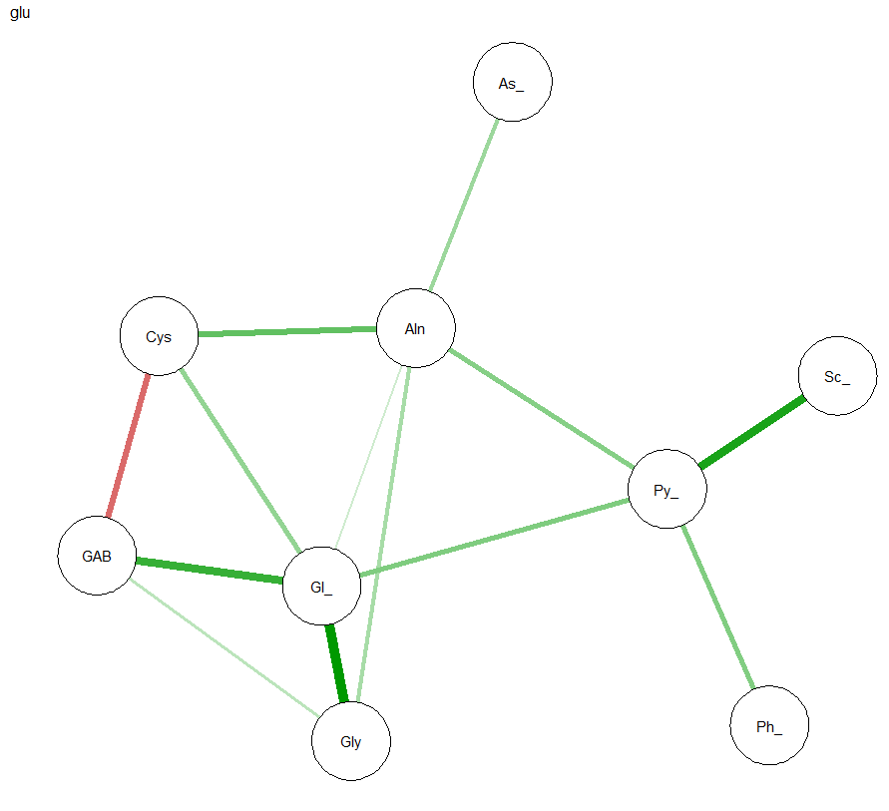
Glu metabolism

Slide 30
Gluconeogenesis

Slide 31
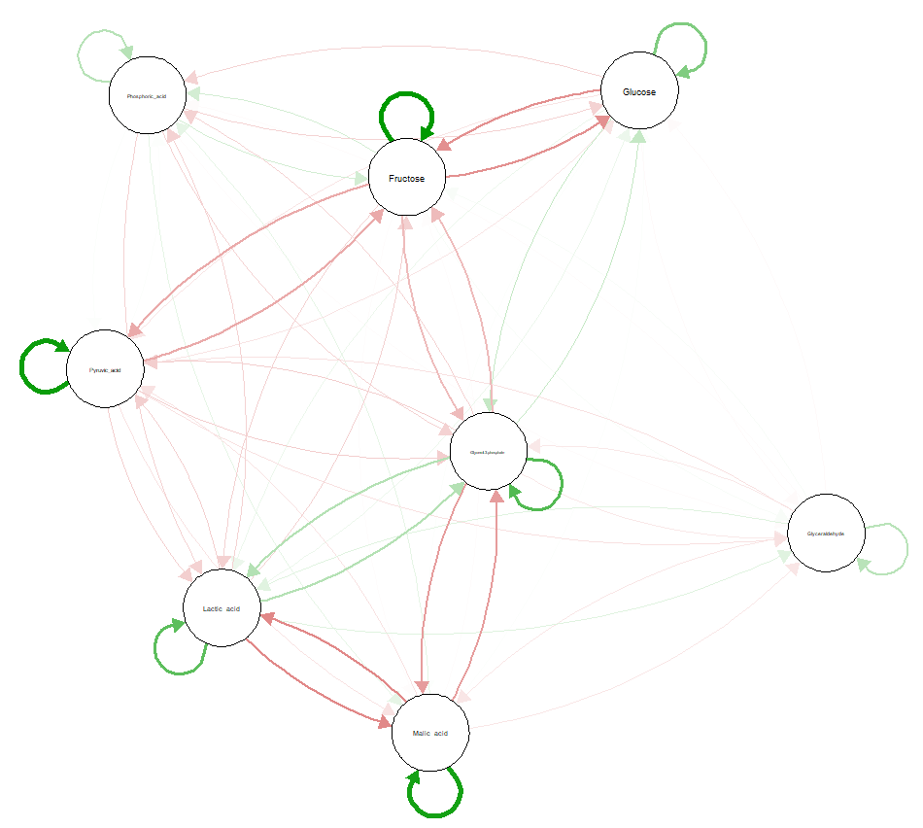
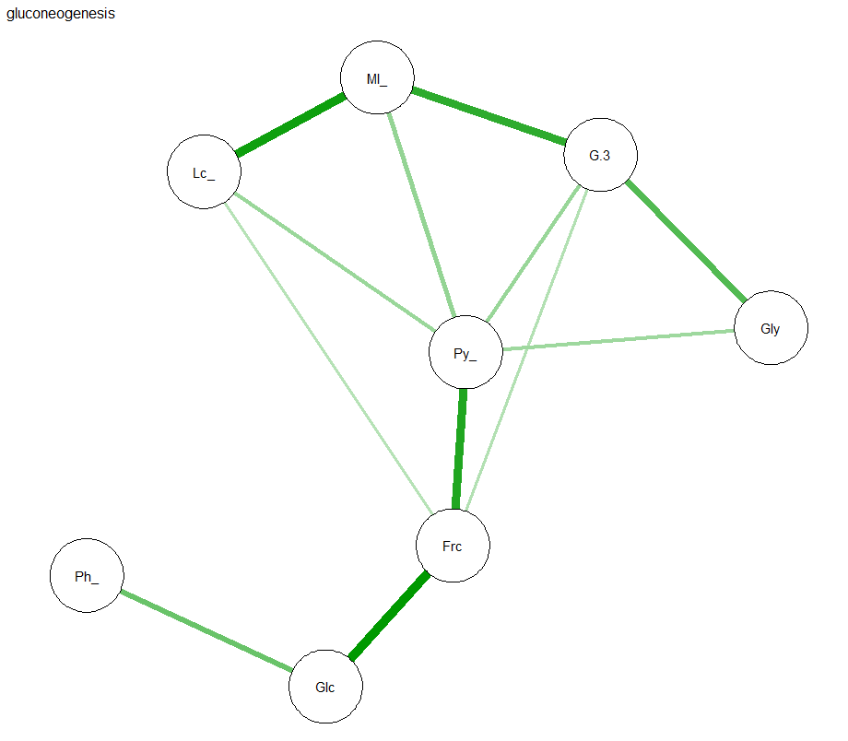
Gluconeogenesis

Slide 32
Glu Ala Cycle

Slide 33
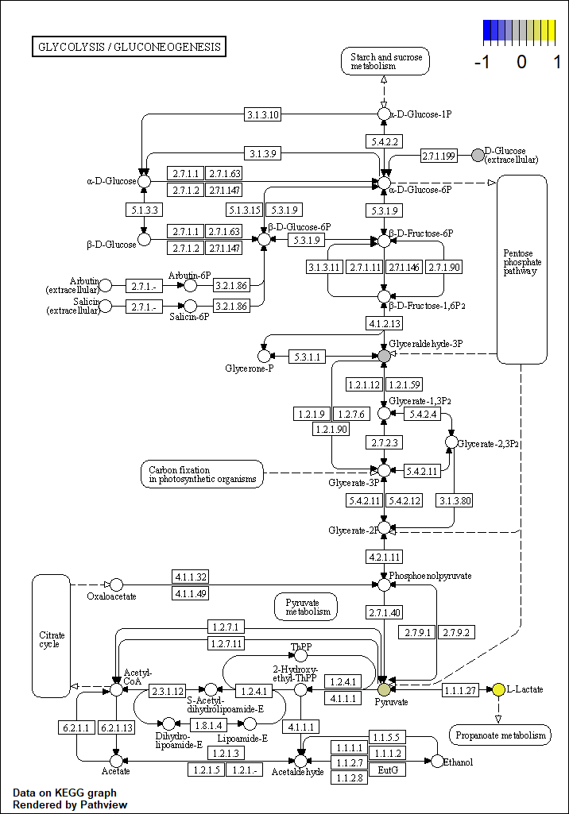
xla; Chlorpyrifos—; xla=hsa

Slide 34
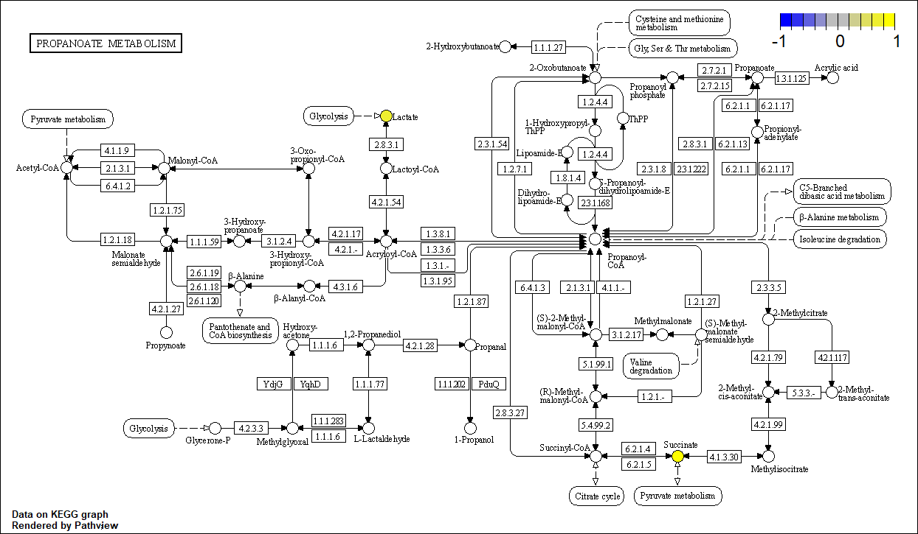
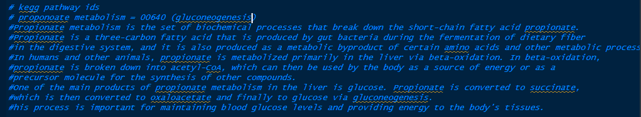
xla; Chlorpyrifos— Proponoate metabolism (Gluconeogenesis); xla=hsa

Slide 35
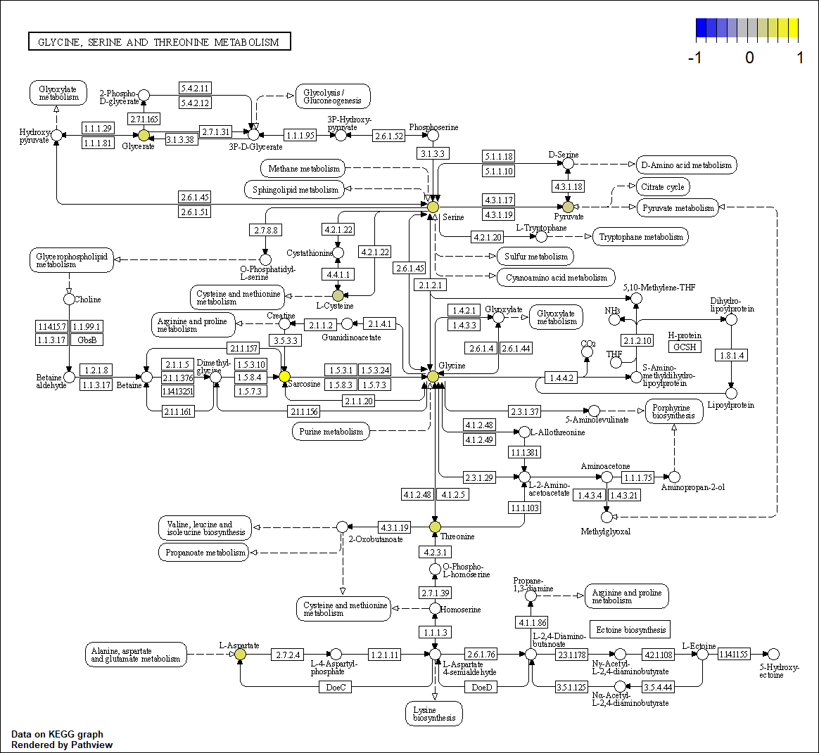
xla; Chlorpyrifos—Glycine, serine, and threonine metabolism; xla=hsa

Slide 36
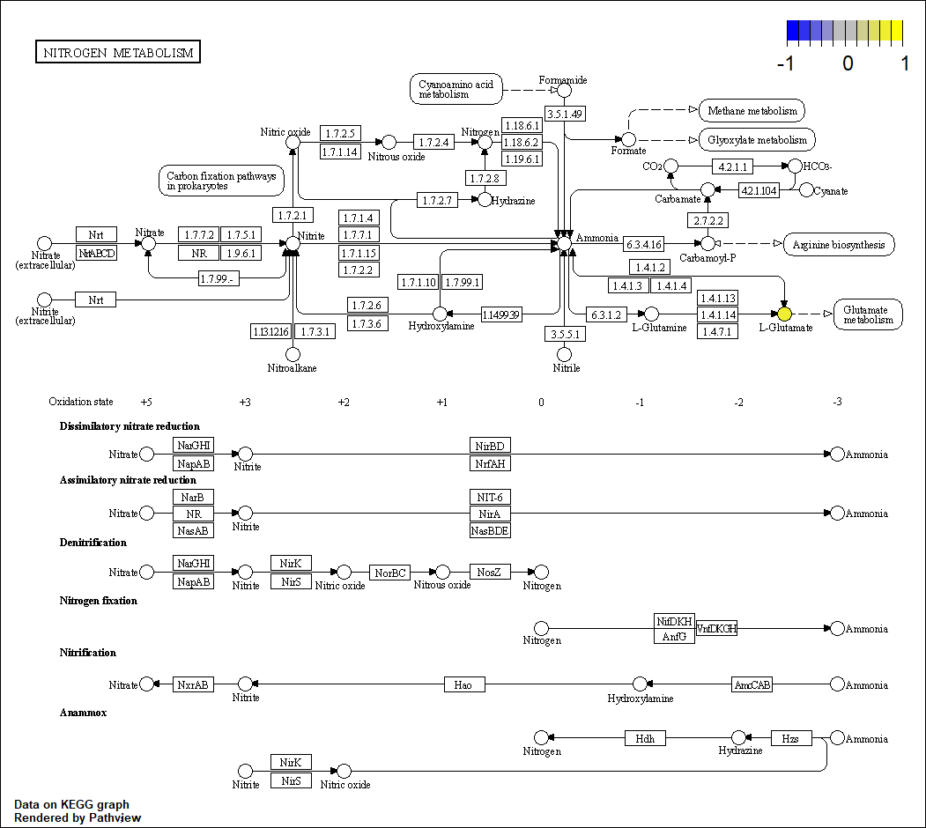
xla; Chlorpyrifos—Glucose alanine cycle; xla=hsa

Slide 37
xla; 24D—; xla=hsa

Slide 38
xla; 24D—; xla=hsa

Slide 39
xla; 24D—; xla=hsa

Slide 40
xla; 24D—; xla=hsa

Slide 41
xla; 24D—; xla=hsa

