Slide 1
Salamander exposures chlorpyrifos, 24d

Slide 2
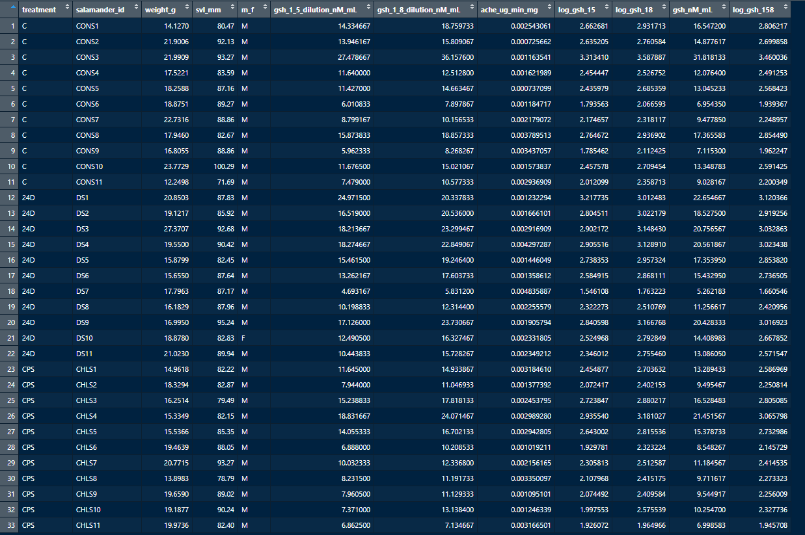

Slide 3


Summary stats for glutathione and acetylcholinesterase before investigating outliers. Note that this summary for ache only reported to one significant digit, but the data and tests go deeper.

Slide 4
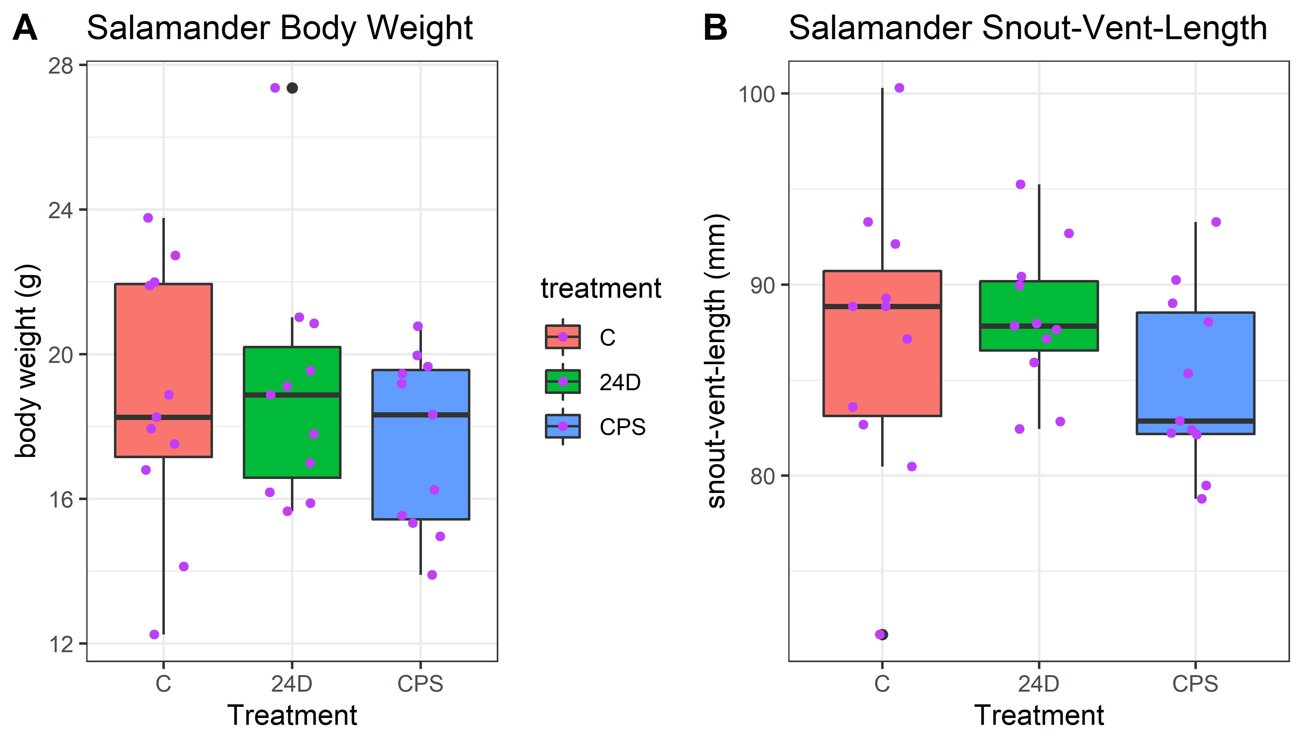
Body weight and SVL plot. Chlorpyrifos treatment ended up using slightly smaller salamanders, but this ended up not being an issue for the analysis (the points plot appears to be doubling the outlier, but that is a combination of the boxplot showing the outlier (black) and the jittered point plot (purple). This figure is not necessarily for the manuscripts main text, if used at all. The higher body weight outlier 24D salamander is the low concentration outlier on the next plot.

Slide 5
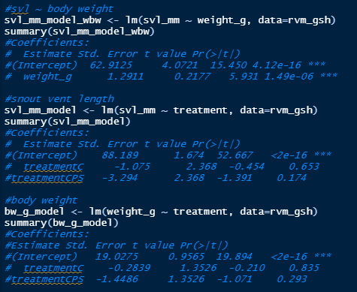
Snout-vent-length and body weight significantly related (as expected), but not a big deal for treatment

Slide 6
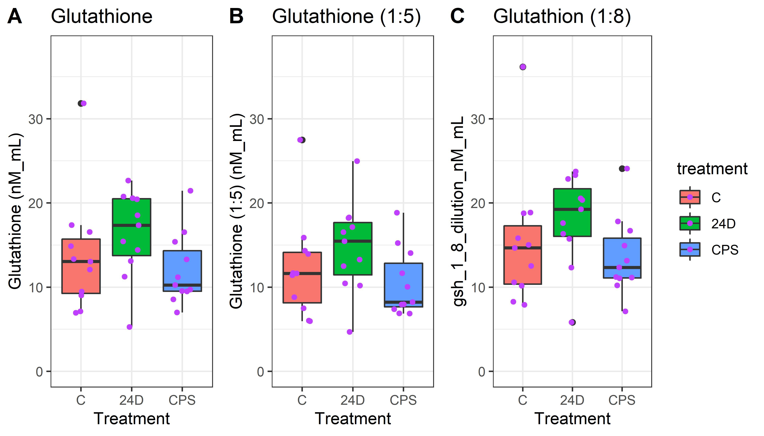
Glutathione variants. Glutathione used 1:5 and 1:8 dilutions, we are using the averaged concentration for the manuscript. The high control was dropped for the statistical comparisons. The points plot appears to be doubling that outlier, but that is a combination of both the boxplot showing that as an outlier and the points plot--these are now differentiated with the colors of black (part of the boxplot) and purple (the jittered sample point). We do not plan to use this plot is not used for the manuscript, it is fyi.

Slide 7
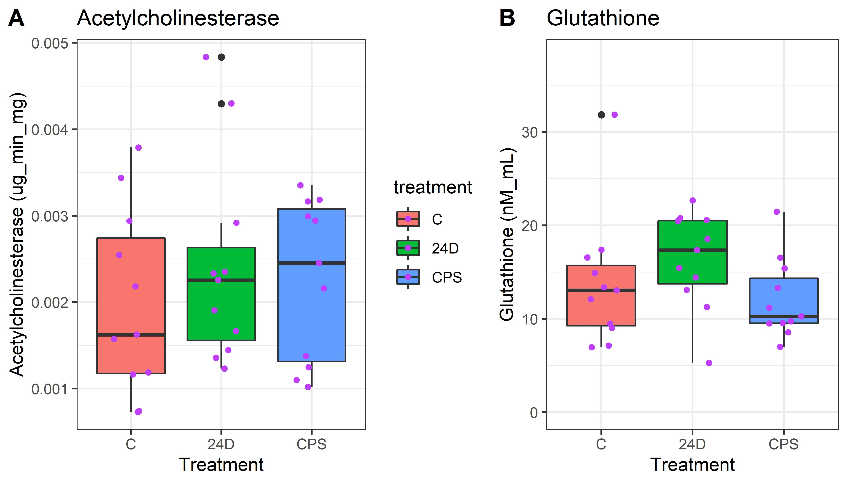
This is the descriptive concentration figure for the manuscript with acetylcholinesterase and the averaged glutathione concentrations versus the treatments. The high control for glutathione, the low 24D glutathione, and 2 high acetylcholinesterase points were all dropped for the statistical comparisons. The points plot appears to be doubling outliers, but that is a combination of both the boxplot showing that as an outlier and the points plot--these are now differentiated with the colors of black (part of the boxplot) and purple (the jittered sample point).

Slide 8
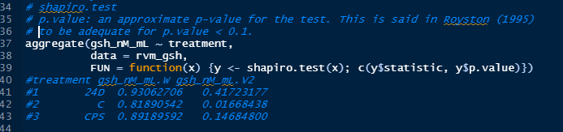
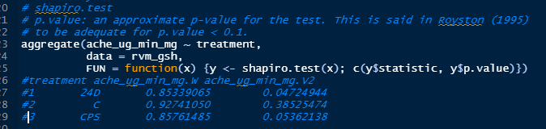
Normality tests for gsh and ache. We run Shapiro tests to test for normality. Red boxes include those sets with data that reject a normality assumption (orange nearly reject).

Slide 9
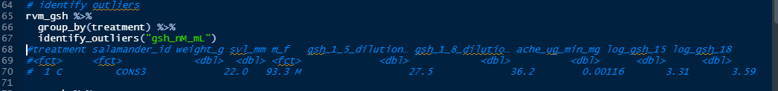
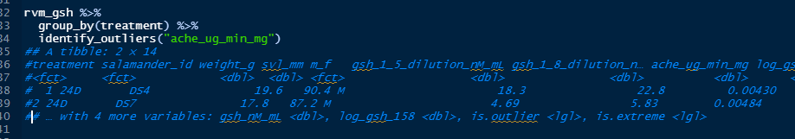
Identify outliers for averaged gsh, the high CONS3 value is identified as an outlier.
Identify outliers for ache, the two high concentrations (DS4 and DS7) are identified as outliers.

Slide 10
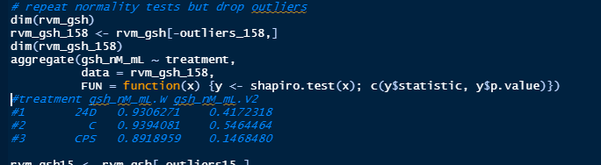
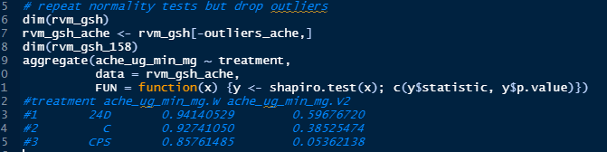
Normality tests for gsh and ache cleared up after dropping outliers, although ache for chlorpyrifos is still on the edge of rejection (only 24D samples were dropped) due to overdispersion in both directions. Also looked at logging but this did not improve the normality fits overall.

Slide 11
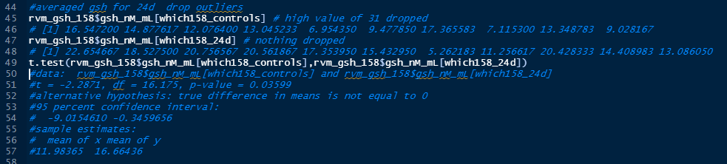
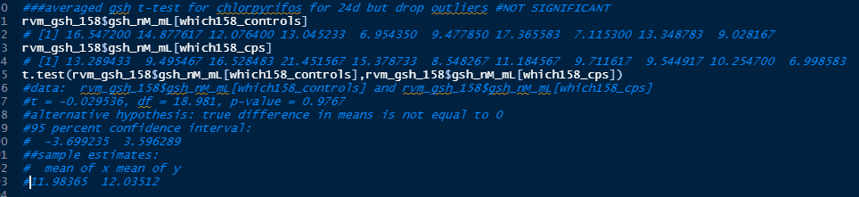
gsh
24d
Significant
gsh
Chlorpyrifos
Not significant

Slide 12
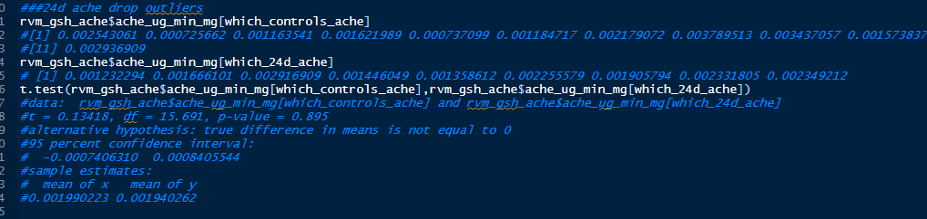
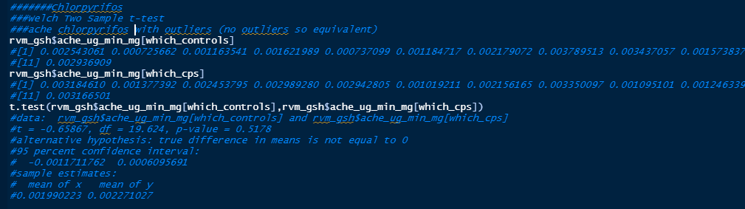
ache
24d
Not significant
ache
Chlorpyrifos
Not significant

Slide 13
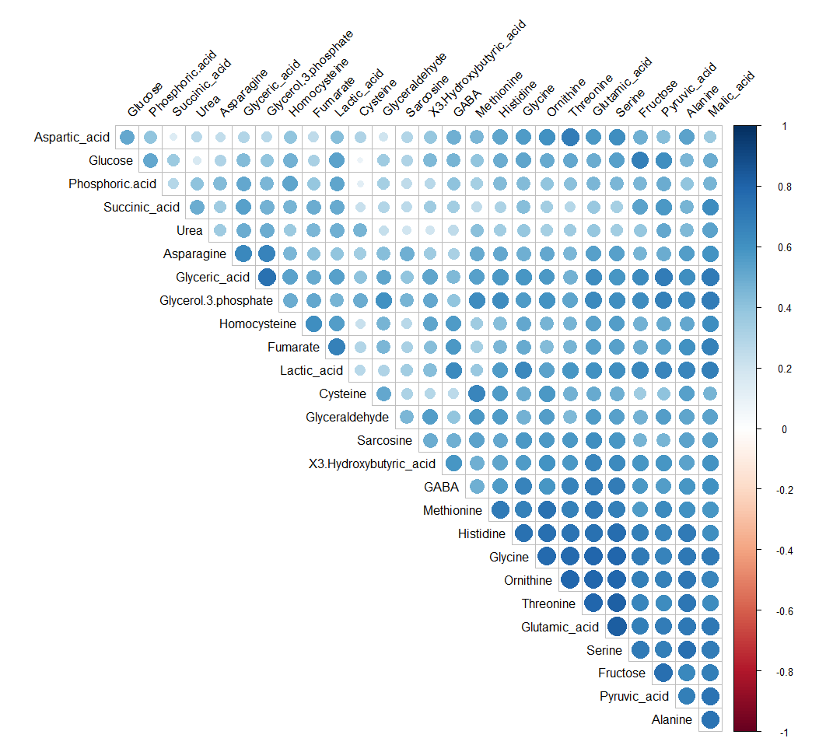

Slide 14
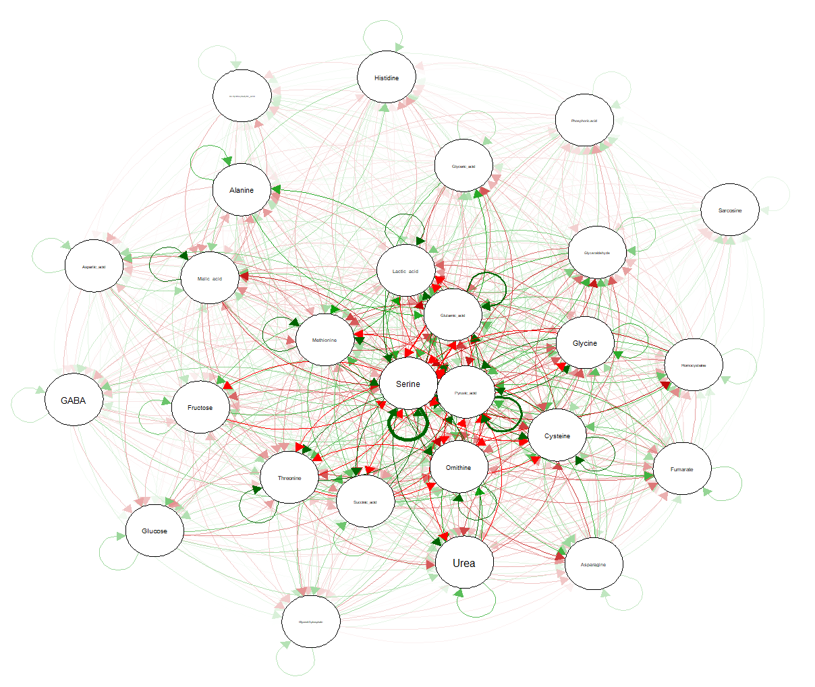

Slide 15
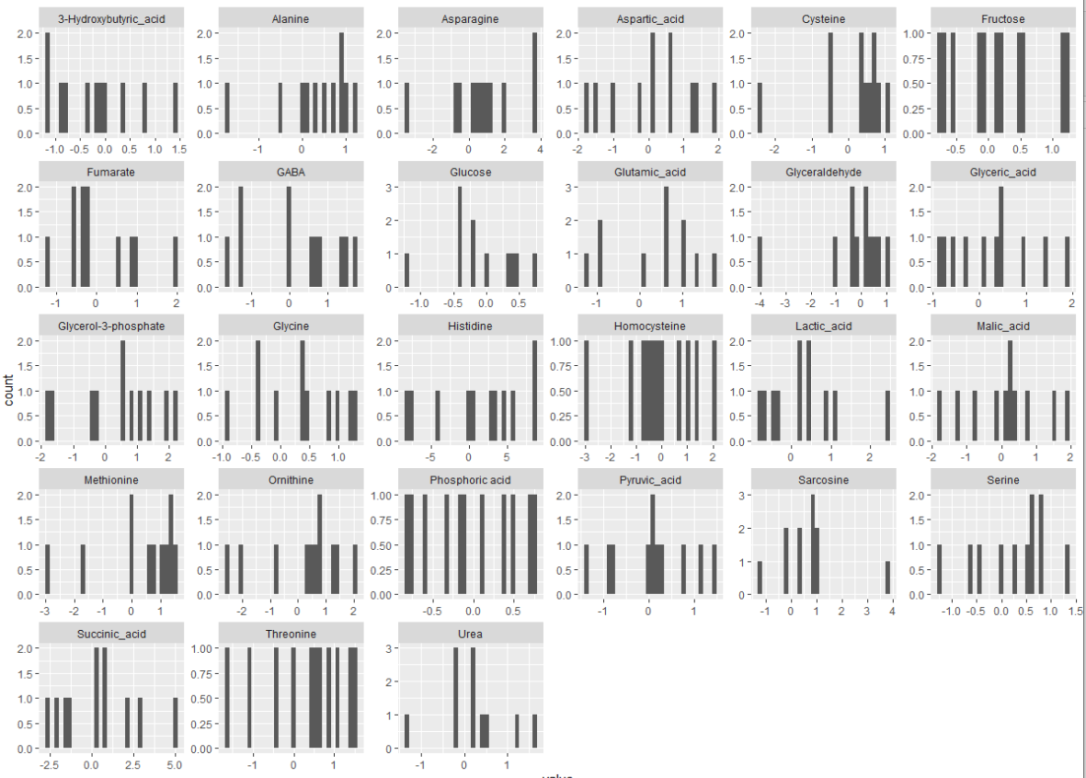
Chlorpyrfos, log2 v control

Slide 17
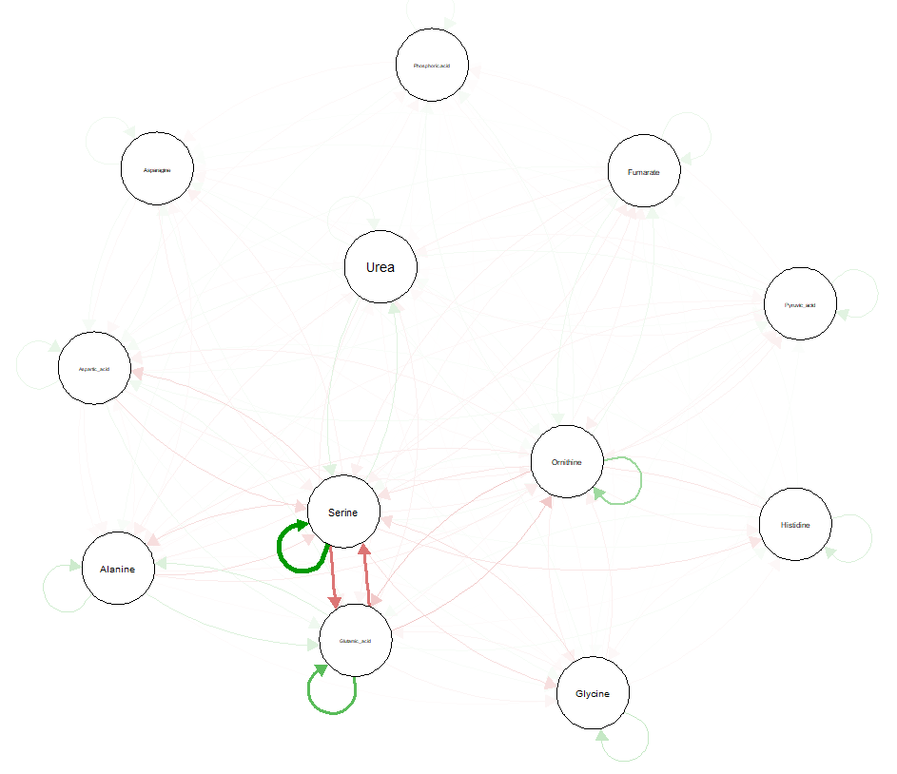
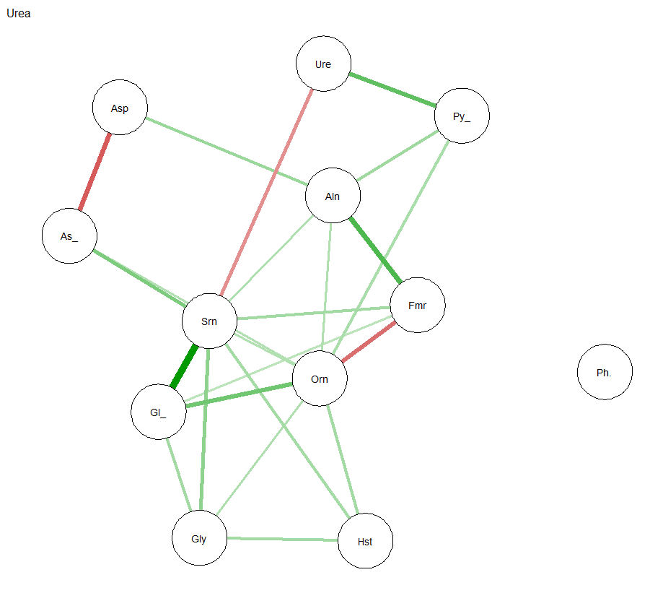
Urea

Slide 18
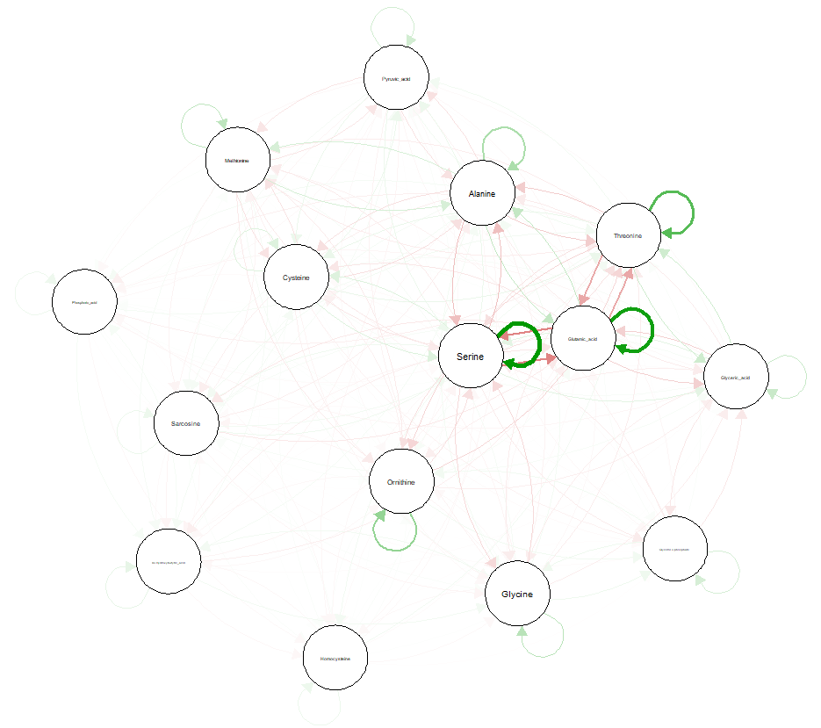
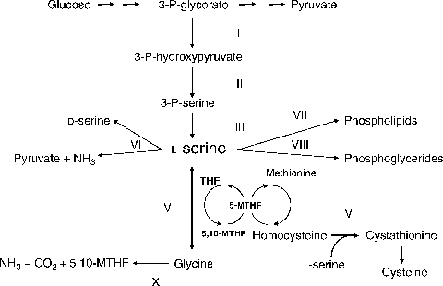
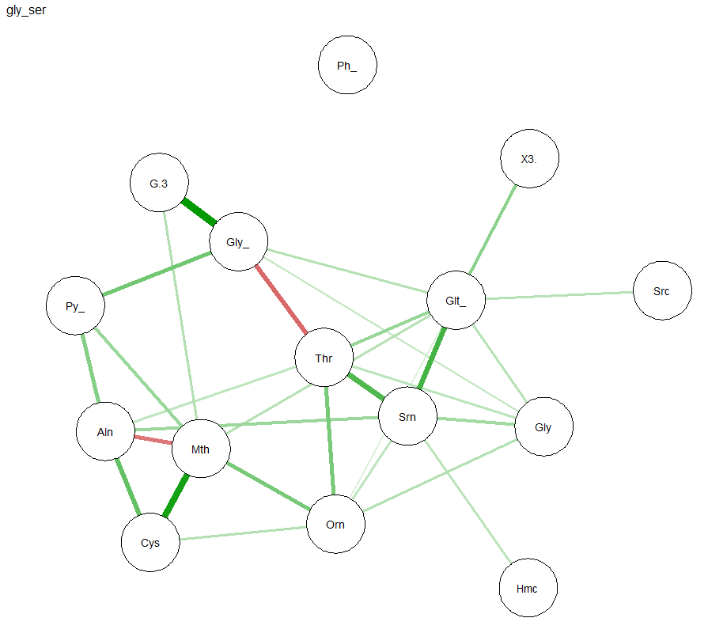
Gly Ser Metabolism

Slide 19
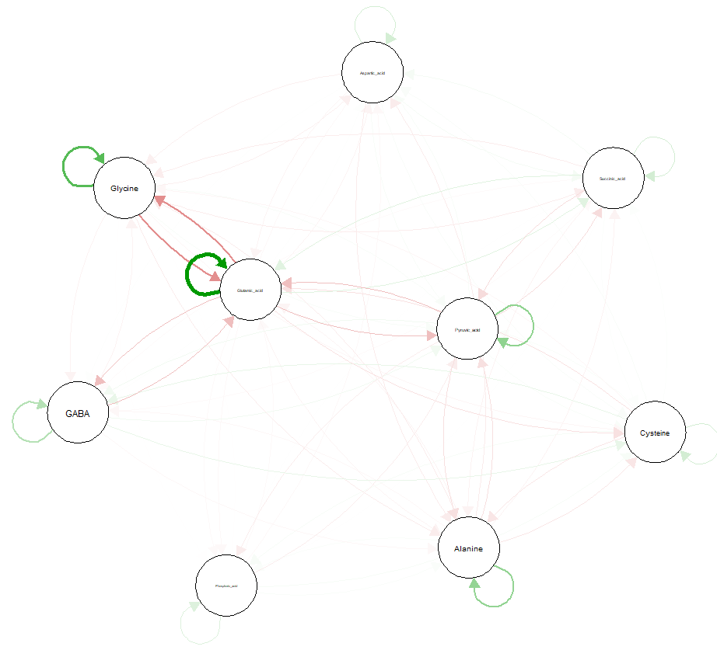
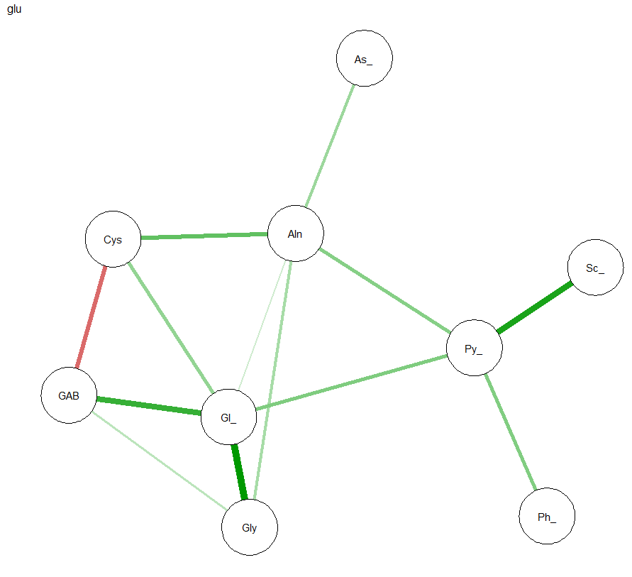
Glu metabolism

Slide 20
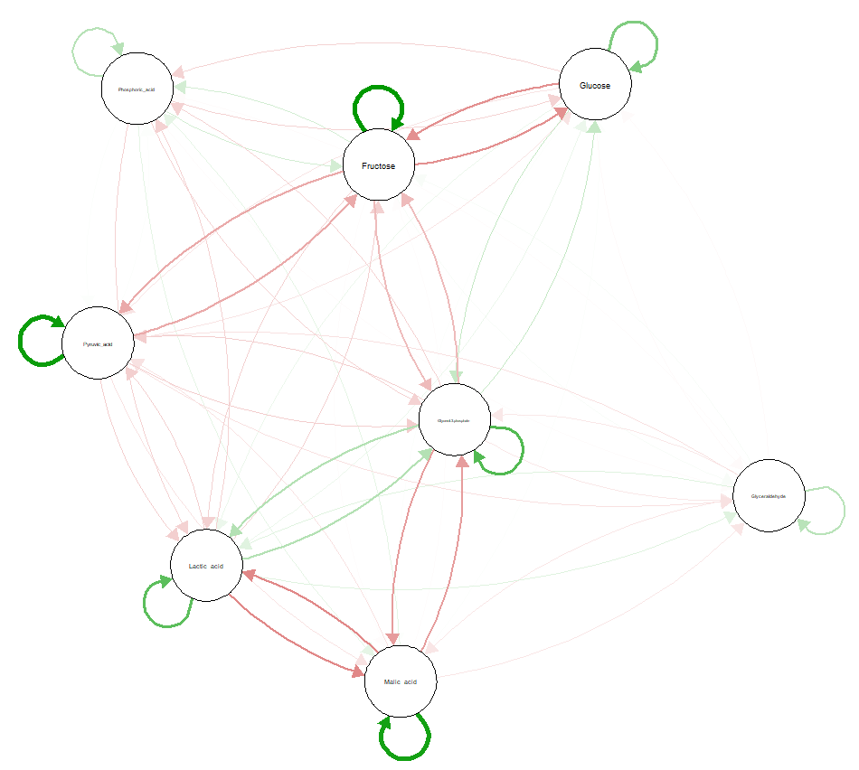
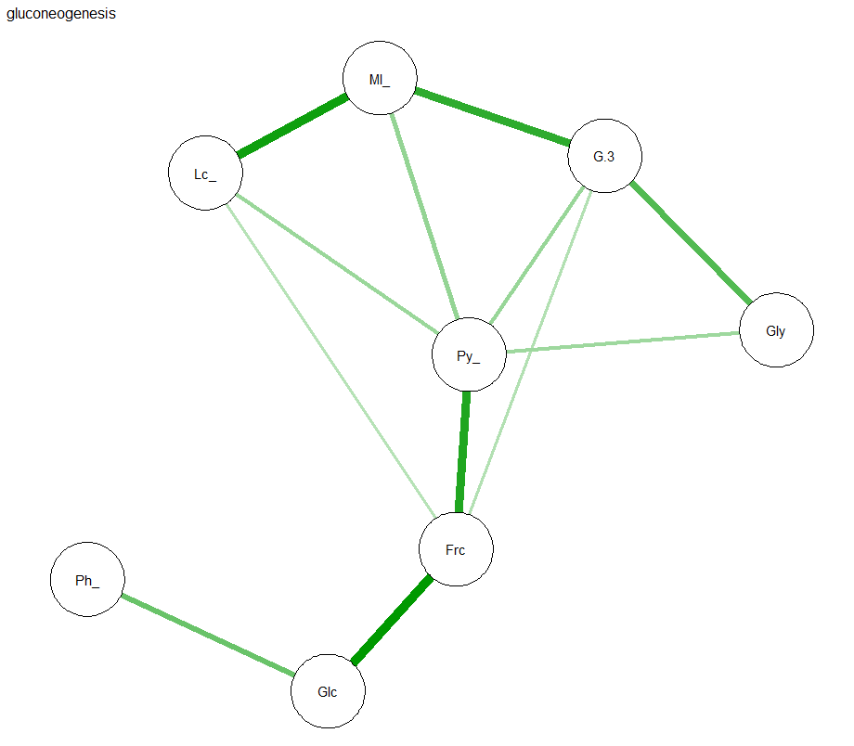
Gluconeogenesis

Slide 21
Glu Ala Cycle

Slide 22
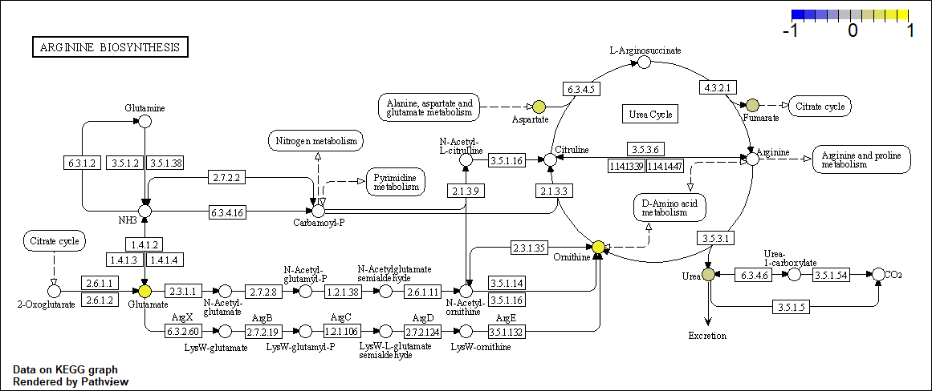
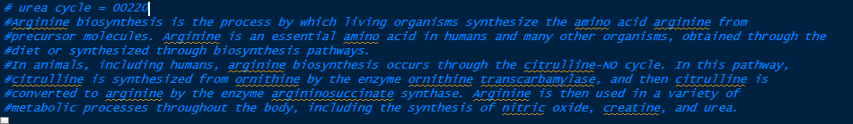
xla; Chlorpyrifos—Arginine biosynthesis (Urea cycle); xla=hsa

Slide 23
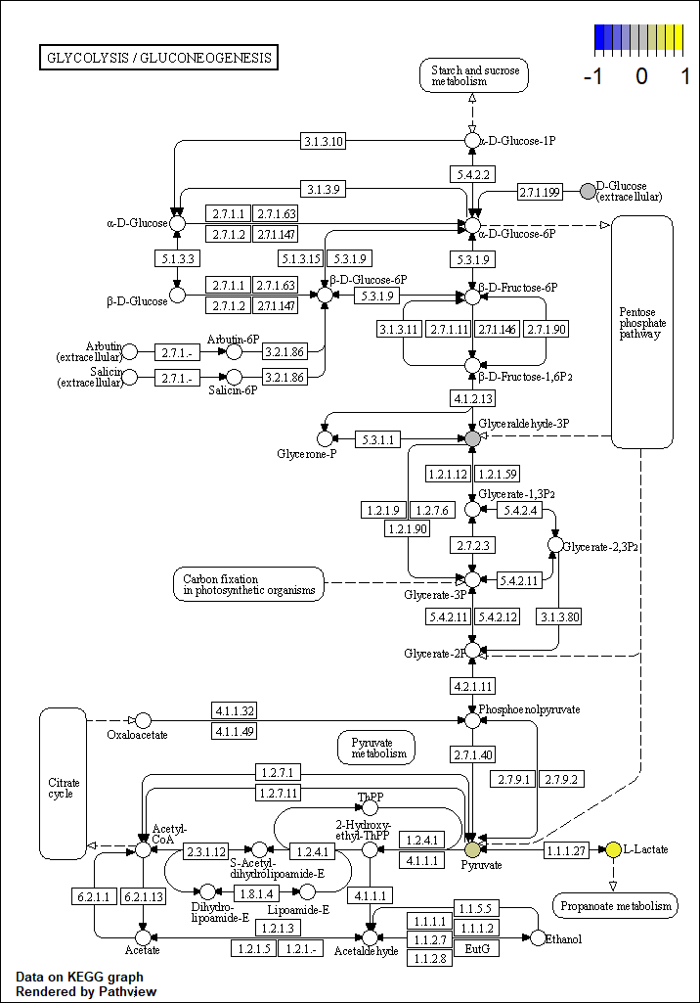
xla; Chlorpyrifos—; xla=hsa

Slide 24
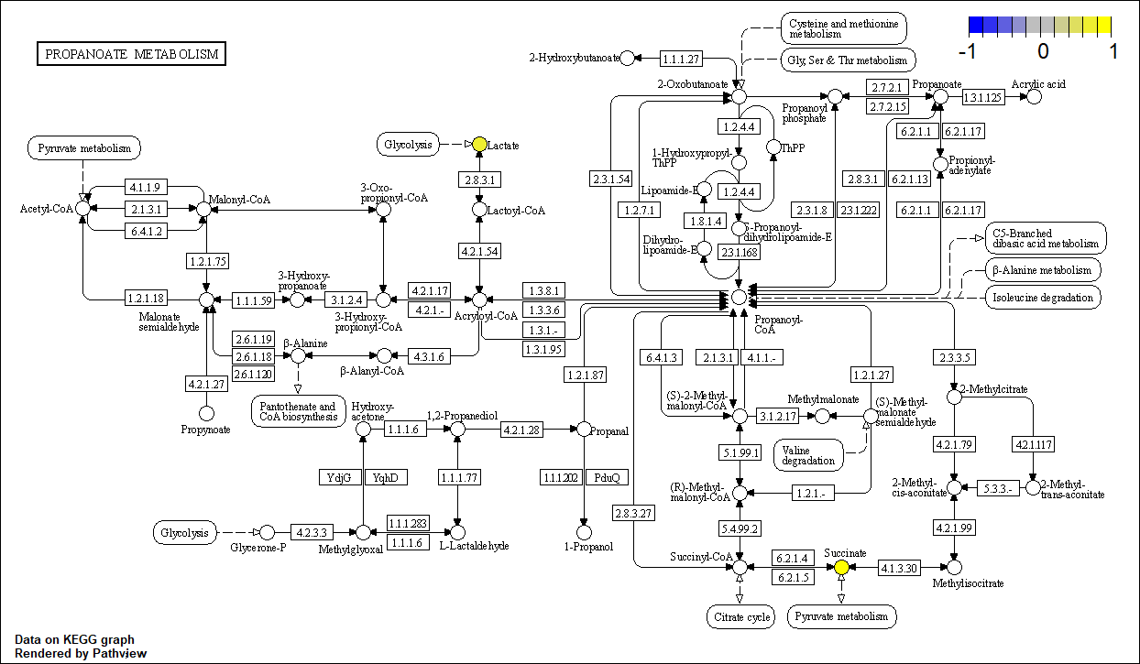
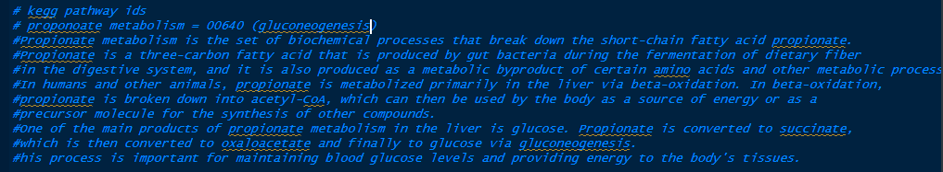
xla; Chlorpyrifos— Proponoate metabolism (Gluconeogenesis); xla=hsa

Slide 25
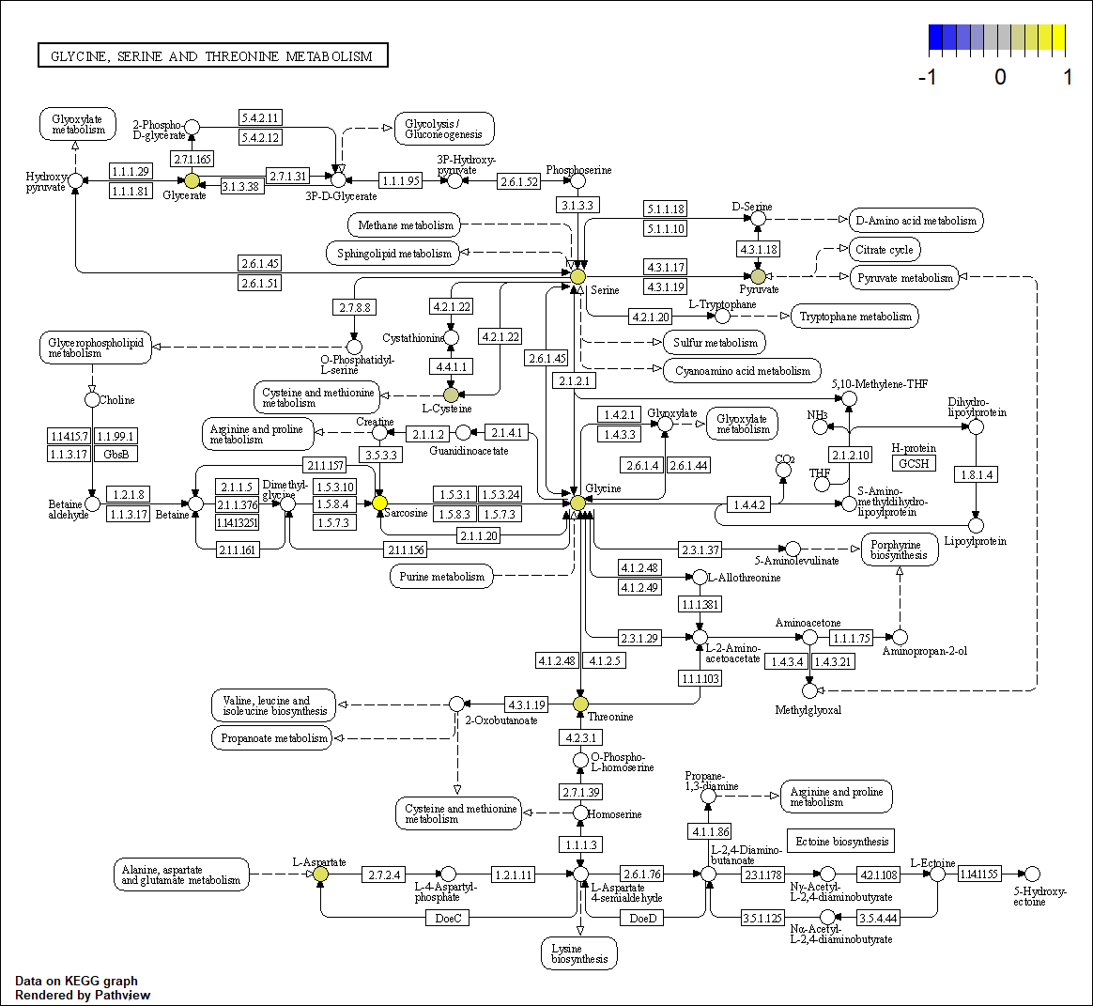
xla; Chlorpyrifos—Glycine, serine, and threonine metabolism; xla=hsa

Slide 26
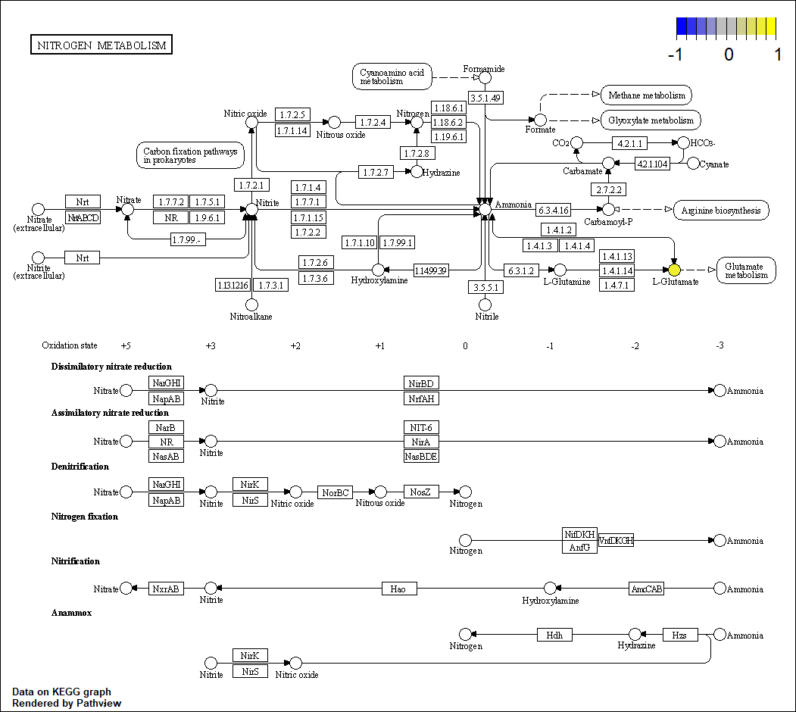
xla; Chlorpyrifos—Glucose alanine cycle; xla=hsa

Slide 27
xla; 24D—; xla=hsa

Slide 28
xla; 24D—; xla=hsa

Slide 29
xla; 24D—; xla=hsa

Slide 30
xla; 24D—; xla=hsa

Slide 31
xla; 24D—; xla=hsa

