Slide 1
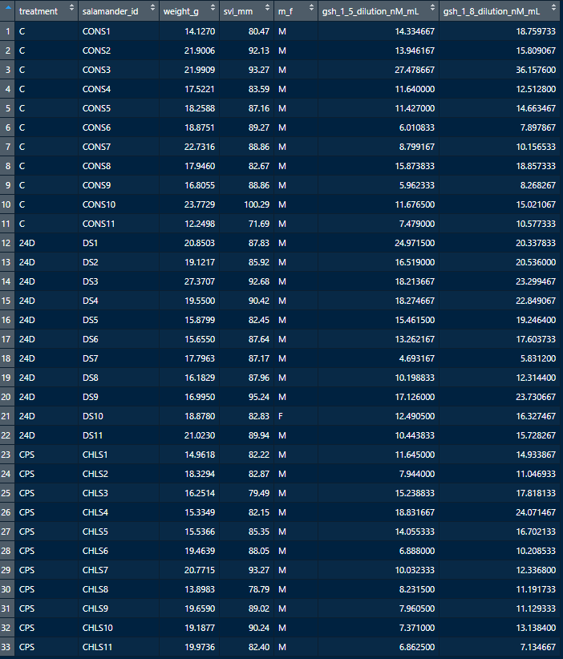

Slide 2
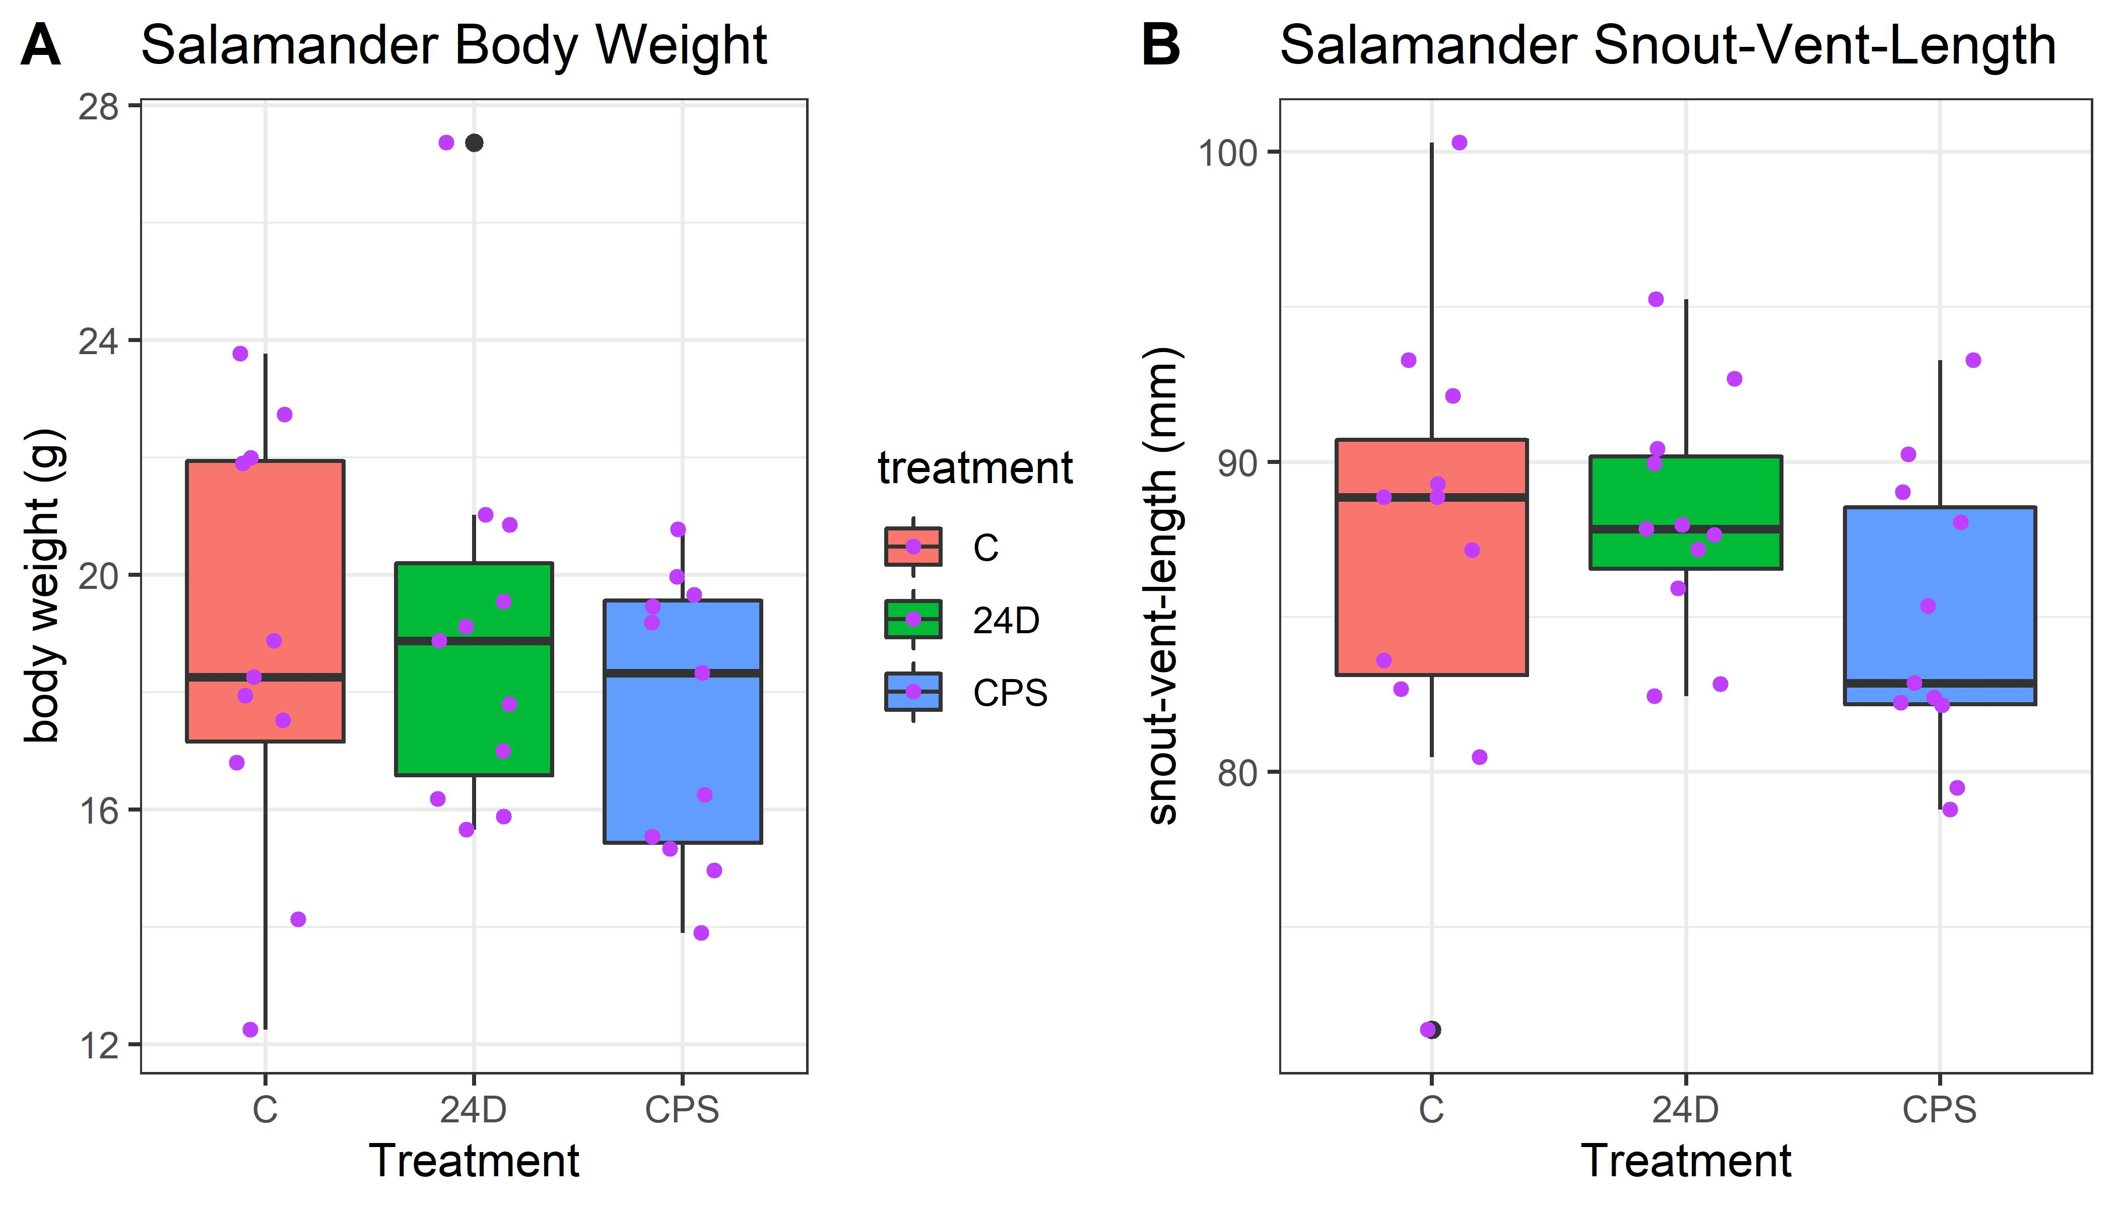
Body weight and SVL plot. Chlorpyrifos treatment ended up using slightly smaller salamanders, but this ended up not being an issue for the analysis (the points plot appears to be doubling the outlier, but that is a combination of the boxplot showing the outlier (black) and the jittered point plot (purple). This figure is not necessarily for the manuscripts main text, if used at all. The higher body weight outlier 24D salamander is the low concentration outlier on the next plot.

Slide 3
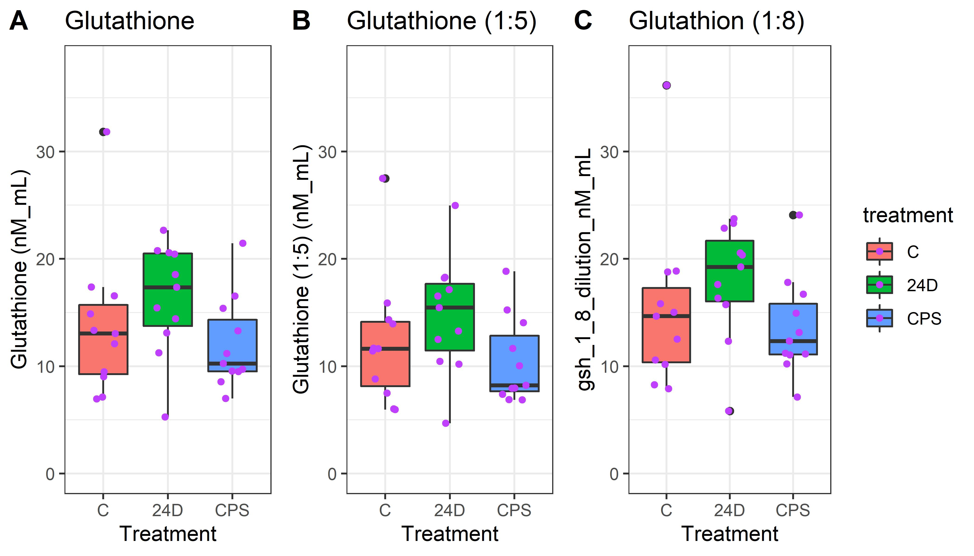
Glutathione variants. Glutathione used 1:5 and 1:8 dilution, we are using the averaged concentration for the analysis. The high control was dropped for the statistical comparisons. The points plot appears to be doubling that outlier, but that is a combination of both the boxplot showing that as an outlier and the points plot--these are now differentiated with the colors of black (part of the boxplot) and purple (the jittered sample point). This plot is not used for the manuscript.

Slide 4
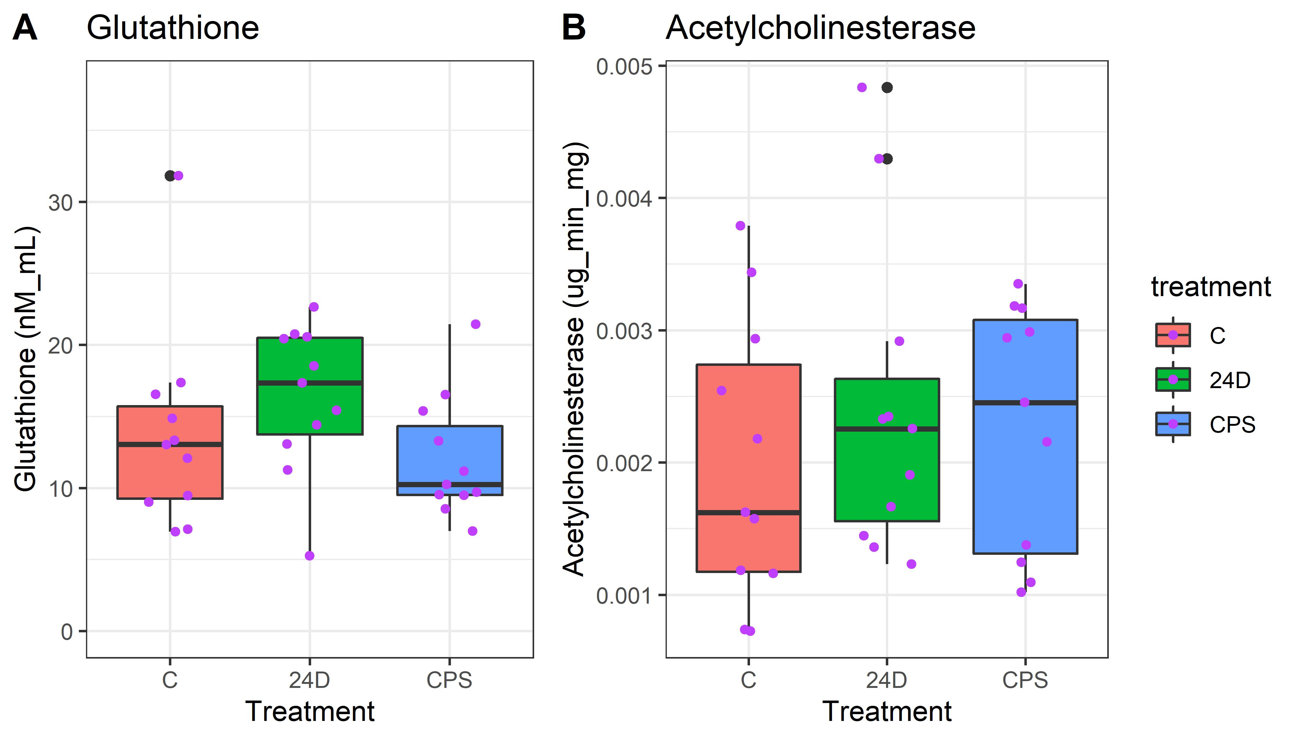
This is the descriptive concentration figure for the manuscript with acetylcholinesterase and the averaged glutathione concentrations versus the treatments. The high control for glutathione, the low 24D glutathione, and 2 high acetylcholinesterase points were all dropped for the statistical comparisons. The points plot appears to be doubling outliers, but that is a combination of both the boxplot showing that as an outlier and the points plot--these are now differentiated with the colors of black (part of the boxplot) and purple (the jittered sample point).

Slide 5
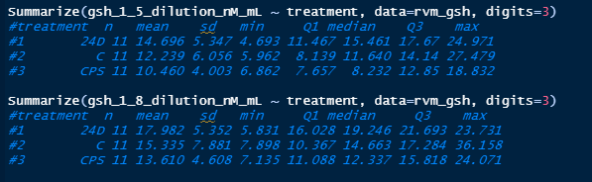
Summary stats before investigating outliers

Slide 6
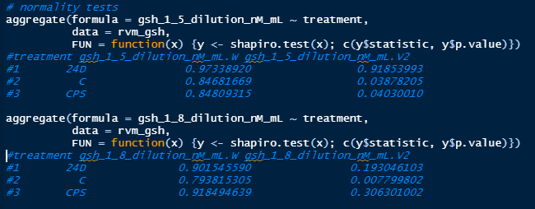
Shapiro tests show some normality rejections

Slide 7
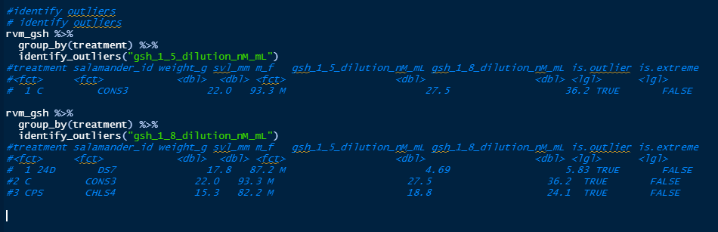
Identify outliers, 4 outliers seen across the 2 response variables, none extreme

Slide 8
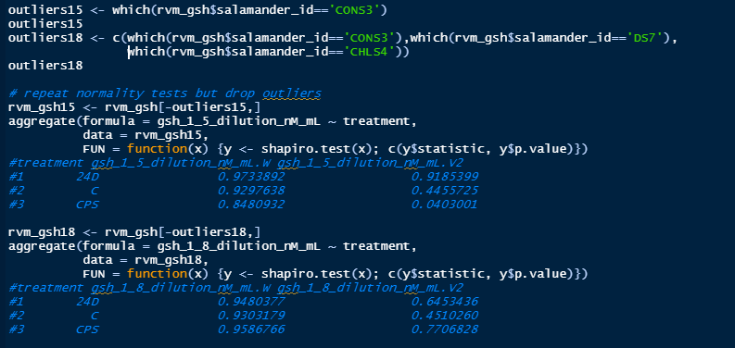
Normality tests mostly cleared up

Slide 9
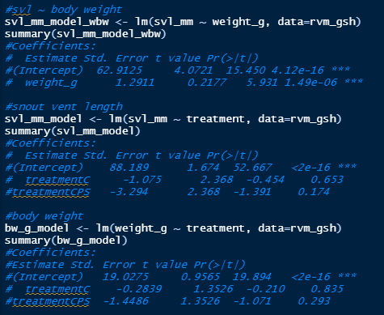
Snout-vent-length and body weight significantly related as, but not a big deal for treatment

Slide 10
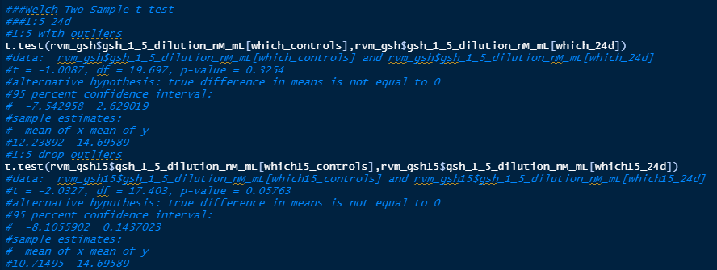
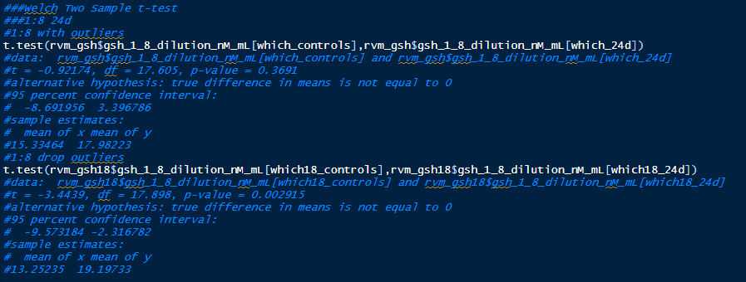
1:5
24d
24d exposure results in significant gsh elevation (when outliers are dropped)
1:8
24d

Slide 11
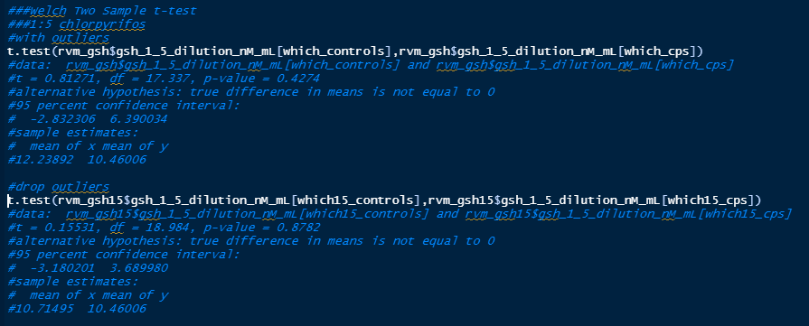
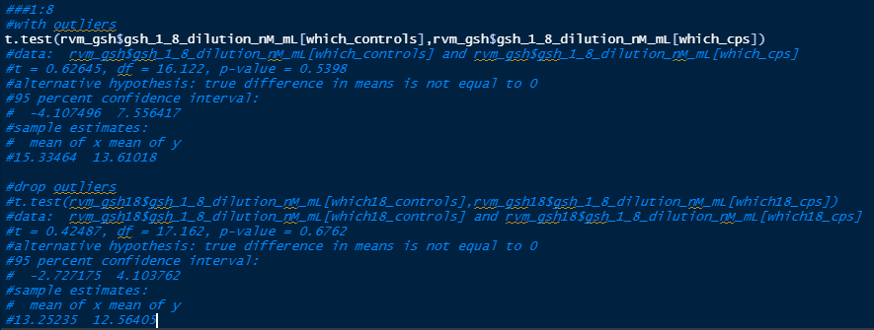
1:5
chlorpyrifos
chlorpyrifos exposure results in insignificant gsh suppression
1:8
chlorpyrifos

Slide 12
Metabolomics in process…

