Slide 1
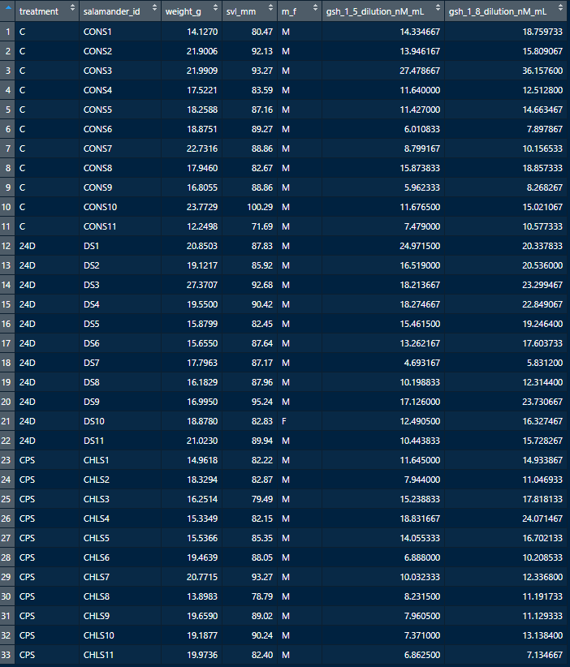

Slide 2
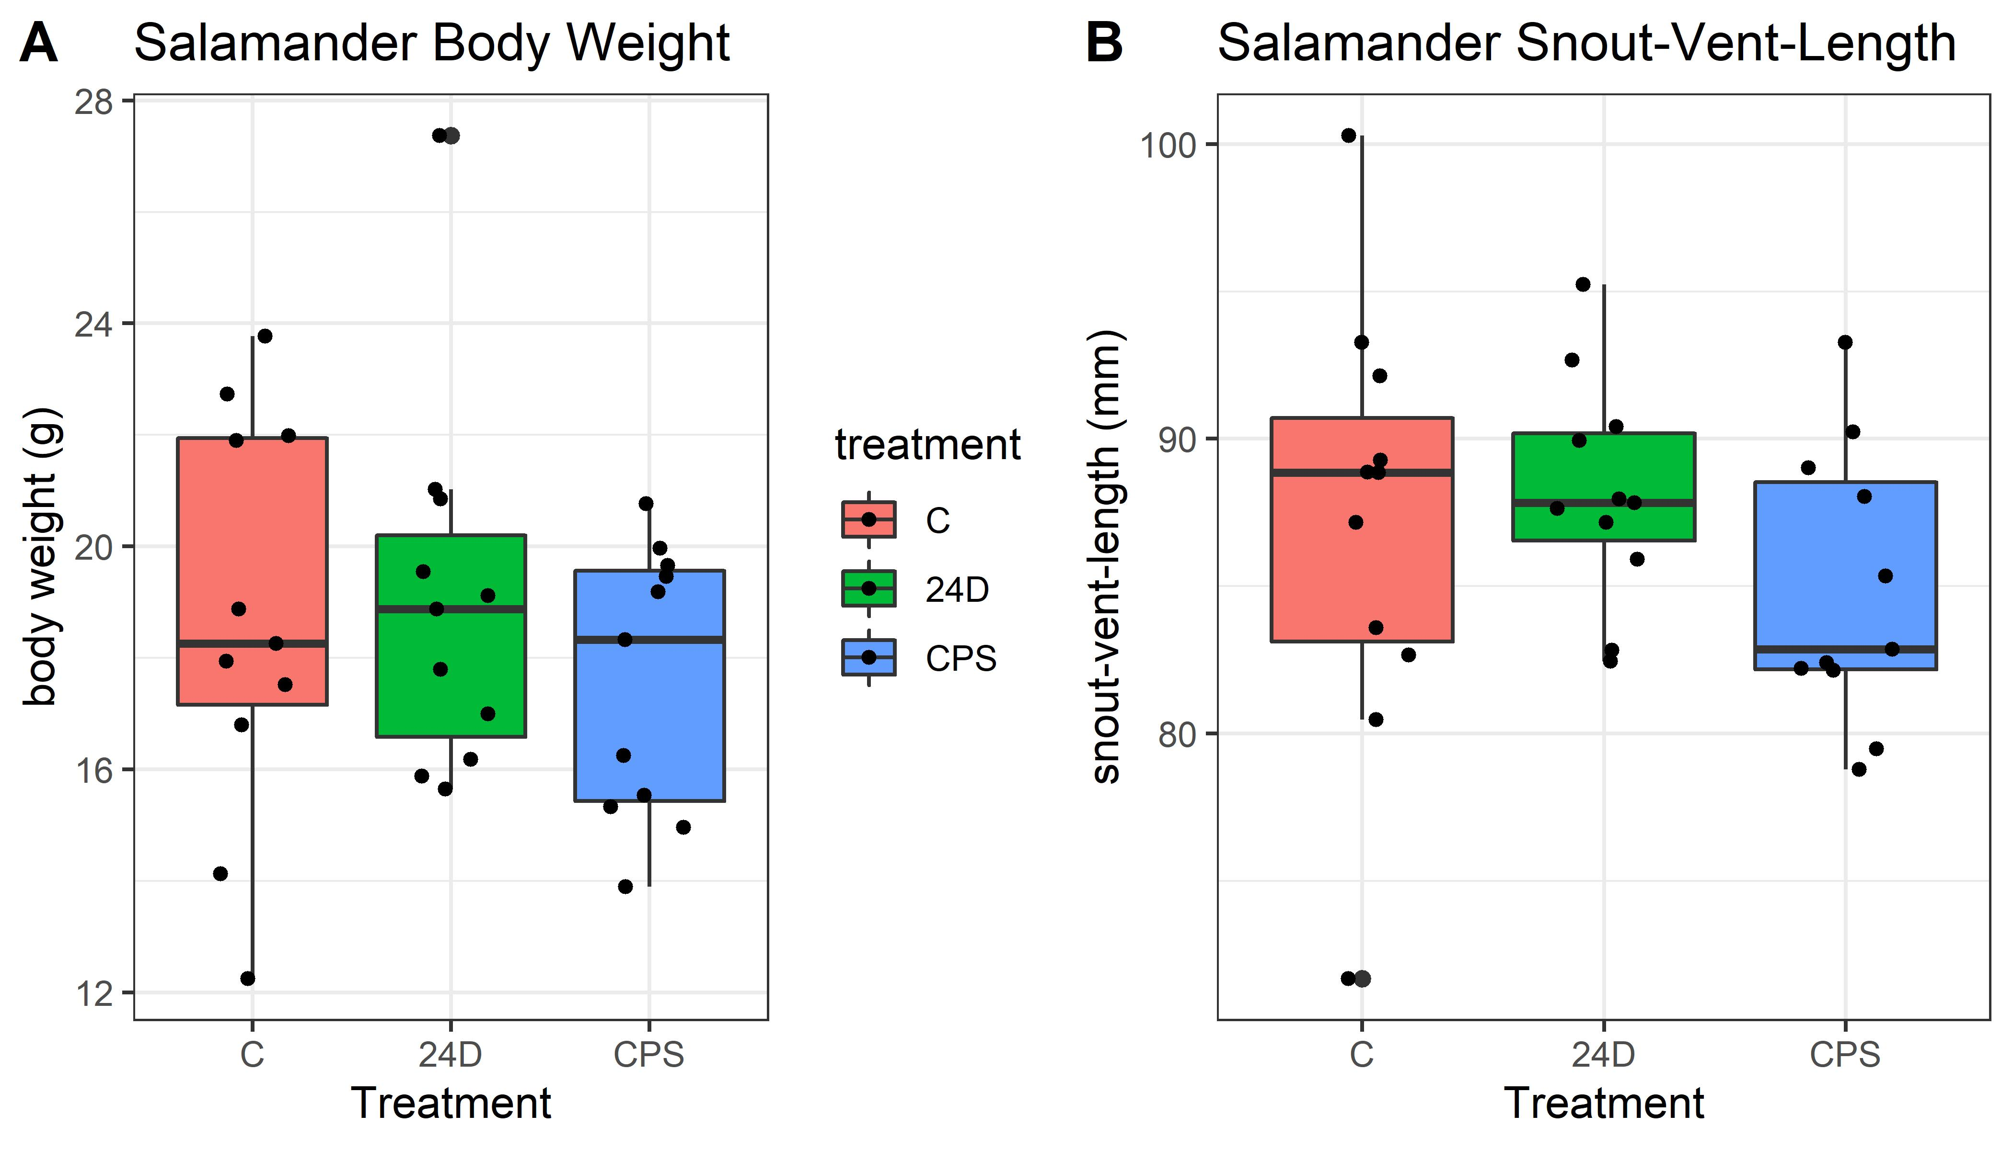
Chlorpyrifos treatment ended up using slightly smaller salamanders, but this ended up not being an issue for the analysis

Slide 3
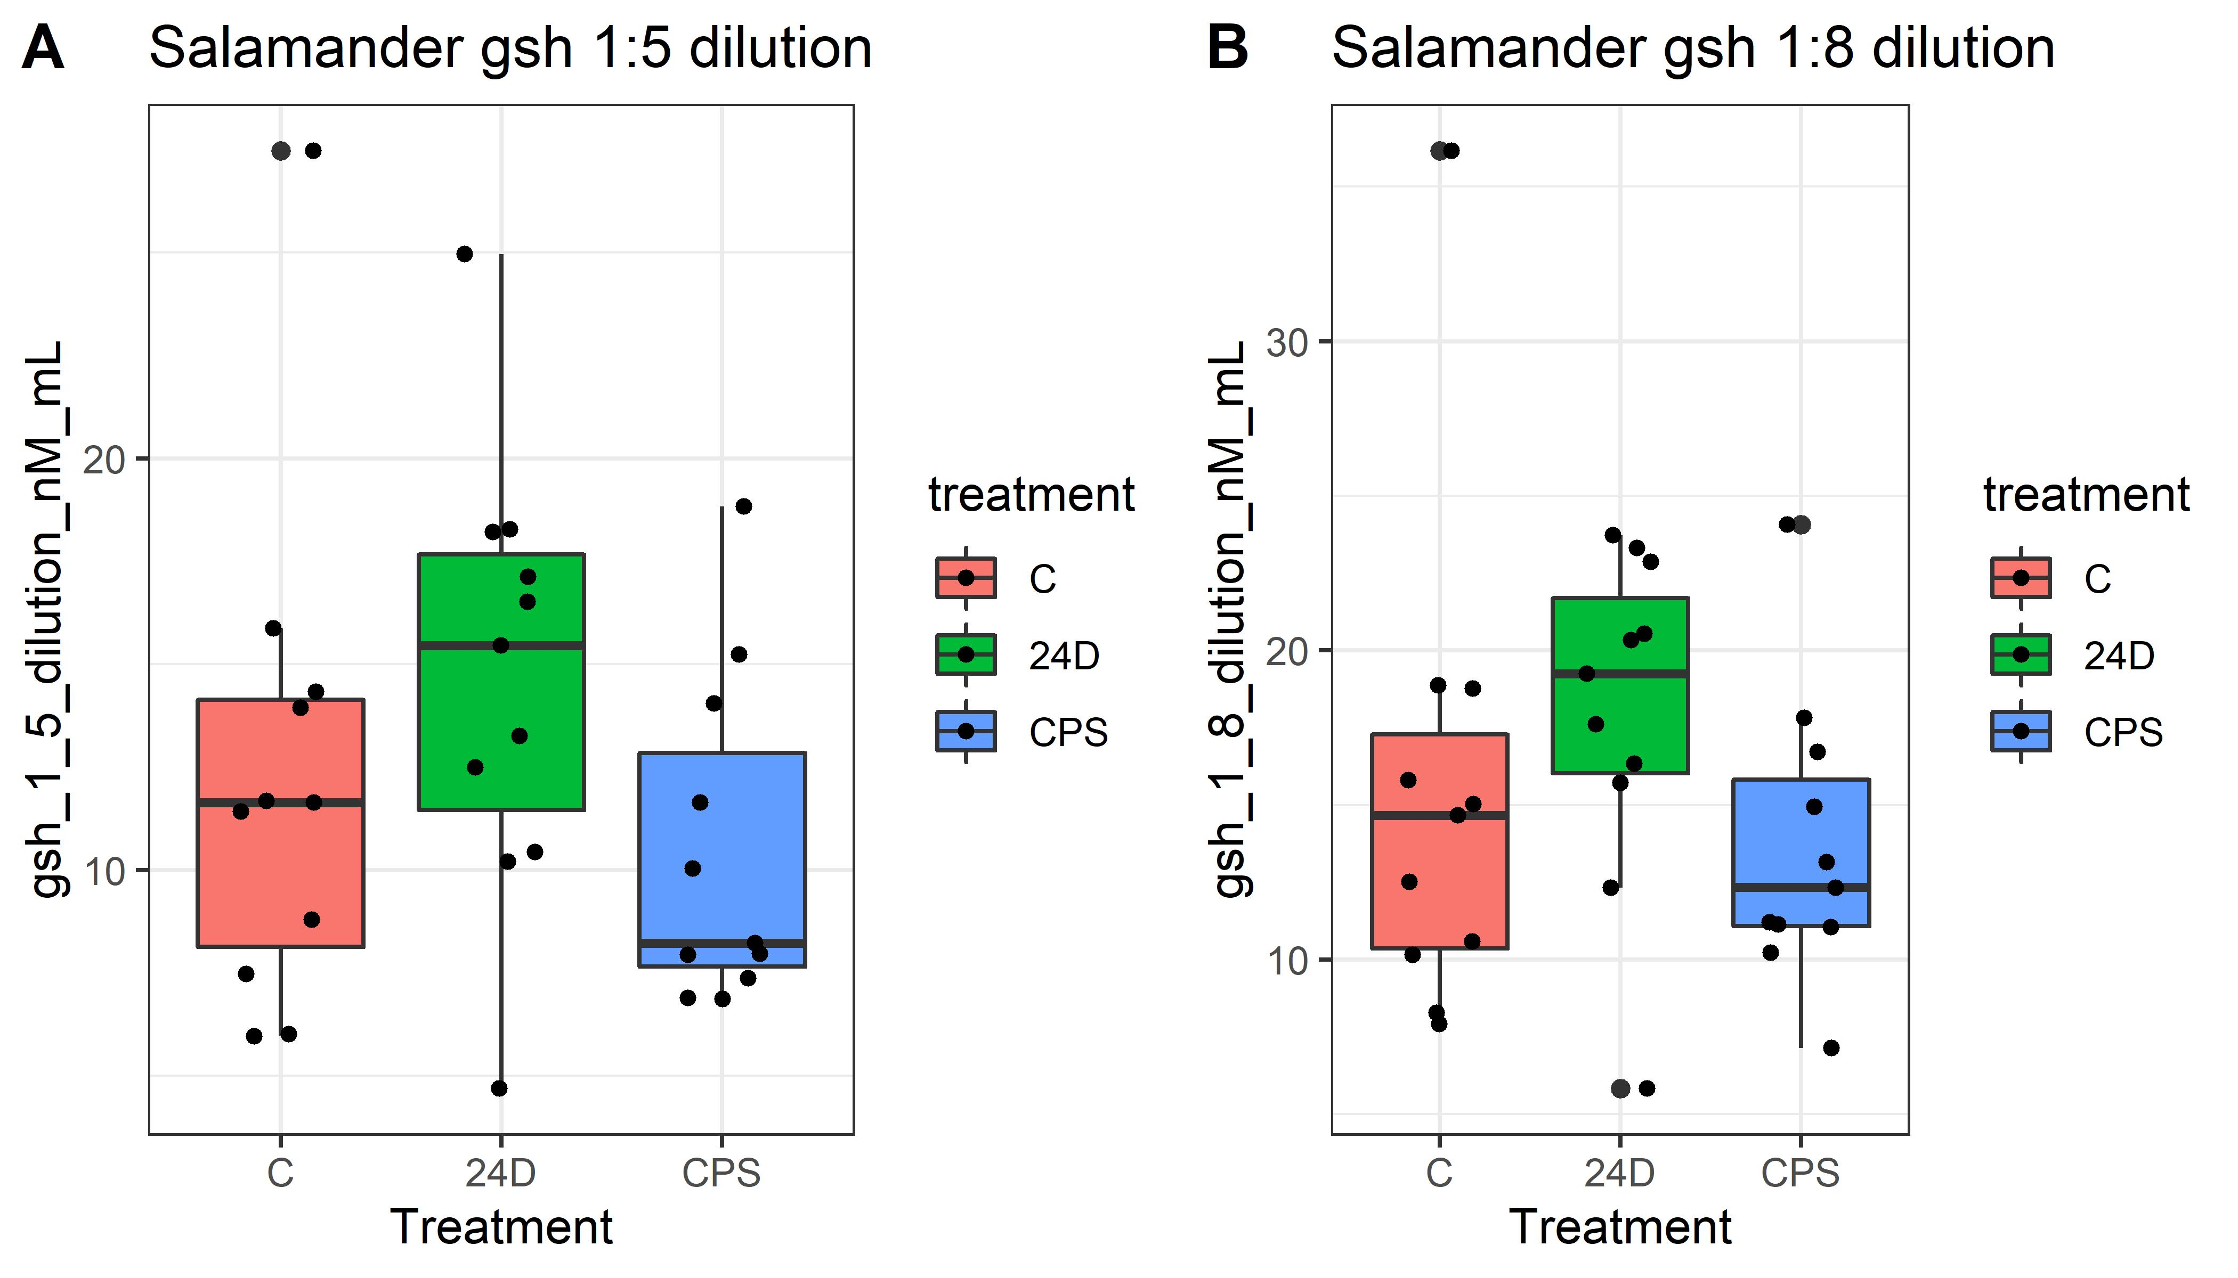
Chlorpyrifos treatment ended up using slightly smaller salamanders, but this ended up not being an issue for the analysis (the points plot is appears to be doubling the outlier, but that is a combination of the boxplot showing the outlier and the point plot)

Slide 4
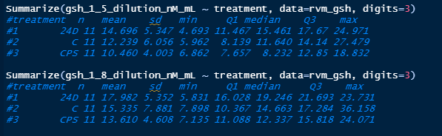
Summary stats before investigating outliers

Slide 5
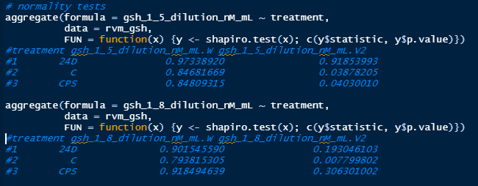
Shapiro tests show some normality rejections

Slide 6
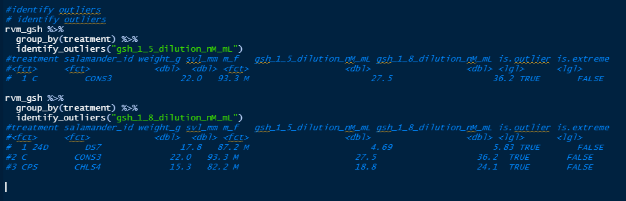
Identify outliers, 4 outliers seen across the 2 response variables, none extreme

Slide 7
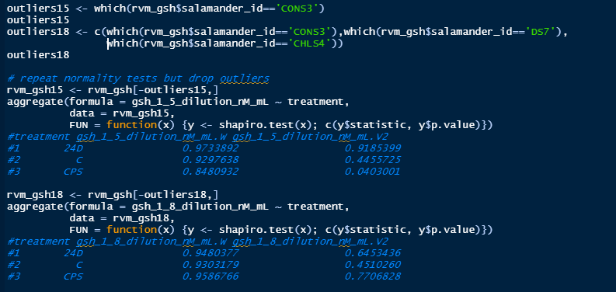
Normality tests mostly cleared up

Slide 8
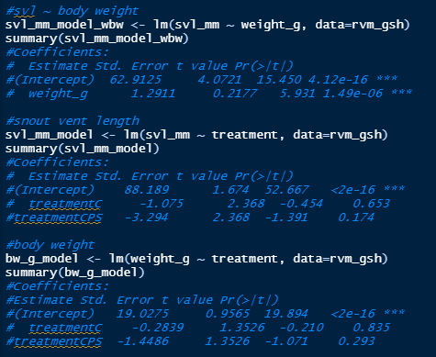
Snout-vent-length and body weight significantly related as, but not a big deal for treatment

Slide 9
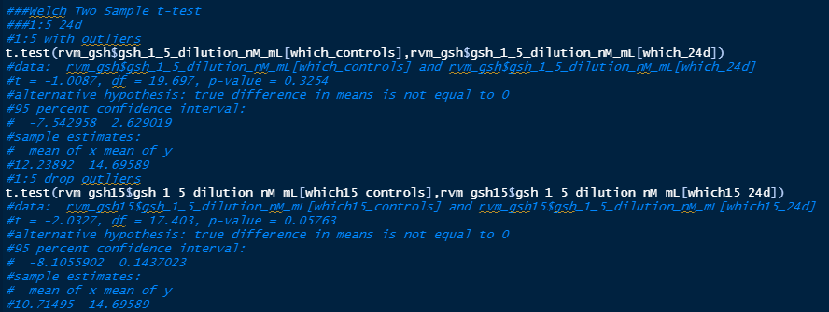
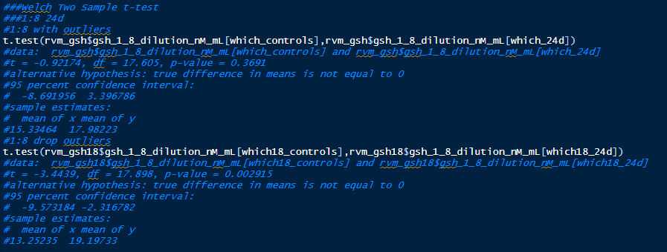
1:5
24d
24d exposure results in significant gsh elevation (when outliers are dropped)
1:8
24d

Slide 10
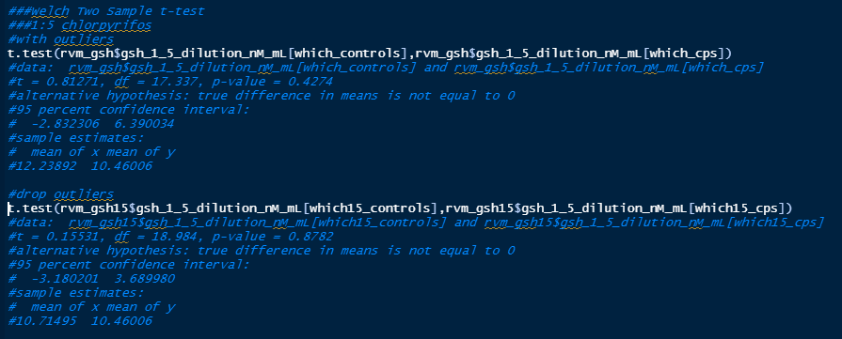
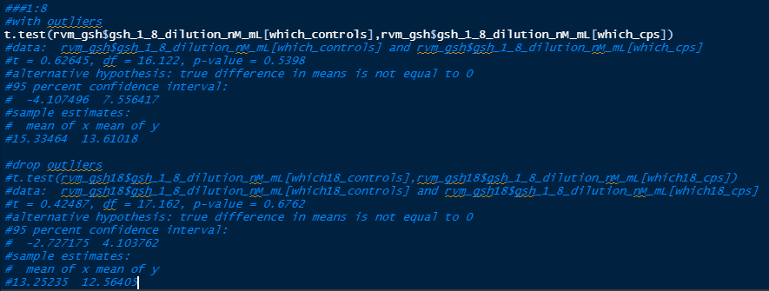
1:5
chlorpyrifos
chlorpyrifos exposure results in insignificant gsh suppression
1:8
chlorpyrifos

