Slide 1
Metabolomic workflows including filtering

Slide 2
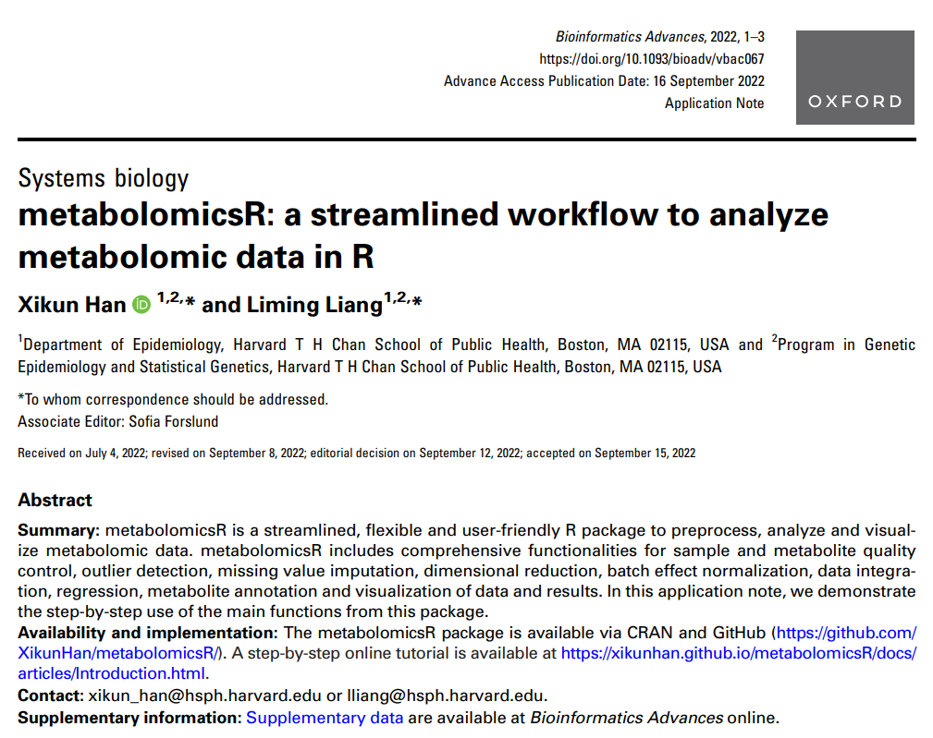
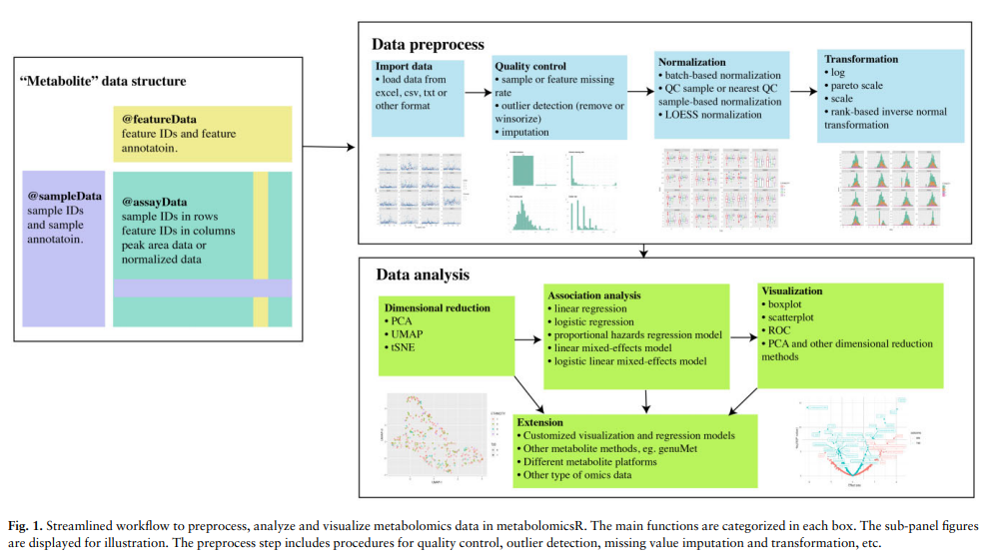
https://watermark.silverchair.com/vbac067.pdf

Slide 3
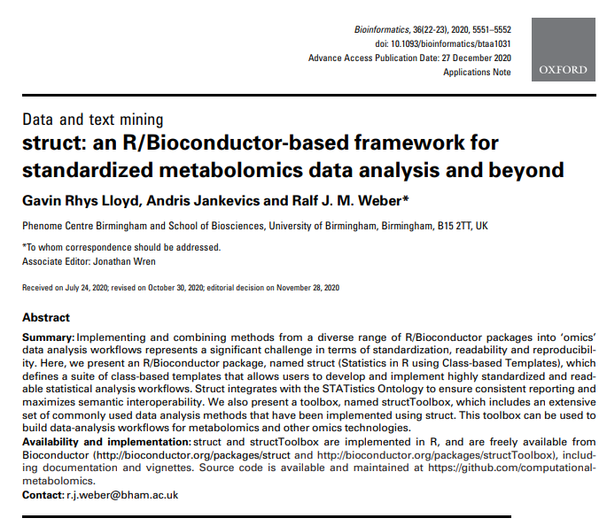
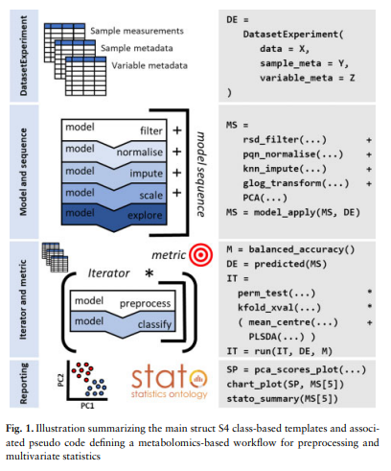
structToolbox: Data processing & analysis tools for Metabolomics and other omics (bioconductor.org) https://watermark.silverchair.com/btaa1031.pdf

Slide 4
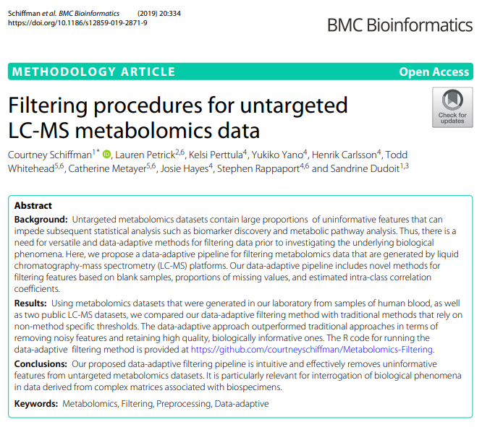
Filtering procedures for untargeted LC-MS metabolomics data | BMC Bioinformatics | Full Text (biomedcentral.com) courtneyschiffman/Metabolomics-Filtering: This repository contains code and data for reproducing the data-adaptive filtering method described in "Filtering procedures for untargeted LC-MS metabolomics data." (github.com)

