Slide 1
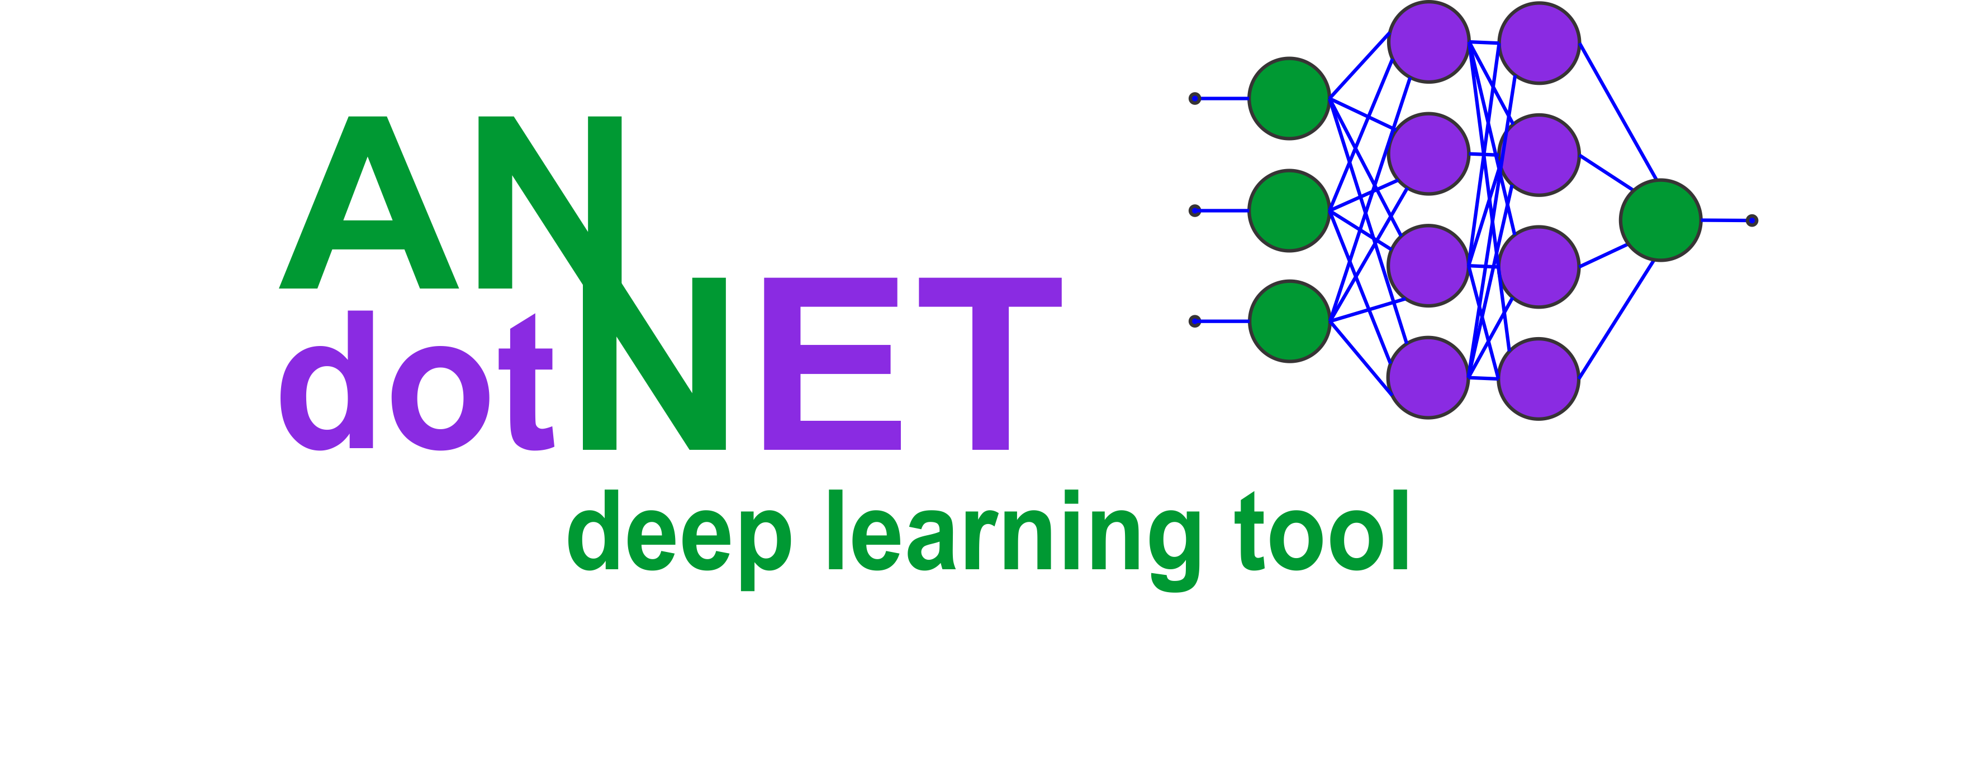
ANNdotNET – deep learning tool on .NET Platform
MVP Global Summit, 2019
Bahrudin Hrnjica,
MVP, Bosnia and Herzegovina

Slide 2
What is ANNdotNET?
Open source at github.com/bhrnjica/anndotnet
Windows WPF Desktop application
Creating, training, evaluation, testing and deploying DL models.
Machine Learning Engine, ML Engine – based on CNTK , GPU support
Introduces Visual Network Designer, VNN Designer
Introduces „Machine Learning Configuration, MLConfig file.
Currently supports: regression, binary and multiclass clasification, image classification.

Slide 3
Why ANNdotNET
creating, training, evaluating and deploying models from GUI
does not require knowledge of programming languages
The ANNdotNET is ideal in several scenarios:
more focus on network development and training process using classic desktop approach, instead of focusing on coding,
less time spending on debugging source code, more focusing on different configuration and parameter variants,
ideal for engineers/users who are not familiar with programming languages,
in case the problem requires coding custom models, or training process, ANNdotNET CMD provides high level of API for such implementation,
all ml configurations developed with GUI tool, can be handled with CMD tool and vice versa.

Slide 4
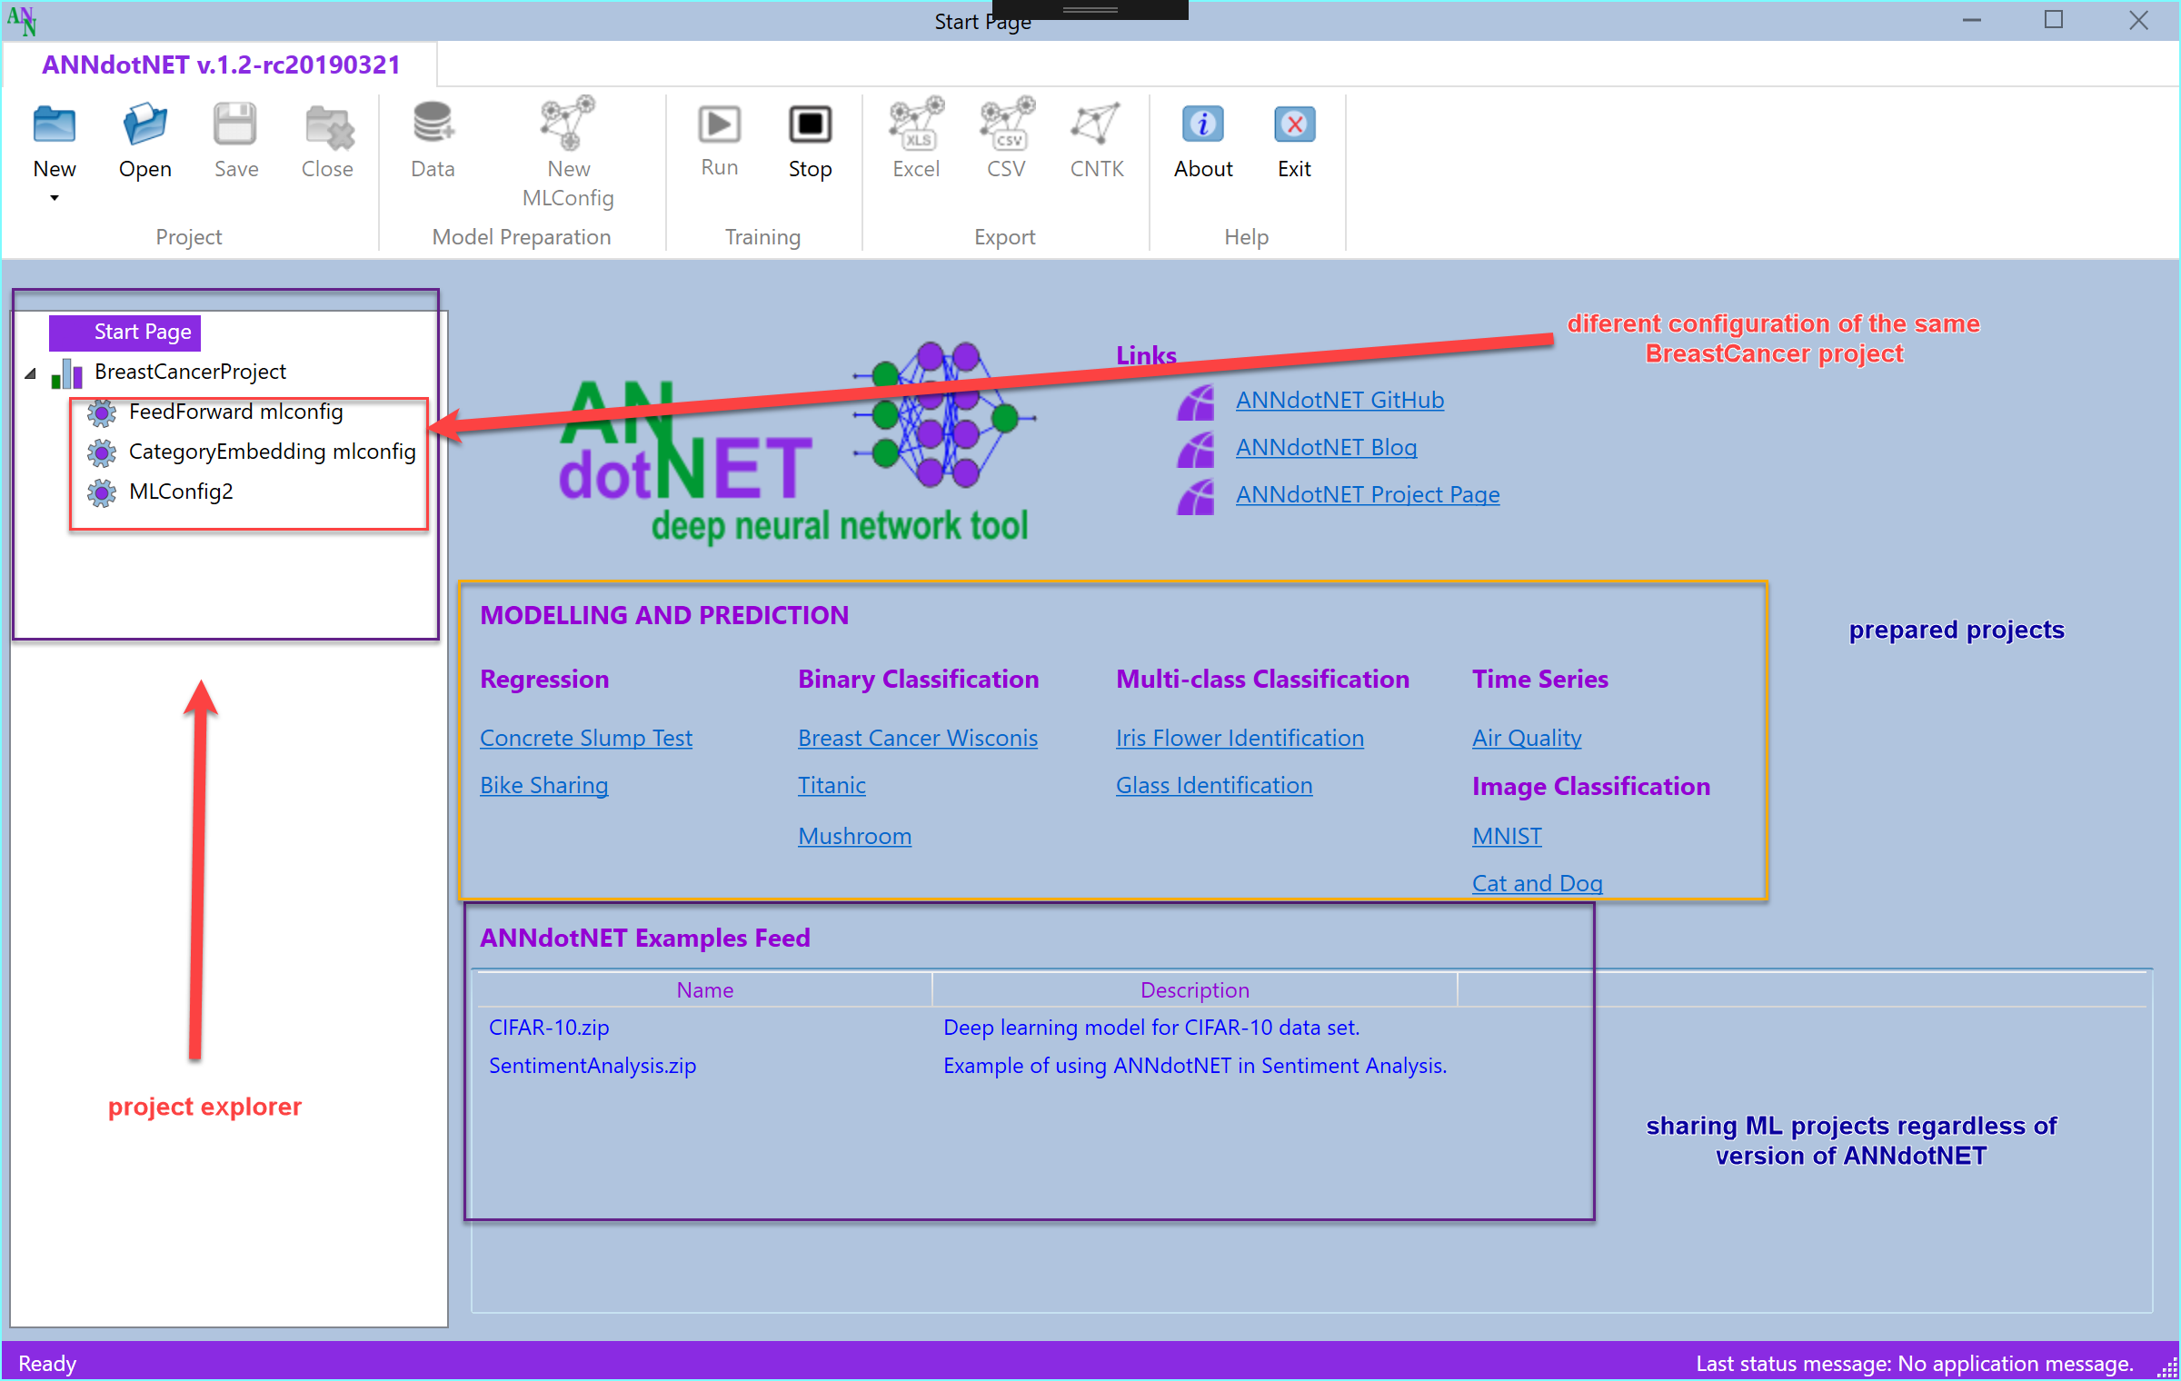
ANNdotNET start screen

Slide 5
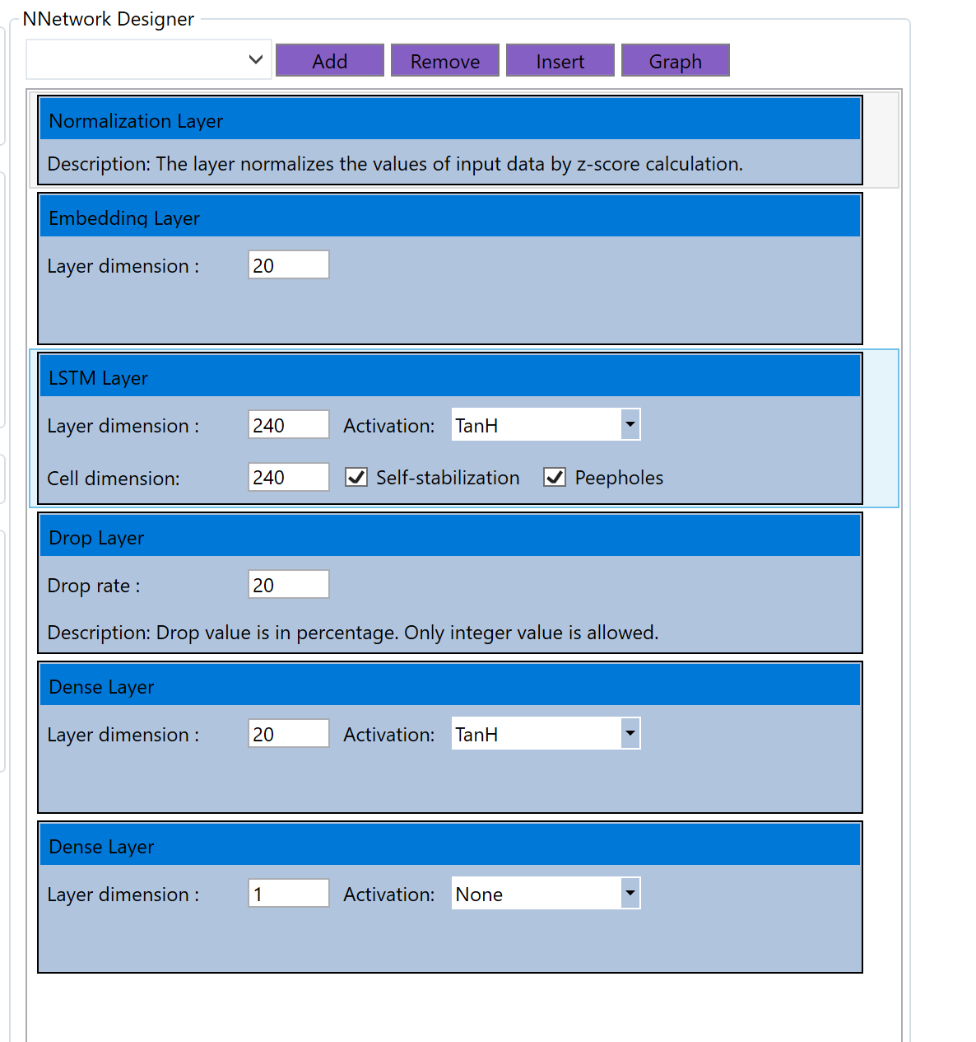
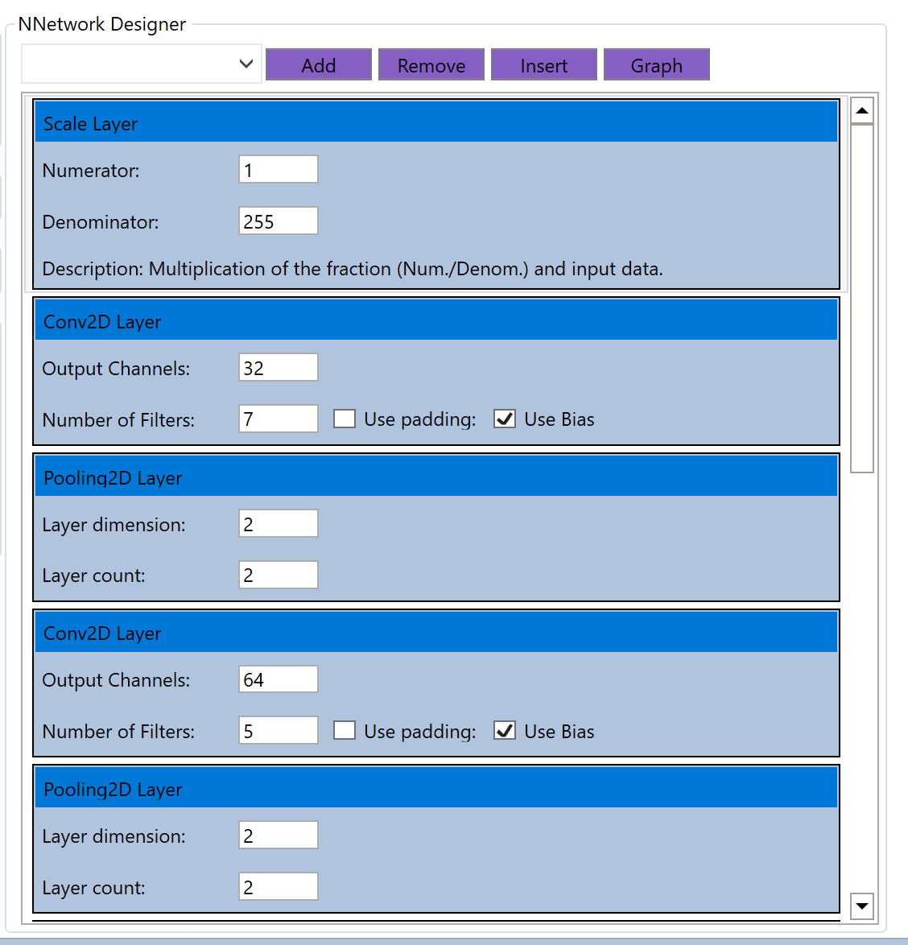
Visual Network Designer

Slide 6
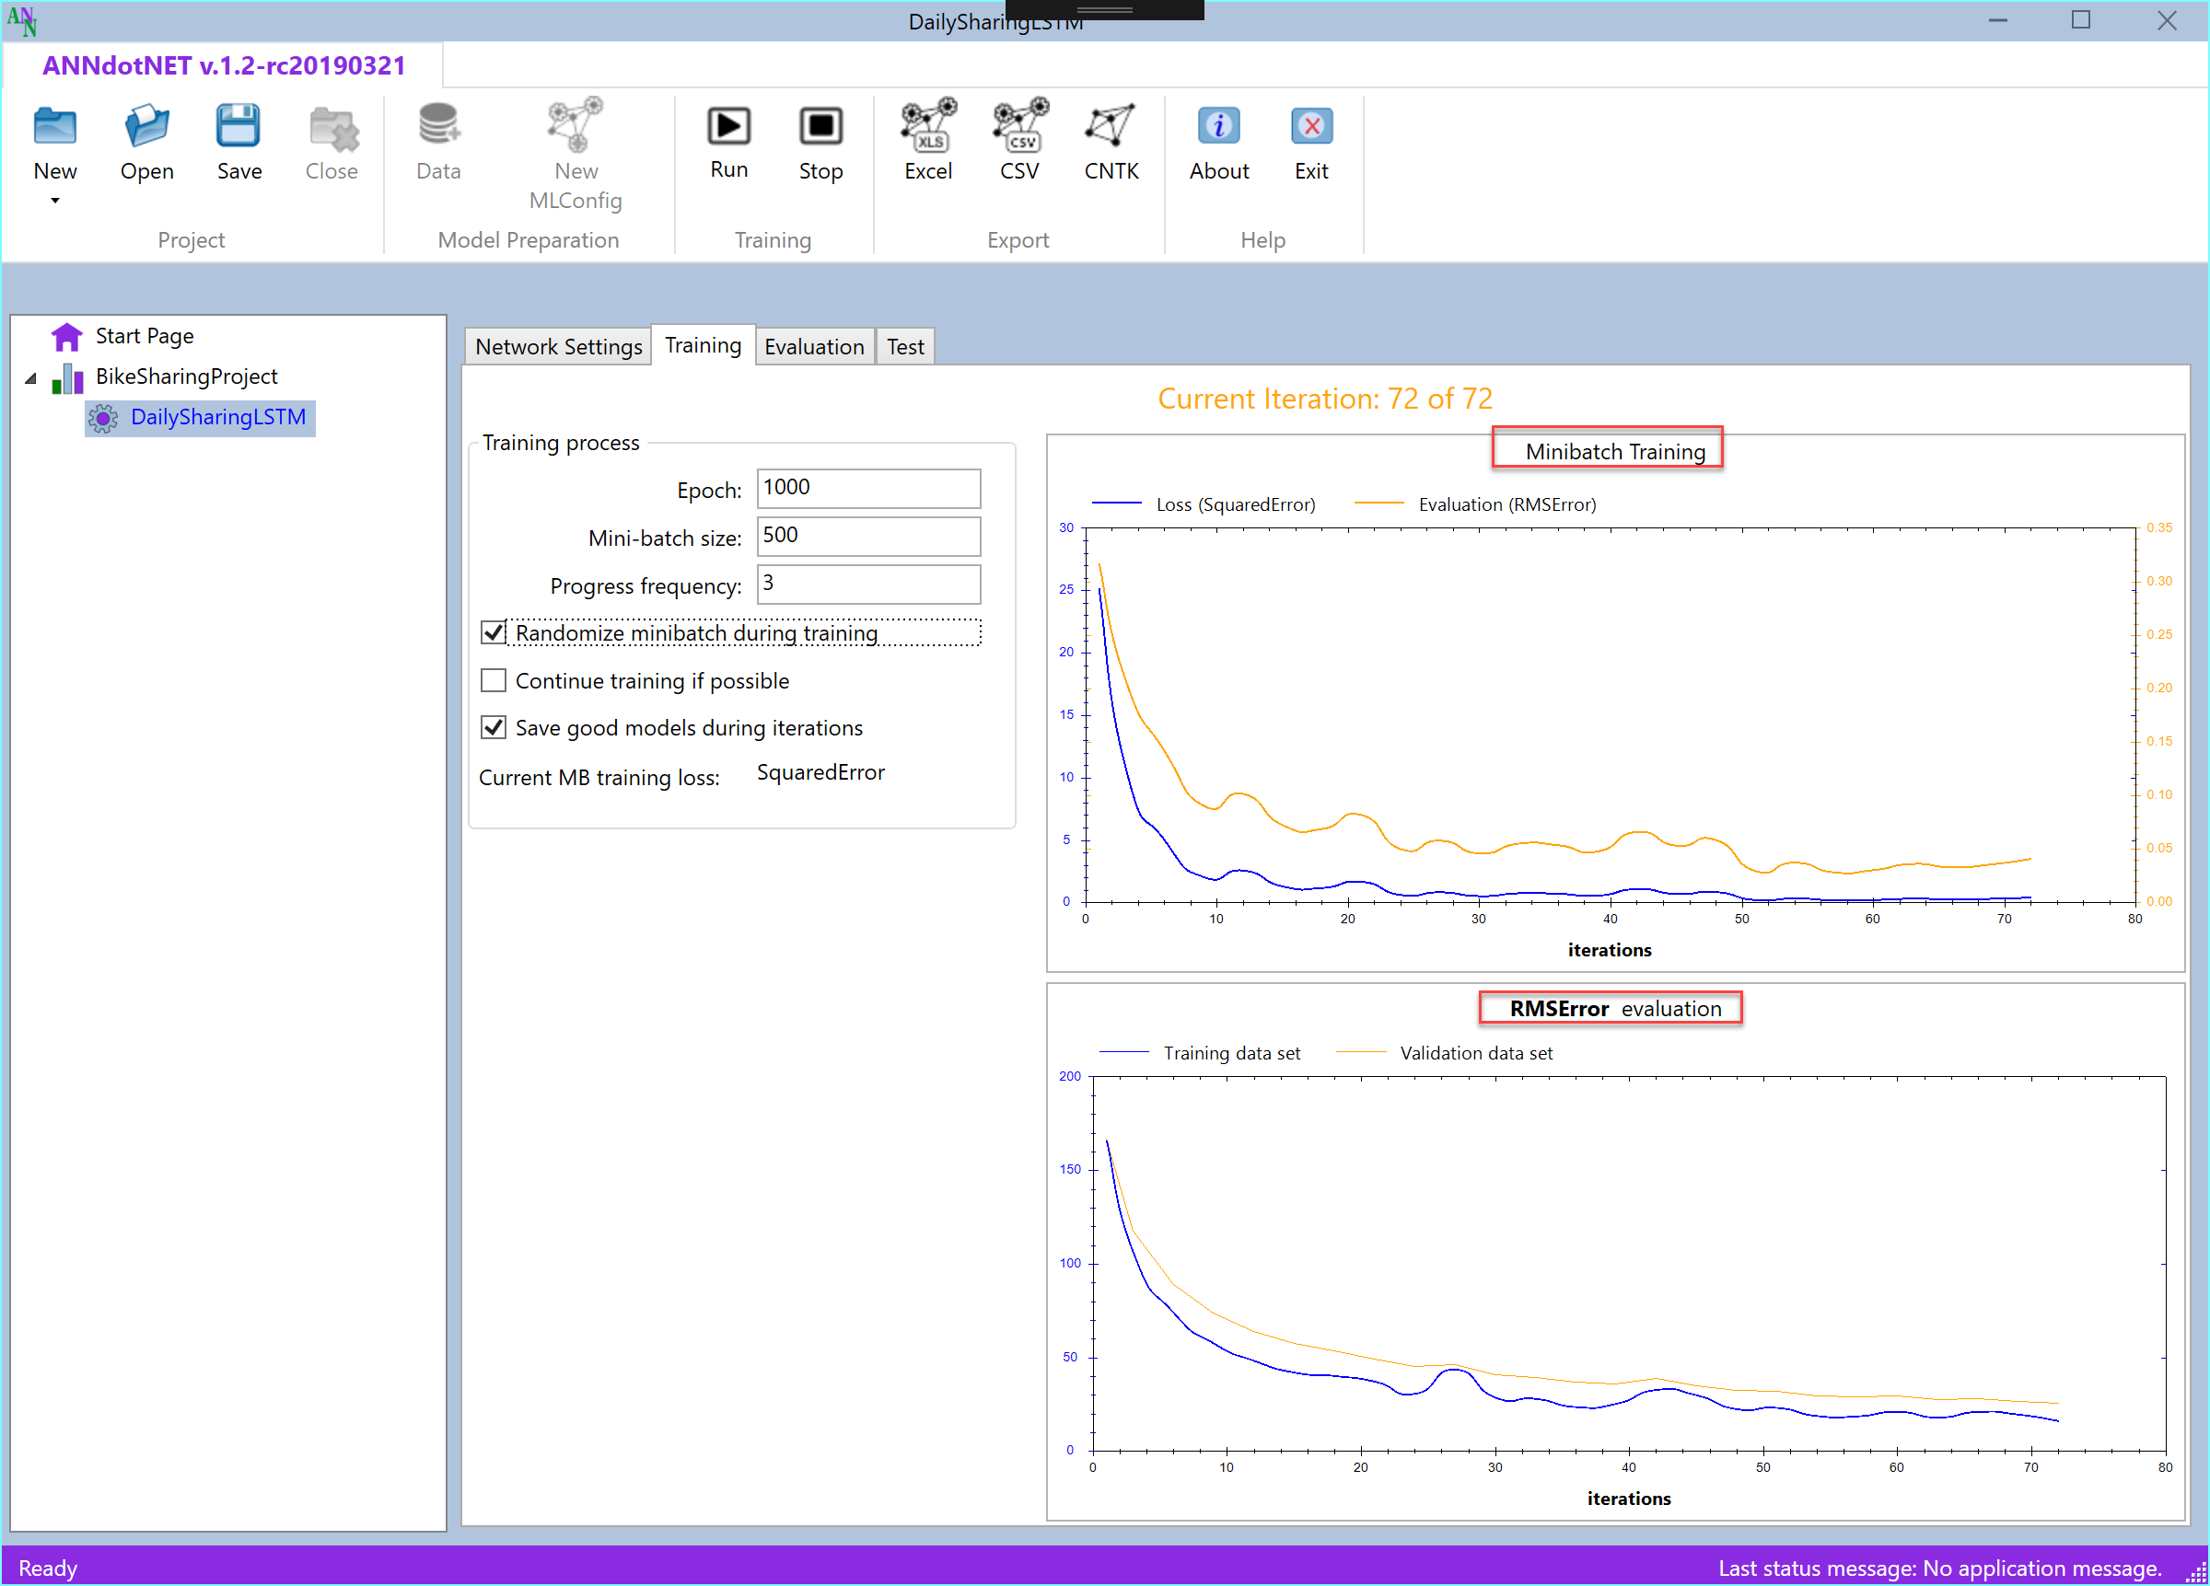
Training process
Run-Time evaluation
Training History
Early Stopping Strategy
Model Re -training

Slide 7
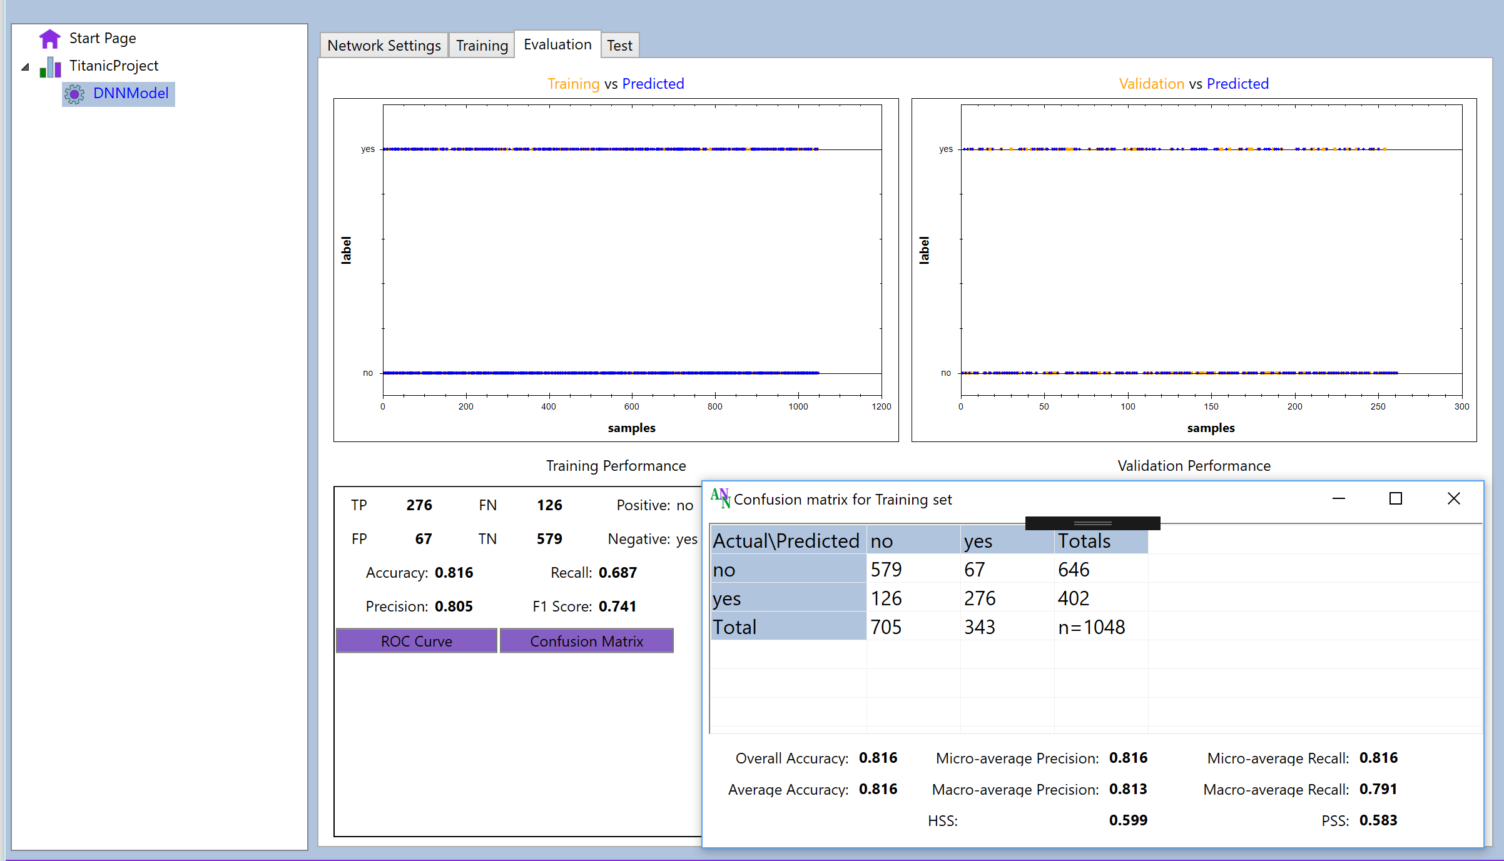
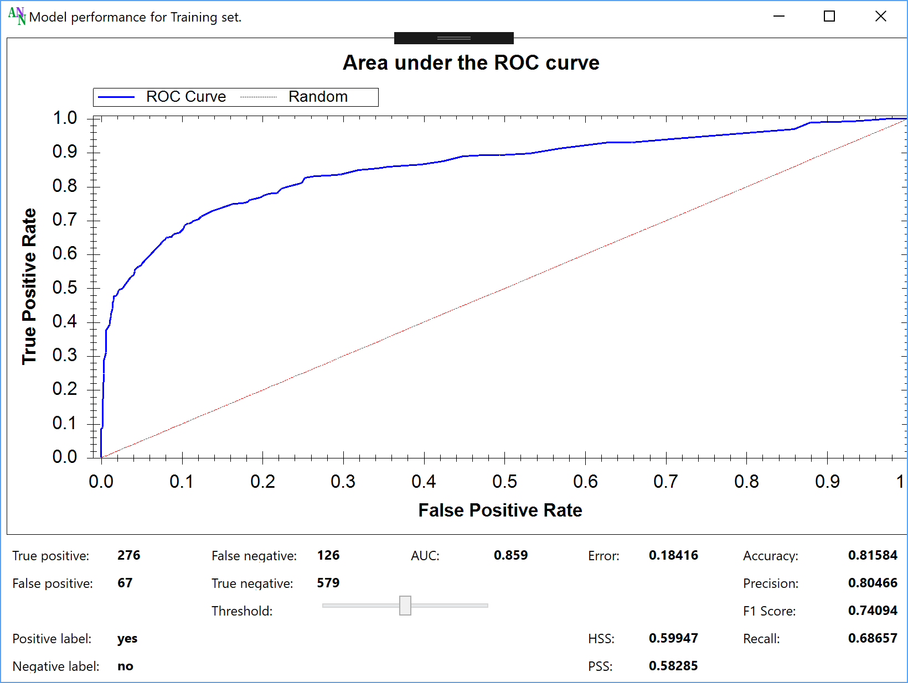
Model Evaluation

Slide 8
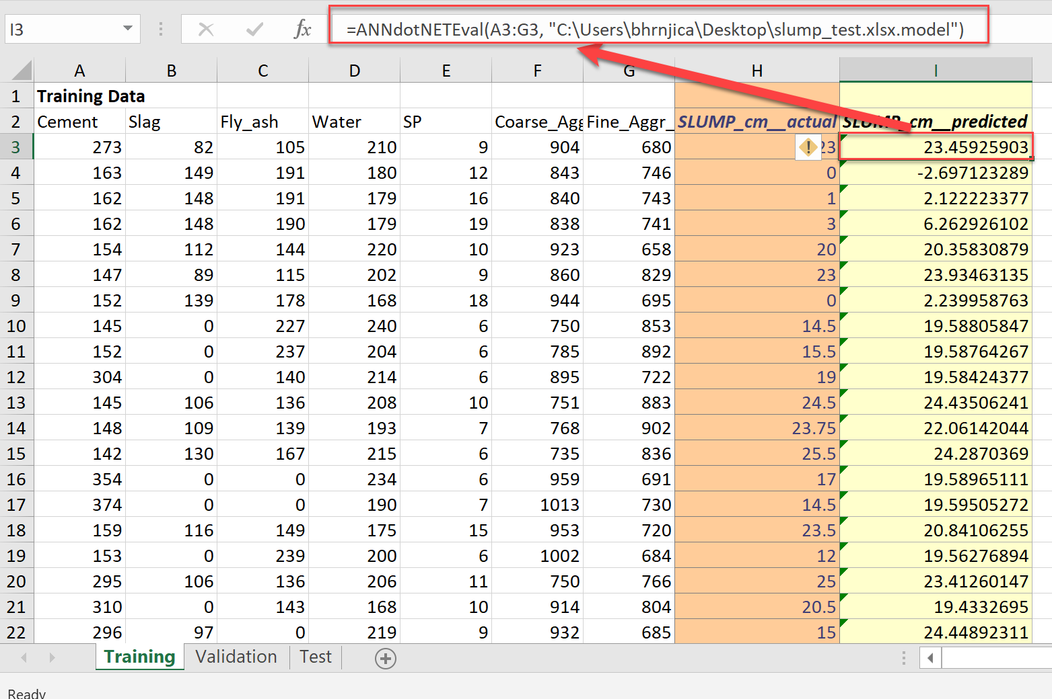
Model deployment to Excel

