Slide 1
Intersectional Data Feminism
Week 2: 1/27/2025
Examining Power Structures

Slide 2



Slide 3


Slide 4


Slide 5


Slide 6


Slide 7


Slide 8



Slide 9
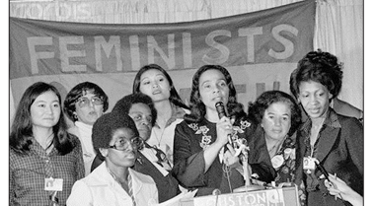

Slide 10
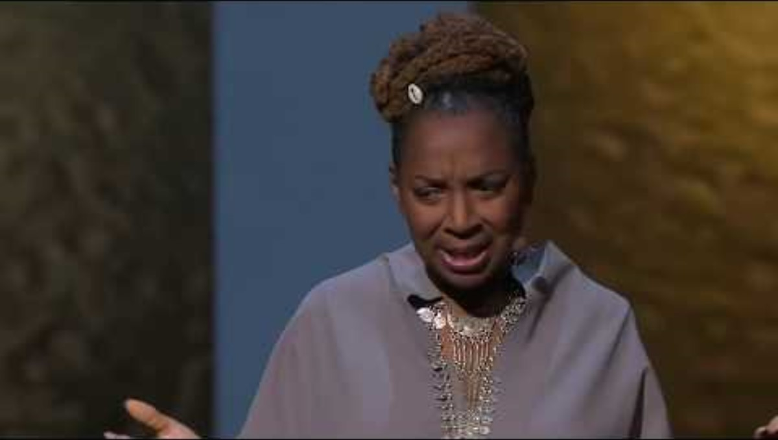
Kimberlé Crenshaw

Slide 11
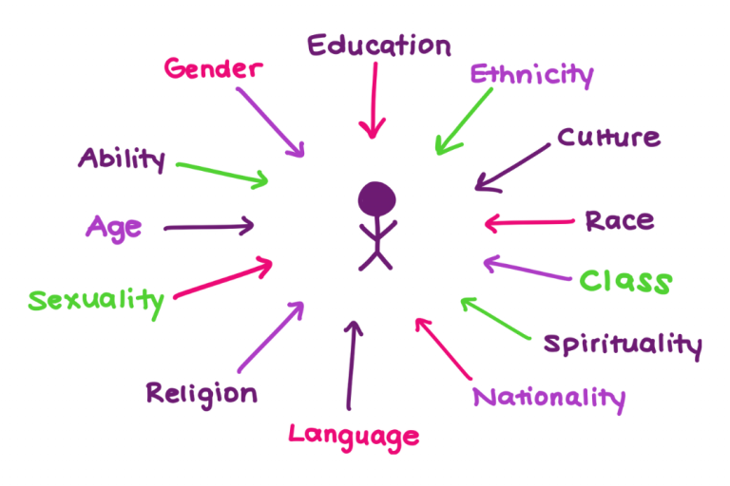
Positionalities as the intersecting aspects of any person’s identity
Intersecting forces of privilege and oppression at work in society.
IWDA. https://iwda.org.au/what-does-intersectional-feminism-actually-mean/

Slide 12
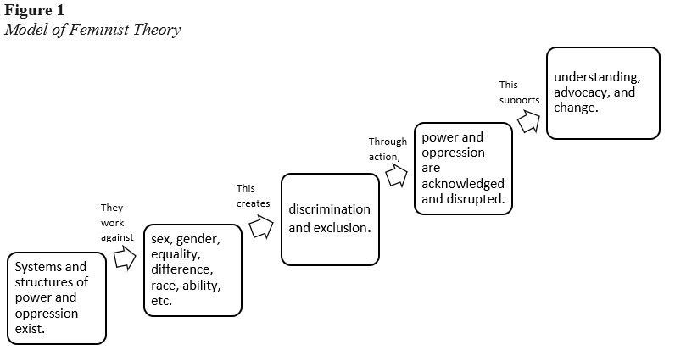
Jo Ann Arinder, Feminist Theory, https://opentext.wsu.edu/theoreticalmodelsforteachingandresearch/chapter/feminist-theory/

Slide 13

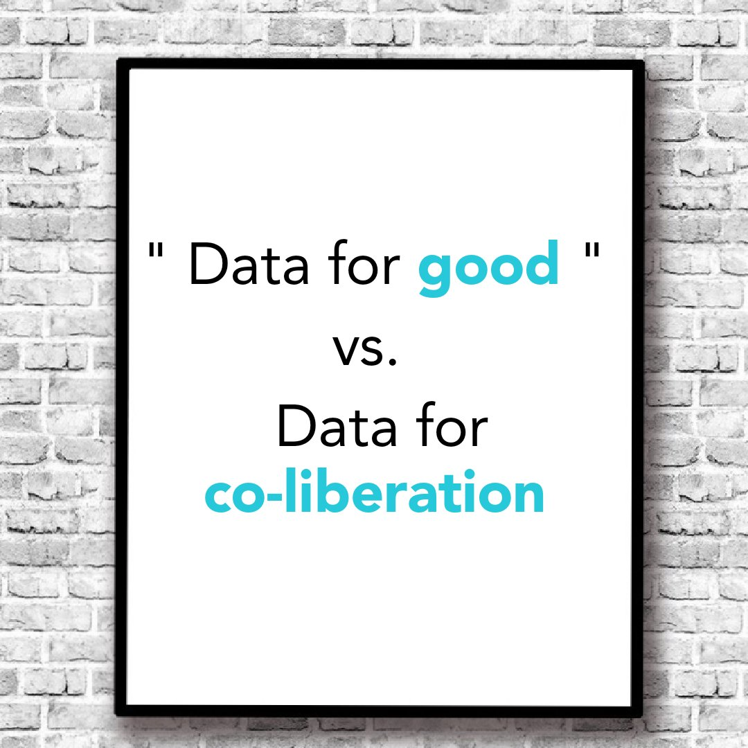
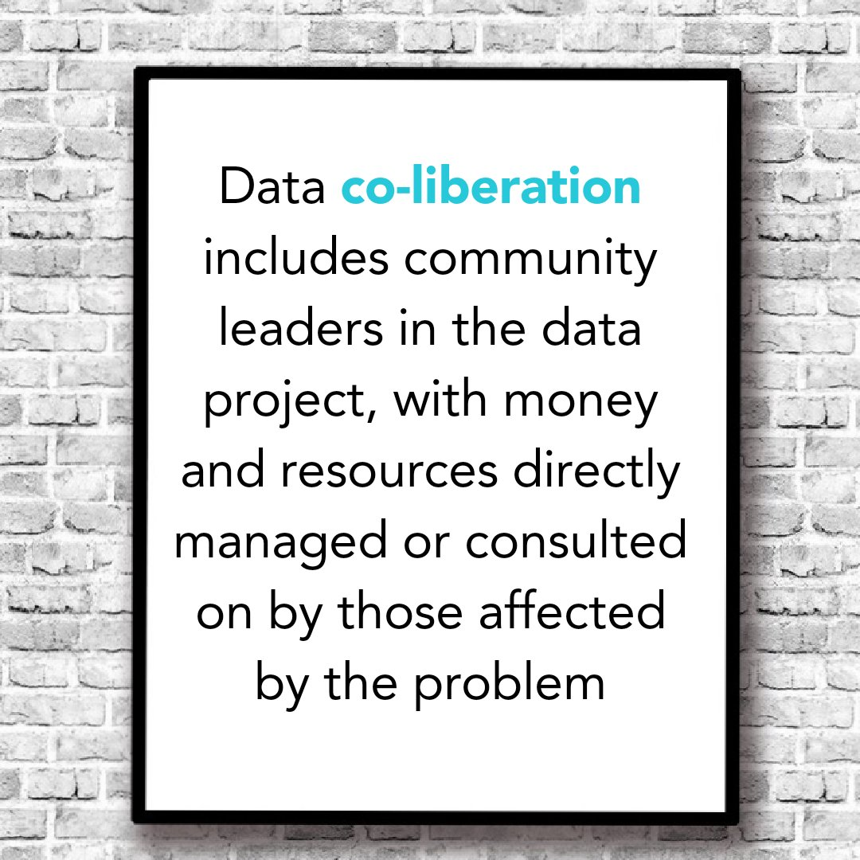

Slide 14
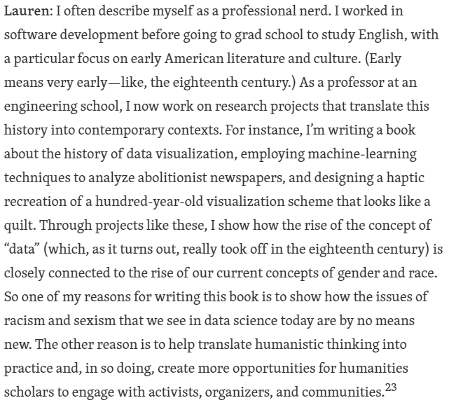
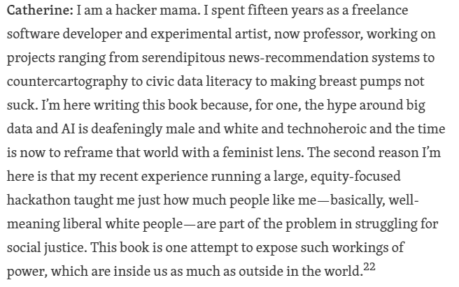
What brings you here today?

Slide 15
Seven Principles
Examine Power
Challenge Power
Elevate emotion and embodiment
Rethink binaries and hierarchies
Embrace pluralism
Consider context
Make labor visible

Slide 16
Small Group: Ethical Considerations in Data
Scenario: Developing a Health Monitoring App
You are part of a team developing a health monitoring app to help users track their heart health. The app collects data such as heart rate, activity levels, sleep patterns, and user-reported stress levels. The data will be analyzed to provide personalized health recommendations and risk alerts for conditions like heart disease.
Key Considerations:
The app will primarily use wearable fitness tracker data but will also ask users to self-report certain behaviors and symptoms.
The app is funded by a healthcare company that wants to use aggregated data to inform new product development.
It will be marketed to a general audience, but the initial dataset comes from a clinical trial with participants who are mostly middle-aged men.

Slide 17
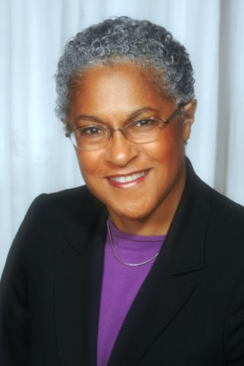
Patricia Hill Collins & Black Feminist Thought (1990)
Matrix of Domination:
Four domains of power in society.
Not only describes systems of power but also how an individual might experience them.

Slide 18
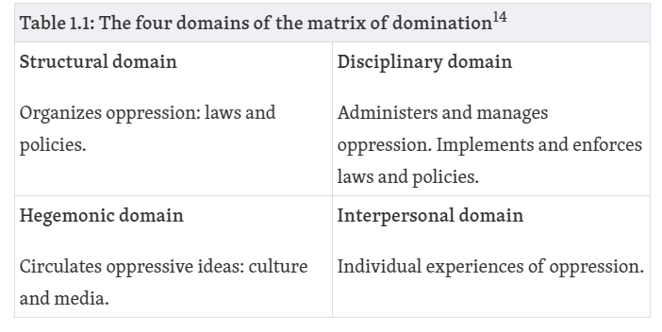
Matrix of Domination

