Slide 1
How to pull updates from original repository

Slide 2
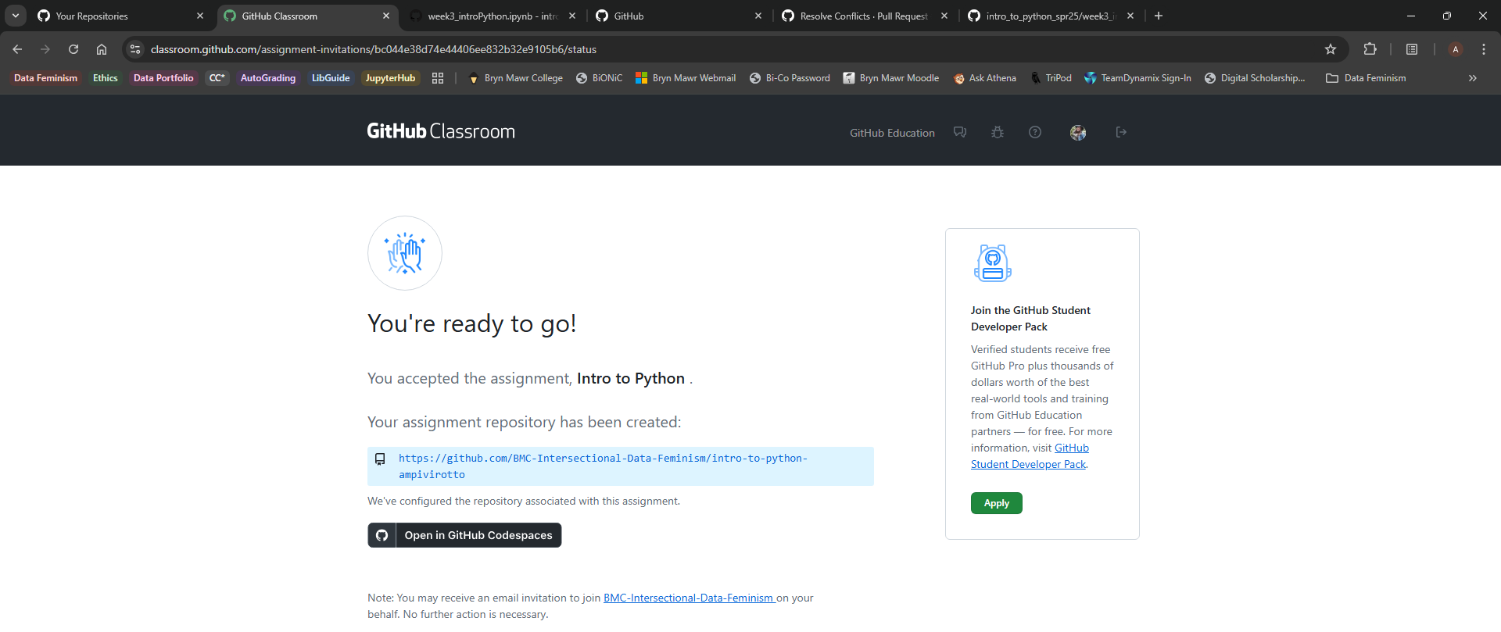
1. Click the link in Moodle for the Intro to Python Tutorial. This will bring you back to this page. Click the repository link in the red box shown above.

Slide 3
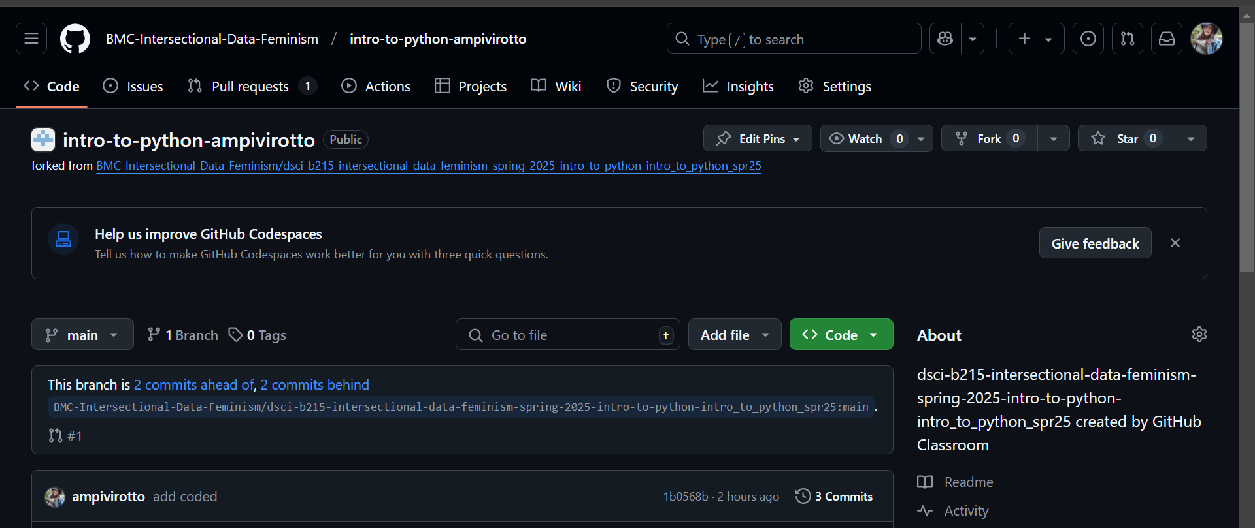
2. This will bring you to your repository page. Make sure its your username in the title (light blue box). Click the pull request tab (red box).

Slide 4
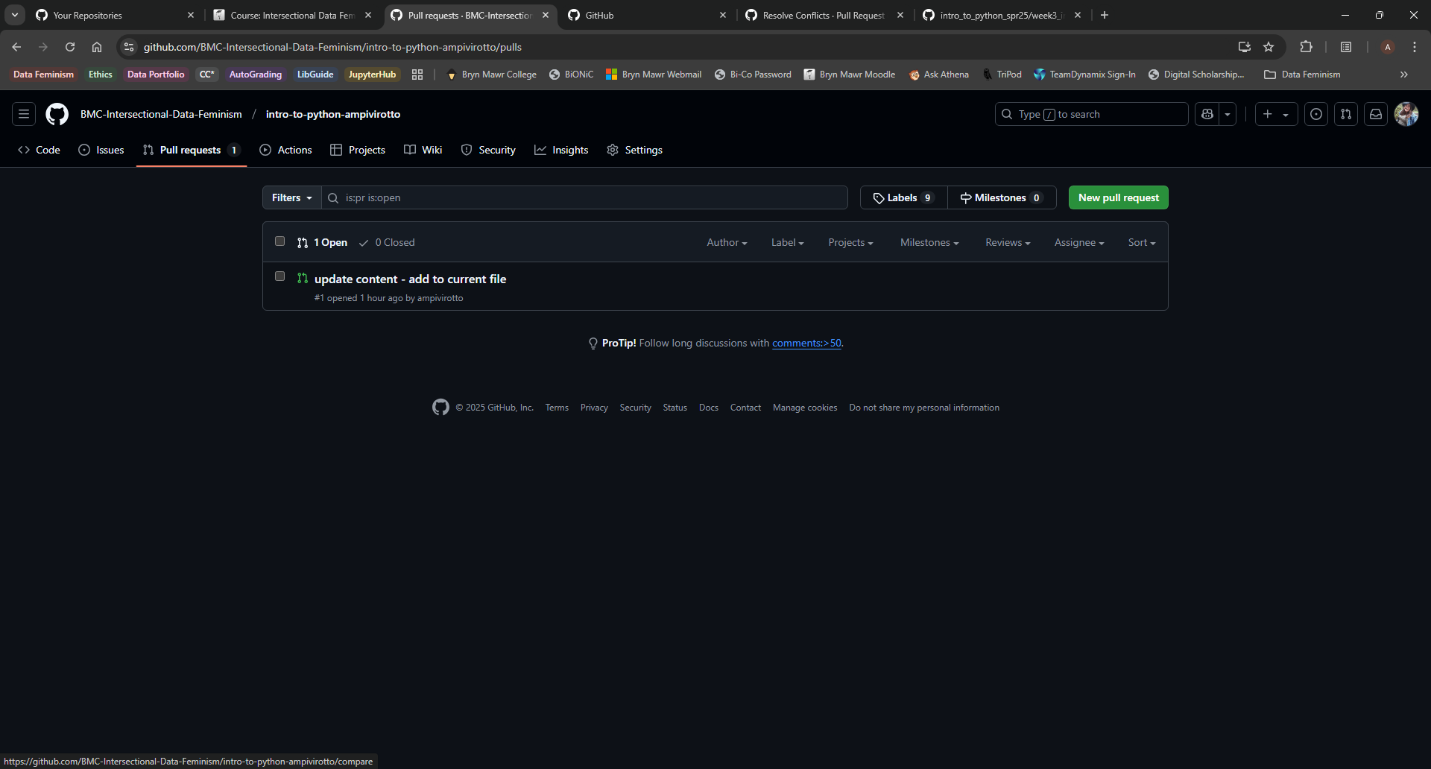
3. Click the ‘New pull request’ button (red box).

Slide 5
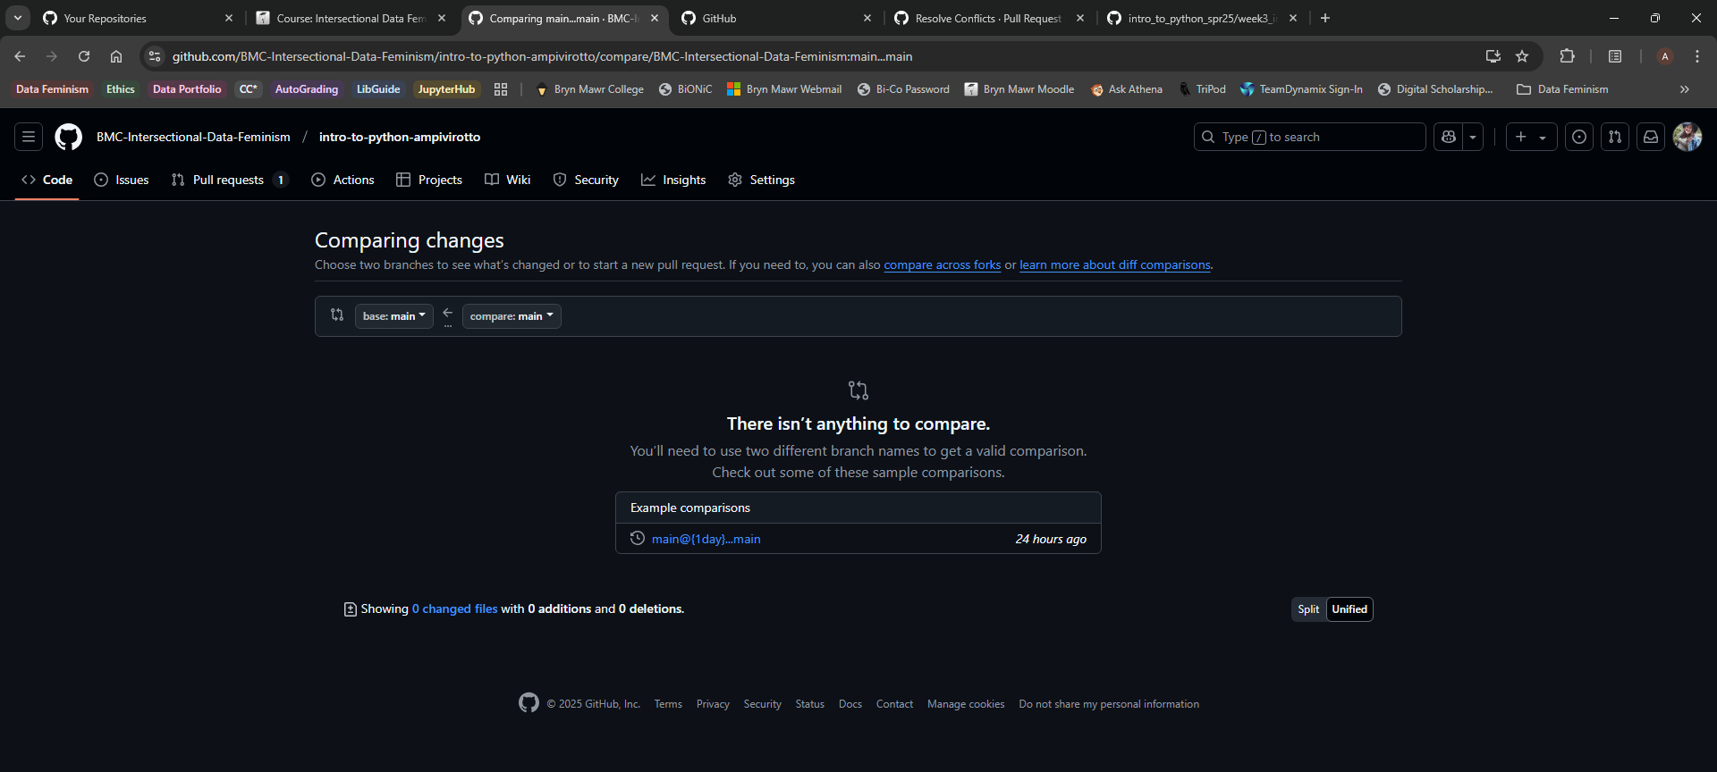
4. Click the button to compare across forks. This is because we want to update your repository from the original repo you forked from.

Slide 6
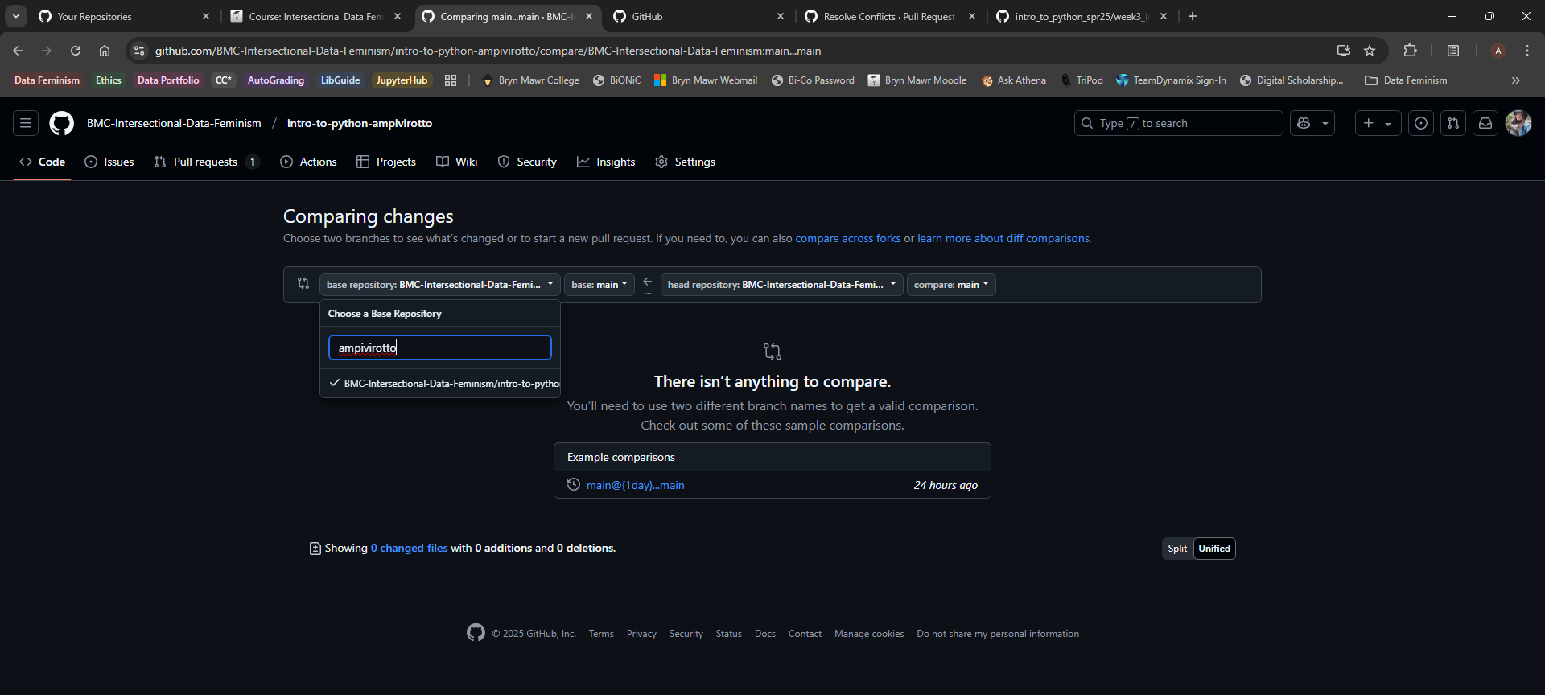
5. For the base repository in the first box (red box), search for your username and select that repository.

Slide 7
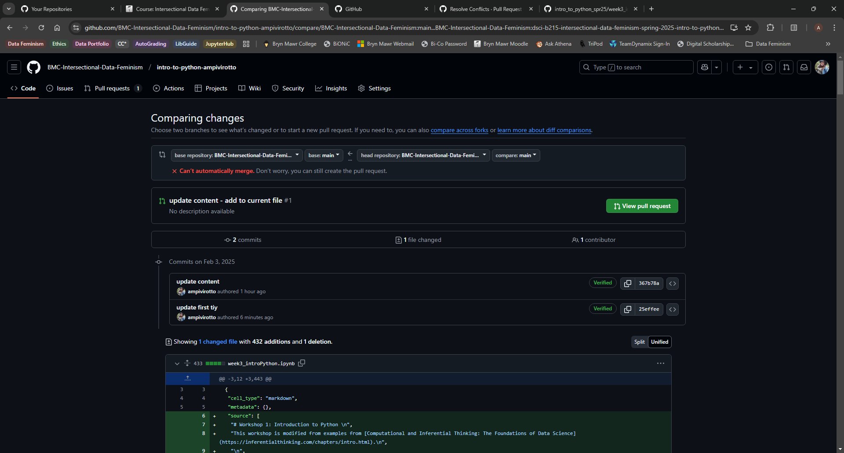
6. For the head repository (red box) you want to select the original repository (search for dsci-b215 to filter to the correct repo). Note that you should get the message ‘Can’t automatically merge’ – that’s okay! Then click ‘Create pull request’ (green button) which will prompt you to give it a title.

Slide 8
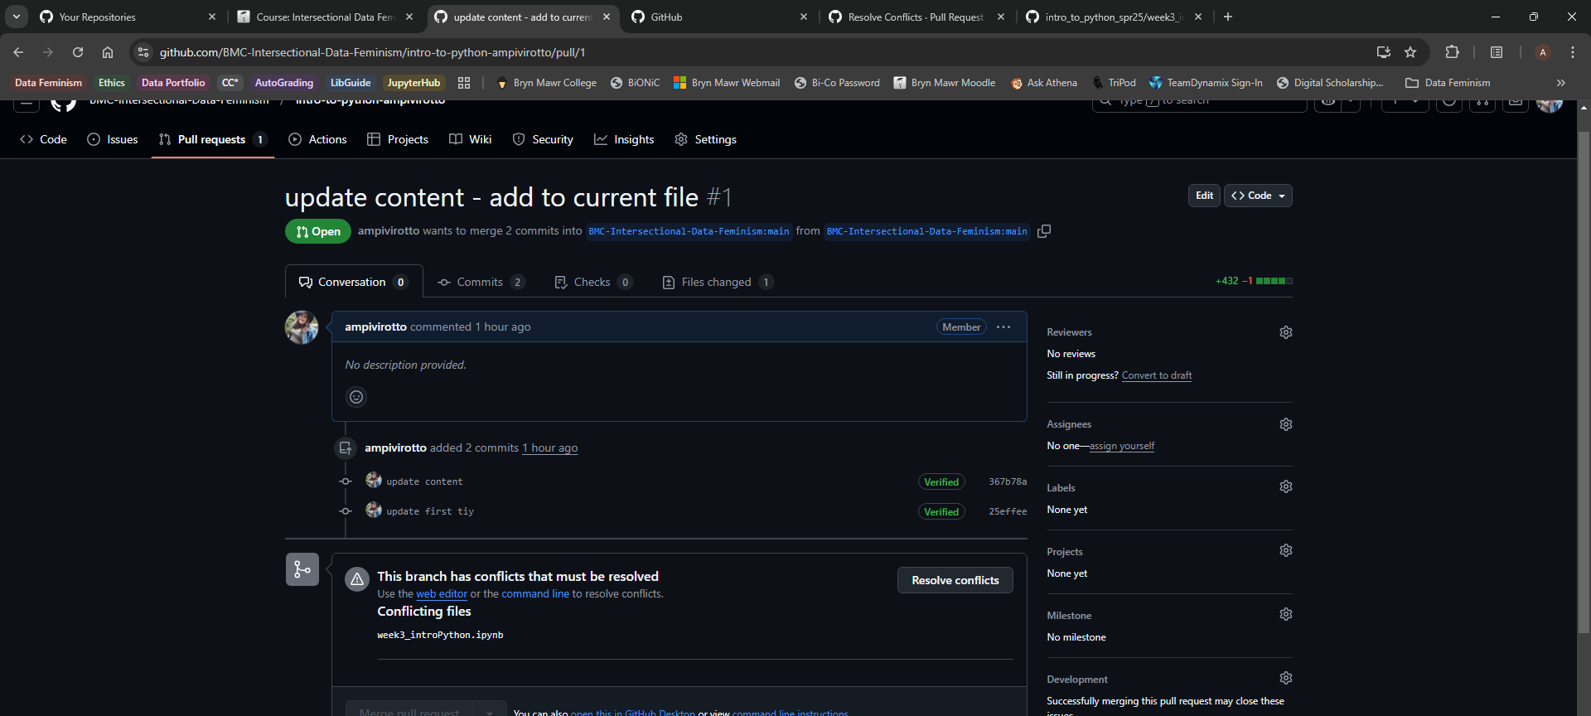
7. You’ll be brought the page with the open pull request. Notice that we have conflicts so we cannot automatically merge. Click the Resolve Conflicts button (red box).

Slide 9
The conflicts between the two files might vary between what you see on your screen and what’s shown here. I’ve included two examples of the two most common variations expected.

Slide 10
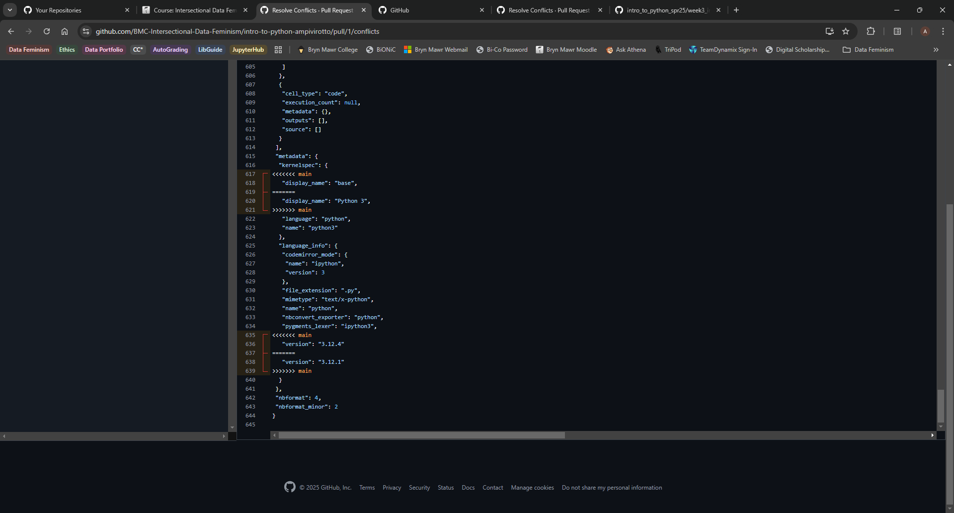

8. (Variation 1) Scroll down towards the bottom looking for the sections indicated with the >>>>> line breaks. You want to delete top line of both sections along with the line break indicators. See the red box above – the x’s indicate lines to delete. Line to retain indicated by green checkmark

Slide 11
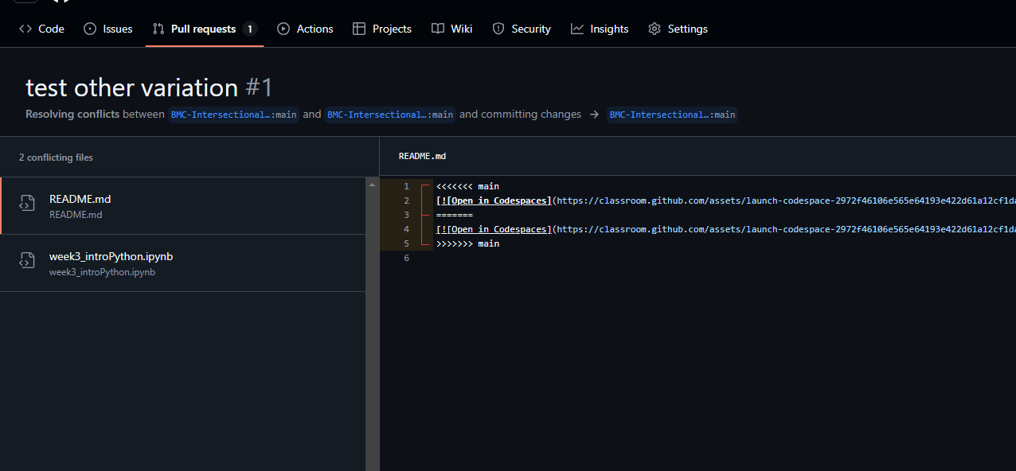
8. (Variation 2) Here you can again remove the first line of along with the indicator lines. Notice also you might have multiple files to resolve (red arrow).

Slide 12
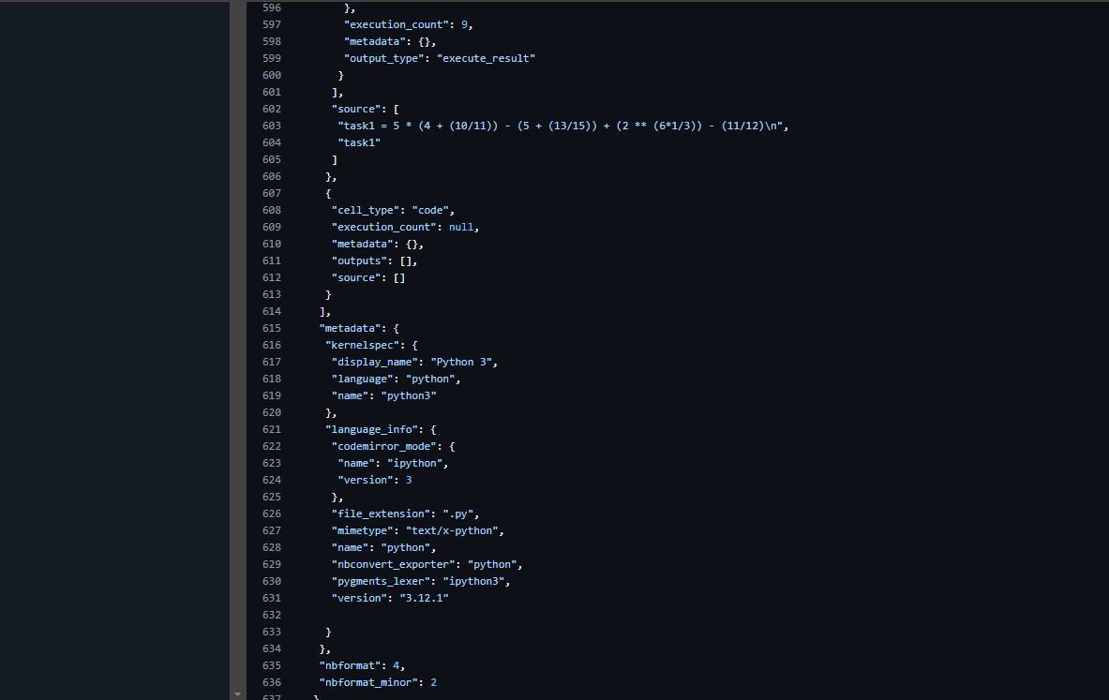
9. Notice now the red brackets around the lines of code are gone. This indicates that all your conflicts are resolved.

Slide 13
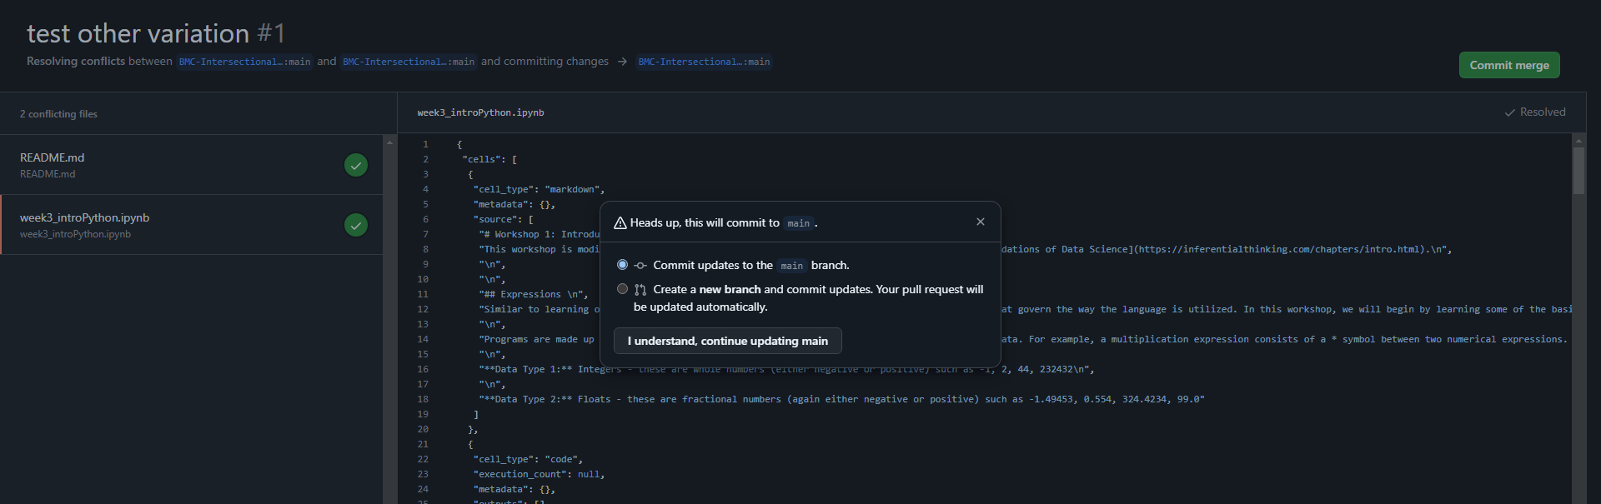
10. Click the ‘Mark as Resolved’ button in the upper right-hand corner. Then select the green ‘Commit merge’ button. This bring up a pop-up box where you should select the main branch and click the button ‘I understand, continue updating main’.

Slide 14
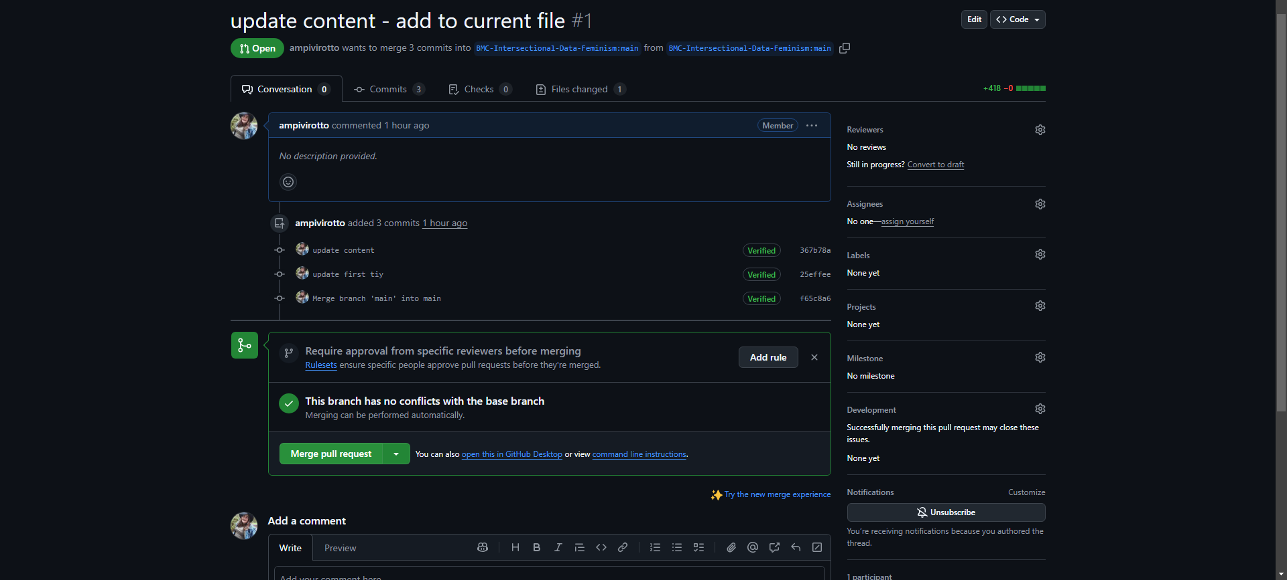
11. Back on the Pull Request page, you can now ‘Merge pull request’ (red box)

Slide 15
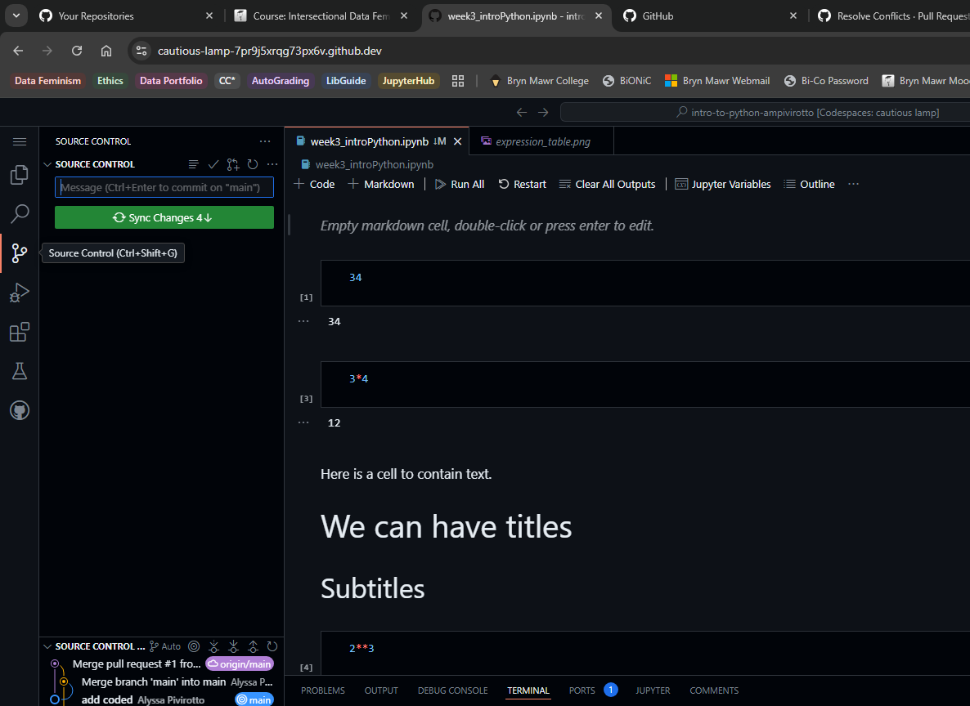
12. Back in your Codespaces server instance, you will have to sync your new changes. First click the correct tab (red box) and then you can click the green button to sync changes (green arrow).

Slide 16
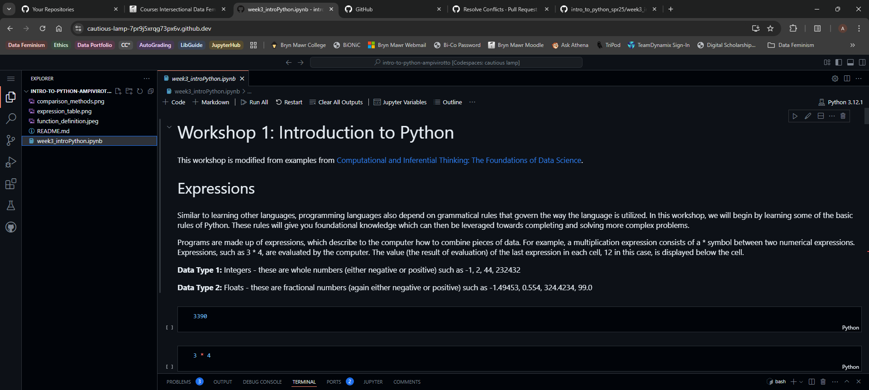
13. Verify that your Jupyter Notebook has now updated.

