Slide 1
Lottery Scheduling and Dominant Resource Fairness (Lecture 24, cs262a)
Ion Stoica,
UC Berkeley
November 7, 2016
Notes:
3-D graph
Checklist
What we want to enable
What we have today
How we’ll get there

Slide 2
Today’s Papers
Lottery Scheduling: Flexible Proportional-Share Resource Management,
Carl Waldspurger and William Weihl, OSDI’94
(www.usenix.org/publications/library/proceedings/osdi/full_papers/waldspurger.pdf)
Dominant Resource Fairness: Fair Allocation of Multiple Resource Types
Ali Ghodsi, Matei Zaharia, Benjamin Hindman, Andy Konwinski, Scott Shenker, Ion Stoica, NSDI’11
(https://www.cs.berkeley.edu/~alig/papers/drf.pdf)

Slide 3
What do we want from a scheduler?
Isolation: have some sort of guarantee that misbehaved processes cannot affect me “too much”
Efficient resource usage: resource is not idle while there is a process whose demand is not fully satisfied
Flexibility: can express some sort of priorities, e.g., strict or time based

Slide 4
Single Resource: Fair Sharing
CPU
100%
33%
n users want to share a resource (e.g. CPU)
Solution: give each 1/n of the shared resource
Generalized by max-min fairness
Handles if a user wants less than its fair share
E.g. user 1 wants no more than 20%
Generalized by weighted max-min fairness
Give weights to users according to importance
User 1 gets weight 1, user 2 weight 2
50%
33%
33%
0%
100%
20%
40%
50%
40%
0%
100%
33%
50%
66%
0%
Notes:
Less than its fair share

Slide 5
Why Max-Min Fairness?
Weighted Fair Sharing / Proportional Shares
User 1 gets weight 2, user 2 weight 1
Priorities
Give user 1 weight 1000, user 2 weight 1
Revervations
Ensure user 1 gets 10% of a resource
Give user 1 weight 10, sum weights ≤ 100
Deadline-based scheduling
Given a user job’s demand and deadline, compute user’s reservation/weight
Isolation
Users cannot affect others beyond their share

Slide 6
Widely Used
OS: proportional sharing, lottery, Linux’s cfs, …
Networking: wfq, wf2q, sfq, drr, csfq, ...
Datacenters: Hadoop’s fair sched, capacity sched, Quincy

Slide 7
Fair Queueing: Max-min Fairness implementation originated in
Fair queueing explained in a fluid flow system: reduces to bit-by-bit round robin among flows
Each flow receives min(r_{i}, f) , where
r_{i} – flow arrival rate
f – link fair rate (see next slide)
Weighted Fair Queueing (WFQ) – associate a weight with each flow [Demers, Keshav & Shenker ’89]
In a fluid flow system it reduces to bit-by-bit round robin
WFQ in a fluid flow system → Generalized Processor Sharing (GPS) [Parekh & Gallager ’92]

Slide 8
Fair Rate Computation
If link congested, compute f such that
f = 4:
min(8, 4) = 4
min(6, 4) = 4
min(2, 4) = 2
8
10
4
6
4
2
2

Slide 9
Fair Rate Computation
Associate a weight w_{i} with each flow i
If link congested, compute f such that
8
10
f = 2:
min(8, 2*3) = 6
min(6, 2*1) = 2
min(2, 2*1) = 2
(w₁ = 3)
4
(w₂ = 1)
6
4
(w₃ = 1)
2
2

Slide 10
Fluid Flow System
Flows can be served one bit at a time
Fluid flow system, also known as Generalized Processor Sharing (GPS) [Parekh and Gallager ‘93]
WFQ can be implemented using bit-by-bit weighted round robin in GPS model
During each round from each flow that has data to send, send a number of bits equal to the flow’s weight

Slide 11
Generalized Processor Sharing Example
Red session has packets backlogged between time 0 and 10
Other sessions have packets continuously backlogged
link
flows
5
1
1
1
1
1
0
2
4
6
8
10
15

Slide 12
Packet Approximation of Fluid System
Standard techniques of approximating fluid GPS
Select packet that finishes first in GPS assuming that there are no future arrivals
Implementation based on virtual time
Assign virtual finish time to each packet upon arrival
Packets served in increasing order of virtual times

Slide 13
Approximating GPS with WFQ
Fluid GPS system service order
0
2
4
6
8
10
Weighted Fair Queueing
select the first packet that finishes in GPS

Slide 14
Implementation Challenge
Need to compute the finish time of a packet in the fluid flow system…
… but the finish time may change as new packets arrive!
Need to update the finish times of all packets that are in service in the fluid flow system when a new packet arrives
But this is very expensive; a high speed router may need to handle hundred of thousands of flows!

Slide 15
Example: Each flow has weight 1
Flow 1
time
Flow 2
time
Flow 3
time
Flow 4
time
ε
Finish times computed at time 0
time
0
1
2
3
Finish times re-computed at time ε
time
0
1
2
3
4

Slide 16
Solution: Virtual Time
Key Observation: while the finish times of packets may change when a new packet arrives, the order in which packets finish doesn’t!
Only the order is important for scheduling
Solution: instead of the packet finish time maintain the number of rounds needed to send the remaining bits of the packet (virtual finishing time)
Virtual finishing time doesn’t change when the packet arrives
System virtual time – index of the round in the bit-by-bit round robin scheme

Slide 17
System Virtual Time: V(t)
Measure service, instead of time
V(t) slope – normalized rate at which every backlogged flow receives service in the fluid flow system
C – link capacity
N(t) – total weight of backlogged flows in fluid flow system at time t
V(t)
time

Slide 18
System Virtual Time (V(t)): Example
V(t) increases inversely proportionally to the sum of the weights of the backlogged flows
Packet arrival: height proportional to packet size
Flow 1 (w1 = 1)
time
Flow 2 (w2 = 1)
time
3
4
5
1
2
1
2
3
4
5
6
V(t)
C/2
C

Slide 19
Fair Queueing Implementation
Define
- virtual finishing time of packet k of flow i
- arrival time of packet k of flow i
- length of packet k of flow i
w_{i} – weight of flow i
The finishing time of packet k+1 of flow i is
Round when last packet of flow i finishes
Current round
# of rounds it takes to serve new packet
Round by which each packet is served

Slide 20
Lottery Scheduling
An approximation of weighted fair sharing
Weight → number of tickets
Scheduling decision → probabilistic: give a slot to a process proportionally to its weight

Slide 21
Fairness analysis (I)
Lottery scheduling is probabilistically fair
If a thread has a t tickets out of T
Its probability of winning a lottery is p = t/T
Its expected number of wins over n drawings is np
Binomial distribution
Variance σ² = np(1 – p)

Slide 22
Fairness analysis (II)
Coefficient of variation of number of wins σ/np = √((1-p)/np)
Decreases with √n
Number of tries before winning the lottery follows a geometric distribution
As time passes, each thread ends receiving its share of the resource

Slide 23
Introduces a bunch of abstractions and mechanisms
Ticket transfers
Ticket currencies
Compensation tickets
Applied to other resources, e.g., memory

Slide 24
Ticket transfers
Explicit transfers of tickets from one client to another
They an be used whenever a client blocks due to some dependency
When a client waits for a reply from a server, it can temporarily transfer its tickets to the server
They eliminate priority inversions

Slide 25
Ticket inflation
Lets users create new tickets
Like printing their own money
Counterpart is ticket deflation
Normally disallowed except among mutually trusting clients
Lets them to adjust their priorities dynamically without explicit communication

Slide 26
Ticket currencies (I)
Consider the case of a user managing multiple threads
Want to let her favor some threads over others
Without impacting the threads of other users

Slide 27
Ticket currencies (II)
Will let her create new tickets but will debase the individual values of all the tickets she owns
Her tickets will be expressed in a new currency that will have a variable exchange rate with the base currency

Slide 28
Example (I)
Ann manages three threads
A has 5 tickets
B has 3 tickets
C has 2 tickets
Ann creates 5 extra tickets and assigns them to process C
Ann now has 15 tickets

Slide 29
Example (II)
These 15 tickets represent 15 units of a new currency whose exchange rate with the base currency is 10/15
The total value of Ann tickets expressed in the base currency is still equal to 10

Slide 30
Compensation tickets (I)
I/O-bound threads are likely get less than their fair share of the CPU because they often block before their CPU quantum expires
Compensation tickets address this imbalance

Slide 31
Compensation tickets (II)
A client that consumes only a fraction f of its CPU quantum can be granted a compensation ticket
Ticket inflates the value of all client tickets by 1/f until the client starts gets the CPU
(Wording in the paper is much more abstract)

Slide 32
Example
CPU quantum is 100 ms
Client A releases the CPU after 20ms
f = 0.2 or 1/5
Value of all tickets owned by A will be multiplied by 5 until A gets the CPU

Slide 33
Compensation tickets (III)
Compensation tickets
Favor I/O-bound—and interactive—threads
Helps them getting their fair share of the CPU

Slide 34
Summary (I)
Weighted max-min fairness a very useful abstraction with strong properties
Provides isolation (sharing guarantee)
Strategy proof (cannot be gained)
Efficient resource usage (if someone doesn’t use resource someone else can use it)
Can emulate lots of scheduling policies

Slide 35
Summary (I|)
Lottery scheduling
An approximation of Weighted Fair Queueing in processor domain
Introduces a bunch of useful abstractions

Slide 36
Dominant Resource Fairness

Slide 37
Thoerethical Properties of Max-Min Fairness
Share guarantee
Each user gets at least 1/n of the resource
But will get less if her demand is less
Strategy-proof
Users are not better off by asking for more than they need
Users have no reason to lie

Slide 38

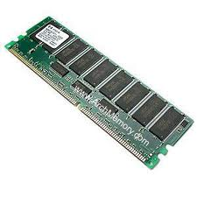
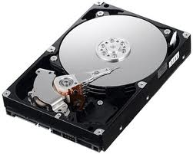
Why is Max-Min Fairness Not Enough?
Job scheduling is not only about a single resource
Tasks consume CPU, memory, network and disk I/O
What are task demands today?

Slide 39
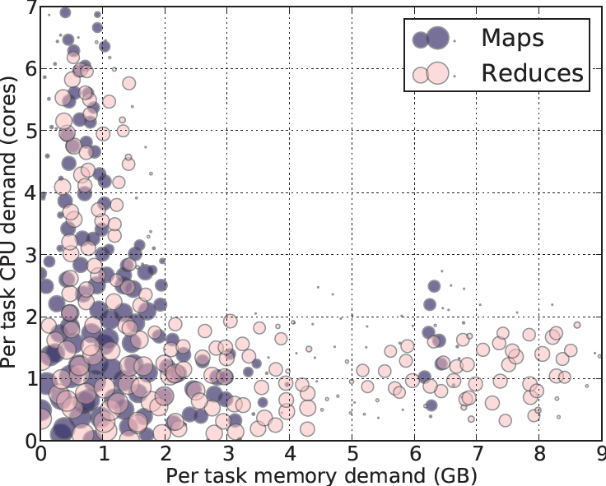
Heterogeneous Resource Demands
Some tasks are CPU-intensive
Most task need ~
<2 CPU, 2 GB RAM>
Some tasks are memory-intensive
2000-node Hadoop Cluster at Facebook (Oct 2010)
Notes:
Put fb in title

Slide 40
Problem
2 resources: CPUs & mem
User 1 wants <1 CPU, 4 GB> per task
User 2 wants <3 CPU, 1 GB> per task
What’s a fair allocation?
100%
? ?
50%
0%
CPU
mem

Slide 41
A Natural Policy
Asset Fairness
Equalize each user’s sum of resource shares
Cluster with 28 CPUs, 56 GB RAM
U₁ needs <1 CPU, 2 GB RAM> per task, or <3.6% CPUs, 3.6% RAM> per task
U₂ needs <1 CPU, 4 GB RAM> per task, or <3.6% CPUs, 7.2% RAM> per task
Asset fairness yields
U₁: 12 tasks: <43% CPUs, 43% RAM> (∑=86%)
U₂: 8 tasks: <28% CPUs, 57% RAM> (∑=86%)
100%
43%
43%
Problem: violates share guarantee
User 1 has < 50% of both CPUs and RAM
Better off in a separate cluster with half the resources
50%
57%
28%
0%
CPU
RAM
User 1
User 2
Notes:
Say whats the prob

Slide 42
Cheating the Scheduler
Users willing to game the system to get more resources
Real-life examples
A cloud provider had quotas on map and reduce slots Some users found out that the map-quota was low. Users implemented maps in the reduce slots!
A search company provided dedicated machines to users that could ensure certain level of utilization (e.g. 80%). Users used busy-loops to inflate utilization

Slide 43
Challenge
Can we find a fair sharing policy that provides
Share guarantee
Strategy-proofness
Can we generalize max-min fairness to multiple resources?

Slide 44
Dominant Resource Fairness (DRF)
A user’s dominant resource is the resource user has the biggest share of
Example:
Total resources:
User 1’s allocation:
Dominant resource of User 1 is CPU (as 25% > 20%)
A user’s dominant share: fraction of dominant resource she is allocated
User 1’s dominant share is 25%
8 CPU
2 CPU
5 GB
1 GB
25% CPUs
20% RAM

Slide 45
Dominant Resource Fairness (DRF)
Apply max-min fairness to dominant shares
Equalize the dominant share of the users. Example:
Total resources: <9 CPU, 18 GB>
User 1 demand: <1 CPU, 4 GB>; dom res: mem (1/9 < 4/18)
User 2 demand: <3 CPU, 1 GB>; dom res: CPU (3/9 > 1/18)
100%
3 CPUs
12 GB
User 1
User 2
66%
50%
66%
6 CPUs
2 GB
0%
CPU
(9 total)
mem
(18 total)

Slide 46
Online DRF Scheduler
Whenever there are available resources and tasks to run:
Schedule a task to the user with smallest dominant share

Slide 47
Why not use pricing?
Approach
Set prices for each good
Let users buy what they want
Problem
How do we determine the right prices for different goods?

Slide 48
How would an economist solve it?
Let the market determine the prices
Competitive Equilibrium from Equal Incomes (CEEI)
Give each user 1/n of every resource
Let users trade in a perfectly competitive market
Not strategy-proof!
Notes:
Setup using pricing

Slide 49
Properties of Policies
Property | Asset | CEEI | DRF
Share guarantee |  | ✔ | ✔
Strategy-proofness | ✔ |  | ✔
Pareto efficiency | ✔ | ✔ | ✔
Envy-freeness | ✔ | ✔ | ✔
Single resource fairness | ✔ | ✔ | ✔
Bottleneck res. fairness |  | ✔ | ✔
Population monotonicity | ✔ |  | ✔
Resource monotonicity
Conjecture: Assuming non-zero demands, DRF is
the only allocation that is strategy proof and
provides sharing incentive (Eric Friedman, Cornell)

Slide 50
Summary
Scheduling necessary to deal with oversubscribed resources
Need to provide isolation
Need high resource efficiency
Weighted fair queuing achieves many desirable properties
Many mechanisms to implement it (e.g., Lottery scheduling)
But limited to a single resource..
Dominant Resource Fairness (DRF):
Schedules resources of multiple types while preserving WFQ properties

