Slide 1
MPI and OpenMP (Lecture 25, cs262a)
Ion Stoica,
UC Berkeley
November 19, 2016
Notes:
3-D graph
Checklist
What we want to enable
What we have today
How we’ll get there

Slide 2
Message passing vs. Shared memory
Client
Client
Client
Client
send(msg)
recv(msg)
send(msg)
recv(msg)
MSG
MSG
Shared
Memory
MSG
IPC
Message passing: exchange data explicitly via IPC
Application developers define protocol and exchanging format, number of participants, and each exchange
Shared memory: all multiple processes to share data via memory
Applications must locate and and map shared memory regions to exchange data

Slide 3

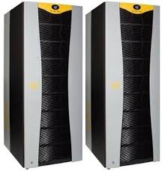

Architectures
Uniformed Shared
Memory (UMA)
Cray 2
Non-Uniformed Shared
Memory (NUMA)
SGI Altix 3700
Massively Parallel
DistrBluegene/L
Orthogonal to programming model

Slide 4
MPI
MPI - Message Passing Interface
Library standard defined by a committee of vendors, implementers, and parallel programmers
Used to create parallel programs based on message passing
Portable: one standard, many implementations
Available on almost all parallel machines in C and Fortran
De facto standard platform for the HPC community

Slide 5
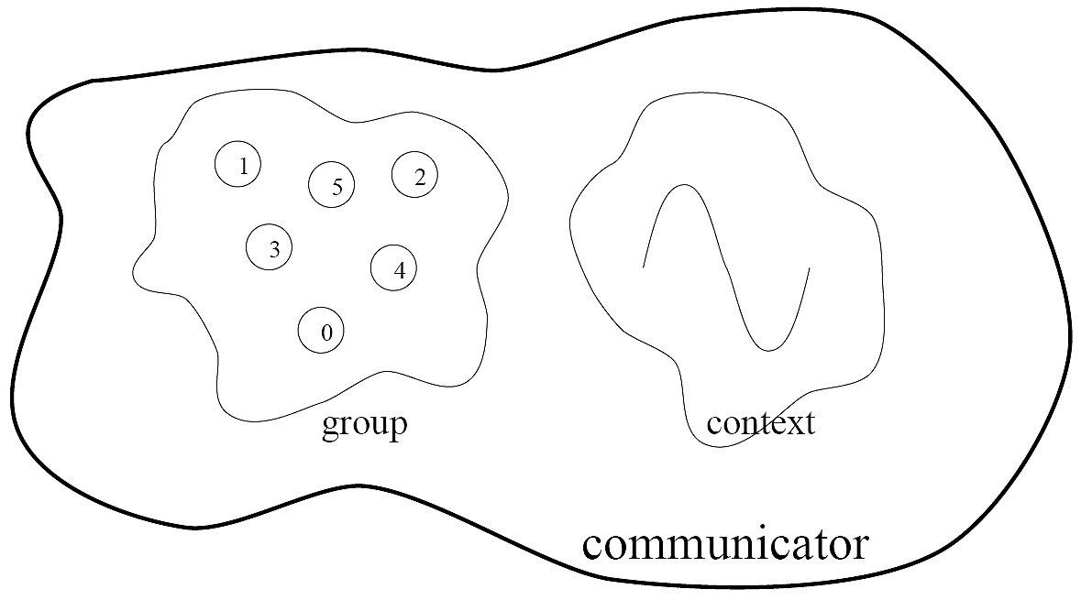
Groups, Communicators, Contexts
Group: a fixed ordered set of k processes, i.e., 0, 1, .., k-1
Communicator: specify scope of communication
Between processes in a group
Between two disjoint groups
Context: partition communication space
A message sent in one context cannot be received in another context
This image is captured from:
“Writing Message Passing Parallel Programs with MPI”, Course Notes, Edinburgh Parallel Computing Centre
The University of Edinburgh

Slide 6
Synchronous vs. Asynchronous Message Passing
A synchronous communication is not complete until the message has been received
An asynchronous communication completes before the message is received

Slide 7
Communication Modes
Synchronous: completes once ack is received by sender
Asynchronous: 3 modes
Standard send: completes once the message has been sent, which may or may not imply that the message has arrived at its destination
Buffered send: completes immediately, if receiver not ready, MPI buffers the message locally
Ready send: completes immediately, if the receiver is ready for the message it will get it, otherwise the message is dropped silently

Slide 8
Blocking vs. Non-Blocking
Blocking, means the program will not continue until the communication is completed
Synchronous communication
Barriers: wait for every process in the group to reach a point in execution
Non-Blocking, means the program will continue, without waiting for the communication to be completed

Slide 9
MPI library
Huge (125 functions)
Basic (6 functions)

Slide 10
MPI Basic
Many parallel programs can be written using just these six functions, only two of which are non-trivial;
MPI_INIT
MPI_FINALIZE
MPI_COMM_SIZE
MPI_COMM_RANK
MPI_SEND
MPI_RECV

Slide 11
Skeleton MPI Program (C)
#include <mpi.h>
main(int argc, char** argv)
{
MPI_Init(&argc, &argv);
/* main part of the program */
/* Use MPI function call depend on your data
* partitioning and the parallelization architecture
*/
MPI_Finalize();
}

Slide 12
A minimal MPI program (C)
#include “mpi.h”
#include <stdio.h>
int main(int argc, char *argv[])
{
MPI_Init(&argc, &argv);
printf(“Hello, world!\n”);
MPI_Finalize();
return 0;
}

Slide 13
A minimal MPI program (C)
#include “mpi.h” provides basic MPI definitions and types.
MPI_Init starts MPI
MPI_Finalize exits MPI
Notes:
Non-MPI routines are local; this “printf” run on each process
MPI functions return error codes or MPI_SUCCESS

Slide 14
Error handling
By default, an error causes all processes to abort
The user can have his/her own error handling routines
Some custom error handlers are available for downloading from the net

Slide 15
Improved Hello (C)
#include <mpi.h>
#include <stdio.h>
int main(int argc, char *argv[])
{
int rank, size;
MPI_Init(&argc, &argv);
/* rank of this process in the communicator */
MPI_Comm_rank(MPI_COMM_WORLD, &rank);
/* get the size of the group associates to the communicator */
MPI_Comm_size(MPI_COMM_WORLD, &size);
printf("I am %d of %d\n", rank, size);
MPI_Finalize();
return 0;
}

Slide 16
Improved Hello (C)
/* Find out rank, size */
int world_rank, size;
MPI_Comm_rank(MPI_COMM_WORLD, &world_rank);
MPI_Comm_size(MPI_COMM_WORLD, &world_size);
int number;
if (world_rank == 0) {
number = -1;
MPI_Send(&number, 1, MPI_INT, 1, 0, MPI_COMM_WORLD);
} else if (world_rank == 1) {
MPI_Recv(&number, 1, MPI_INT, 0, 0, MPI_COMM_WORLD, MPI_STATUS_IGNORE);
printf("Process 1 received number %d from process 0\n", number);
}
Tag to identify message
Number of elements
Rank of destination
Default communicator
Rank of source
Status

Slide 17
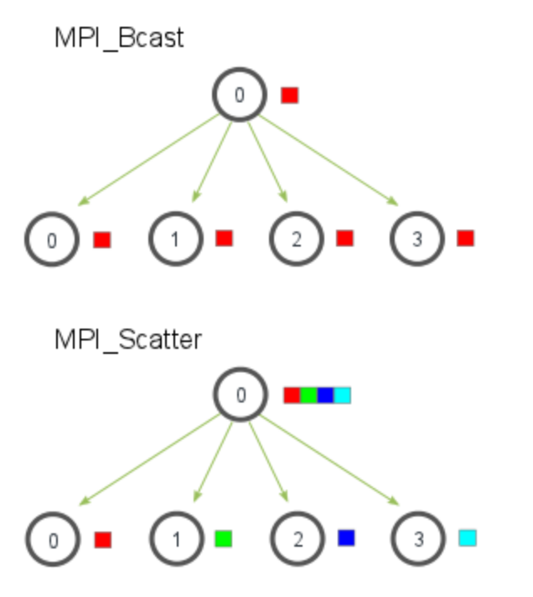
Many other functions…
MPI_Bcast: send same piece of data to all processes in the group
MPI_Scatter: send different pieces of an array to different processes (i.e., partition an array across processes)
From: http://mpitutorial.com/tutorials/mpi-scatter-gather-and-allgather/

Slide 18
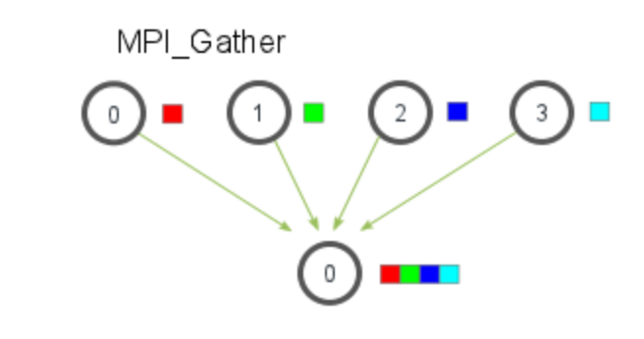
Many other functions…
MPI_Gather: take elements from many processes and gathers them to one single process
E.g., parallel sorting, searching
From: http://mpitutorial.com/tutorials/mpi-scatter-gather-and-allgather/

Slide 19
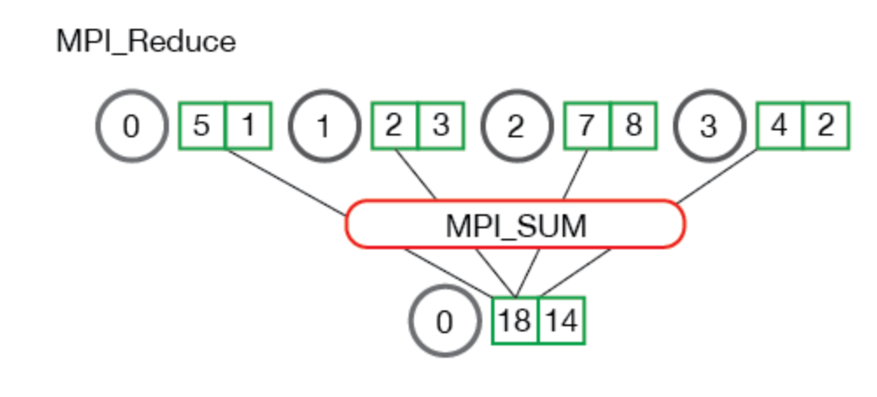
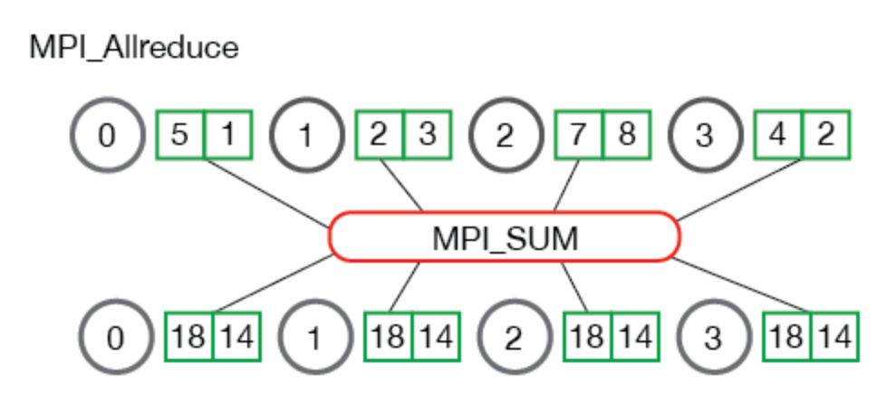
Many other functions…
MPI_Reduce: takes an array of input elements on each process and returns an array of output elements to the root process given a specified operation
MPI_Allreduce: Like MPI_Reduce but distribute results to all processes
From: http://mpitutorial.com/tutorials/mpi-scatter-gather-and-allgather/

Slide 20
MPI Discussion
Gives full control to programmer
Exposes number of processes
Communication is explicit, driven by the program
Assume
Long running processes
Homogeneous (same performance) processors
Little support for failures, no straggler mitigation
Summary: achieve high performance by hand-optimizing jobs but requires experts to do so, and little support for fault tolerance

Slide 21
OpenMP
Based on the “Introduction to OpenMP” presentation:
(webcourse.cs.technion.ac.il/236370/Winter2009.../OpenMPLecture.ppt)

Slide 22
Motivation
Multicore CPUs are everywhere:
Servers with over 100 cores today
Even smartphone CPUs have 8 cores
Multithreading, natural programming model
All processors share the same memory
Threads in a process see same address space
Many shared-memory algorithms developed

Slide 23
But…
Multithreading is hard
Lots of expertise necessary
Deadlocks and race conditions
Non-deterministic behavior makes it hard to debug

Slide 24
Example
Parallelize the following code using threads:
for (i=0; i<n; i++) {
sum = sum + sqrt(sin(data[i]));
}
Why hard?
Need mutex to protect the accesses to sum
Different code for serial and parallel version
No built-in tuning (# of processors?)

Slide 25
OpenMP
A language extension with constructs for parallel programming:
Critical sections, atomic access, private variables, barriers
Parallelization is orthogonal to functionality
If the compiler does not recognize OpenMP directives, the code remains functional (albeit single-threaded)
Industry standard: supported by Intel, Microsoft, IBM, HP

Slide 26
OpenMP execution model
Fork and Join: Master thread spawns a team of threads as needed
Worker
Thread
Master thread
Master thread
FORK
JOIN
FORK
JOIN
Parallel regions

Slide 27
OpenMP memory model
Shared memory model
Threads communicate by accessing shared variables
The sharing is defined syntactically
Any variable that is seen by two or more threads is shared
Any variable that is seen by one thread only is private
Race conditions possible
Use synchronization to protect from conflicts
Change how data is stored to minimize the synchronization

Slide 28
OpenMP: Work sharing example
answer1 = long_computation_1();
answer2 = long_computation_2();
if (answer1 != answer2) { … }
How to parallelize?

Slide 29
OpenMP: Work sharing example
answer1 = long_computation_1();
answer2 = long_computation_2();
if (answer1 != answer2) { … }
How to parallelize?
#pragma omp sections
{
#pragma omp section
answer1 = long_computation_1();
#pragma omp section
answer2 = long_computation_2();
}
if (answer1 != answer2) { … }

Slide 30
OpenMP: Work sharing example
Sequential code
for (int i=0; i<N; i++) { a[i]=b[i]+c[i]; }

Slide 31
OpenMP: Work sharing example
Sequential code
(Semi) manual parallelization
for (int i=0; i<N; i++) { a[i]=b[i]+c[i]; }
#pragma omp parallel
{
int id = omp_get_thread_num();
int nt = omp_get_num_threads();
int i_start = id*N/nt, i_end = (id+1)*N/nt;
for (int i=istart; i<iend; i++) { a[i]=b[i]+c[i]; }
}

Slide 32
OpenMP: Work sharing example
Sequential code
(Semi) manual parallelization
for (int i=0; i<N; i++) { a[i]=b[i]+c[i]; }
Launch nt threads
Each thread uses id and nt variables to operate on a different segment of the arrays
#pragma omp parallel
{
int id = omp_get_thread_num();
int nt = omp_get_num_threads();
int i_start = id*N/nt, i_end = (id+1)*N/nt;
for (int i=istart; i<iend; i++) { a[i]=b[i]+c[i]; }
}

Slide 33
OpenMP: Work sharing example
Sequential code
(Semi) manual parallelization
Automatic parallelization of the for loop using
#parallel for
for (int i=0; i<N; i++) { a[i]=b[i]+c[i]; }
#pragma omp parallel
{
int id = omp_get_thread_num();
int nt = omp_get_num_threads();
int i_start = id*N/nt, i_end = (id+1)*N/nt;
for (int i=istart; i<iend; i++) { a[i]=b[i]+c[i]; }
}
Increment:
var++, var--, var += incr, var -= incr
Comparison: var op last, where
op: <, >, <=, >=
One signed variable in the loop
#pragma omp parallel
#pragma omp for schedule(static)
{
for (int i=0; i<N; i++) { a[i]=b[i]+c[i]; }
}
Initialization:
var = init

Slide 34
Challenges of #parallel for
Load balancing
If all iterations execute at the same speed, the processors are used optimally
If some iterations are faster, some processors may get idle, reducing the speedup
We don’t always know distribution of work, may need to re-distribute dynamically
Granularity
Thread creation and synchronization takes time
Assigning work to threads on per-iteration resolution may take more time than the execution itself
Need to coalesce the work to coarse chunks to overcome the threading overhead
Trade-off between load balancing and granularity

Slide 35
Schedule: controlling work distribution
schedule(static [, chunksize])
Default: chunks of approximately equivalent size, one to each thread
If more chunks than threads: assigned in round-robin to the threads
Why might want to use chunks of different size?
schedule(dynamic [, chunksize])
Threads receive chunk assignments dynamically
Default chunk size = 1
schedule(guided [, chunksize])
Start with large chunks
Threads receive chunks dynamically. Chunk size reduces exponentially, down to chunksize

Slide 36
OpenMP: Data Environment
Shared Memory programming model
Most variables (including locals) are shared by threads { int sum = 0; #pragma omp parallel for for (int i=0; i<N; i++) sum += i; }
Global variables are shared
Some variables can be private
Variables inside the statement block
Variables in the called functions
Variables can be explicitly declared as private

Slide 37
Overriding storage attributes
private:
A copy of the variable is created for each thread
There is no connection between original variable and private copies
Can achieve same using variables inside { }
firstprivate:
Same, but the initial value of the variable is copied from the main copy
lastprivate:
Same, but the last value of the variable is copied to the main copy
int i;
#pragma omp parallel for private(i)
for (i=0; i<n; i++) { … }
int idx=1;
int x = 10;
#pragma omp parallel for \
firsprivate(x) lastprivate(idx)
for (i=0; i<n; i++) {
if (data[i] == x)
idx = i;
}

Slide 38
Reduction
for (j=0; j<N; j++) {
sum = sum + a[j]*b[j];
}
How to parallelize this code?
sum is not private, but accessing it atomically is too expensive
Have a private copy of sum in each thread, then add them up
Use the reduction clause
#pragma omp parallel for reduction(+: sum)
Any associative operator could be used: +, -, ||, |, *, etc
The private value is initialized automatically (to 0, 1, ~0 …)

Slide 39
#pragma omp reduction
float dot_prod(float* a, float* b, int N)
{
float sum = 0.0;
#pragma omp parallel for reduction(+:sum)
for(int i = 0; i < N; i++) {
sum += a[i] * b[i];
}
return sum;
}

Slide 40
Conclusions
OpenMP: A framework for code parallelization
Available for C++ and FORTRAN
Based on a standard
Implementations from a wide selection of vendors
Relatively easy to use
Write (and debug!) code first, parallelize later
Parallelization can be incremental
Parallelization can be turned off at runtime or compile time
Code is still correct for a serial machine

