Slide 1
CRDTs and Coordination Avoidance (Lecture 16, cs262a)
Ion Stoica,
UC Berkeley
October 19, 2016
Notes:
3-D graph
Checklist
What we want to enable
What we have today
How we’ll get there

Slide 2
Today’s Papers
CRDTs: Consistency without concurrency control, Marc Shapiro, Nuno Preguica, Carlos Baquero, Marek Zawirski Research Report, RR-6956, INRIA, 2009
(https://hal.inria.fr/inria-00609399v1/document)
Coordination Avoidance in Database Systems, Peter Bailis, Alan Fekete, Michael J. Franklin, Ali Ghodsi, Joseph M. Hellerstein, Ion Stoica, Proceedings of VLDB’14
(http://www.vldb.org/pvldb/vol8/p185-bailis.pdf)

Slide 3
Replicated Data
Replicate data at many nodes
Performance: local reads
Fault-tolerance: no data loss unless all replicas fail or become unreachable
Availability: data still available unless all replicas fail or become unreachable
Scalability: load balance across nodes for reads
Updates
Push to all replicas
Consistency: expensive!

Slide 4
Conflicts
Updating replicas may lead to different results → inconsistent data
s₁
5
3
7
s₂
5
3
7
s₃
5
7
3

Slide 5
Strong Consistency
All replicas execute updates in same total order
Deterministic updates: same update on same objects → same result
s₁
5
3
3
7
s₂
5
3
7
s₃
5
7
3
7
coordinate

Slide 6
Strong Consistency
All replicas execute updates in same total order
Deterministic updates: same update on same objects → same result
Requires coordination and consensus to decide on total order of operations
N-way agreement, basically serialize updates → very expensive!

Slide 7
Eventual Consistency
If no new updates are made to an object all replicas will eventually converge to the same value
Update local and propagate
No consensus in the background → scale well for both reads and writes
Expose intermediate state
Assume, eventual, reliable delivery
On conflict
Arbitrate & Rollback

Slide 8
Eventual Consistency
If no new updates are made to an object all replicas will eventually converge to the same value
Move consensus to background
However:
High complexity
Unclear semantics if application reads data and then we have a rollback!

Slide 9
Strong Eventual Consistency
Like eventual consistency but with deterministic outcomes of concurrent updates
No need for background consensus
No need to rollback
Available, fault-tolerant, scalable
But not general; works only for a subset of updates

Slide 10
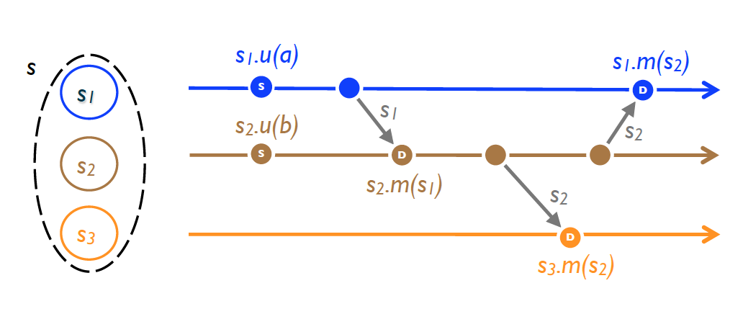
State-based Replication
Replicated object: a tuple (S, s₀, q, u, m).
Replica at process p_{i} has state s_{i} ∈ S
s₀: initial state
Each replica can execute one of following commands
q: query object’s state
u: update object’s state
m: merge state from a remote replica

Slide 11
State-based Replication
Algorithm
Periodically, replica at p_{i} sends its current state to p_{j}
Replica p_{j} merges received state into its local state by executing m
After receiving all updates (irrespective of order), each replica will have same state

Slide 12
Semi-lattice
Partial order ≤ set S with a least upper bound (LUB), denoted ⊔
m = x ⊔ y is a LUB of { x, y} under ≤ iff ∀ m′, x ≤ m′ ∧ y ≤ m′ ⇒ x ≤ m ∧ y ≤ m ∧ m ≤ m′
It follows that ⊔ is:
commutative: x ⊔ y = y ⊔ x
idempotent: x ⊔ x = x
associative: ( x ⊔ y) ⊔ z = x ⊔ ( y ⊔ z)

Slide 13
Example
Partial order ≤ on set of integers
⊔: max( )
Then, we have:
commutative: max(x, y) = max(y, x)
idempotent: max(x, x) = x
associative: max(max(x, y), z) = max(x, max(y, z))

Slide 14
Example
Partial order ⊆ on sets
⊔: U (set union)
Then, we have:
commutative: A U B = B U A
idempotent: A U A = A
associative: (A U B) U C = A U (B U C)

Slide 15
Monotonic Semi-lattice Object
A state-based object with partial order ≤, noted (S,≤, s₀, q, u, m), that has following properties, is called a monotonic semi-lattice:
Set S of values forms a semi-lattice ordered by ≤
Merging state s with remote state s′ computes the LUB of the two states, i.e., s •m (s′ ) = s⊔s′
State is monotonically non-decreasing across updates, i.e., s ≤ s • u

Slide 16
Convergent Replicated Data Type (CvRDT)
Theorem: Assuming eventual delivery and termination, any state-based object that satisfies the monotonic semi-lattice property is
SEC

Slide 17
Why does it work?
Don’t care about order:
Merge is both commutative and associative
Don’t care about delivering more than once
Merge is idempotent

Slide 18
Numerical Example: Union Set
u: add new element to local replica
q: return entire set
merge: union between remote set and local replica
{5}
{5} U {3} = {3, 5}
{3, 5} U {5, 7} = {3, 5, 7}
{5}
{5}
{5} U {3, 5} = {3, 5}
{5}
{5}
{3, 5} U {5, 7} = {3, 5, 7}
{5}
{5} U {7} = {5, 7}
{5, 7} U {3, 5} = {3, 5, 7}

Slide 19
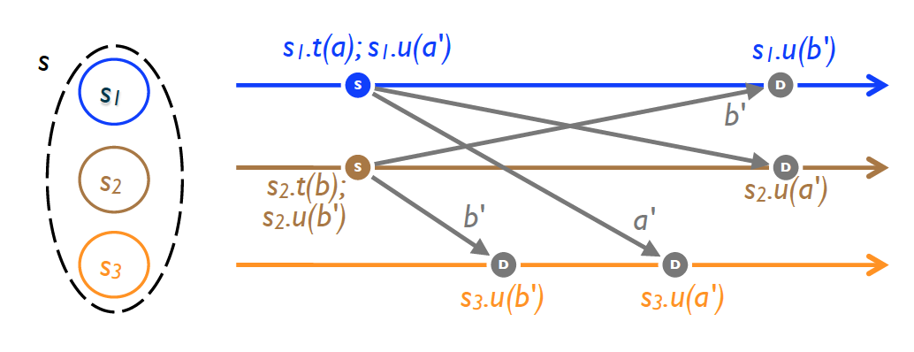
Operation-based Replication
An op-based object is a tuple (S, s₀, q, t, u, P ), where S, s₀ and q have same meaning: state domain, initial state and query method
No merge method; instead an update is split into a pair (t, u ), where
t: side-effect-free prepare-update method (at local copy)
u: effect-free update method (at all copies)
P: delivery precondition (see next)

Slide 20
Operation-based Replication
Algorithm
Updates are delivered to all replicas
Use causally-ordered broadcast communication protocol, i.e., deliver every message to every node exactly once, consistent with happen-before order
Happen-before: updates from same replica are delivered in the order they happened to all recipients (effectively delivery precondition, P)
Note: concurrent updates can be delivered in any order

Slide 21
Commutativity Property
Updates (t, u) and (t′, u′) commute, iff for any reachable
replica state s where both u and u′ are enabled
u (resp. u′ ) remains enabled in state s • u′ (resp. s • u )
s • u • u′ ≡ s • u′ • u
Commutativity holds for concurrent updates

Slide 22
Commutative Replicated Data Type (CmRDT)
Assuming causal delivery of updates and method termination, any op-based object that satisfies the commutativity property for all concurrent updates is SEC

Slide 23
Numerical Example: Union Set
t: add a set to local replica
u: add delta to every remote replica
{5}
{5} U {3} = {3, 5}
{3, 5} U {7} = {3, 5, 7}
{5}
{5}
{5} U {3} = {3, 5}
{5}
{5}
{3, 5} U {7} = {3, 5, 7}
{5}
{5} U {5, 7} = {5, 7}
{5, 7} U {3} = {3, 5, 7}

Slide 24
State-based vs Operation-based Replication
Both are equivalent!
You can use one to emulate the other
Operation-base
More efficient since you can ship only small updates
State-based
Just requires reliable broadcast; causally-ordered broadcast much more complex!

Slide 25
CRDT Examples (cont’d)
Integer vector (virtual clock):
u: increment value at corresponding index by one
m: maximum across all values, e.g., m([1, 2, 4], [3, 1, 2]) = [3, 2, 4]
Counter: use an integer vector, with query operation
q: returns sum of all vector values (1-norm), e.g., q([1, 2, 4]) = 7
Counter that decrements as well:
Use two integer vectors:
I updated when incrementing
D updated when decrementing
q: returns difference between 1-norms of I and D

Slide 26
CRDT Examples (cont’d)
Add only set object
u: add new element to set
m: union between two sets
q: return local set
Add and remove set object
Two add only sets
A: when adding an element, add it to A
R: when removing an element, add it to R
q: returns A\R

Slide 27
CAP Theorem
You cannot achieve simultaneously
Strong consistency
Availability
Partition tolerance
Why?

Slide 28
SEC a Solution for CAP?
Availability: a replica is always available for both reads and writes
Partition tolerance: any communicating subset of replicas of
eventually converges
even if partitioned from the rest of the network. SEC is weaker than
Fault tolerance: n-1 nodes can fail!
Almost a solution: SEC weaker than Strong Consistency, though good enough for many practical situations

Slide 29
Summary
Serialization, strong consistency
Easy to use by applications, but don’t scale well due to conflicts
Two solutions to dramatically improve performance:
CRDTs: eliminate coordination by restricting types of supported objects for concurrent updates
Coordination avoidance: rely on application hints to avoid coordination for transactions
Question: what do these model mean for applications?

