Slide 1
Virtual Machines Disco and Xen (Lecture 10, cs262a)
Ion Stoica,
UC Berkeley
September 28, 2016
Notes:
3-D graph
Checklist
What we want to enable
What we have today
How we’ll get there

Slide 2
Today’s Papers
Disco: Running Commodity Operating Systems on Scalable Multiprocessors, Edouard Bugnion, Scott Devine, and Mendel Rosenblum, SOSP’97 (https://amplab.github.io/cs262a-fall2016/notes/Disco.pdf)
Xen and the Art of Virtualization, P. Barham, B. Dragovic, K Fraser, S. Hand, T. Harris, A. Ho, R. Neugebauer, I. Pratt and A. Warfield, SOSP’03 (www.cl.cam.ac.uk/research/srg/netos/papers/2003-xensosp.pdf)

Slide 3
What is Virtual Machine?
Virtual Machine:
“A fully protected and isolated copy of the underlying physical machine’s hardware.” -- definition by IBM
Virtual Machine Monitor (aka Hypervisor):
“A thin layer of software that's between the hardware and the Operating system, virtualizing and managing all hardware resources”

Slide 4
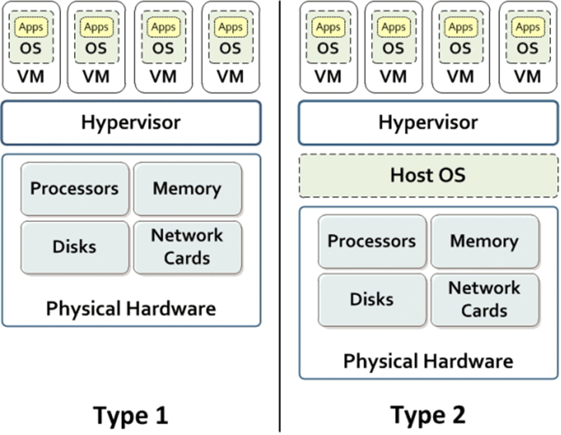
VM Classification: Type 1 vs Type 2
VMM implemented directly on physical hardware
VMM performs scheduling and allocation of system’s resources
E.g., IBM VM/370, Disco, VMware’s ESX Server, Xen
(VMM)
(http://www.ibm.com/developerworks/library/mw-1608-dejesus-bluemix-trs/index.html)

Slide 5
VM Classification: Type 1 vs Type 2
VMMs built completely on top of a host OS
Host OS provides resource allocation and standard execution environment to each “guest OS”
User-mode Linux (UML), UMLinux
(VMM)
(http://www.ibm.com/developerworks/library/mw-1608-dejesus-bluemix-trs/index.html)

Slide 6
VM Classification: Type 1 vs Type 2
(VMM)
(VMM)
(http://www.ibm.com/developerworks/library/mw-1608-dejesus-bluemix-trs/index.html)

Slide 7
Virtual Machine – An Old Idea
CP/CMS (Control Program/Cambridge Monitor System), 1968
Time sharing providing each user with a single-user OS
Allow users to concurrently share a computer
IBM System/370, 1972
Run multiple OSes
Hot research topic in 60s-70s; entire conferences devoted to VMs

Slide 8
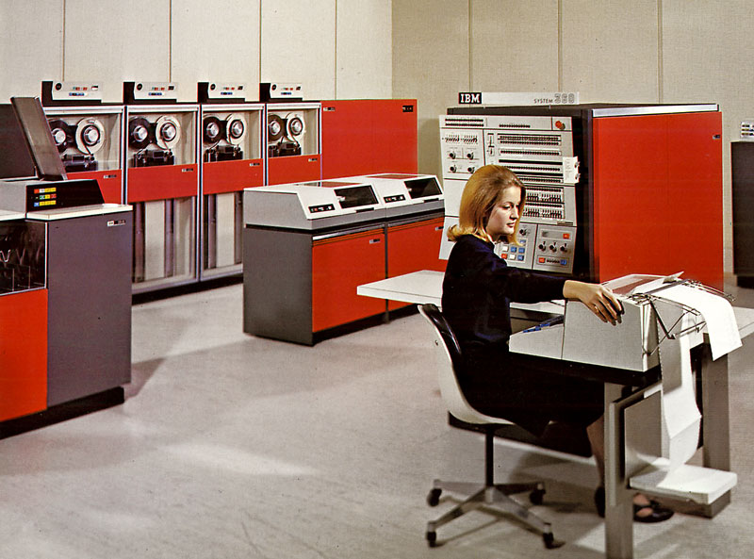
Why Virtual Machine?
Multiplex an expensive machine
Ability to run multiple OSes targeted for different workloads
Ability to run new OS versions side by side with a stable older version
No problem if new OS breaks compatibility for existing apps; just run them in a VM on old OS
IBM System/360

Slide 9
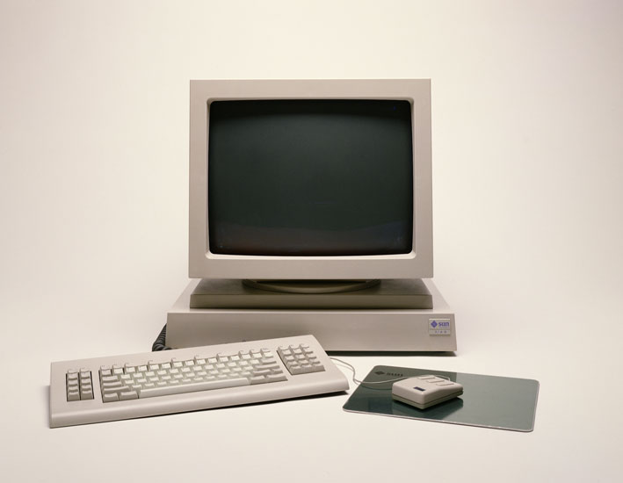
What Happened?
Interest died out in 80s (why?)
More powerful, cheaper machines
Could deploy new OS on different machine
More powerful OSes (e.g., Unix running on Workstations)
No need to use VM to provide multi-user support
Sun Workstation, late 80s

Slide 10
New Motivation (1990s)
Multiprocessor in the market
Innovative Hardware
Hardware development faster than system software
Customized OS are late, incompatible, and possibly bug
Commodity OSes not suited for multiprocessors
Do not scale due to lock contention, memory architecture
Do not isolate/contain faults; more processors, more failures

Slide 11
Two Approaches
Modify OS to handle multiprocessor machines:
Hive , Hurricane, Cellular-IRIX
Innovative, single system image
But large effort, can take a long time
Hard-partition machine into independent failure units: OS-light
Sun Enterprise10000 machine
Partial single system image
Cannot dynamically adapt the partitioning

Slide 12
Disco Solution
Virtual Machine Monitor between hardware and OS running commercial OS
Virtualization:
Used to be: make a single resource appear as multiple resources
Disco: make multiple resources appear like a single resource
Trading off between performance and development costs

Slide 13
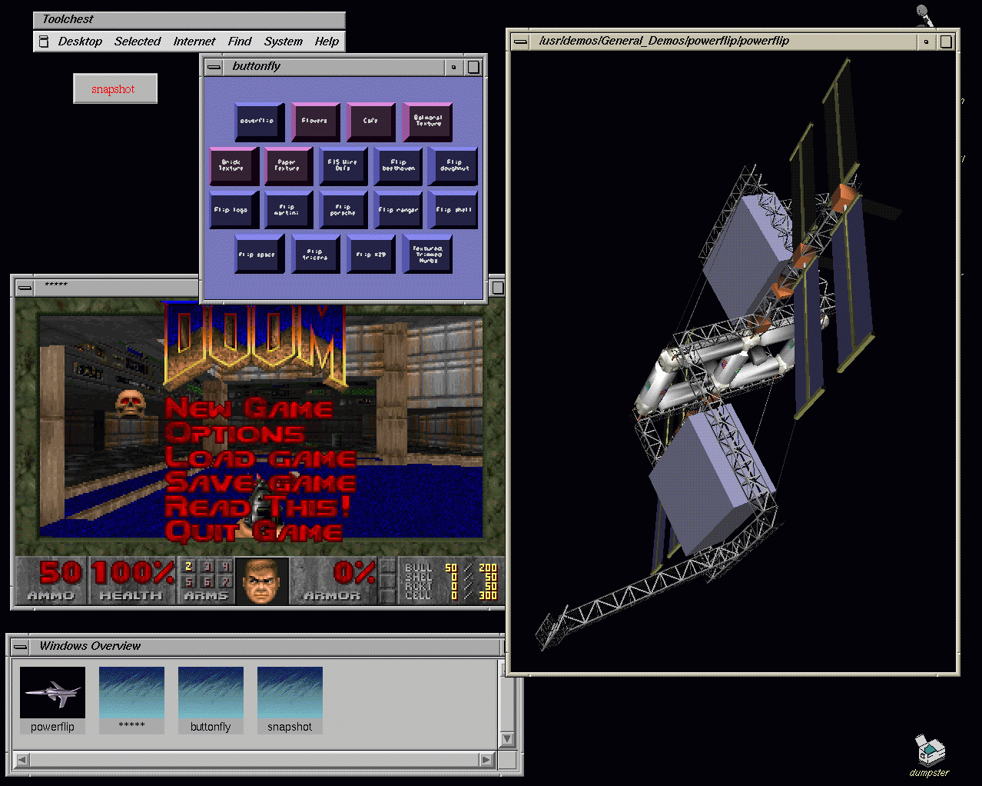
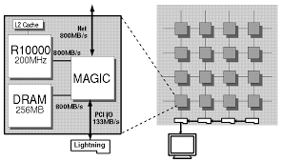
Disco
Extend modern OS to run efficiently on shared memory multiprocessors with minimal OS changes
A VMM built to run multiple copies of Silicon Graphics IRIX operating system on Stanford Flash multiprocessor
IRIX Unix based OS
Stanford FLAS: cache coherent NUMA

Slide 14
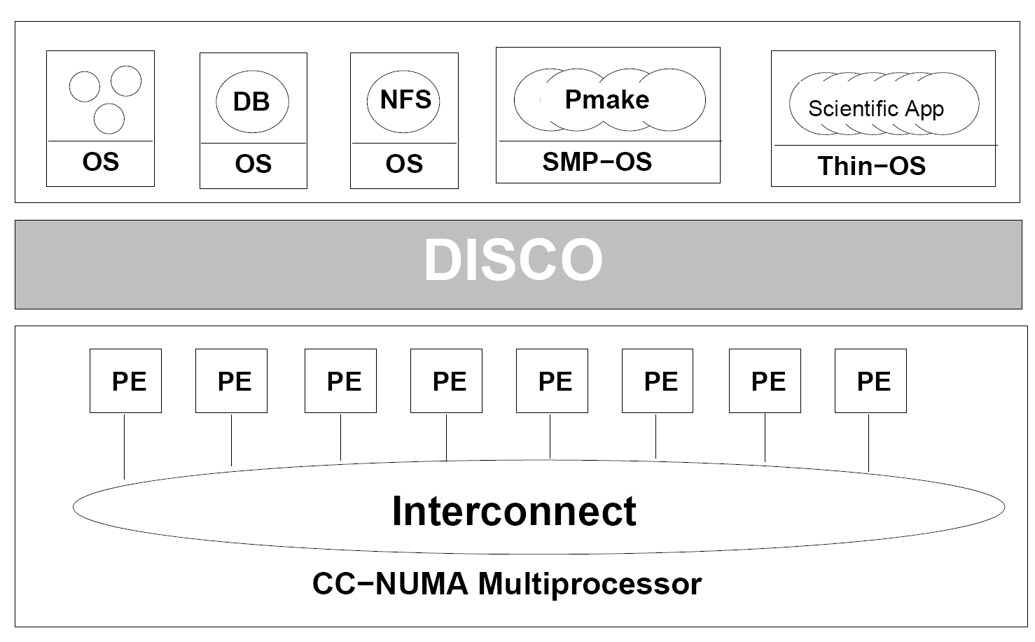
Disco Architecture

Slide 15
Challenges Facing Virtual Machines
Overhead
Trap and emulate privileged instructions of guest OS
Access to I/O devices
Replication of memory in each VM
Resource Management
Lack of information to make good policy decisions
Communication and Sharing
Hard to communicate between stand alone VMs

Slide 16
Disco’s Interface
Processors
MIPS R10000 processor: emulates all instructions, MMU, trap architecture
Extension to support common processor operations
Enabling/disabling interrupts, accessing privileged registers
Physical memory
Contiguous, starting at address 0
I/O devices
Virtualize devices like I/O, disks
Physical devices multiplexed by Disco
Special abstractions for SCSI disks and network interfaces
Virtual disks for VMs
Virtual subnet across all virtual machines

Slide 17
Disco Implementation
Multi threaded shared memory program
Attention to NUMA memory placement, cache aware data structures and IPC patterns
Disco code copied to each flash processor
Communicate using shared memory

Slide 18
Virtual CPUs
Direct execution on real CPU:
Set real CPU registers to those of virtual CPU
Jump to current PC of virtual CPU
Maintains data structure for each virtual CPU for trap emulation
Trap examples: page faults, system calls, bus errors
Scheduler multiplexes virtual CPU on real processor

Slide 19
Virtual Physical Memory
Extra level of indirection: physical-to-machine address mappings
VM sees contiguous physical addresses starting from 0
Map physical addresses to the 40 bit machine addresses used by FLASH
When OS inserts a virtual-to-physical mapping into TLB, translates the physical address into corresponding machine address
App
VM OS
App
OS
VM TLB
virtual address
physical address
TLB
virtual address
physical address
pmap
physical address
machine address
TLB
virtual address
machine address
Traditional OS
Disco

Slide 20
Virtual Physical Memory
Extra level of indirection: physical-to-machine address mappings
VM sees contiguous physical addresses starting from 0
Map physical addresses to the 40 bit machine addresses used by FLASH
When OS inserts a virtual-to-physical mapping into TLB, translates the physical address into corresponding machine address
To quickly compute corrected TLB entry, Disco keeps a per VM pmap data structure that contains one entry per VM physical page
Each entry in TLB tagged with address space identifier (ASID) to avoid flushing TLB on MMU context switches
TLB flushed when scheduling a different virtual CPU on a physical processor
Software TLB to cache recent virtual-to-machine translations

Slide 21
NUMA Memory Management
Dynamic Page Migration and Replication
Pages frequently accessed by one node are migrated
Read-shared pages are replicated among all nodes
Write-shared are not moved, since maintaining consistency requires remote access anyway
Migration and replacement policy is driven by cache-miss-counting facility provided by the FLASH hardware

Slide 22
Transparent Page Replication
Two different virtual processors of same virtual machine logically read-share same physical page, but each virtual processor accesses a local copy
2. memmap maintains an entry for each machine page that contains which virtual page reference it; used during TLB shootdown*
*Processors flushing their TLBs when another processor restrict access to a shared page.

Slide 23
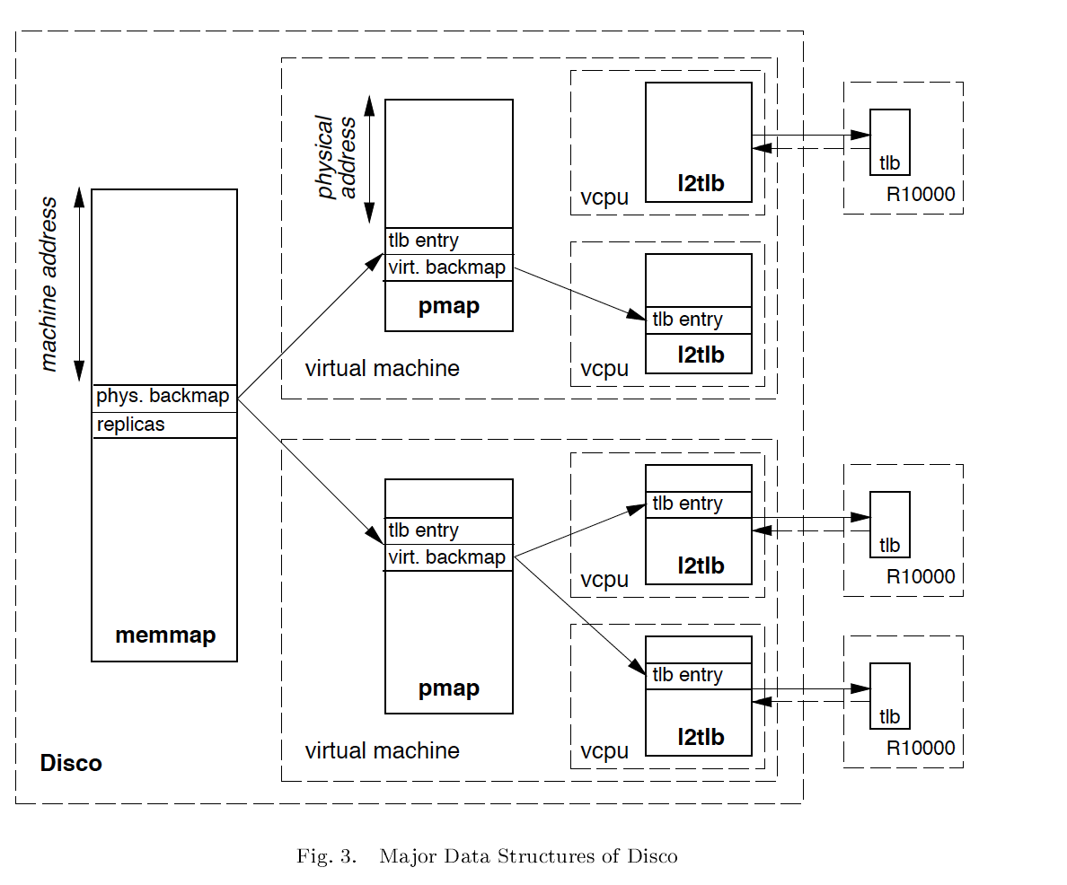
Disco Memory Management

Slide 24
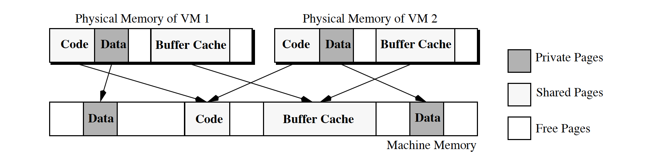
Transparent Page Sharing
Global buffer cache that can be transparently shared between virtual machines

Slide 25
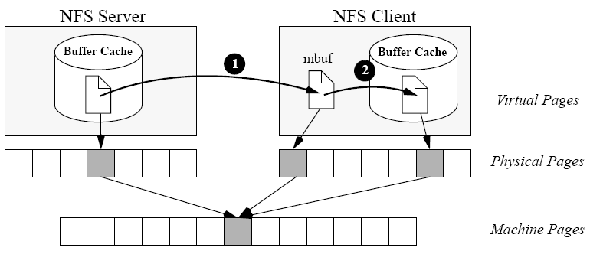
Transparent Page Sharing over NFS
The monitor’s networking device remaps data page from source’s machine address to destination’s
The monitor remaps data page from driver’s to client’s buffer cache

Slide 26
Impact
Revived VMs for the next 20 years
Now VMs are commodity
Every cloud provider, and virtually every enterprise uses VMs today
VMWare successful commercialization of this work
Founded by authors of Disco in 1998, $6B revenue today
Initially targeted developers
Killer application: workload consolidation and infrastructure management in enterprises

Slide 27
Summary
Disco VMM hides NUMA-ness from non-NUMA aware OS
Disco VMM is low effort
Only 13K LoC
Moderate overhead due to virtualization
Only 16% overhead for uniprocessor workloads
System with eight virtual machines can run some workloads 40% faster

Slide 28
Xen

Slide 29
Xen Motivation
Performance
Goal to run 100 simultaneously
Security: resource isolation
Functionality

Slide 30
Virtualization vs Paravirtualization
Full Virtualization: expose “hardware” as being functionally identical to the physical hardware (e.g., Disco, VMWare)
Cannot access the hardware
Challenging to emulate some privileged instructions (e.g., traps)
Hard to provide real-time guarantees
Paravirtualization: just expose a “similar” architecture, not 100% identical to physical hardware (e.g., Xen)
Better performance
Need modifications to the OS
Still no modifications to applications

Slide 31
The Cost of Porting an OS to Xen
Privileged instructions
Page table access
Network driver
Block device driver
<2% of code-base

Slide 32
Xen Terminology
Guest OS: OS hosted by VM
Domain: VM within which a guest operating system executes
Guest OS and domain analogous to program and process
Hypervisor: VMM

Slide 33
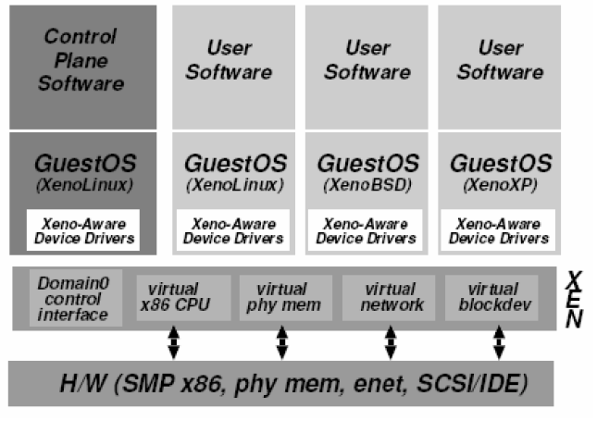
Xen’s Architecture
Domain0 hosts application-level management software
E.g., creation/deletion of virtual network interfaces and block devices

Slide 34
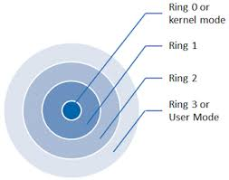
CPU
X86 supports 4 privilege levels
0 for OS, and 3 for applications
Xen downgrades OS to level 1, and it runs on level 2
System-call and page-fault handlers registered to Xen
“fast handlers” for most exceptions, doesn’t involve Xen

Slide 35
CPU Scheduling: Borrowed Virtual Time Scheduling
Fair sharing scheduler: effective isolation between domains
However, allows temporary violations of fair sharing to favor recently-woken domains
Reduce wake-up latency → improves interactivity

Slide 36
Times and Timers
Times:
Real time since machine boot: always advances regardless of the executing domain
Virtual time: time that only advances within the context of the domain
Wall-clock time
Each guest OS can program timers for both:
Real time
Virtual time

Slide 37
Control Transfer: Hypercalls and Events
Hypercalls: synchronous calls from a domain to Xen
Allows domains to perform privileged operation via software traps
Similar to system calls
Events: asynchronous notifications from Xen to domains
Replace device interrupts

Slide 38
Exceptions
Memory faults and software traps
Virtualized through Xen’s event handler
Most frequent exceptions: system calls and page faults
Use ‘fast’ handler bypassing hypervisor: direct calls from an application into its guest OS avoiding indirection through Xen

Slide 39
Memory
Physical memory
Reserved at domain creation time
Statically partitioned among domains
Virtual memory:
OS allocates a page table from its own reservation and registers it with Xen
OS gives up all direct privileges on page table to Xen
All subsequent updates to page table must be validated by Xen
Guest OS typically batch updates to amortize hypervisor calls

Slide 40
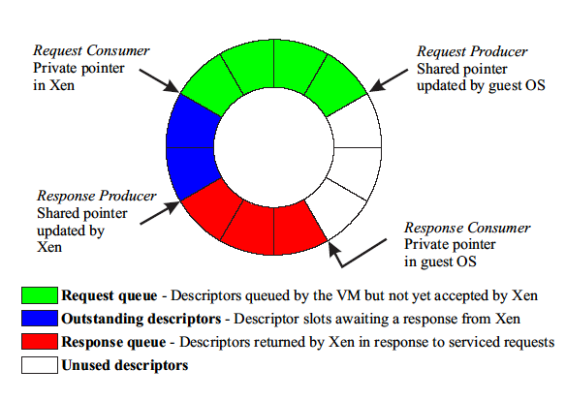
Data Transfer: I/O Rings
Zero-copy semantics
Data is transferred to/from domains via Xen through a buffer ring

Slide 41
History and Impact
Released in 2003 (Cambridge University)
Authors founded XenSource, acquired by Citrix for $500M in 2007
Widely used today:
Linux supports dom0 in Linux’s mainline kernel
AWS EC2 based on Xen

Slide 42
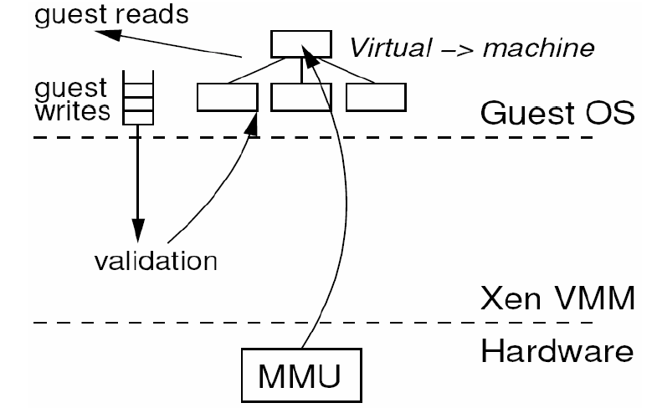
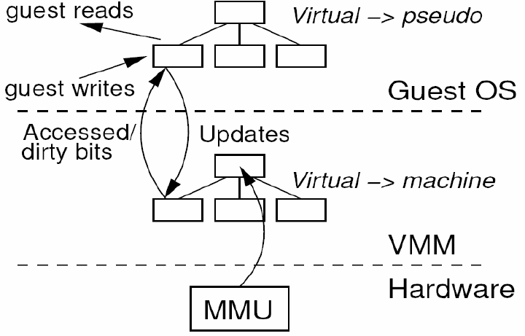
Paravirtualization of the MMU
Paravirtualization
Full Virtualization
Diagrams provided by a presentation from the Universität Karlsruhe

