Slide 1

Visualizing Nourishment Around the World
Ahmed J Khan
Candidate for MS in Analytics and Policy
Johns Hopkins University
Fall 2020

Slide 2
Overview
Contents
Visualizations of how effectively various world regions have met basic nutrition needs or established access to clean water. Some implications are also noted.
Certain charts offer links to interactive visualizations published on the web for richer, accessible insights
Definitions
Minimum Dietary/Nutrition Needs: Basic nutritive needs of an average individual (varies by region) to survive and function.
Food Insecurity: Not having enough to eat due a lack of resources.
Conclusions
As expected, economic activity is strongly associated with meeting nutrition needs; stronger economics are positively correlated with diet adequacy and clean water access.
The world has made significant gains in meeting nutrition needs and in establishing clean water access, although variations by region persist.
Population growth in Africa is unsustainable; need for continued food aid and economic cooperation continues.

Slide 3
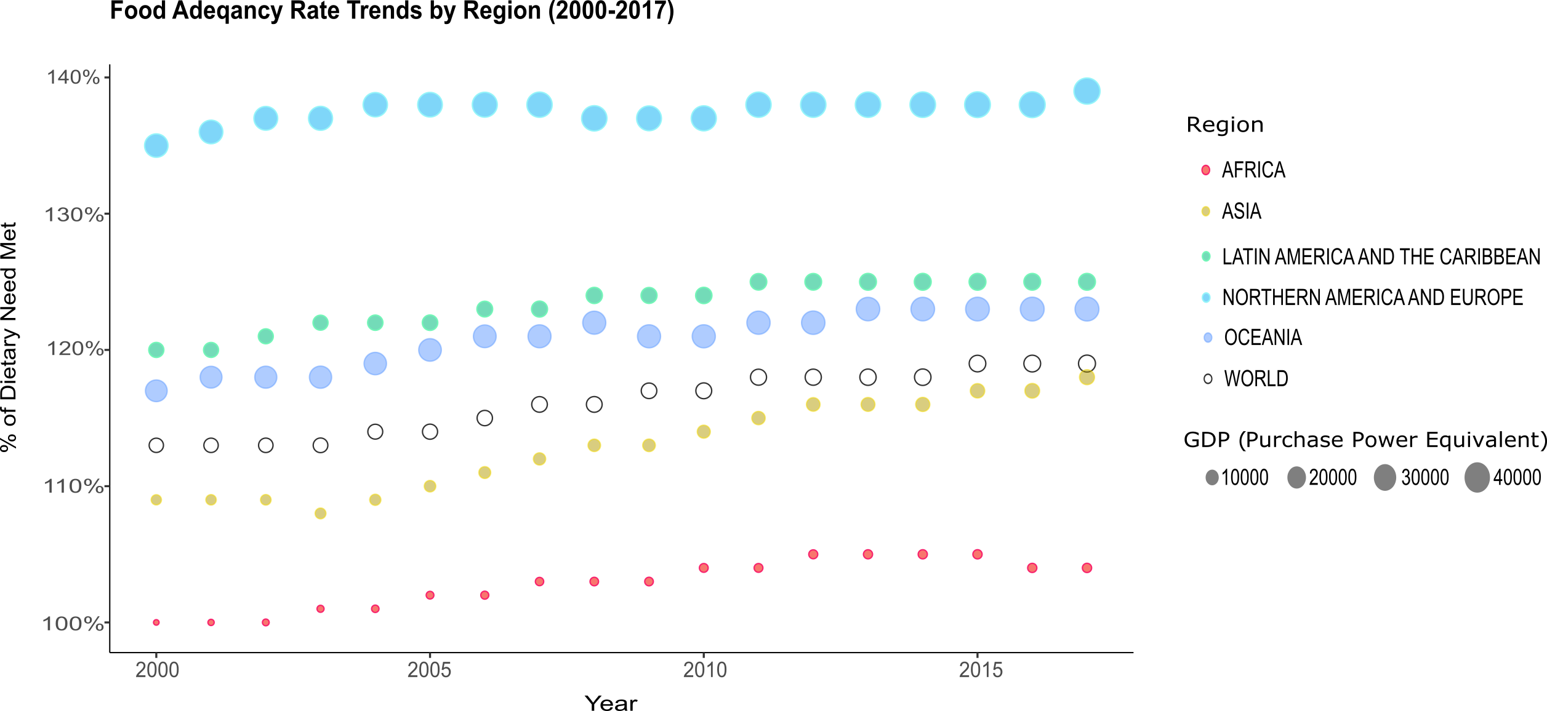
The world has increasingly met dietary needs overall since 2000, but variations persist by region
The world overall as increasingly met basic dietary needs, even through the great recession of 2009. But variations exist by region. North America and Europe, both economically well-off, out-perform all other regions. But Africa, economically struggling, continues to lag other regions. Asia, with growing economic development in recent decades, has improved faster than any other region. These trends suggests – as expected – that, on average, higher economic activity is associated with meeting dietary needs better.*
*Oceania GDP higher than Latin America’s but average dietary need met is lower as Oceania includes small island states, lowering official reported average.
Source: UN Food and Agriculture Organization
Notes:
Nice aH ☺

Slide 4
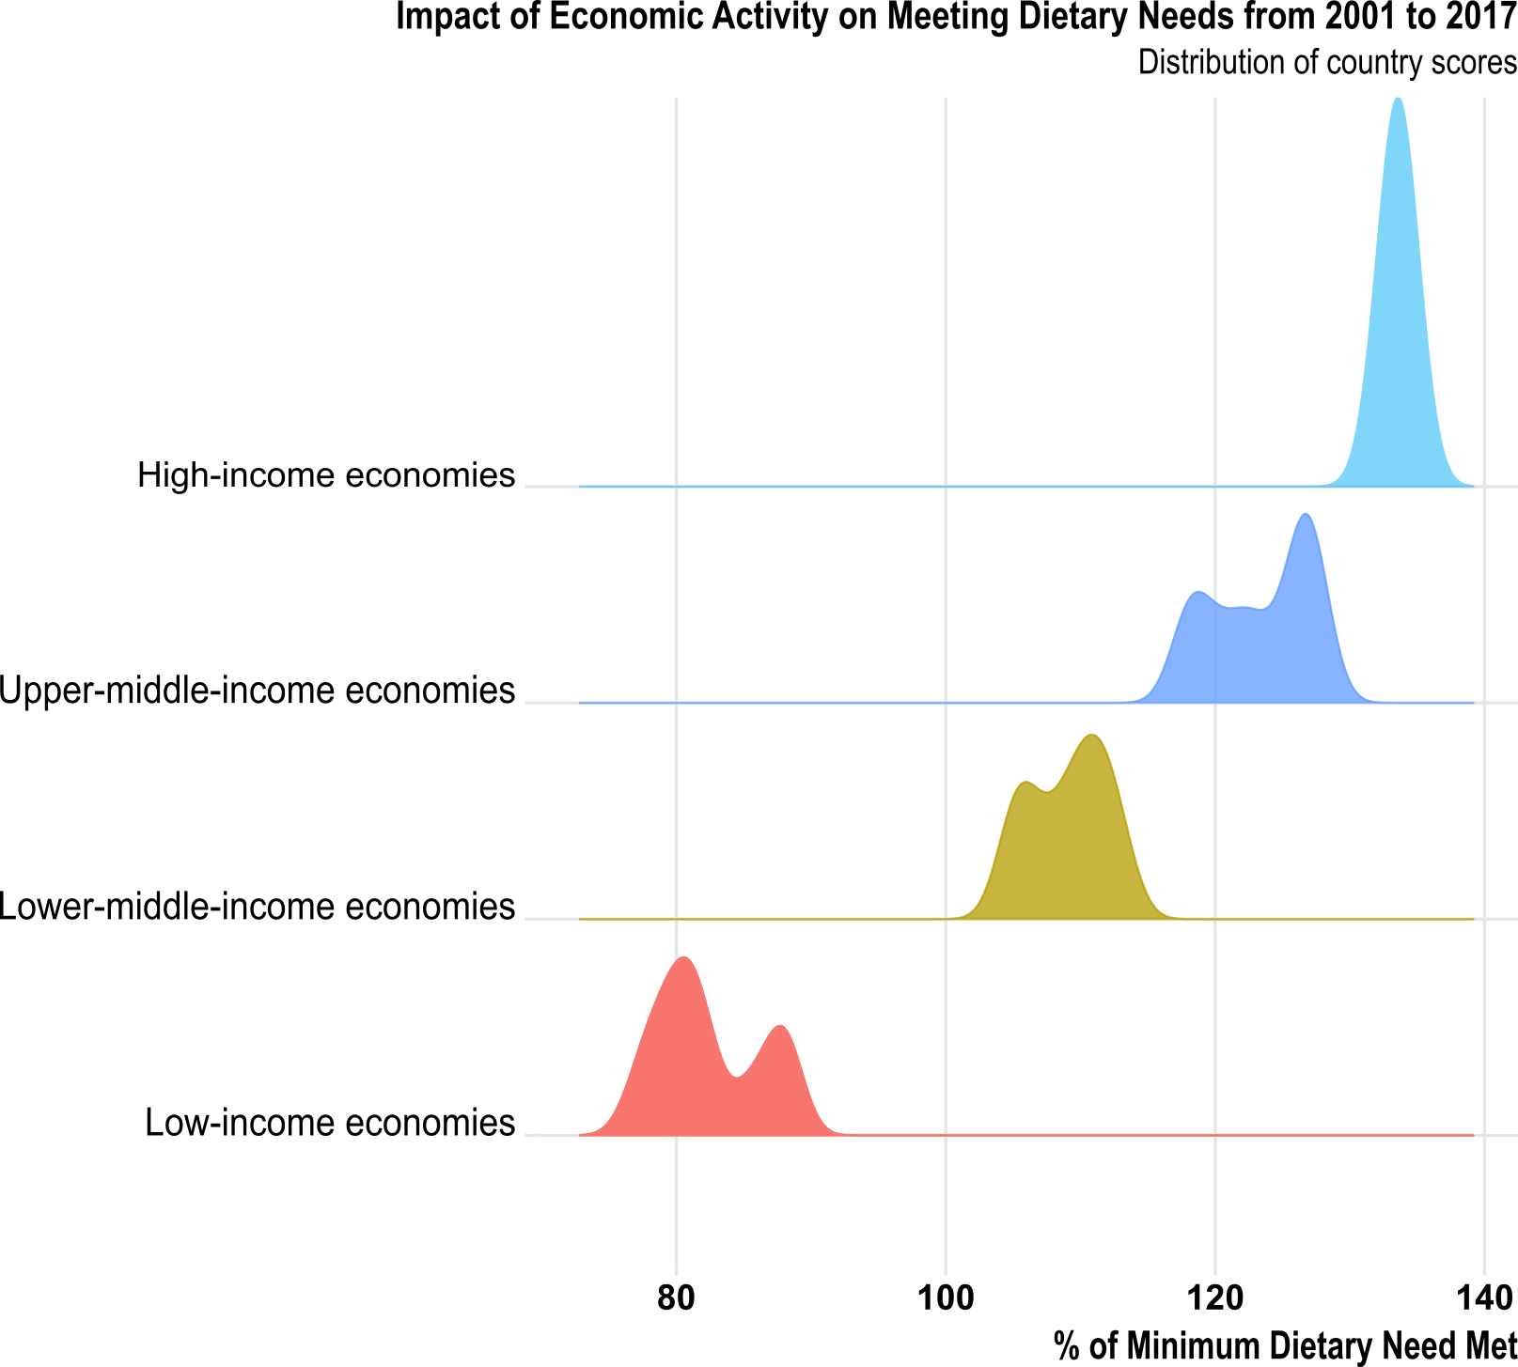
Greater economic activity translates to more dietary needs met
Counties at various levels of economic activity perform differently in meeting citizen’s basic dietary needs. High income economies far exceed meeting citizens’ basic dietary needs. Economies with low income, however, fall short in meeting basic needs. This presents an opportunity for economic cooperation between high and low income economies. Click the link below for an interactive dashboard view with linear trends by region.
Interactive time series look available at: https://rpubs.com/AJK_Hopkins/DietaryNeeds
Source: UN Food and Agriculture Organization.
Notes:
Nice aH ☺

Slide 5
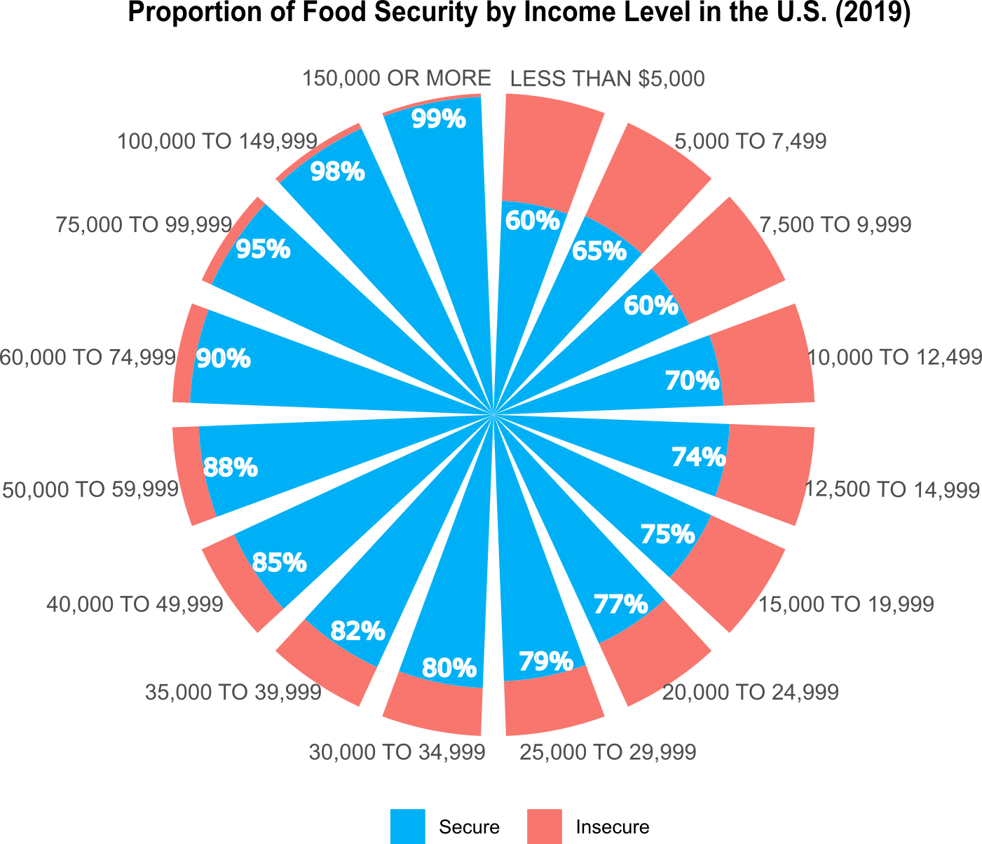
Case study: Income and food security in the United States
In the U.S., income strongly affects an individual’s ability to be food secure (i.e. having enough to eat). Data from the 2019 Food Security Survey show that people with lower income tend to be much less food secure than those with higher incomes. This highlights an opportunity to focus federal programs towards holistic solutions that provide food aid with skills training or education to help people lift themselves out of hunger and poverty.
Source: US Department of Agriculture
Notes:
Nice aH ☺

Slide 6
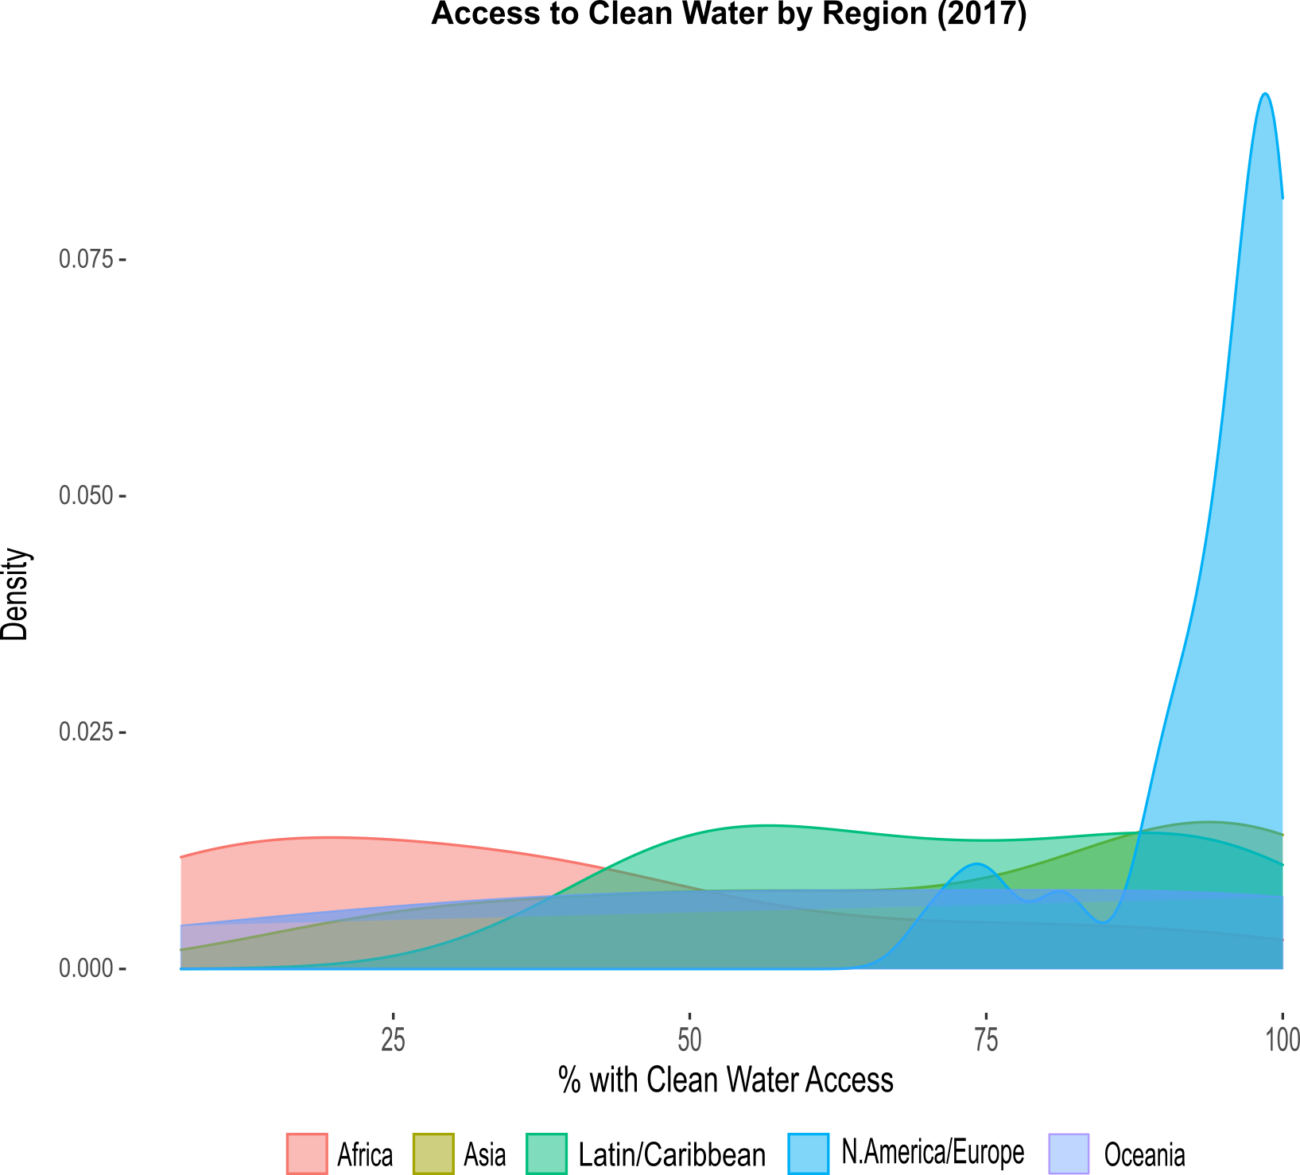
Density of countries by world region with access to clean water (2017)
More economically advantaged regions such as North America and Europe have greater access to clean water, however all regions have made progress over recent decades. Click the link below for an interactive time series view that shows how access to clean water has improved around the world since 2000.
Interactive time series look available at: https://ahmedjkhan.shinyapps.io/CleanWaterAccess/
Source: World Health Organization. Points are country years. Oceania includes small islands.
Notes:
Nice aH ☺

Slide 7
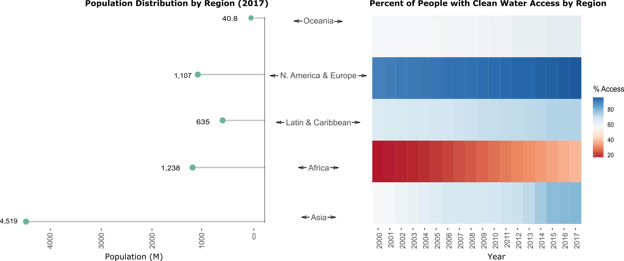
Population and change in access to clean water by region (2017)
This view shows the distribution of world population (left) and access to clean water by region (right). Water access has improved in all regions over time but variation by region persists. Africa continues to struggle, although it has made significant gains. Asia has also made sizable gains, likely due to growing economies.
Source: UN Food and Agriculture Organization. Tiles are median values. Oceania includes small island nations.
Notes:
Nice aH ☺

Slide 8
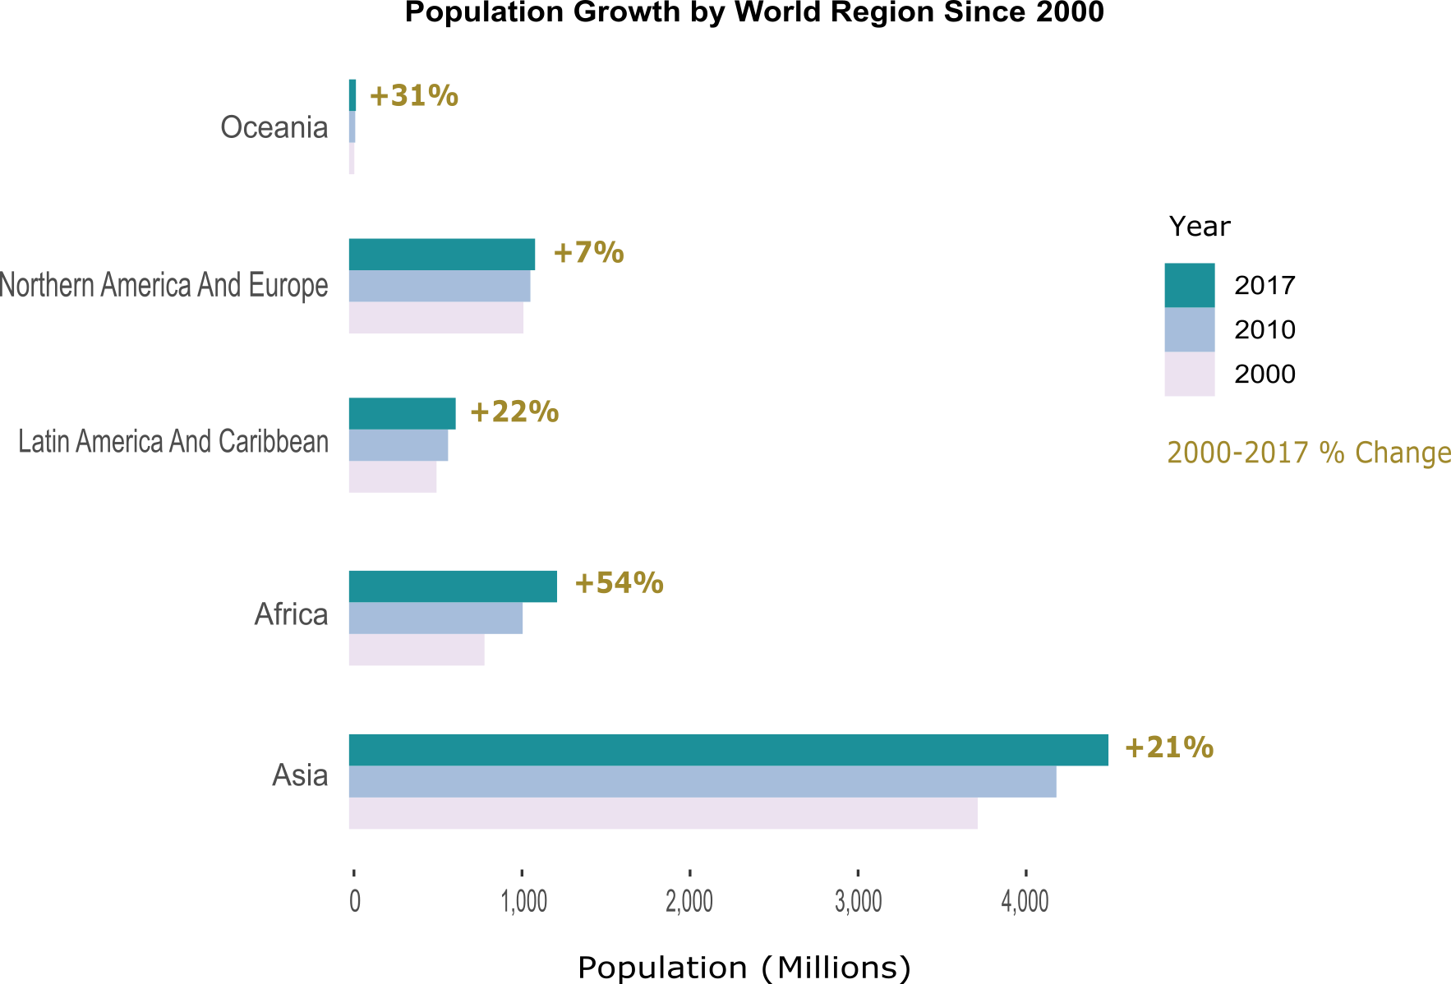
Global population growth by region (2000-2017)
Population growth over the last few decades has been concentrated in Africa and Asia. While Asia has seen economic booms in recent decades, African countries tend to remain economically disadvantaged. This growth may prove unsustainable for Africa as indicators shown earlier show an existing struggle in the region to make nutrition and clean water gains. Continued need for nutritional aid flowing into to Africa will likely continue.
Source: UN Food and Agriculture Organization
Notes:
Nice aH ☺

Slide 9
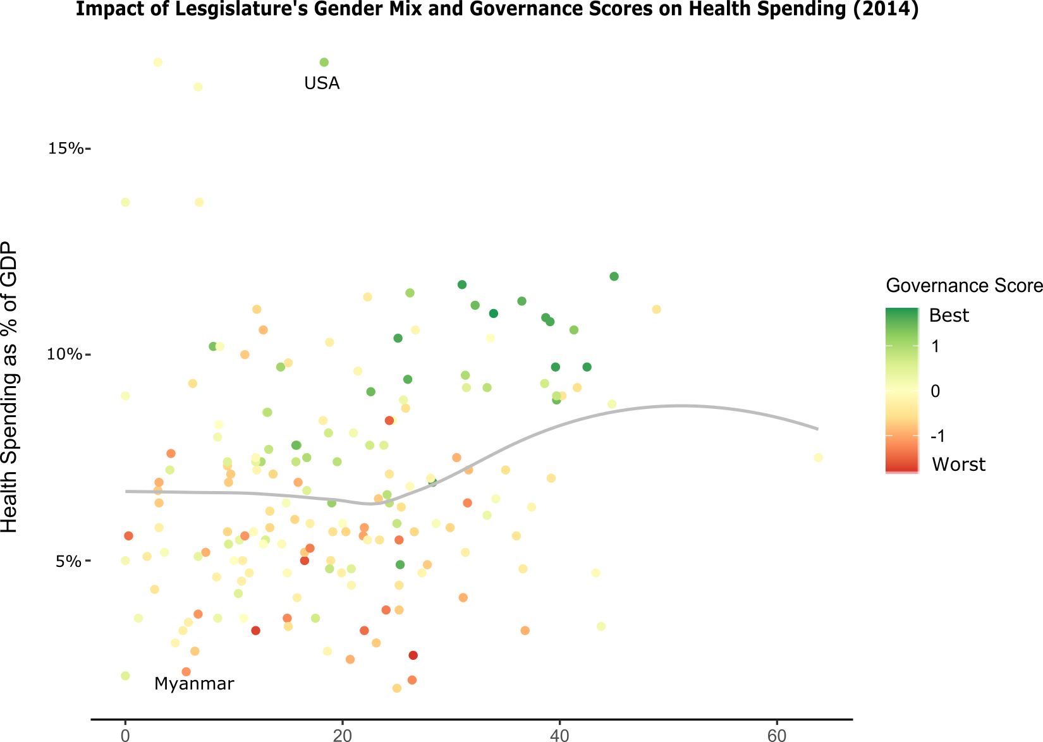
Governance, not gender mix in legislature, determines healthcare spending
There is no real relationship between more women being in legislatures and healthcare spending. However, good governance - as measured by the World Health Organization’s Governance Score - is associated with greater healthcare spending. USA and Myanmar are noted as references. Click the link below for an interactive time-series view.
Interactive time series look available at: https://rpubs.com/AJK_Hopkins/HealthSpendLegGender
Source: World Health Organization
Notes:
Nice aH ☺

Slide 10
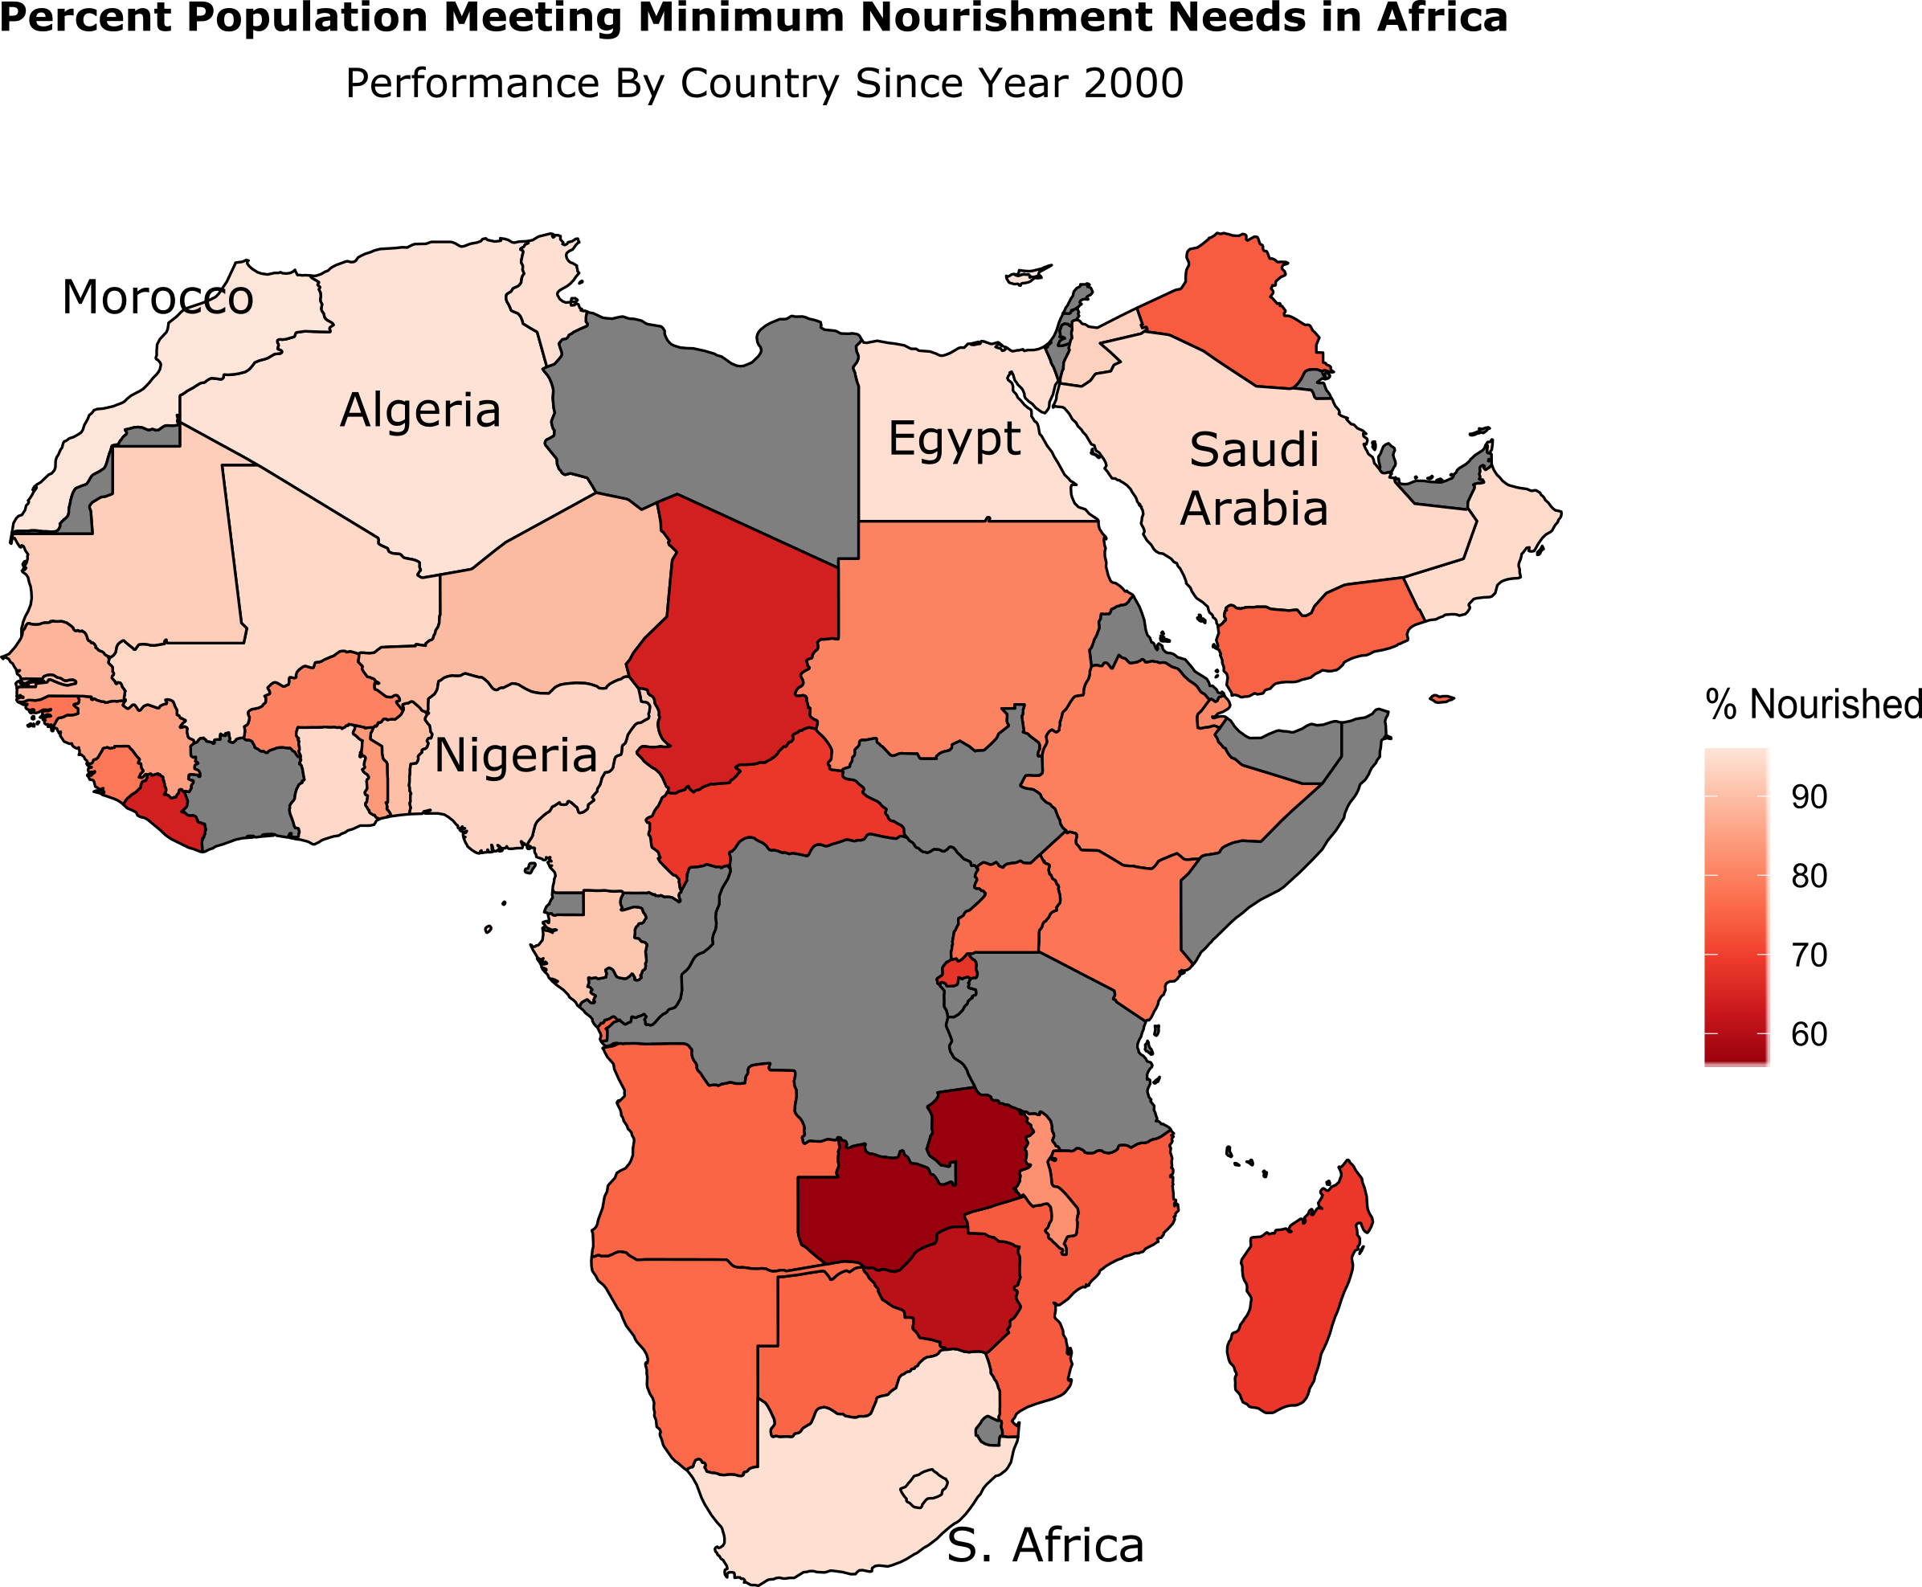
Case study: Meeting nourishment needs in Africa
African countries with traditionally more access to trade or capital - South Africa and Arab countries – tend to meet nutrition needs better than others do in the greater African region. Continued food aid will likely be needed for Africa to sustainably meet nutrition needs ahead.
Source: World Health Organization. Data unavailable for countries in gray.
Notes:
Nice aH ☺

Slide 11
Appendix

Slide 12
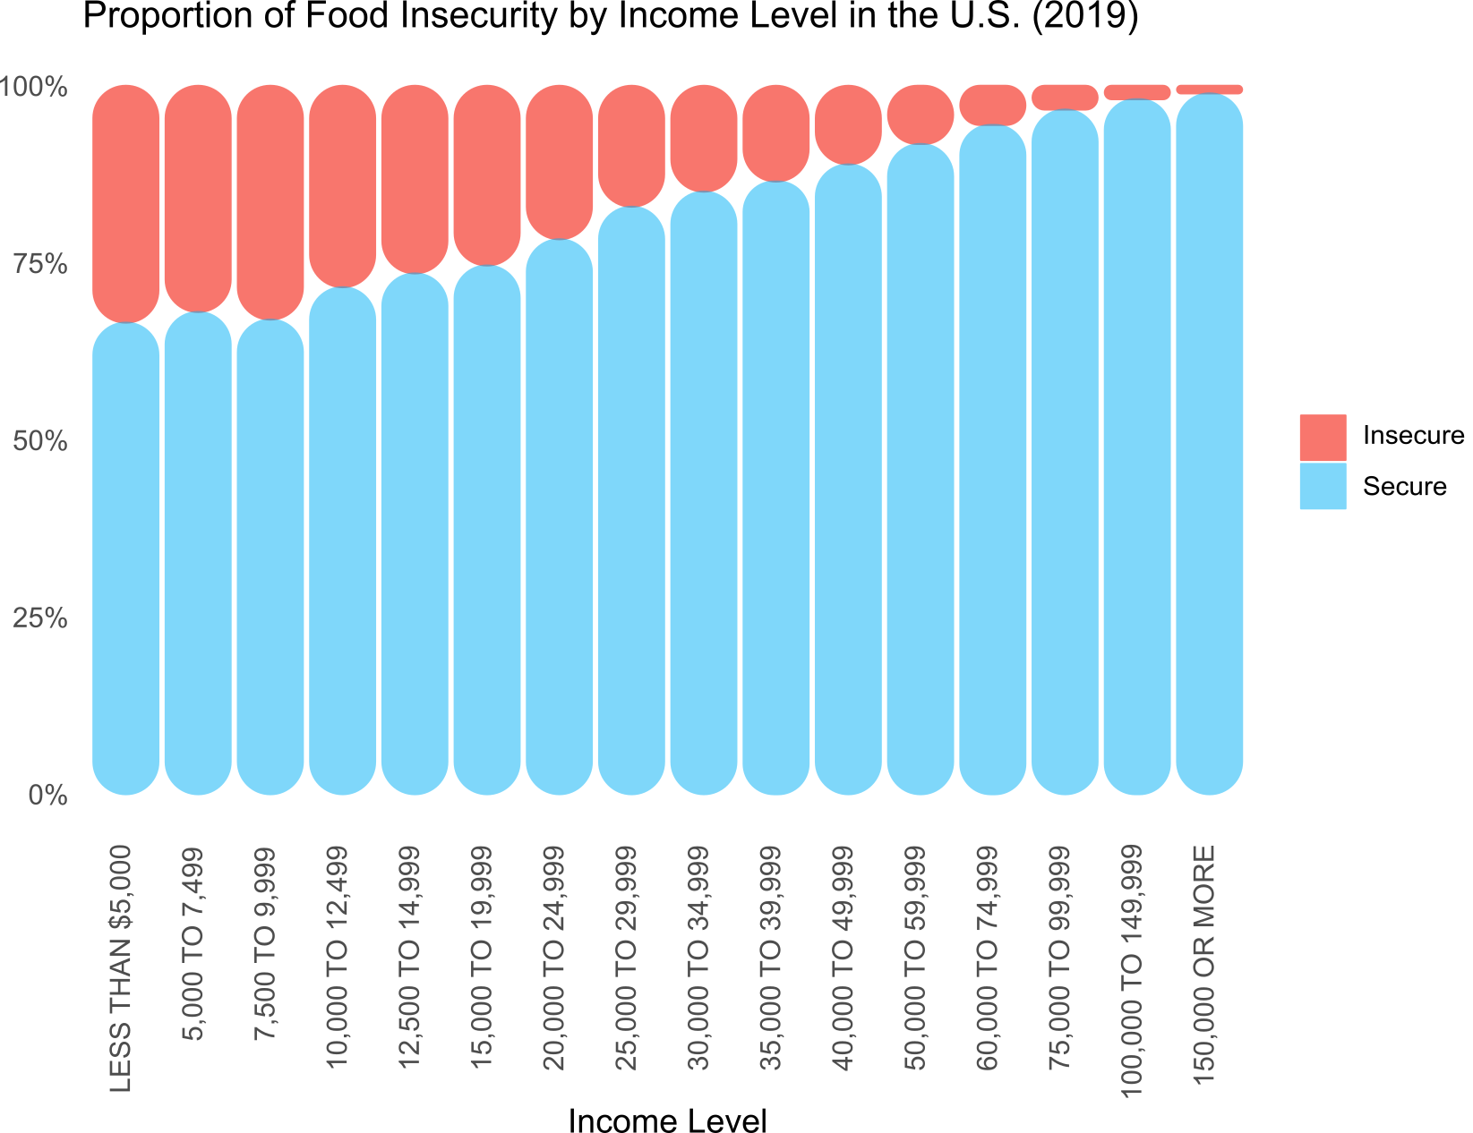
Case study: Income and food security in the United States
This view has the same information as the circular view– only in the traditional clustered column format. In the U.S., income strongly affects an individual’s ability to be food secure (i.e. having enough to eat). Data from the 2019 Food Security Survey show that people with lower income tend to be much less food secure than those with higher incomes. This highlights an opportunity to focus federal programs towards holistic solutions that provide food aid with skills training or education to help people lift themselves out of hunger and poverty.
Source: US Department of Agriculture
Notes:
Nice aH ☺

