Slide 1
CS581 · CLOUD SECURITY · SPRING 2026
Secure Cloud-Native
Application on AWS EKS
Design · Implementation · Security Hardening · Threat Simulation
Abigail Ampomaah
San Francisco Bay University · Account: 552823820626 · Cluster: cs581-secure-cluster (us-east-1)
P1
IAC
P2
App
P3
IAM
P4
Net
P5
Data
P6
Cont
P7
Mon
P8
Threat
P9
Docs

Slide 2
The Problem: Fintech Cloud Security Threats
Why securing a cloud-native application is mission-critical
☁ Unsecured Workloads
🔑 Credential Exposure
Container breakout and lateral movement across pods and namespaces
Hardcoded secrets in code, environment vars, and unencrypted config maps
🌐 Over-Permissive Network
🔓 Weak IAM Controls
Flat network allows any pod to communicate with any other pod
Overly broad IAM roles grant excessive permissions to workloads
📦 Vulnerable Images
👁 No Threat Detection
Unscanned container images with known CVEs deployed to production
Attackers operate undetected without runtime monitoring and alerting
This project addresses ALL six threat categories using AWS EKS security best practices.

Slide 3
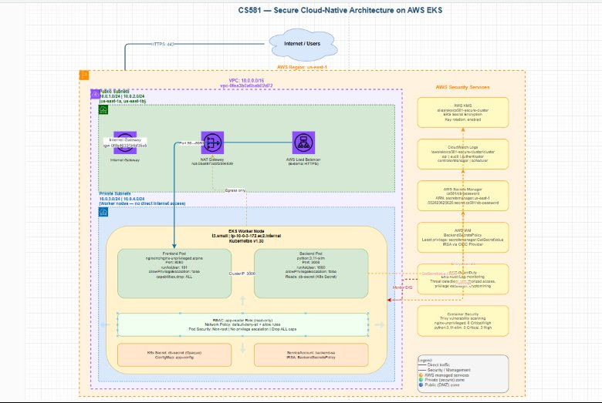
System Architecture
CS581 — Secure Cloud-Native Architecture on AWS EKS

Slide 4
Phase 1 — Infrastructure as Code (Terraform)
Complete EKS cluster provisioned with Terraform v1.14.8
What Was Deployed
Tools & Versions
✅ VPC 10.0.0.0/16 · public/private subnets
Terraform
v1.14.8
✅ EKS cluster: cs581-secure-cluster
eksctl
v0.225.0
✅ Managed node group (t3.medium, private)
kubectl
v1.35.3
✅ IAM roles · IRSA · KMS key
Helm
v4.1.3
✅ EKS encryptionConfig for etcd secrets
Trivy
v0.69.3
✅ Security groups · VPC Flow Logs
AWS CLI
v2.34.29
✅ Terraform apply: ~17 minutes
arn:aws:eks:us-east-1:552823820626:cluster/cs581-secure-cluster

Slide 5
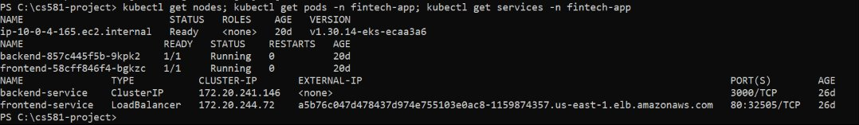
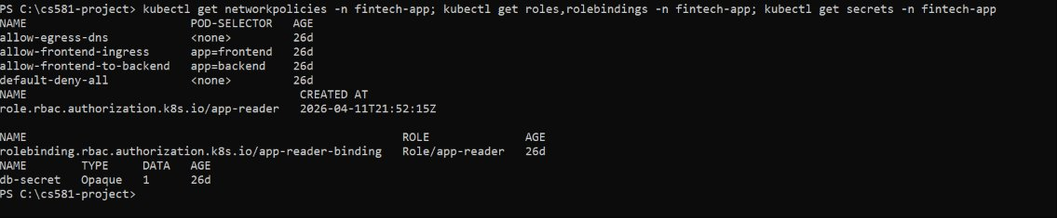
Phase 2 — Application Deployment
Live kubectl evidence: pods running for 20+ days, zero restarts
LIVE EVIDENCE — kubectl get nodes; get pods; get services
LIVE EVIDENCE — kubectl get networkpolicies; roles; rolebindings; secrets

Slide 6
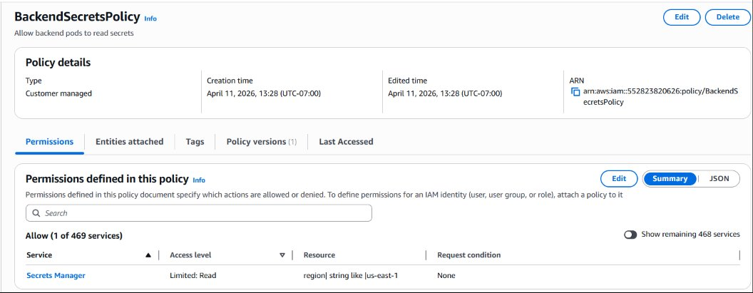
Phase 3 — Identity & Access Management
Least-privilege IAM · IRSA scoped to ONE pod · Kubernetes RBAC
BackendSecretsPolicy — Customer Managed IAM Policy
IAM + RBAC + IRSA
BackendSecretsPolicy
secretsmanager:GetSecretValue
kms:Decrypt on 1 key
region: us-east-1 only
IRSA: ONE pod only
system:serviceaccount:
fintech-app:app-backend
RBAC: app-reader (read only)
RoleBinding: app-reader-binding
LIVE — Roles, RoleBindings, Kubernetes Secrets

Slide 7
Phase 4 — Network Security
Zero-trust Kubernetes NetworkPolicies — 4 policies enforced for 26 days
default-deny-all
allow-frontend-ingress
Blocks ALL ingress and egress. No pod communicates unless explicitly allowed.
Only internet traffic to frontend pods on port 80 via ALB.
allow-frontend-to-backend
allow-egress-dns
Frontend (app=frontend) to backend (app=backend) on port 3000 only.
Permits DNS (UDP 53) for all pods to resolve service names.
kubectl get networkpolicies -n fintech-app → 4 policies active · AGE: 26d each

Slide 8
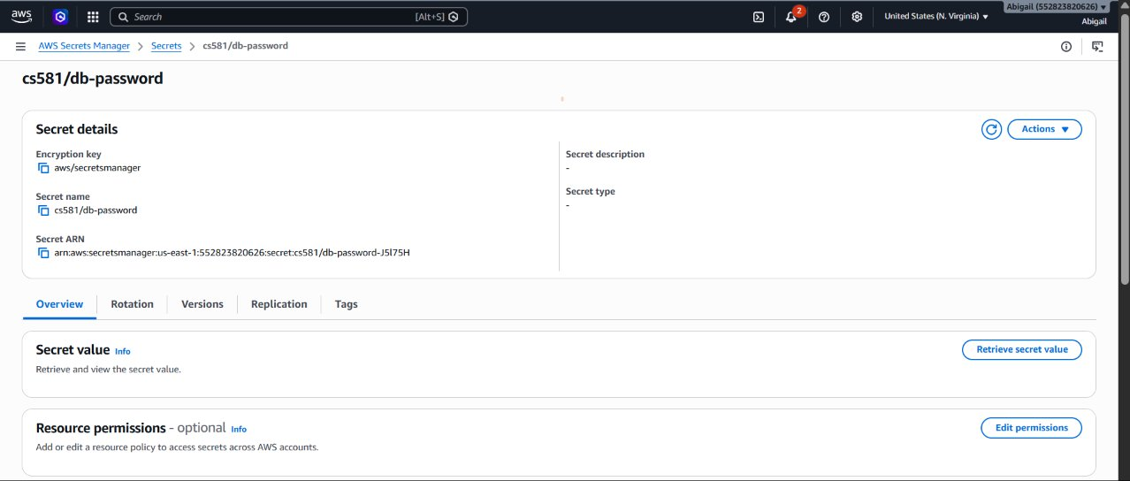
Phase 5 — Data Security & Encryption
Secrets Manager · KMS AES-256 · db-secret in Kubernetes
LIVE — AWS Secrets Manager: cs581/db-password
Encryption Details
Secret Name:
cs581/db-password
Encryption:
aws/secretsmanager KMS
Algorithm:
AES-256 envelope
Account:
552823820626
K8s Secret:
db-secret (Opaque, 26d)
IRSA Access:
app-backend only
kms:Decrypt:
1 key, scoped only
Rotation:
Lambda ready
encryptionConfig verified: aws eks describe-cluster → resources:[secrets] ✅

Slide 9
Data Security: Encryption Everywhere
AES-256 at rest · TLS 1.3 in transit · KMS key management · Zero plaintext credentials
🔒 Encryption at Rest
🌐 Encryption in Transit
• KMS AES-256 envelope encryption
• ALB: TLS 1.3 (ACM certificate)
• EKS etcd encryptionConfig active
• EKS control plane ↔ node: mTLS
• EBS worker node volumes encrypted
• AWS API calls: HTTPS + SigV4
• Secrets Manager: aws/secretsmanager key
• Pod-to-pod: Nitro hypervisor layer
🔑 Key Management & Rotation
🛡 Zero Plaintext Policy
• KMS annual automatic rotation
• No secrets in code or env vars
• IRSA STS tokens: 1-hour TTL
• No credentials in ConfigMaps
• Secrets Manager Lambda rotation ready
• No :latest image tags (immutable)
• No long-lived access keys anywhere
• kms:Decrypt scoped to 1 key only

Slide 10
Phase 6 — Container Security
Trivy scanning · Pod Security Standards · Hardened runtime
01
Image Scanning (Trivy)
02
Non-Root + ReadOnly FS
nginx:alpine → 0 CRITICAL/HIGH CVEs ✅
nginx:latest → 2 CVEs → replaced
python:3.11-slim → 10 HIGH CVEs documented
runAsNonRoot: true enforced
readOnlyRootFilesystem: true
allowPrivilegeEscalation: false
03
Capabilities + seccomp
04
PSA + Immutable Tags
capabilities.drop: [ALL]
No capabilities added back
seccompProfile: RuntimeDefault
PSA enforce: restricted
No :latest tags — pinned digests
Privileged pod: 1,659 restarts blocked ✅

Slide 11
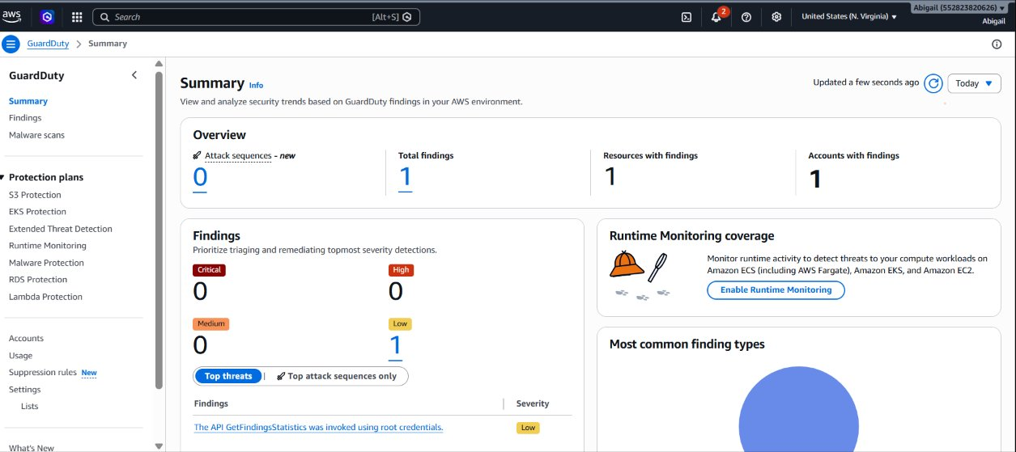
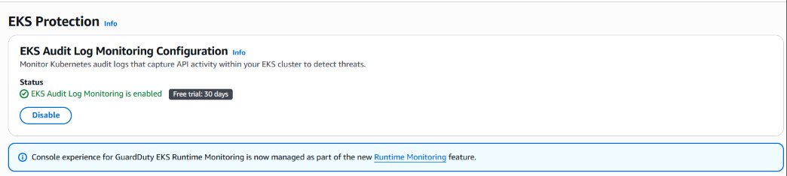
Phase 7 — Observability: See Everything, Alert on What Matters
GuardDuty · EKS Audit Logs · VPC Flow Logs · CloudTrail · Container Insights · SNS Alarms
LIVE — GuardDuty Summary (Account: 552823820626)
EKS Audit Log Monitoring — ENABLED
CloudWatch
835MB · 18,575 records · 24 streams
VPC Flow Logs
Packet metadata · network forensics
CloudTrail
Every AWS API call · full account
1
LOW
ENABLED
ENABLED
SNS
Total Findings
Severity
EKS Audit
EKS Protection
3 Alarms
Container Insights
Per-pod CPU · memory · stderr
CloudWatch Alarms → SNS → Email: GuardDuty HIGH/MEDIUM · Node CPU >80% · Failed auth >10 in 5min

Slide 12
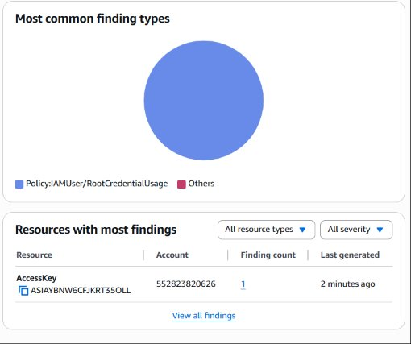
Phase 8 — Three Threat Scenarios Validated
Every attack detected and neutralized end-to-end
LIVE FINDING — Policy:IAMUser/RootCredentialUsage
Root Credential → GuardDuty
01
ATTACK AWS root API call
DETECT Policy:IAMUser/RootCredentialUsage
RESPOND < 2 min · SNS alert
Privileged Container → PSA
02
ATTACK Privileged pod breakout attempt
DETECT PSA admission webhook blocked
RESPOND 1,659 restarts · neutralized
Unauthorized API → RBAC
03
ATTACK kubectl delete deployment (viewer)
DETECT 403 Forbidden · EKS audit log
RESPOND >10 denials → SNS alarm
3/3 threat scenarios detected and neutralized ✅

Slide 13
Results — All 9 Phases Complete
Live AWS infrastructure verified May 7, 2026
P1
Infrastructure as Code
✅
P6
Container Security
✅
Terraform — EKS, VPC, IAM, KMS, VPC Flow Logs
Trivy + non-root + drop ALL caps + seccomp + PSA restricted
P2
Application Deployment
✅
P7
Monitoring
✅
frontend + backend pods — Running 20+ days, 0 restarts
GuardDuty + CloudTrail + VPC Flow Logs + SNS + Container Insights
P3
Identity & Access
✅
P8
Threat Simulation
✅
BackendSecretsPolicy + kms:Decrypt + IRSA + RBAC
3/3 scenarios: GuardDuty · PSA · RBAC
P4
Network Security
✅
4 NetworkPolicies — zero-trust default-deny-all
P5
Data Security
✅
Secrets Manager + KMS AES-256 + encryptionConfig verified
P9 Documentation — Technical Report + GitHub + Presentation ✅

Slide 14
Lessons Learned
Key takeaways from building a production-grade secure EKS environment
🔐 Secrets Belong in AWS Secrets Manager
🌐 Default-Deny is the Foundation
Never use Kubernetes ConfigMaps or env vars for secrets. Secrets Manager with IRSA is the correct production pattern.
Starting with default-deny-all NetworkPolicy is simpler than blocking bad traffic. Any unmapped pod is automatically isolated.
🛡 Detection Works — In Under 2 Minutes
📦 Scan Before Deploy — Gate the Pipeline
GuardDuty caught root credential usage in 2 minutes. Enable monitoring from day one, not as an afterthought.
Trivy found HIGH CVEs in standard images. A CI/CD scan gate must block deployment — manual scanning is not sufficient.
⚙ IaC Enables Auditability
🔑 Least Privilege is Measurable
Every resource documented in Terraform. Manual console provisioning leaves no audit trail and cannot be reproduced.
BackendSecretsPolicy: Read on 1 secret, kms:Decrypt on 1 key, in 1 region. This precision should be standard for all IAM.

Slide 15
THANK YOU
Abigail Ampomaah · CS581 Cloud Security · Spring 2026
🔗 GitHub
github.com/ampomaahabigail76-spec/cs581-secure-eks
☁ Cluster
cs581-secure-cluster · us-east-1 · EKS v1.30
🔍 GuardDuty
Detector f0cf0254fe2e09f6c53af60b11b1b116 · 3/3 scenarios validated
🔐 Secrets
arn:aws:secretsmanager:us-east-1:552823820626:secret:cs581/db-password
✅ P1
✅ P2
✅ P3
✅ P4
✅ P5
✅ P6
✅ P7
✅ P8
✅ P9

